Slide 1
Maritime Tracking
Arch Docs 01

Slide 2
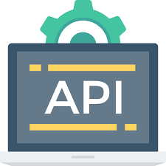




Data Source
https://www.digitraffic.fi/en/marine-traffic/#general-info
max request 5 per minute per IP
POLLING PROXY
Proxy icon (to be implemented)
Python or golang
Role : Queue publisher
Role: Launch API requests
QUEUE
Queue Manager
RabbitMQ or Kafka
DATA PROCESSOR
Python or Golang
- Transform geographic coordinates to x,y
- Parse data to create routes
- Parse data to identify clusters
- Query data to identify traveling groups
- Identify ouliers (speed)
DATA STORAGE/ANALYTICS
Elastic stack (elasticsearch/kibana)

