Slide 1
MAINTENANCE AND SERVICE
VLBAII – System Architectures

Slide 2
Agenda
Introduction
Aim of project
Task 1 – Learning curve generation
Task 1- Visualisation graphs
Task 2 – Employee team evaluation
Task 2 – Visualisation graphs
Task 3 – Machine learning model
Task 3 – Simulation model

Slide 3
Introduction
Mobility Worldwide is a globally operating corporation specializing in innovation and mobility services
Our job as analysts:
Use data from SAP DWP to optimize employee assignment for tasks in the Maintenance and Service department of MWW
Tools and data sources to be used:
BigQuery and BigQueryML
App Engine
Looker Studio
Google Distance Matrix API

Slide 4
Aim of project
Optimize employee assignments to improve the quality of services at MWW
Modus operandi:
Learn trajectories of individuals employees and employee service teams
Identify the best-performing individuals and teams
Assign the most qualified individuals to new service requests

Slide 5
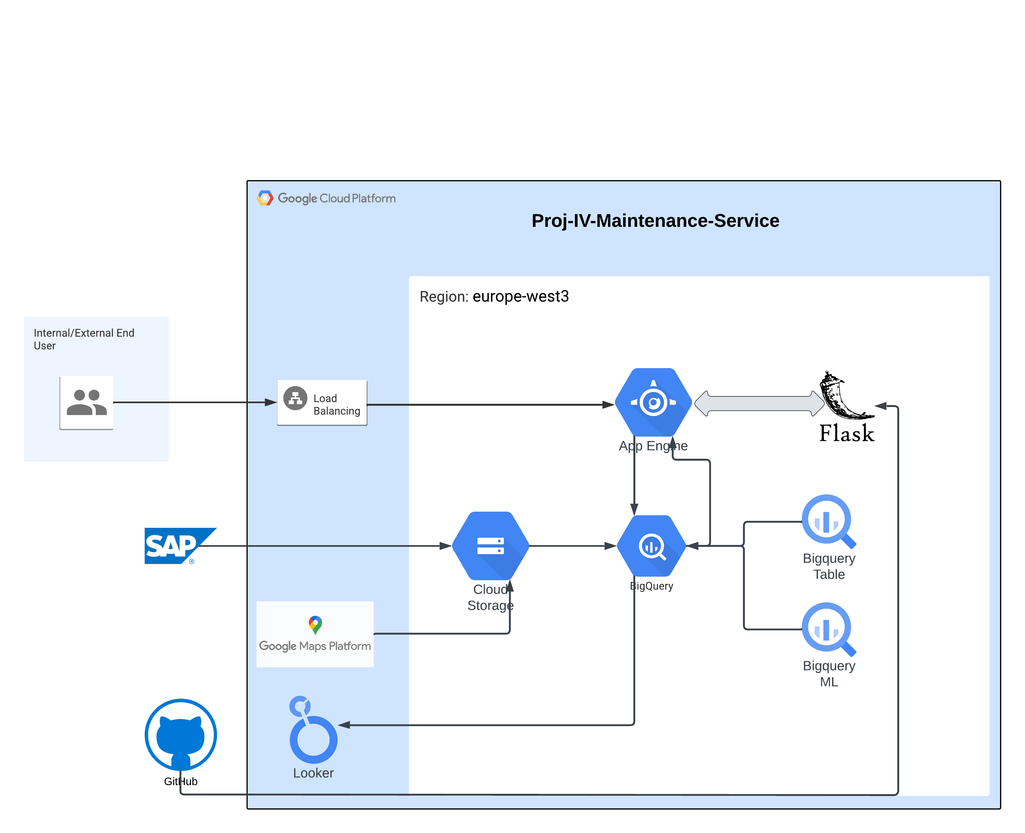
System Architecture

Slide 6
BigQuery Tables
The CSV data files provided by MWW were uploaded in BigQuery tables, to facilitate the tasks
BigQuery tables formed with the data:
MwwMsServicePoints
MwwMsClients
MwwMsOpenContracts
MwwMsServiceEmployees
MwwMsCompletedTasks
MwwMsAssignedEmployees

Slide 7
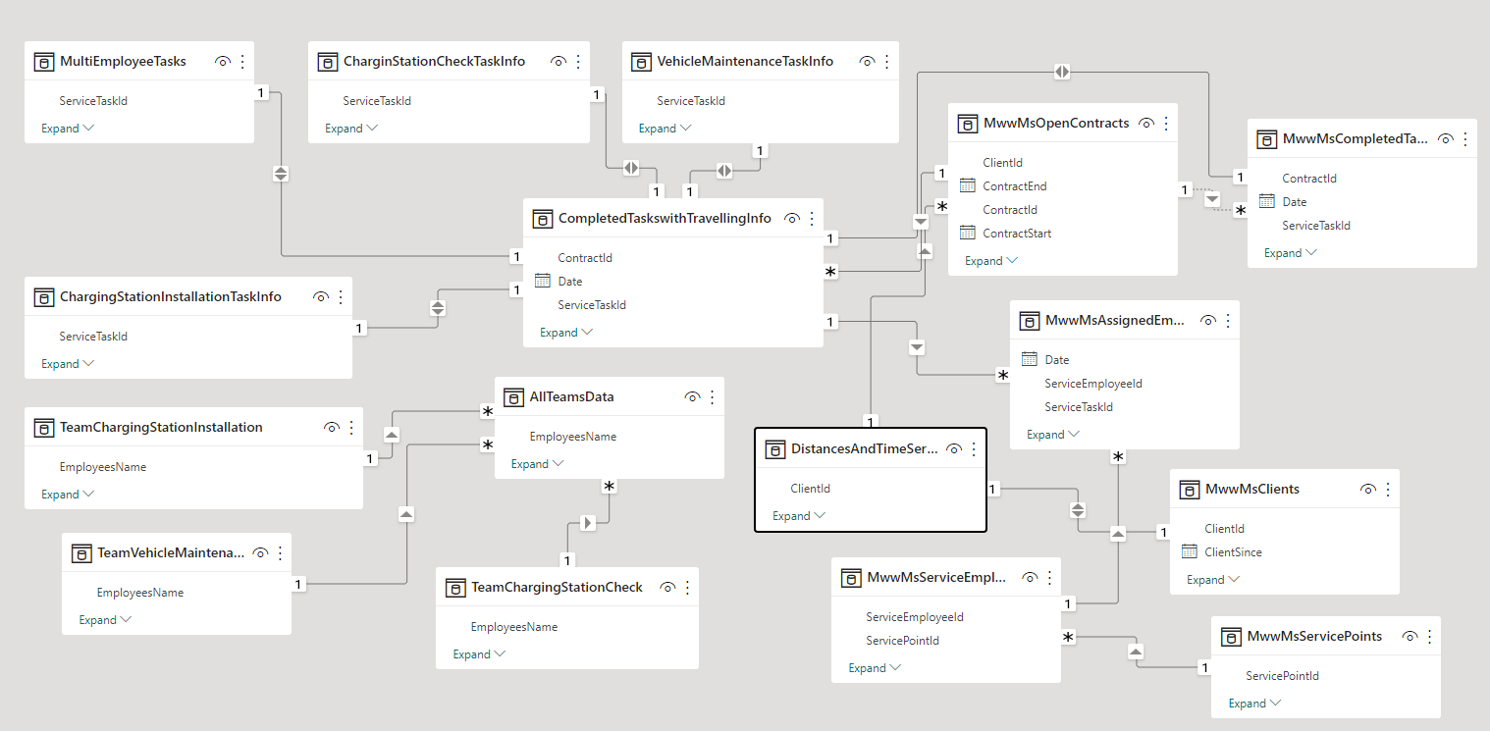
ER Diagram for Tables

Slide 8
Task-1
Start by visualizing the learning curves of individual employees. It is likely that the personnel learn over time and thus need less time for repeating tasks.

Slide 9
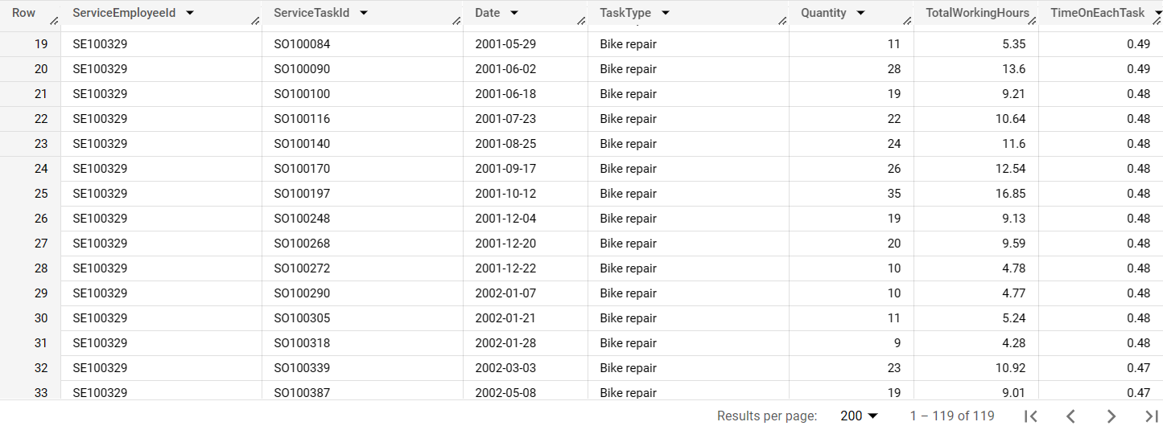
Task 1 - Learning curve generation
Joined the datasets ‘MwwMsAssignedEmployees’ and ‘MwwMsCompletedTasks’ on ServiceTaskId
Assumption: Each person in a team works for the same amount of time.
TimeOnEachTask = TotalWorkingHours/Quantity

Slide 10
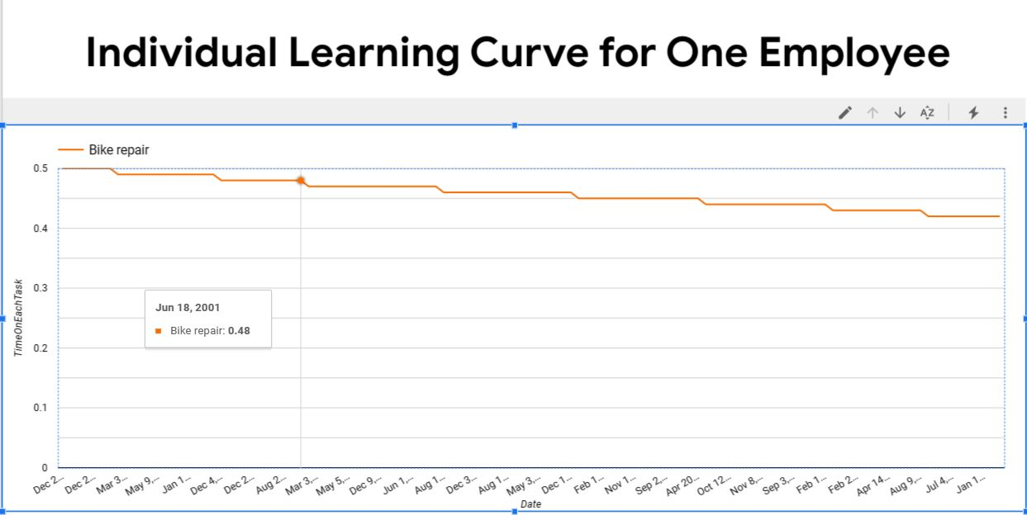
Task 1-Visualization using Looker studio
Individual Learning graphs – single employee, single task:
Learning Curve of Employee: SE100329 for Task: Bike repair on June 18, 2001

Slide 11
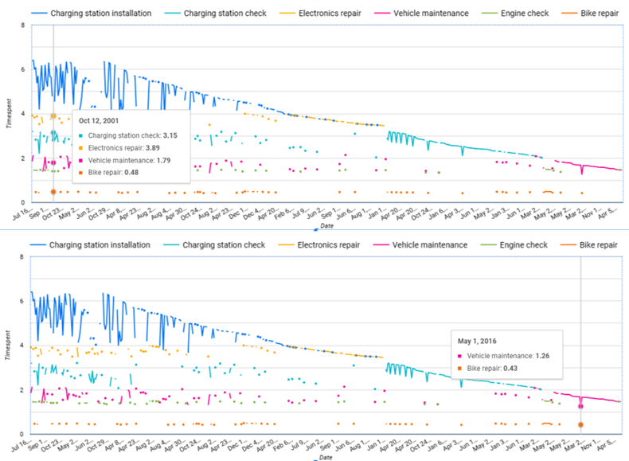
Task 1-Visualization using Looker studio
Individual employee learning over time for Employee SE100329 :

Slide 12
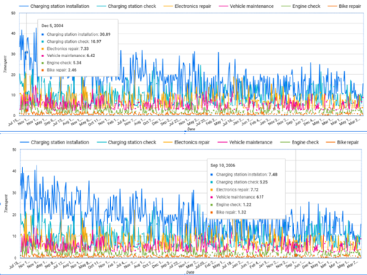
Task 1-Visualization using Looker studio
Learning Curve of all employees over time:

Slide 13
Task-2
Some jobs require more than one employee. Evaluate whether there are teams whose work is more effective than the work of other teams. The distance to the client site might also play a role in this regard.

Slide 14
Task 2 – Employee team evaluation
Task scrutiny
Task types requiring employee teams:
Charging Station Installation
Charging Station Check
Vehicle Maintenance
Observations:
A team consists of at most 2 members.
Our 25 employees belong to a single service point - Königsee
A contract spans over multiple years and can contain multiple tasks.

Slide 15
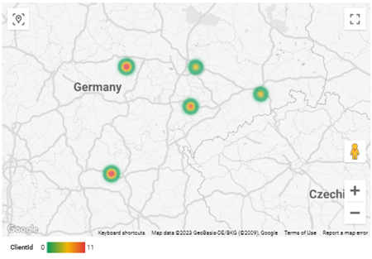
Distance computation to client sites
All clients belong to 5 cities
Distance and time to the client sites computed using the Google distance matrix API.
Added this information to Client relationships and created new dataset ‘DistancesAndTimeServiceToClient’.

Slide 16
Team segregation for analysis
For our analysis, we segregated teams based on task type
Tasks specific teams:
Team-ChargingStationInstallation
Team-ChargingStationCheck
Team-VehicleMaintenance

Slide 17
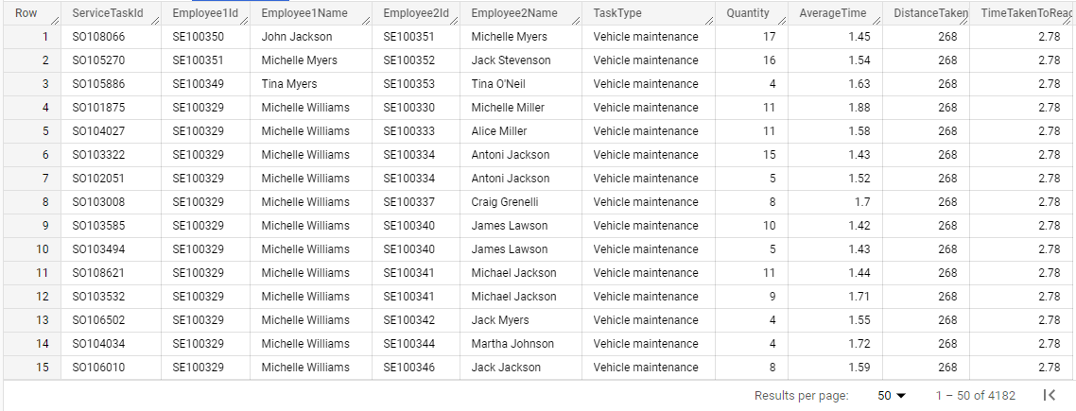
Preparation of dataset for analysis
Created dataset ‘CompletedTaskWithTravellingInfo’ as a join of ‘CompletedTask’ relation with ‘DistanceAndTimeServicePointToClient’ relation
Joined datasets ‘CompletedTaskWithTravellingInfo’ with ServiceEmployee and AssignedEmployee to add employee info to the data.

Slide 18
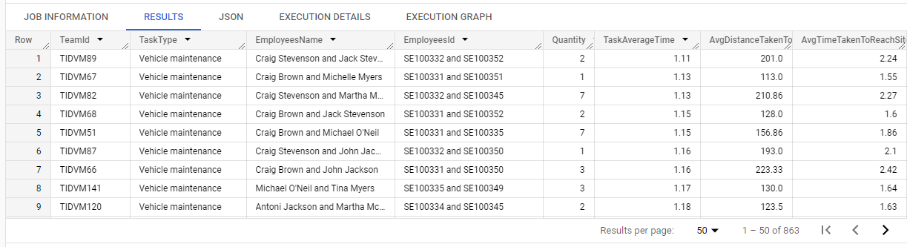
Preparation of dataset for analysis - continued
Created three test datasets,’ChargingStationCheckWithTravellingInfo’, ‘ChargingStationInsatallationWithTravellingInfo’ and ‘VehivleMaintenanceWithTravellingInfo’ for each of the three multi team tasks
Lastly, joined all teams and assigned unique Teamid for each task.

Slide 19
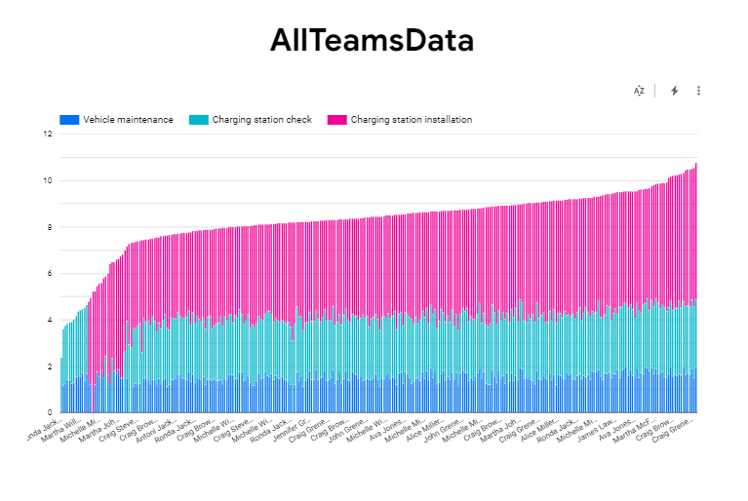
Team performance evaluation - Visualizations
Teams with less average time to complete the tasks are considered as more efficient.
X-Axis=Team Members ; Y-Axis=Average time to complete the task

Slide 20
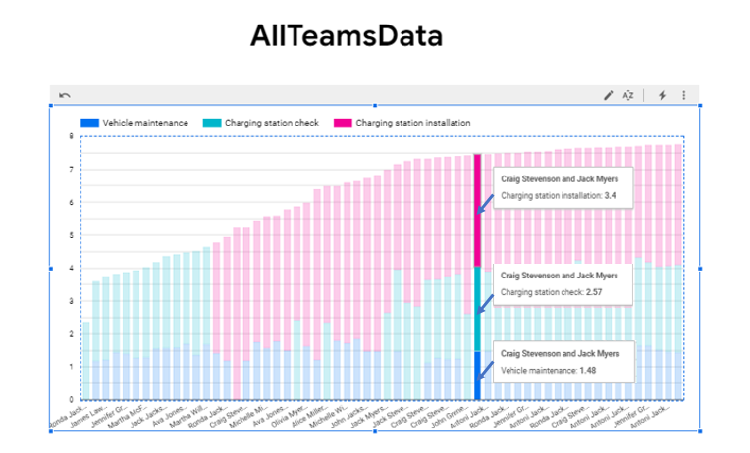
Performance visualization of team with three tasks

Slide 21
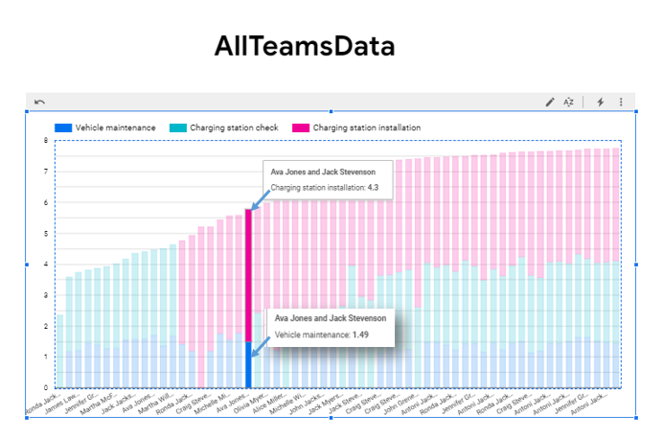
Performance visualization of teams with two tasks

Slide 22
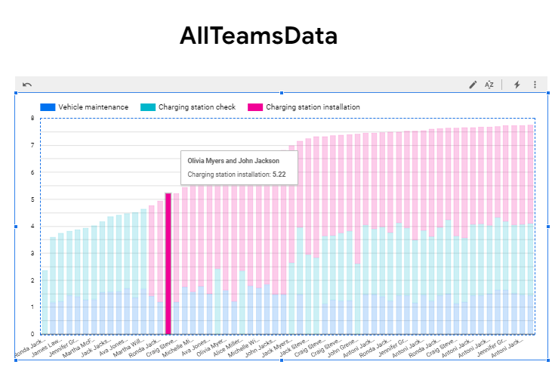
Performance visualization of teams with one task

Slide 23
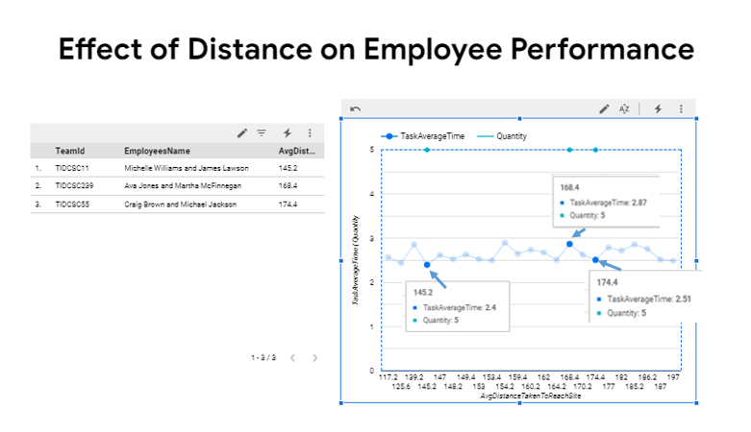
Effect of distance on team efficiency
Analysed the effect of distance on teams by filtering the task type to a single task type and setting a fixed quantity

Slide 24
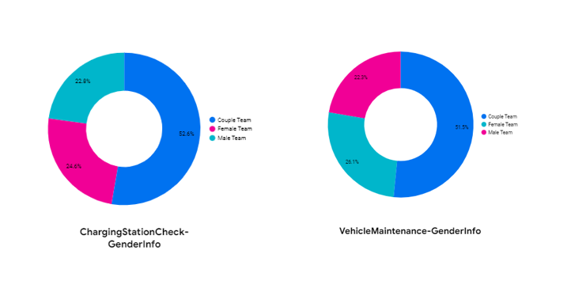
Effect of distance on team efficiency – continued
The effect of distance is indecisive
Possibility of influence of team gender on task performance

Slide 25
Task-3 Develop a simple simulation to create new tasks and assign them to the assumingly best workers or teams. Demonstrate the board the benefits that a data-driven assignment of employees has on the overall efficiency

Slide 26
Task 3 - Simulation model
This task was divided into two parts:
Creation of a Machine Learning Model which considers all the individual employees/teams and finds out the time taken by them to complete each task.
Development of a Simulation Model (flask application) that generates a list n-best employees/teams along with their corresponding completion times for the selected task
Tools used: BigQuery ML, App Engine

Slide 27
Model Selection and Creation
Feature Space consists of three categorical features
TeamID: represents the unique identifier for each employee/team
UniqueTeams: refers to the teams for completed task assignments
TaskType: refers to the type of task being assigned to the teams
Continuous target variable
AverageTimeToCompleteTheTask: represents the average time taken by the teams to complete the assigned task
Selected approach: Linear Regression

Slide 28
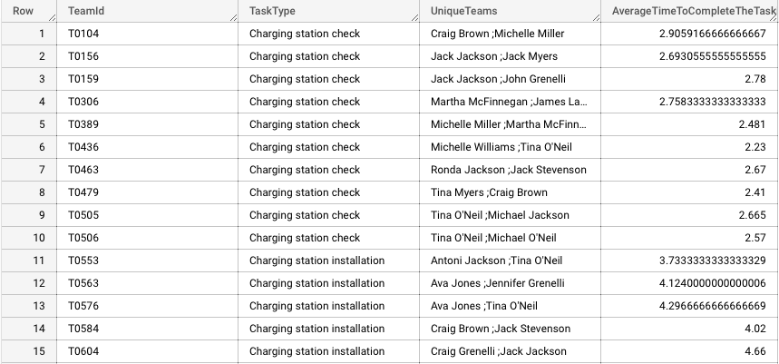
ML model - Data for ML model
Distance for each employee/team for the same client site is constant. Hence it was excluded from the data for the model
Data split: 80% Training Data, 20% Testing Data

Slide 29

Model Evaluation
The Training Data Loss is a measure of the difference between predicted values and actual values
Evaluation data Loss is a measure of the performance of the model on the evaluation dataset or validation dataset

Slide 30
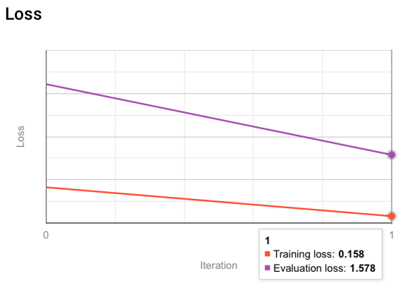
Model Evaluation
Conclusion: There is room for improvement

Slide 31
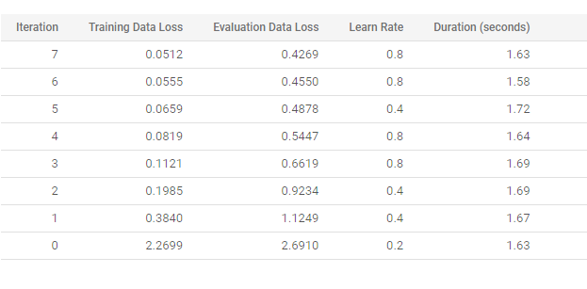
Final model with improvements
Removed TeamID from dataset (Feature Space Reduction)
Re-trained the Model using updated features

Slide 32
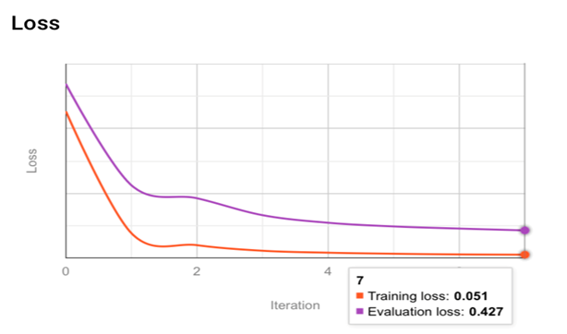
Model Evaluation

Slide 33
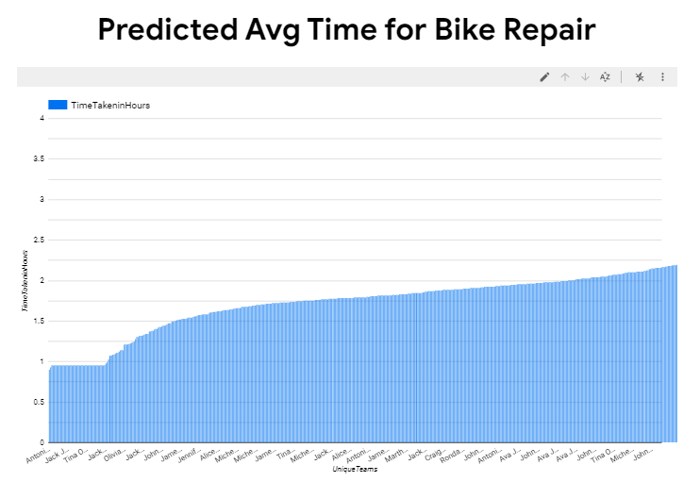
Model prediction

Slide 34
Simulation model
Created simulation model to generate employee assignments for new task
The simulation model was developed as a Flask application, which was deployed on Google Cloud's App Engine
Tools used: BigQuery, App Engine
Application URL: https://proj-iv-maintenance-service.uc.r.appspot.com
Technology Stack: Python (Flask), HTML, CSS (Bootstrap)

Slide 35
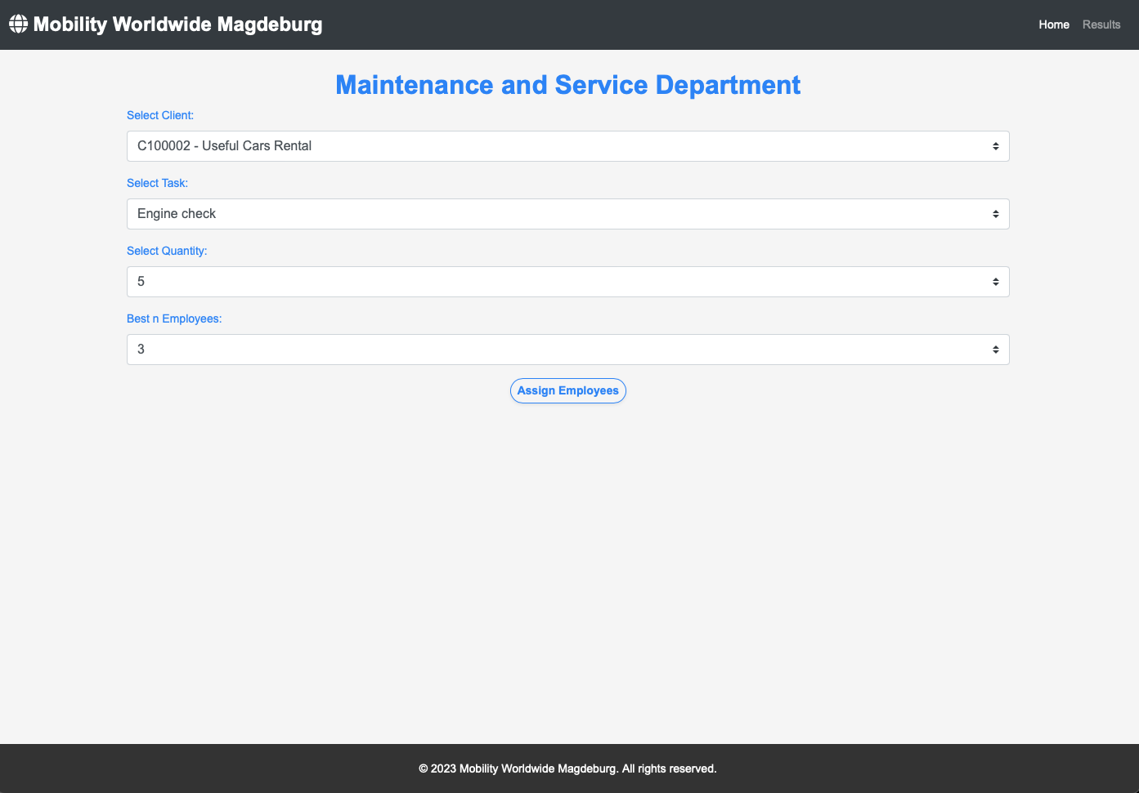
Application UI

Slide 36
Application Components
Drop-Downs
Client Selection
Task Selection
Quantity Selection
No. of Employees

Slide 37
Simulation model results
Application simulates task assignments for the given specifications.
Results consists of predicted time estimates for all employees or teams arranged in ascending order.

Slide 38
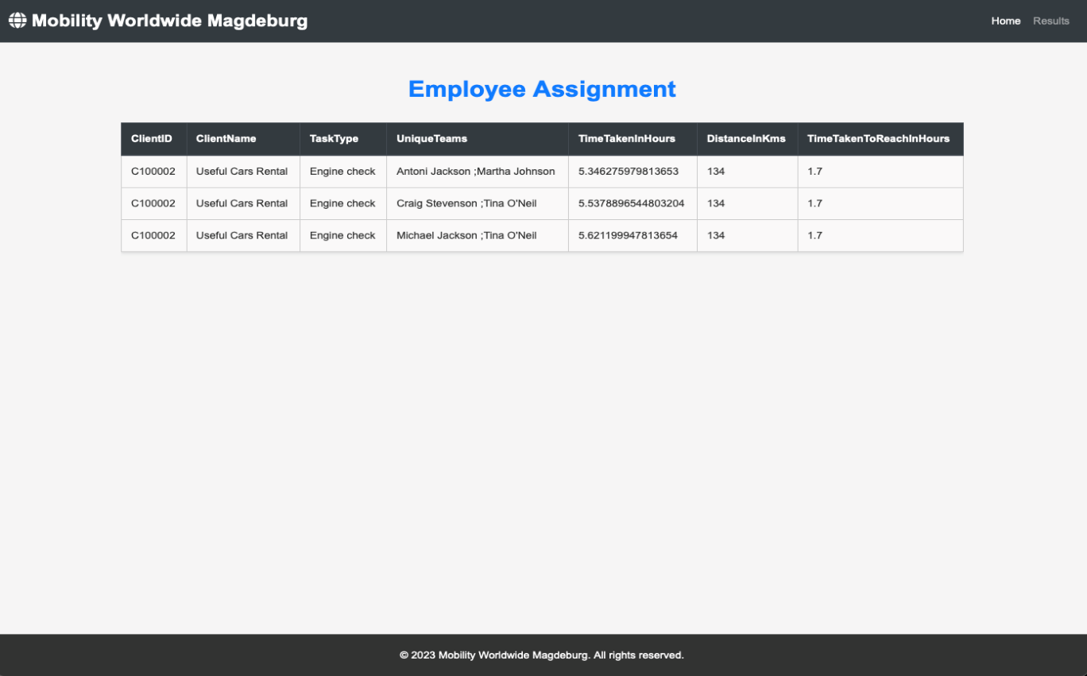
Employee Assignment Results

Slide 39
Thank you!

Slide 40
Questions?

