Slide 1
Broadcom Licensing Information – View From a Customer
Matt Heldstab
Systems Engineer – Minnesota State Colleges and Universities
VMUG Leader – Minneapolis, MN
Current VMUG Vice President
Contact: mheldstab@vmug.com -- @mattheldstab on X

Slide 2
I put this presentation together on Monday.
Lots of information here – my apologies for the “eye chart”
Presentation is available on my GitHub (link coming)

Slide 3
Broadcom Licensing Information
Who am I
Matt Heldstab – Enterprise Systems Engineer with the
Minnesota State Colleges and Universities System
Double VCP (Desktop and Datacenter)
VMware Customer for 18 years (ESX 3.0)
Horizon Customer since View 3.0 (2009)
VMUG Leader in Minneapolis
Current Global Vice President for the VMUG Organization
Current goat-wrangler for 26 VMware Customers (my campuses)
(Just kidding – they are all awesome!)

Slide 4

Broadcom Licensing Information
Thanks to Blackfoot for the GIF

Slide 5
Broadcom Licensing Information
What I have heard
Thanks to Blackfoot for the GIF

Slide 6
Broadcom Licensing Information
What I have heard
Thanks to my team at Broadcom
Thanks to Blackfoot for the GIF

Slide 7
Broadcom Licensing Information
What I have heard
Thanks to my team at Broadcom
Additional thanks to my “THREE LETTER” VAR
Thanks to Blackfoot for the GIF

Slide 8
Broadcom Licensing Information
This information is
Subject to change
What I have heard
Thanks to my team at Broadcom
Additional thanks to my “THREE LETTER” VAR
Thanks to Blackfoot for the GIF

Slide 9
Broadcom Licensing Information
Items to consider:
I would like this to be interactive
I am not a Broadcom employee
Discussions around
VCF (VMware Cloud Foundation)
VVF (VMware vSphere Foundation)
VVS (VMware vSphere Standard)
VVEP (VMware vSphere Essentials Plus)
Perpetual vs. Subscription
Current Subscription Model vs. vSphere+ Subscription Model
Impact to VMware Horizon customers

Slide 10
Broadcom Licensing Information
Items to consider:
I would like this to be interactive
I am not a Broadcom employee
Discussions around
VCF (VMware Cloud Foundation)
VVF (VMware vSphere Foundation)
VVS (VMware vSphere Standard)
VVEP (VMware vSphere Essentials Plus)
Perpetual vs. Subscription
Current Subscription Model vs. vSphere+ Subscription Model
Impact to VMware Horizon customers
I will be using these abbreviations
quite a bit during the presentation

Slide 11
Broadcom Licensing Information
Other Considerations
Impact to VMUG Advantage and EvalExperience 365-day Evaluation Keys
Ways to save money
Some of these methods will be geared to SMB / Commercial customers with small-to-medium sized environments
Preparing for the future (Infrastructure Planning)
3rd Party Software Licensing Constraints and how they might impact your vSphere licensing from here on out

Slide 12
Broadcom Licensing Information
Level-set -- VMware Cloud Foundation
VCF is a best-in class suite of products that comprise the Software-Defined Datacenter
VCF will absolutely transform your datacenter, especially if you need to
Streamline the deployment of VMware products
Eliminate configuration inconsistencies that come with manual deployments
Standardize how infrastructure is deployed
Bring cloud methods into your on-premises datacenter
Integrate with other VMware Cloud products such as VMC on AWS, AVS, OCVS, GCVE
If your organization can afford VCF, you won’t be sorry. Just understand that the technology is more expensive than other editions of vSphere.
This presentation will discuss what some of the differences are, and compare it to other products that are available.

Slide 13
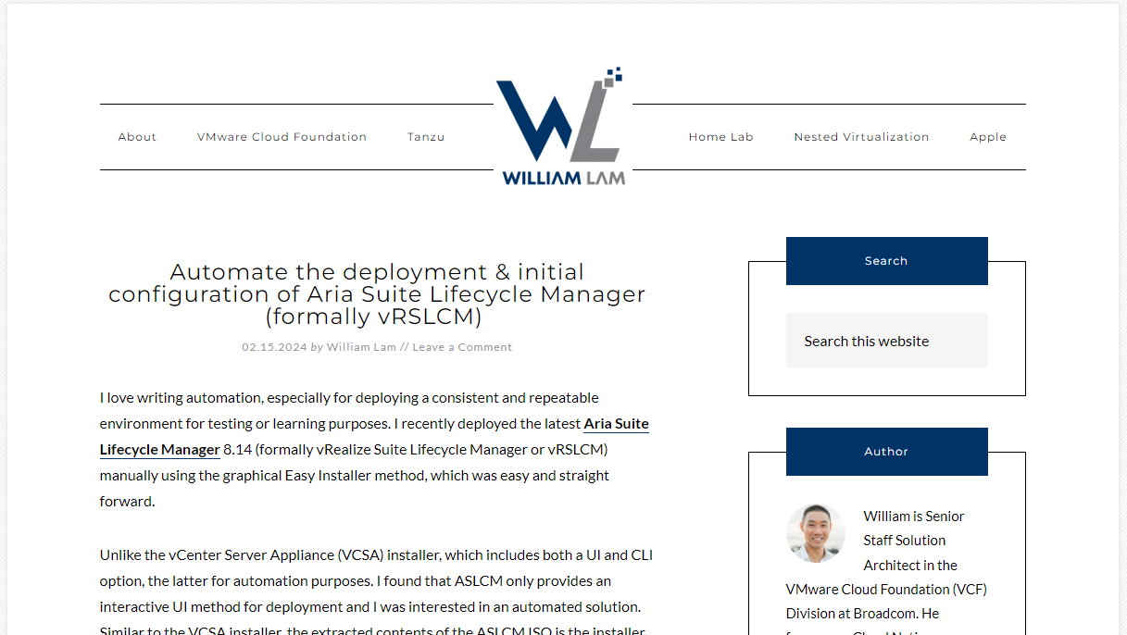
William Lam is a fantastic resource – www.williamlam.com

Slide 14
Broadcom Licensing Information
VCF
VMware Cloud Foundation

Slide 15
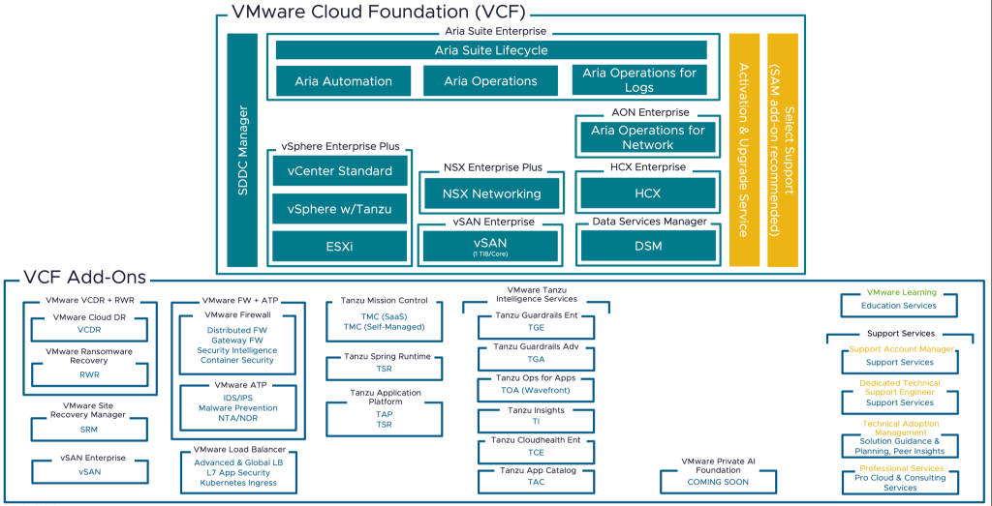
https://williamlam.com/2024/01/whats-in-the-new-vmware-vsphere-foundation-vvf-and-vmware-cloud-foundation-vcf-offers.html
VCF
VMware Cloud Foundation
Entire feature list available at:
https://www.vmware.com/content/dam/digitalmarketing/vmware/en/pdf/docs/vmw-datasheet-vsphere-product-line-comparison.pdf

Slide 16
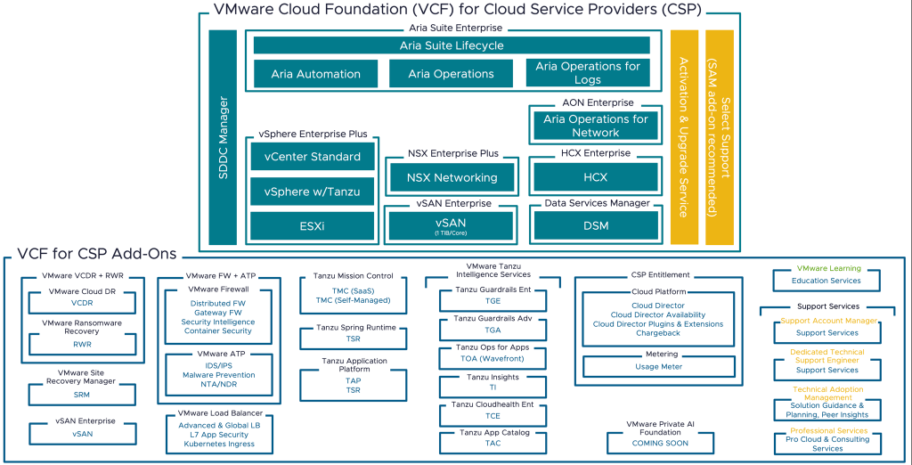
https://williamlam.com/2024/01/whats-in-the-new-vmware-vsphere-foundation-vvf-and-vmware-cloud-foundation-vcf-offers.html
VCF
VMware Cloud Foundation (Cloud Service Providers)
Entire feature list available at:
https://www.vmware.com/content/dam/digitalmarketing/vmware/en/pdf/docs/vmw-datasheet-vsphere-product-line-comparison.pdf

Slide 17
Broadcom Licensing Information
VVF
VMware vSphere Foundation

Slide 18
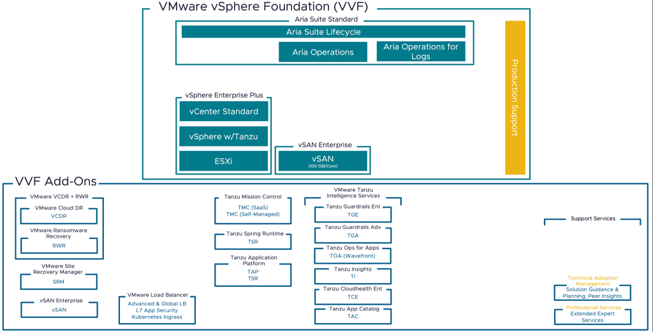
VVF
VMware vSphere Foundation
Entire feature list available at:
https://www.vmware.com/content/dam/digitalmarketing/vmware/en/pdf/docs/vmw-datasheet-vsphere-product-line-comparison.pdf

Slide 19
VVF
Most vSAN customers
Will need to purchase the
1TiB add-on to license their
cluster.
VMware vSphere Foundation
Entire feature list available at:
https://www.vmware.com/content/dam/digitalmarketing/vmware/en/pdf/docs/vmw-datasheet-vsphere-product-line-comparison.pdf

Slide 20
Broadcom Licensing Information
VVS
VMware vSphere Standard

Slide 21
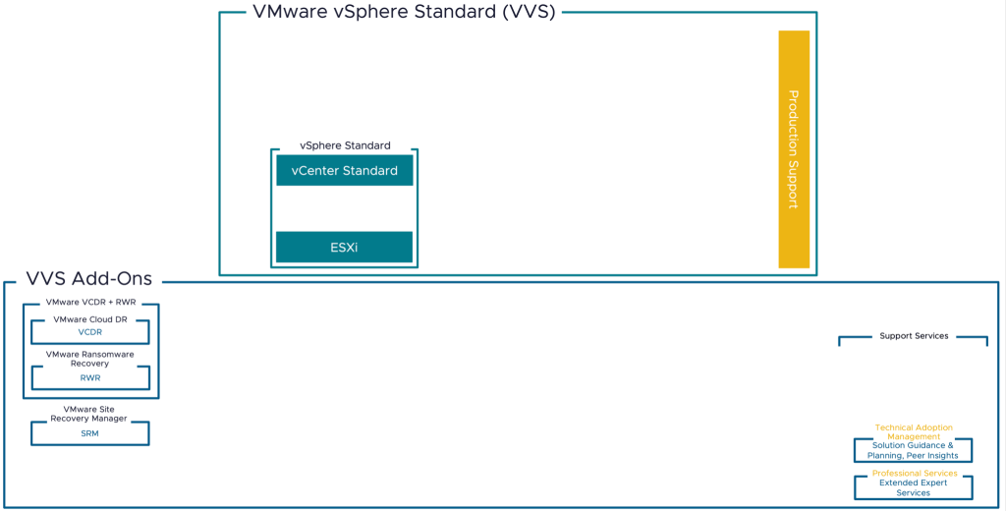
VVS
VMware vSphere Standard
Entire feature list available at:
https://www.vmware.com/content/dam/digitalmarketing/vmware/en/pdf/docs/vmw-datasheet-vsphere-product-line-comparison.pdf

Slide 22
Allows for multiple
vCenter Instances
VVS
VMware vSphere Standard
Entire feature list available at:
https://www.vmware.com/content/dam/digitalmarketing/vmware/en/pdf/docs/vmw-datasheet-vsphere-product-line-comparison.pdf

Slide 23
Allows for multiple
vCenter Instances
VVS
Includes:
VMware HA
VMware VMotion
VMware FT (1-2 vCPU only)
Storage VMotion
Hybrid Linked Mode
Content Libraries
Virtual Volumes (VVOLs)
TPM 2.0 and Virtual TPM
Enhanced vMotion Compatibility (EVC)
vCenter Native Backup
vSphere Replication
VMware vSphere Standard
Entire feature list available at:
https://www.vmware.com/content/dam/digitalmarketing/vmware/en/pdf/docs/vmw-datasheet-vsphere-product-line-comparison.pdf

Slide 24
Allows for multiple
vCenter Instances
Does not include:
Distributed Switches
Distributed Resource Scheduler (DRS)
VM Encryption
Storage DRS
Storage and Network I/O Controls
Host Profiles
Distributed Power Management
Proactive HA
vSphere Persistent Memory
VVS
Includes:
VMware HA
VMware VMotion
VMware FT (1-2 vCPU only)
Storage VMotion
Hybrid Linked Mode
Content Libraries
Virtual Volumes (VVOLs)
TPM 2.0 and Virtual TPM
Enhanced vMotion Compatibility (EVC)
vCenter Native Backup
vSphere Replication
VMware vSphere Standard
Entire feature list available at:
https://www.vmware.com/content/dam/digitalmarketing/vmware/en/pdf/docs/vmw-datasheet-vsphere-product-line-comparison.pdf

Slide 25
Broadcom Licensing Information
VVEP
VMware vSphere Essentials Plus

Slide 26
Broadcom Licensing Information
VVEP
VMware vSphere Essentials Plus
NO, that didn’t say Enterprise Plus ☺

Slide 27
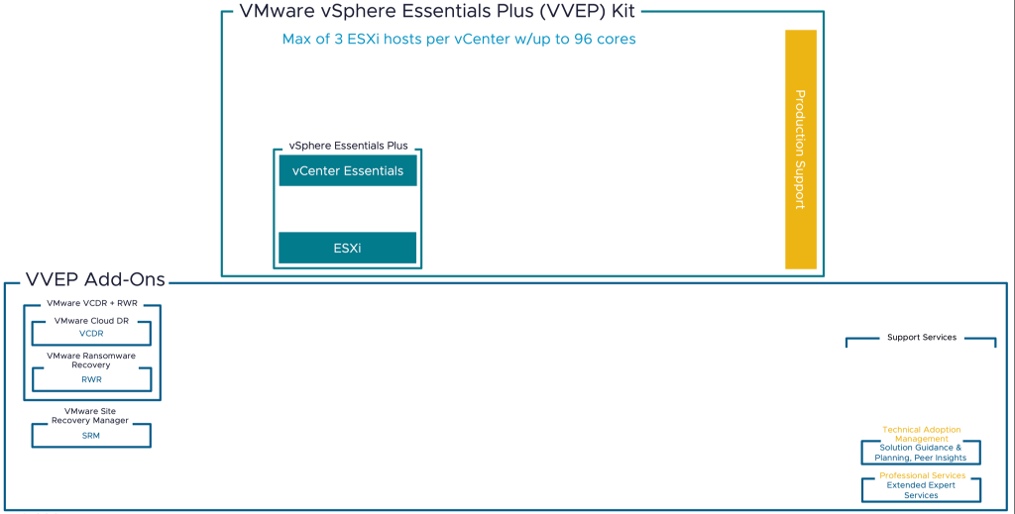
VVEP
VMware vSphere Essentials Plus
Entire feature list available at:
https://www.vmware.com/content/dam/digitalmarketing/vmware/en/pdf/docs/vmw-datasheet-vsphere-product-line-comparison.pdf

Slide 28
VVEP
Pay for all 96 cores
(3 hosts, 2x 16 core
or 1x 32 core)
VMware vSphere Essentials Plus
Entire feature list available at:
https://www.vmware.com/content/dam/digitalmarketing/vmware/en/pdf/docs/vmw-datasheet-vsphere-product-line-comparison.pdf

Slide 29
You cannot manage other ESXi hosts
With vCenter Essentials (VCF, VVF, VVS)
VVEP
Pay for all 96 cores
(3 hosts, 2x 16 core
or 1x 32 core)
VMware vSphere Essentials Plus
Entire feature list available at:
https://www.vmware.com/content/dam/digitalmarketing/vmware/en/pdf/docs/vmw-datasheet-vsphere-product-line-comparison.pdf

Slide 30
Broadcom Licensing Discussion
vSphere ROBO Licensing has not returned
Formerly sold in 25 VM or 100 VM packs
Allowed unlimited sockets of vSphere that shared the VM packs
Used in small-footprint ROBO solutions
VSAN and vRealize Operations also had ROBO SKU’s that are no longer available
Replacing ROBO Standard with vSphere Standard might be a good strategy for many customers.
There is a new “Edge Compute Stack” available to cover some remove/edge solutions.
Managed differently than traditional vSphere
More information on the VMware Edge Compute Stack:
https://www.vmware.com/products/edge-compute-stack.html

Slide 31
Broadcom Licensing Discussion
VMware’s Enterprise License Agreement Changes – View from a customer
Past ELA negotiations usually centered around purchasing new software and not renewing what you have.
Subscription plans are all new so the game has changed
Historically, an ELA has a stated out year which includes a pro-rated year after your ELA has expired.
EXAMPLE:
Customer has a 4-year ELA -- $4 Million over 4 years (January 2021 thru January 2025)
Normally, a 5th year “Stated out year” of $1 million from January 2025 thru January 2026 would be available.
Broadcom has canceled all “Stated out years” so customers cannot use their perpetual licensing for an additional year.

Slide 32
Broadcom Licensing Discussion
Planning for your next agreement
Understand what products are available at each level
Consider ways to leverage savings in other areas
IP-based storage vs. Fibre Channel
Infrastructure Consolidation (more memory, fewer hosts)
CPU strategies (fewer cores/sockets)
NOTE: Moving from traditional storage to VSAN may increase your memory and CPU requirements.

Slide 33
Broadcom Licensing Discussion
Perpetual vs. Subscription
Current Subscription Model vs. vSphere+ Subscription Model

Slide 34
Broadcom Licensing Discussion
Perpetual vs. Subscription
Perpetual Licensing Concept: Purchase the license outright and maintain with a support
agreement – typically ~20% of the original license cost, per year
Subscription Licensing Concept: No outright purchase is required, but the annual subscription cost will include the purchase over time

Slide 35
Broadcom Licensing Discussion
Perpetual vs. Subscription
Customers’ complaint: “My renewal is tripling!!”
Perpetual Example (static customer)
Subscription Example (static customer)
$2,000 – Typical maintenance (year 1)
$2,000 – Typical maintenance (year 2)
$2,000 – Typical maintenance (year 3)
TOTAL for 3 years - $6,000
$6,000 – Year 1 subscription cost
$6,000 – Year 2 subscription cost
$6,000 – Year 3 subscription cost
TOTAL for 3 years - $18,000

Slide 36
Broadcom Licensing Discussion
Perpetual vs. Subscription
Customers’ complaint: “My renewal is tripling!!”
Perpetual Example (static customer)
Subscription Example (static customer)
$2,000 – Typical maintenance (year 1)
$2,000 – Typical maintenance (year 2)
$2,000 – Typical maintenance (year 3)
TOTAL for 3 years - $6,000
$6,000 – Year 1 subscription cost
$6,000 – Year 2 subscription cost
$6,000 – Year 3 subscription cost
TOTAL for 3 years - $18,000
300% increase

Slide 37
Broadcom Licensing Discussion
Perpetual vs. Subscription
Customers’ complaint: “My renewal is tripling!!”
Perpetual Example (static customer)
Subscription Example (static customer)
$2,000 – Typical maintenance (year 1)
$2,000 – Typical maintenance (year 2)
$2,000 – Typical maintenance (year 3)
TOTAL for 3 years - $6,000
$6,000 – Year 1 subscription cost
$6,000 – Year 2 subscription cost
$6,000 – Year 3 subscription cost
TOTAL for 3 years - $18,000
300% increase
Perpetual Example
Subscription Example
$10,000 – one-time purchase of software
$2,000 – Year 1 maintenance
$2,000 – Year 2 maintenance
$2,000 – Year 3 maintenance
TOTAL for 3 years - $16,000
$6,000 – Year 1 subscription cost
$6,000 – Year 2 subscription cost
$6,000 – Year 3 subscription cost
TOTAL for 3 years - $18,000

Slide 38
Broadcom Licensing Discussion
Perpetual vs. Subscription
Customers’ complaint: “My renewal is tripling!!”
Perpetual Example (static customer)
Subscription Example (static customer)
$2,000 – Typical maintenance (year 1)
$2,000 – Typical maintenance (year 2)
$2,000 – Typical maintenance (year 3)
TOTAL for 3 years - $6,000
$6,000 – Year 1 subscription cost
$6,000 – Year 2 subscription cost
$6,000 – Year 3 subscription cost
TOTAL for 3 years - $18,000
300% increase
Perpetual Example
Subscription Example
$10,000 – one-time purchase of software
$2,000 – Year 1 maintenance
$2,000 – Year 2 maintenance
$2,000 – Year 3 maintenance
TOTAL for 3 years - $16,000
$6,000 – Year 1 subscription cost
$6,000 – Year 2 subscription cost
$6,000 – Year 3 subscription cost
TOTAL for 3 years - $18,000
12.5% increase

Slide 39
Broadcom Licensing Discussion
According to the US Inflation
Calculator, Inflation from
1/2021-12/2023 was 17.83%
Perpetual vs. Subscription
Customers’ complaint: “My renewal is tripling!!”
Perpetual Example (static customer)
Subscription Example (static customer)
$2,000 – Typical maintenance (year 1)
$2,000 – Typical maintenance (year 2)
$2,000 – Typical maintenance (year 3)
TOTAL for 3 years - $6,000
$6,000 – Year 1 subscription cost
$6,000 – Year 2 subscription cost
$6,000 – Year 3 subscription cost
TOTAL for 3 years - $18,000
300% increase
Perpetual Example
Subscription Example
$10,000 – one-time purchase of software
$2,000 – Year 1 maintenance
$2,000 – Year 2 maintenance
$2,000 – Year 3 maintenance
TOTAL for 3 years - $16,000
$6,000 – Year 1 subscription cost
$6,000 – Year 2 subscription cost
$6,000 – Year 3 subscription cost
TOTAL for 3 years - $18,000
12.5% increase

Slide 40
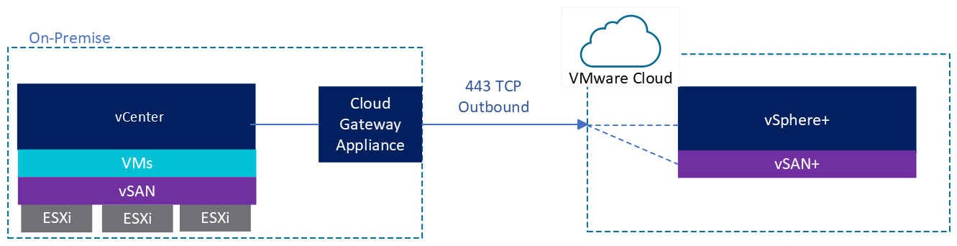
Broadcom Licensing Discussion
Current Subscription Model vs. vSphere+ Subscription Model
vSphere+ was VMware’s new subscription-model (pre-Broadcom Acquisition)
Required the use of a “VMware Cloud Gateway” using your VMware Cloud Services account
Perpetual and vSphere+ licenses must use separate vCenter Servers (not compatible)
(I was told) that this eliminated your ability to deploy ESXi, join it to your vCenter, and leverage your 60-day Evaluation window.
https://core.vmware.com/resource/vsphereplus-FAQS

Slide 41
Broadcom Licensing Discussion
Current Subscription Model vs. vSphere+ Subscription Model
Current Subscription Model eliminates the Cloud Gateway Appliance
Once you purchase your subscription, you receive keys that function like perpetual
Subscription and Perpetual keys work with each other on the same vCenter Server
60-day Evaluation mode works the same way as it did with perpetual keys

Slide 42
Broadcom Licensing Discussion
If I purchase VCF, do I need to run the entire Software-Defined Datacenter?
NO. VCF doesn’t even have a license key.
Purchasing VCF gives you the software keys for products such as:
vSphere
vCenter
NSX-T
VSAN (with up to a 1TiB per physical core entitlement)

Slide 43
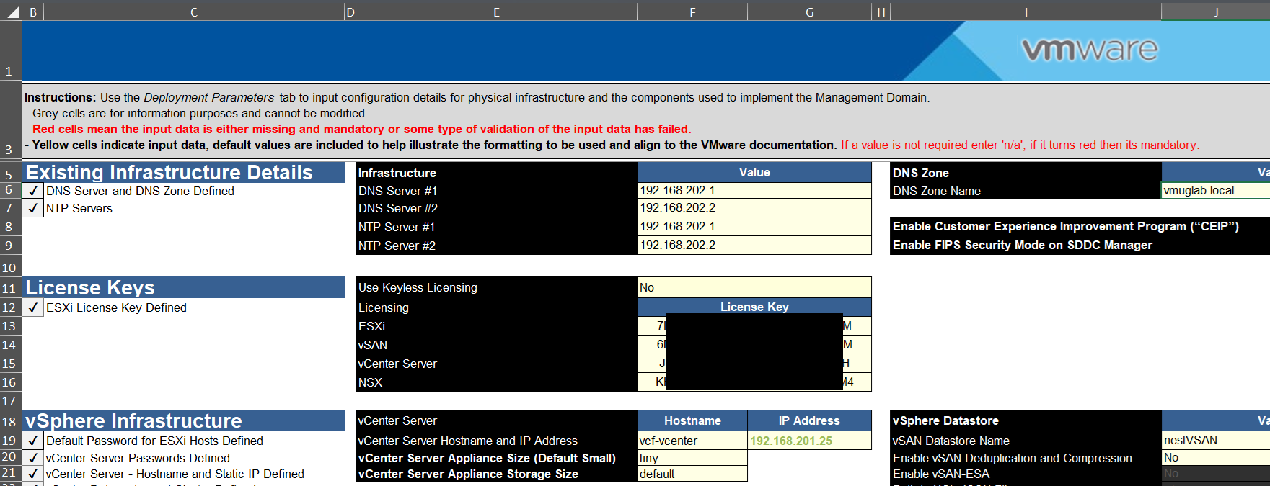
Broadcom Licensing Discussion
If I purchase VCF, do I need to run the entire Software-Defined Datacenter?
NO VCF KEY

Slide 44
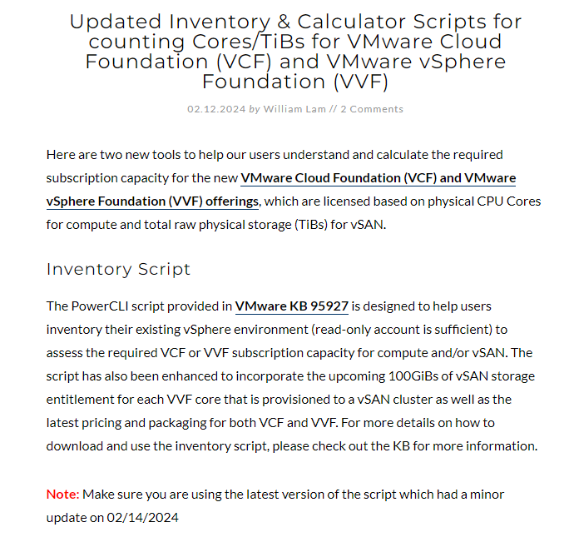
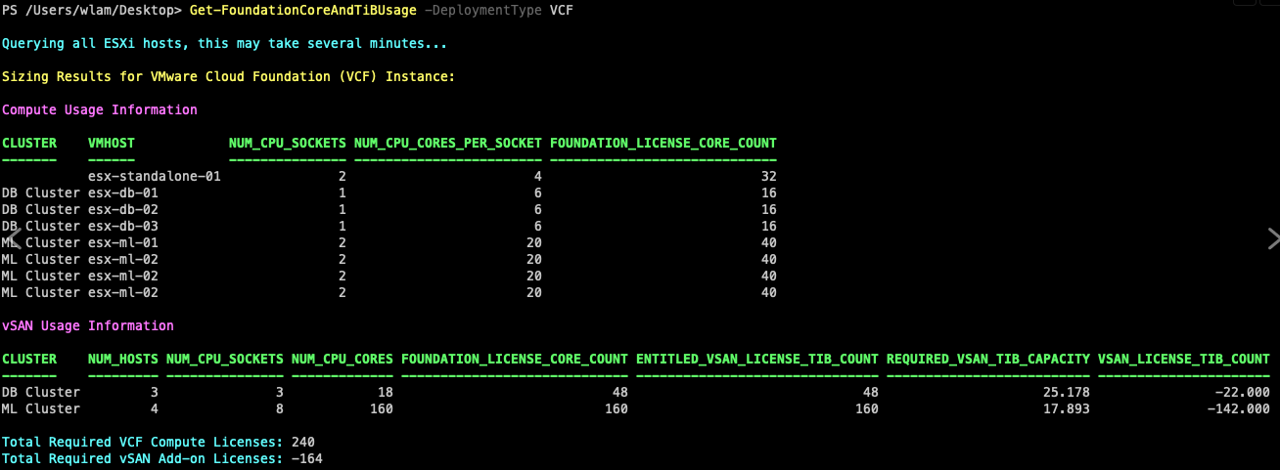
Broadcom Licensing Discussion
How do I know how many cores I need to buy in my next agreement?
williamlam.com
NO V KEY
https://williamlam.com/2024/02/updated-inventory-calculator-scripts-for-counting-cores-tibs-for-vmware-cloud-foundation-vcf-and-vmware-vsphere-foundation-vvf.html

Slide 45
Broadcom Licensing Discussion
Impacts to Horizon Environments
NOTE: Broadcom has decided to divest the EUC Division
Until that time, there are a ton of unknowns
Currently, partners are working with Broadcom’s EUC Division to provide renewals for expiring
customers. This includes renewed licenses for vSphere for Desktops.
When the divestment occurs, it is unknown whether this will remain the same. Other EUC solutions such as Cloud Software Group’s Citrix Virtual Apps and Desktops (CVAD) leverage vSphere for Desktops at a cost.
Currently, VMUG Advantage’s “EvalExperience” which provides 365-day evaluation licenses to
most VMware products (for non-production use) includes VMware Horizon Advanced.

Slide 46
Broadcom Licensing Discussion
Impacts to VMUG Advantage and EvalExperience
VMUG and Broadcom will continue our partnership as it has been in the past. VMUG Advantage subscribers will continue to receive 365-day Evaluation keys within the EvalExperience program.
Since Broadcom’s subscription model gives customers a set of installation keys, VMUG Advantage subscribers do not need to worry about keys going away as a part of Broadcom’s move to subscription licensing.
VMware’s vSphere+ and Cloud Gateway model did not fit VMUG Advantage’s key-based model.
A case could be made that Broadcom’s subscription model is much more VMUG Advantage-friendly!

Slide 47
Broadcom Licensing Discussion
Impacts to Horizon Licenses within
VMUG Advantage and EvalExperience
NOTE: Broadcom has decided to divest the EUC Division
Until that time, there are a ton of unknowns
VMUG will make every effort to convey to whomever acquires Broadcom’s EUC Division the importance of VMUG Advantage to Horizon Customers for testing VDI solutions. Currently, no 3rd party solutions are a part of EvalExperience.
VMUG is discussing the feasibility of adding other 3rd party solutions to EvalExperience in advance of a possible EUC Division Divestment. If you have any requests/recommendations, please reach out to memberservices@vmug.com

Slide 48
Broadcom Licensing Discussion
Impacts to Licensing Purchases from a Solution like Dell/EMC VxRail or VSAN Ready Nodes
Scenario: Customer purchased a solution from an OEM that included VSAN licensing but not vSphere licensing
Customer uses perpetual keys to license vSphere, but has VSAN licensing paid through 2027
My partner contact told me the following:
Any perpetual keys for a solution such as VSAN will work with either VCF, VVF or VVS until the solution licenses expire.
Once the solution licenses expire, VSAN entitlement will need to follow VCF or VVF rules. Customer will not be able to use VVS when the VSAN licensing expires.

Slide 49
Broadcom Licensing Discussion
Ways to save money if cost is a concern
Take a deep look at your CPU utilization – Calculate your true CPU need
Take into consideration your availability requirements
N+1 – Always have enough resources if you lose a host
N+2 – Always have enough resources if you lose two hosts, or are patching, and lose a host
Example:
6 node environment, N+1 requirement
2x Intel Xeon CPU’s per host
Current cluster CPU Utilization is 20%
Give your CPU utilization a “score” – 20% * 6 = 120
Assume you are at “N” (5 hosts in this case)
Calculate the impact if you were to remove a CPU on each host. Total CPU capacity would be 50% of what it was, for 5 hosts.

Slide 50
Broadcom Licensing Discussion
Ways to save money if cost is a concern
Current Capacity = 100% * 6 hosts – Score of 600
Worst Case Cap. = 50% * 5 hosts – Score of 250
Current CPU Utilization Score is 120. Therefore a workload of 20% would now be at 48%
Why do this? Your VMware contract will be cut in HALF.
Before you do this:
Contact your vendor to see if it violates your support agreement – possibly order CPU covers
Verify you have enough memory slot capacity to move all memory sticks to one CPU
Verify your compute platform doesn’t have any dependency on your 2nd CPU
Sometimes a 2nd CPU can increase the amount of PCI-e devices you can install

Slide 51
Broadcom Licensing Discussion
Ways to save money if cost is a concern
Look at your feature set and see if you are actually using those features
Example:
Current vSphere Enterprise Plus Customer
Not using Distributed Switches, Network I/O controls, Host Profiles
Customer uses the Distributed Resource Scheduler (DRS) but the workloads rarely move
Actions:
Reduce licensing to VVS
Create PowerCLI scripts for these features made easy by DRS
Script host creation of Standard Switches and port groups (for reconfiguring or building hosts)
Create scheduled tasks to check whether or not application servers are running on the same ESXi host (replaces DRS Anti-Affinity -- useful after maintenance or HA events)
Script the VMotion of VM’s for maintenance operations

Slide 52
Broadcom Licensing Discussion
Use PowerCLI for Maintenance Operations
Host 1
Host 2
Host 3
Host 4
Host 5
Host 6
Move 1/5th of all VM’s on Host 1 to Hosts 2-6 – Patch and reboot
Move all VM’s from Host 2 to Host 1 – Patch and reboot
Move all VM’s from Host 3 to Host 2 – Patch and reboot
Move all VM’s from Host 4 to Host 3 – Patch and reboot
Move all VM’s from Host 5 to Host 4 – Patch and reboot
Move all VM’s from Host 6 to Host 5 – Patch and reboot
Move the same VM’s that were moved in step 1 to Host 6

Slide 53
Broadcom Licensing Discussion
Ways to save money if cost is a concern
Work with other teams to make sure old licensing rules still apply
Example:
A legacy software licensing rule for an application required a different strategy for physical host core count
Vendor required customer to license all physical cores on a host even though it was virtualized
Customer purchased four hosts with a single quad-core CPU to reduce physical core count
Problem:
Broadcom’s new subscription-based licensing approach includes a minimum of 16 cores per socket
Customer would be required to pay for 64 cores of vSphere despite having only 16 cores total
Actions:
After talking with software vendor, they no longer license physical cores, only virtual cores
Vendor approves customer to move software to their normal production cluster
Customer was able to move the RAM from the dedicated cluster to their primary cluster

Slide 54
Broadcom Licensing Discussion
Ways to save money if cost is a concern
Change compute purchasing strategy to account for CPU footprint
Example:
Customer is memory-bound and not CPU-bound in most environments
Customer has a few appliances where the vendor requires 32-cores on the VM
Actions:
Create dedicated 2-3 host clusters for non-conforming workloads
Hosts in this cluster would have more CPU and less RAM
Production clusters would standardize on dual-16 core CPU’s
Savings:
Customer will save 50% in vSphere licensing over their current dual 32 core CPU hosts

Slide 55

Broadcom Licensing Discussion
Questions anyone?

