Slide 1
Ranking of Classification Algorithms in AutoML
A Comparison of Regression-Based Ranking and Preference Models
Bachelor’s Thesis Presentation by Helena Graf
Supervisors: Prof. Dr. Eyke Hüllermeier Prof. Dr. Axel-Cyrille Ngonga Ngomo
Notes:
Good afternoon everyone
My name is Helena
Thank you so much for attending the presentation of my bachelor‘s thesis, which I hope you will enjoy
The topic today is the ranking of classification algorithms in AutoML (Automated Machine Learning) – With a comparison of regression-based ranking and preference models

Slide 2
Motivation and Problem Statement
Increasing demand for machine learning functionality
AutoML: (partially) automate the creation of machine learning applications
Important problem: Finding a fitting classification algorithm for a new data set
Current AutoML approaches often do not …
… explicitly take into account how properties of a data set influence algorithm performances
… recommend more than a single algorithm
Notes:
What is motivation? As you know, Many have realised the potential of big data; lead to an increasing amount of information is collected (zettabytes) and available for analysis, but this potential is not utilized (only 0.5% in 2015)
So why is it not analyzed? One reason could be that expertise is necessary for analysis, and experts cannot cover this vast amount of data that we have
-> increasing demand for ML functionality, has been answered by attempts to automate the process
One important ML task is classification, and one of the difficulties here is finding a fitting algorithm for a new data set, bc performances vary across dataset –even though some seem to generally be a better choice than others, there is no one best, and just trying them out can be very expensive, depending on data set and classifier
So this is one of the tasks that these AutoML tools try to solve
But they have some drawbacks
-> as perf vary, likely that properties of the data set influence how well classif performs

Slide 3
Objectives
Implement a tool that returns a ranking of classification algorithms based on properties of a data set, either …
… with a regression-based approach
… with a preference-based approach
Evaluate the performance of both alternatives …
… by comparison with a static baseline
… by comparison among each other

Slide 4
Approach
Pre-processing
Step 1: Record classifier performances on a number of data sets, together with properties of the data sets (5-times MCCV 70/30 split)
Step 2:
Regression-based ranker: Train a regression model to predict performance values for each classifier
Preference-based ranker: Train a label-ranking model with the rankings induced from the performance values
Notes:
The first step here is a pre-processing phase
Since we want to rank classifiers based on properties of a data set, we first need to gather same training examples, so properties of data sets together with performances of classifiers.
The second step of the pre-proesssing phase is then to train the rankers, which of course depends on the variant that is used
For regression, a regression model for each classifier is trained (predicts performance value for that classifier, examples have the form meta features -> performance value
For preference, there is a label ranking model (preference learning task) that directly learns rankings induced from the performance values (training examples meta features –> performance values)
So this is how both rankers are built. Afterwards, they can be used for predictions, which will now be explained in detail for both

Slide 5
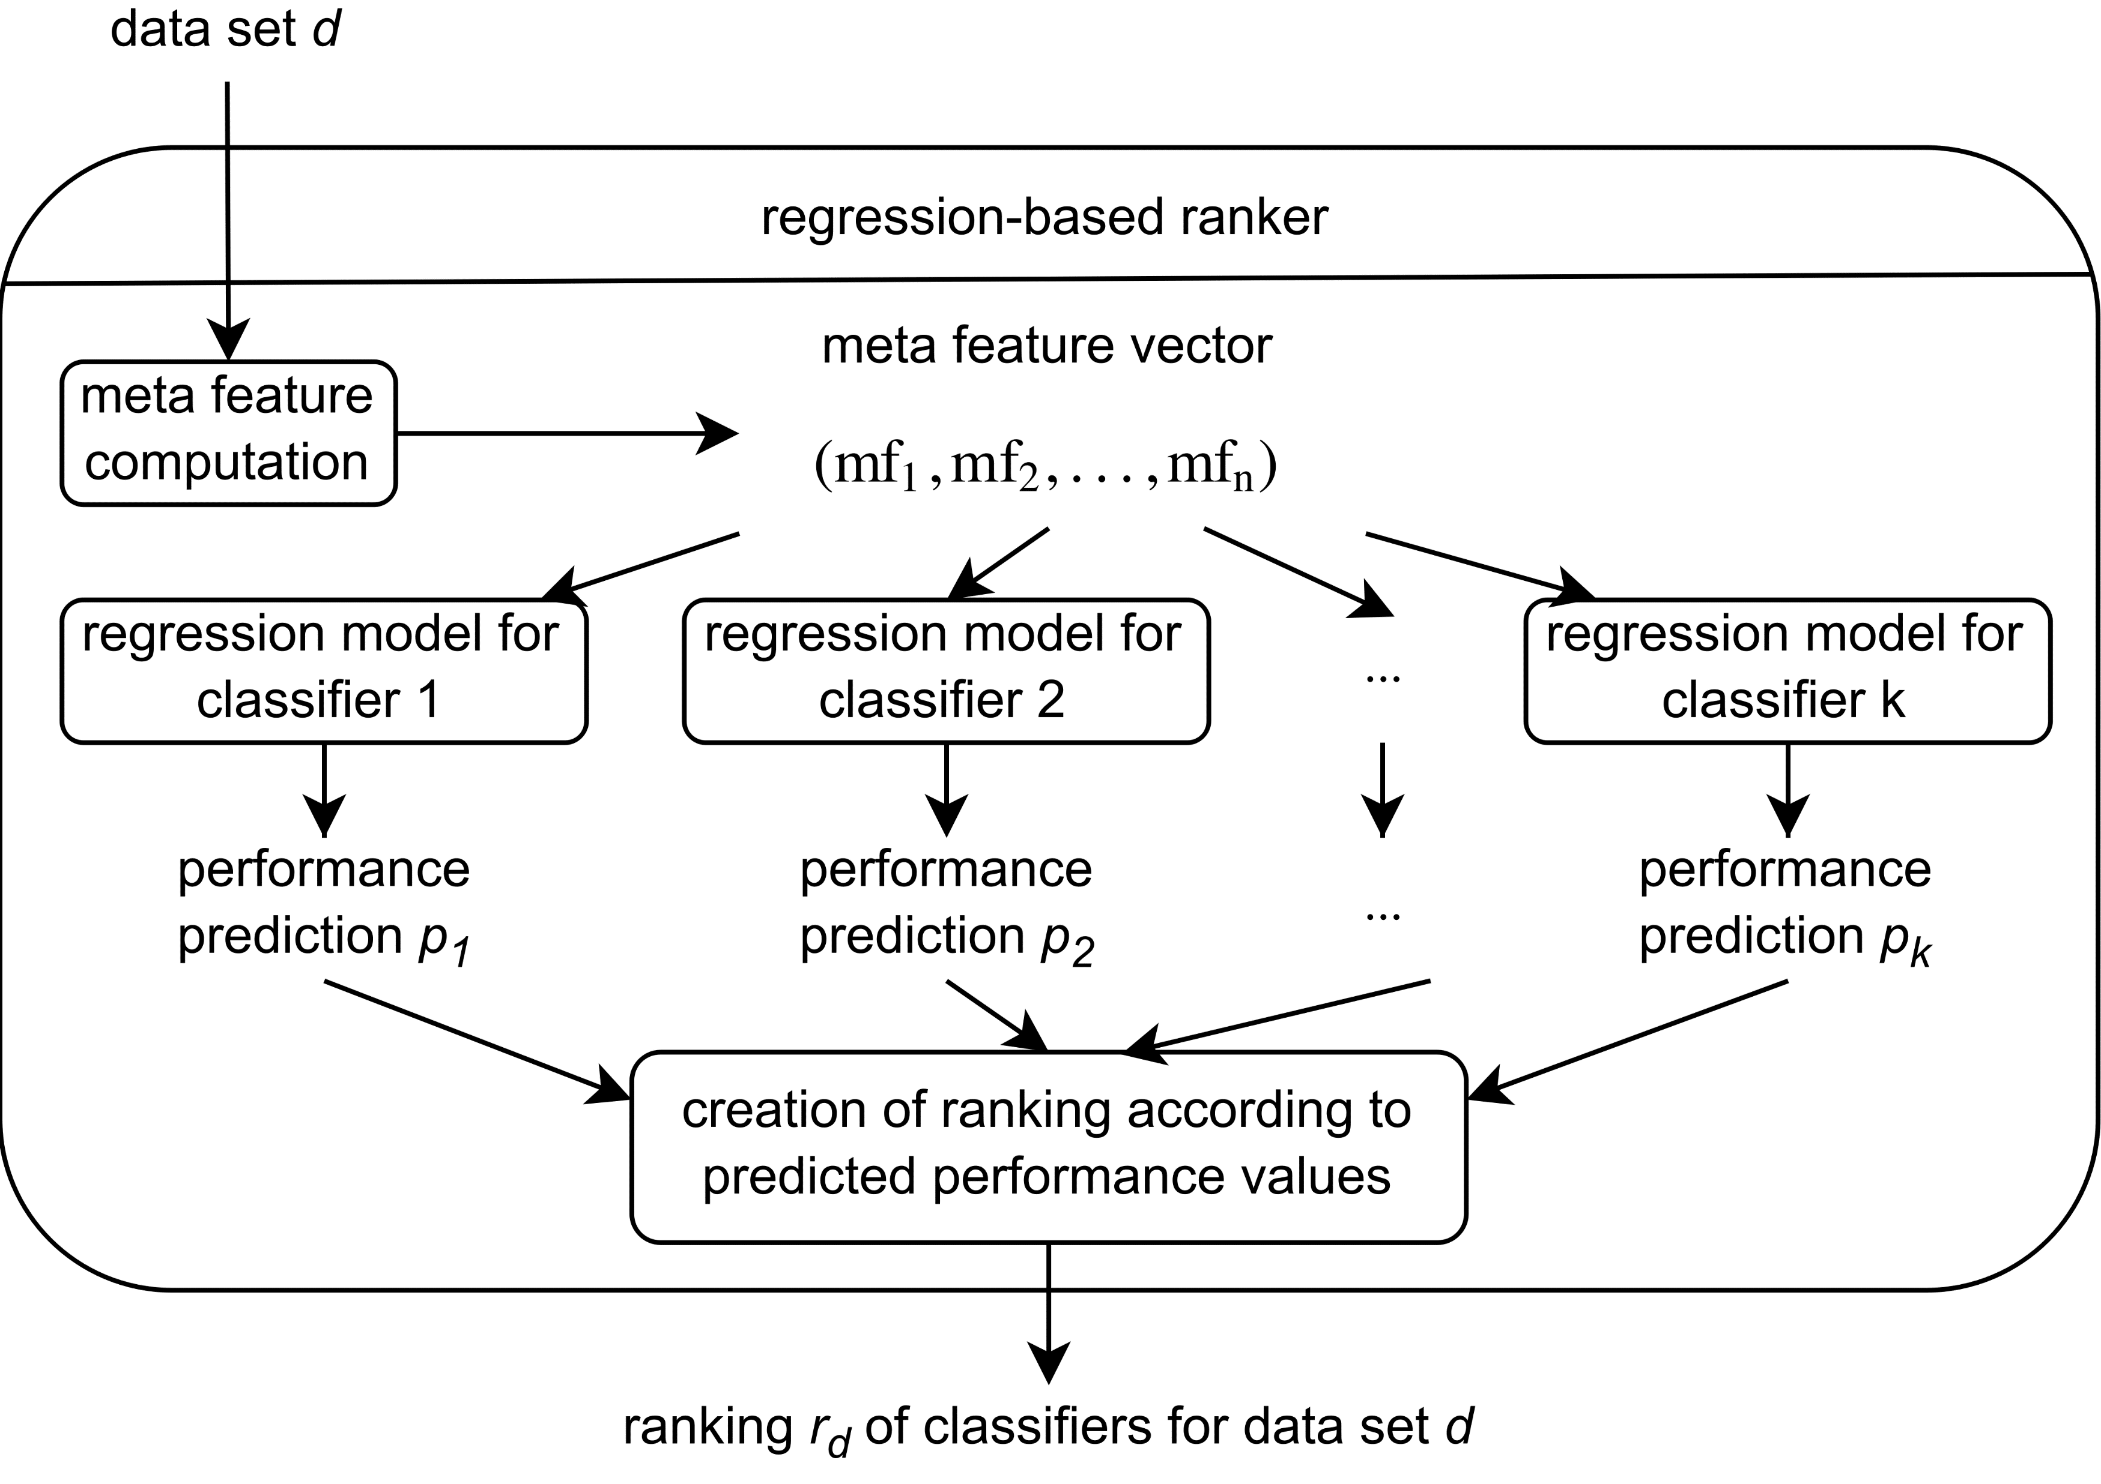
Approach: Regression-Based Ranker
Notes:
Here: Prediction – Ranker has been trained (After pre-processing)

Slide 6
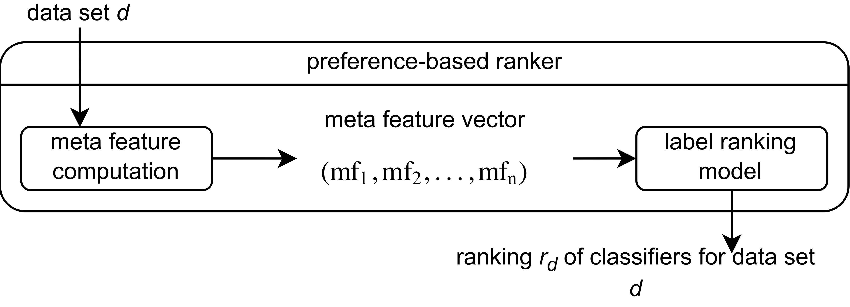
Approach: Preference-Based Ranker

Slide 7
Evaluation: Oracle and Baseline
Oracle: correct ranking for each data set
Induced by classifier performances (predictive accuracy)
Used to determine quality of rankings (Kendall‘s Tau)
Best algorithm baseline: static ranking, not influenced by data set properties
First algorithm in static ranking: best choice on most data sets, second algorithm: best choice on most data sets after first algorithm, …
Notes:
Ideal: 1. algo in ranking is best, last worst, etc. Likely not bc only predict.
Eval how good -> to what degree returned rankings conform with ranking acc. to actual perf.
For this, have ranker that always correct (only after having seen it): oracle
correct rankings induced by classif perfs on a data (perf measure predictive accuracy, could use others like error)
How good predicted ranking? Correlation with correct ranking (Tau)
Then want to know how much knowing about properties helps with prediction of ranking
-> need baseline that does not have this info, therefore always returns same, static ranking …

Slide 8
Evaluation: Experimental Setup
Classifiers: All WEKA classifiers except for ensemble and meta methods (22 in total)
Data Sets: 448 data sets from OpenML, with no more than 100 features or 1000 instances
Properties: 112 meta features from OpenML, 58 simple and 54 from landmarkers
Rankers: 4 regression-based variants and 4 preference-based variants
Procedure: Leave-one-out

Slide 9
Evaluation: Kendall‘s Tau
Regression-Based
Preference-Based
Notes:
Kendall‘s Tau is in range from -1 to 1, (explain meaning) -> higher is better
Can see the different alternatives here, 4 regression and 4 preference based

Slide 10
Evaluation: Loss and B3L
What does one gain/ lose by following the ranking?
Need measure that expresses this
Loss: Absolute difference between the performance of the best classifier and the first recommended classifier
B3L: Absolute difference between the performance of the best classifier and the best of the first three recommended classifiers (best three loss)

Slide 11
Evaluation: Loss and B3L
Regression-Based
Preference-Based
Notes:
Want to minimize loss -> means is good idea to follow the ranking

Slide 12
Evaluation: Ranker Build Times
Regression-Based
Preference-Based

Slide 13
Evaluation: Ranker Prediction Times
Regression-Based
Preference-Based

Slide 14
Evaluation: Meta Feature Computation Times
On the data set selection (small data sets):
Simple meta data: on average 3ms (+/- 3ms)
Landmarkers: on average 135ms (+/- 16ms)
On a larger data set (MNIST: 784 features, 70,000 instanes):
Simple meta data: 24s
Landmarkers: 4h 51m
Only ‚light‘ landmarkers: 8m 30s
Notes:
Light landmarkers: DecisionStump, RandomTreeDepth2, REPTreeDepth2, J48.0001

Slide 15
Conclusion
Both approaches show an advantage over the baseline
Data set properties can be exploited by them to construct a ranking
The regression-based approach has a superior performance compared to the preference-based approach
The additional information of performance values poses an advantage over the abstraction of the preference model for this problem
Among the evaluated alternatives, random forest seems to be the best choice

Slide 16
Future Work
Extend the evaluation
Different set of meta features (more, ‚light‘ probing, …)
Comparison with other AutoML approaches
Loss-time curves
Extend the tool
Other ML-tasks (regression, clustering)
Parameterized algorithms
Other performance measures
Better regression models (pre-processing, auto-fit)

Slide 17
Thank You for Your Attention!
Questions?

Slide 19
Static Baseline Ranking
Rank | Classifier | Rank | Classifier
1 | Random Forest | 12 | Decision Table
2 | Multilayer Perceptron | 13 | JRip
3 | Bayes Net | 14 | PART
4 | Naive Bayes | 15 | J48
5 | Logistic | 16 | REPTree
6 | SGD | 17 | Random Tree
7 | SMO | 18 | OneR
8 | Simple Logistic | 19 | Decision Stump
9 | LMT | 20 | Voted Perceptron
10 | IBk | 21 | ZeroR
11 | KStar | 22 | Naive Bayes Multinomial

Slide 20
Root Mean Square Error of the Regression-Based Rankers
* An outlier has been removed.

Slide 21
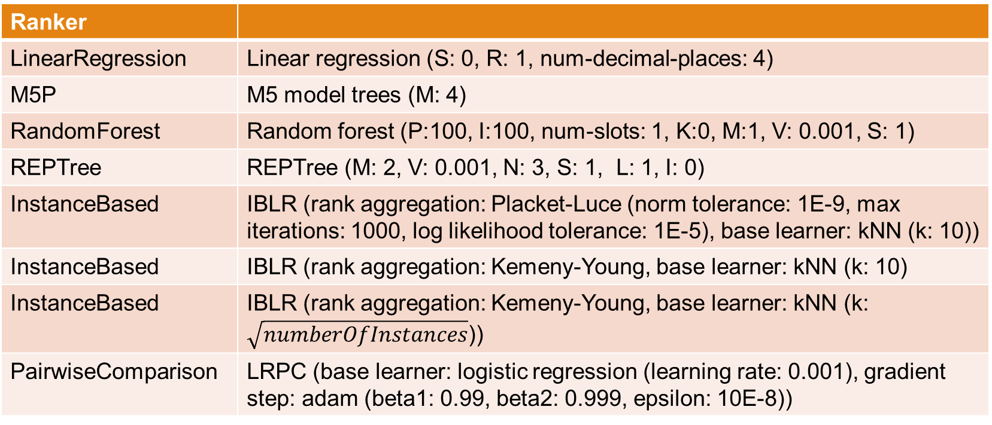
Ranker Configurations
Ranker
LinearRegression | Linear regression (S: 0, R: 1, num-decimal-places: 4)
M5P | M5 model trees (M: 4)
RandomForest | Random forest (P:100, I:100, num-slots: 1, K:0, M:1, V: 0.001, S: 1)
REPTree | REPTree (M: 2, V: 0.001, N: 3, S: 1, L: 1, I: 0)
InstanceBased | IBLR (rank aggregation: Placket-Luce (norm tolerance: 1E-9, max iterations: 1000, log likelihood tolerance: 1E-5), base learner: kNN (k: 10))
InstanceBased | IBLR (rank aggregation: Kemeny-Young, base learner: kNN (k: 10)
InstanceBased | IBLR (rank aggregation: Kemeny-Young, base learner: kNN (k: $\sqrt{numberOfInstances}$))
PairwiseComparison | LRPC (base learner: logistic regression (learning rate: 0.001), gradient step: adam (beta1: 0.99, beta2: 0.999, epsilon: 10E-8))

