Slide 1
Ranking of Classification Algorithms in AutoML
A Comparison of Regression-Base Ranking and Preference Models
Bachelor Thesis Presentation by Helena Graf
Supervisors: Prof. Dr. Eyke Hüllermeier Prof. Dr. Axel-Cyrille Ngonga Ngomo

Slide 2
Motivation and Problem Statement
Increasing demand for machine learning functionality
aim to (partially) automate the creation of machine learning applications

Slide 3
Objectives

Slide 4
Approach

Slide 5
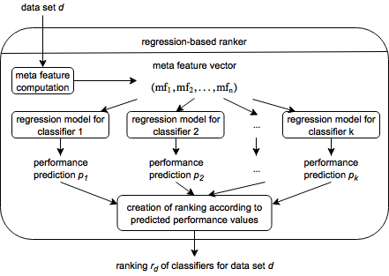
Approach: Regression-Based Ranker

Slide 6
Approach: Preference-Based Ranker

Slide 7
Evaluation: Baseline and Oracle

Slide 8
Evaluation: Kendall‘s Tau

Slide 9
Evaluation: Loss and B3L
What does one gain/ lose by following the ranking?
Need measure that expresses this
Loss: Absolute difference between the performance of the best classifier and the first recommended classifier
B3L: Absolute difference between the performance of the best classifier and the best of the first three recommended classifiers (best three loss)

Slide 10
Evaluation: Loss and B3L

Slide 11
Evaluation: Ranker Build Times

Slide 12
Evaluation: Ranker Prediction Times

Slide 13
Evaluation: Meta Feature Computation TImes

Slide 14
Conclusion

Slide 15
Thank You for Your Attention!
Questions?

Slide 17
The Static Baseline Ranking
Rank | Classifier | Rank | Classifier
1 | Random Forest | 12 | Decision Table
2 | Multilayer Perceptron | 13 | JRip
3 | Bayes Net | 14 | PART
4 | Naive Bayes | 15 | J48
5 | Logistic | 16 | REPTree
6 | SGD | 17 | Random Tree
7 | SMO | 18 | OneR
8 | Simple Logistic | 19 | Decision Stump
9 | LMT | 20 | Voted Perceptron
10 | IBk | 21 | ZeroR
11 | KStar | 22 | Naive Bayes Multinomial

Slide 18
The Root Mean Square Error of the Regression-Based Rankers
* An outlier has been removed.

Slide 19
Ranker configurations

