Slide 1

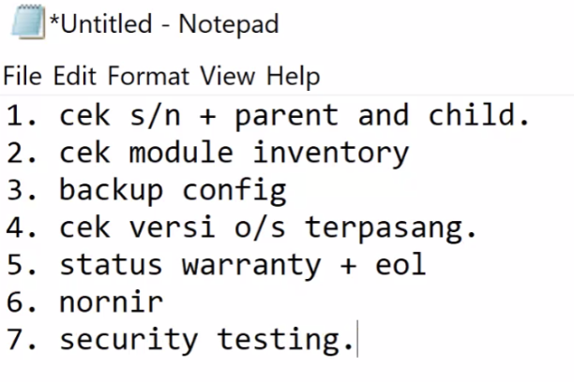
Netmiko
Requests
Open as file
Flask
8. Web GUI View

Slide 2
Function()
def bulan(parameter):
if parameter == 10:
return "oktober"
else:
return "november"
bulanSekarang = bulan(10)
print(bulanSekarang)

Slide 3
Import file python lain
def bulan(parameter):
if parameter == 10:
return "oktober"
else:
return "november"
import file1
bulanSekarang = file1.bulan(10)
print(bulanSekarang)
file1.py
file2.py

Slide 4
Netmiko
from netmiko import ConnectHandler device = { 'device_type': 'cisco_xe', 'host': '198.18.0.72', 'username': 'cisco', 'password': 'cisco', 'secret': 'cisco' } def command(cmd): try: net_connect = ConnectHandler(**device) net_connect.enable() output = net_connect.send_command(cmd) return output except: return "error netmiko"
print(command("show ip int br"))

Slide 5
Open file
......................
def command(cmd): try: net_connect = ConnectHandler(**device) net_connect.enable() output = net_connect.send_command(cmd) return output except: return "error netmiko"
def backup(): with open('router.log', 'w') as f: f.write(command("show run"))
w : write
r : read
a : append

Slide 6
Requests
import requests import urllib3 urllib3.disable_warnings(urllib3.exceptions.SecurityWarning)
def login(): client_id = "8smzjznfz8vmrm7qcft458x2" client_secret = "uqya83hAxn8R6S9vqZjMYW82" url = (f"https://cloudsso.cisco.com/as/token.oauth2?grant_type=client_credentials&client_id={client_id}&client_secret={client_secret}") headers = {"Accept": "application/json"} try: post = requests.post(url, headers=headers, timeout=3, verify=False) result = post.json()["access_token"] return result except: return "err"
def hello(): token = "Bearer " + login() url = ("https://api.cisco.com/hello") headers = { "Accept": "application/json", "Authorization": token} try: post = requests.get(url, headers=headers, timeout=3, verify=False) result = post.json()["helloResponse"]["response"] return result except: return "err"

Slide 7
Flask
from flask import Flask app = Flask(__name__) @app.route('/') def hello_world(): return "Test Hello World" if __name__ == '__main__': app.run()

