Slide 1

Introduction to R Markdown & R Notebooks

Slide 2
What‘s the rough idea for today?
We create an R Notebook aka R Markdown document
We edit the header (meta-information about the document)
We write some text and some code organized in so-called „chunks“
We load some data and save it as a csv file
We „knit“ the document and get the output (as preview, html, pdf or word)

Slide 3
What does an R Notebook do?
combining code and rich text elements, such as headings, paragraphs and links, in one document
Uses Rmarkdown, a language to write fully-formatted documents (file extension .Rmd)
analysis and reporting in the same location, directly linking the two
sometimes called “literate programming”
makes reporting reproducible, as data are directly included in the document and not simply copypasted
https://argoshare.is.ed.ac.uk/healthyr_book/chap12-h1.html

Slide 4
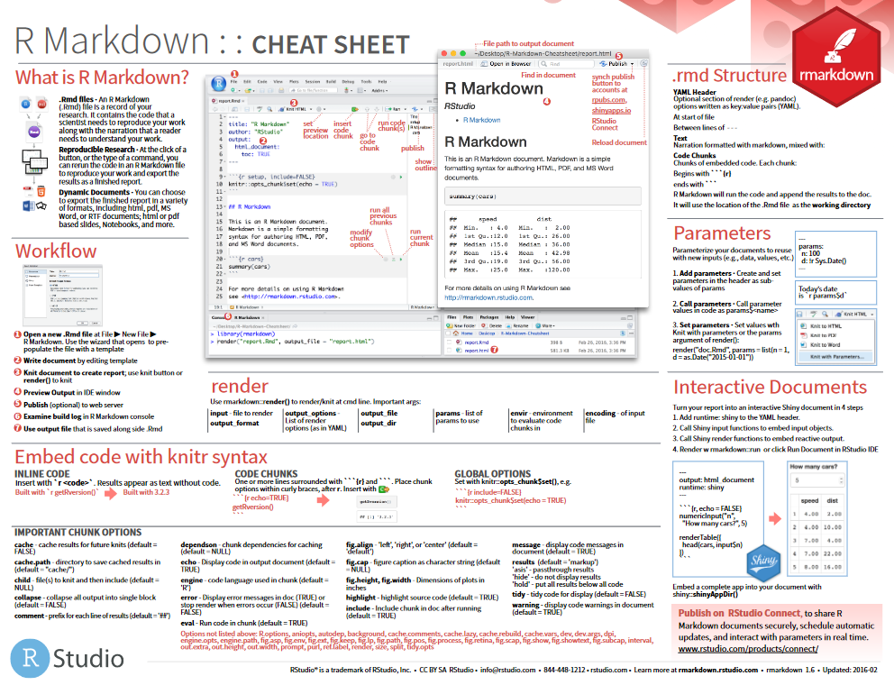
Cheatsheets
https://raw.githubusercontent.com/rstudio/cheatsheets/master/rmarkdown-2.0.pdf

Slide 5
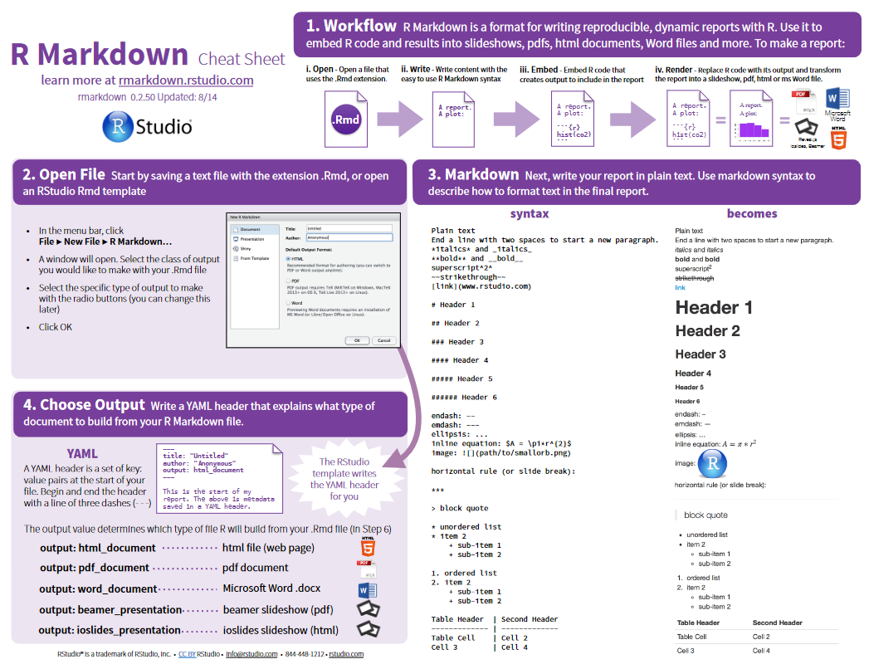
Cheatsheets
www.rstudio.com/wp-content/uploads/2015/02/rmarkdown-cheatsheet.pdf

Slide 6
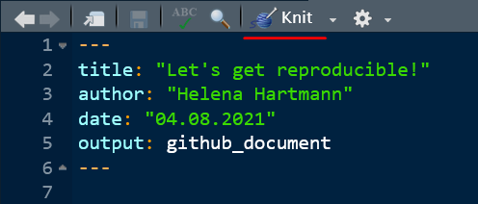
Writing text
When you wrote some text, you can „knit“ the document to get the output

Slide 7
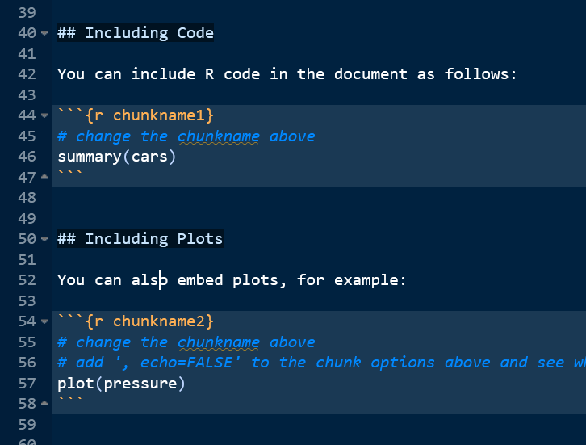
Chunks
Structuring and organizing code for anaysis, tables and plots
Name each chunk so it makes sense
Chunk options

Slide 8
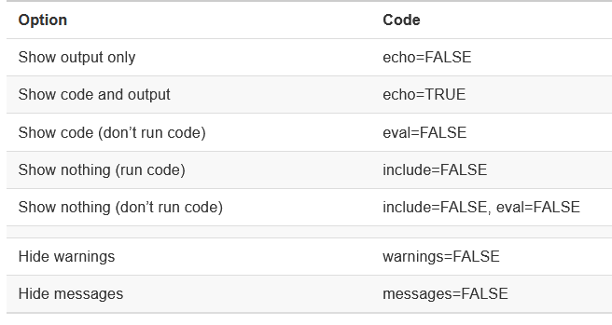
Chunk options using knitr
Name your chunks so that they make sense!
Setup-chunk sets default options for all chunks, but this can be overwritten by settings in single chunks
echo = FALSE prevents printing the R code that generated e.g. a plot
include = FALSE hides that complete code chunk in the output

Slide 9
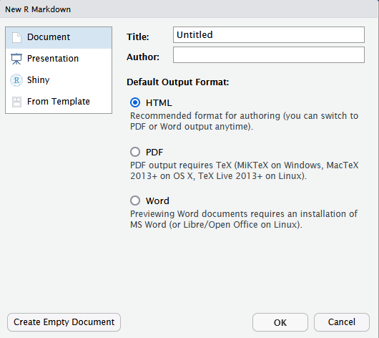
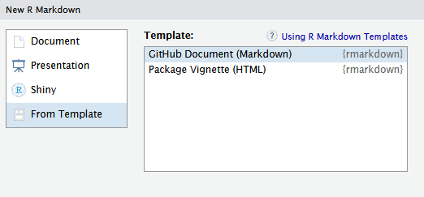
Now let‘s do some exercises!
First step: Get the Rmarkdown file I created for this purpose or create a new document!
Next up:
We go through the exercises together and change/add some things!
We‘ll upload/push that file to GitHub!

