Slide 1
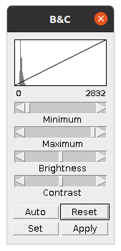
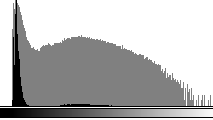
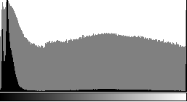
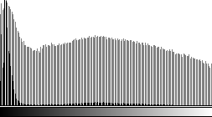
Image histogram examples
Offset, gap to 0
Properly sampled raw images have background!
Peak at 255
High values clipped
No background
!
Scaling artefact
!
pixel intensities

