Slide 1

Influencing Others In the Workplace:
Developing and Validating A Forced-Choice Measure
Student: Helena Lee
Supervisor: Prof. Jennifer Overbeck

Slide 2

https://talkshopworkshops.com/influencing-others/
Notes:
In what cases will this new measurement tool can be useful?
Imagine you are a leader of a newly formed project team, and you want to know what the current team dynamics are.
For example, this member is more aggressive when trying to convince others, while others might be more collaborative.
You may be able to know this through how team members interact with each other, or how they interact with you. But this will take some time to know.
If there is an available measure of influencing behaviour, then you can understand the baseline tendency of each member in using more coercive influence strategies or collaborative strategies. Apply this understanding, you can better cooperate and communicate with your team.

Slide 3
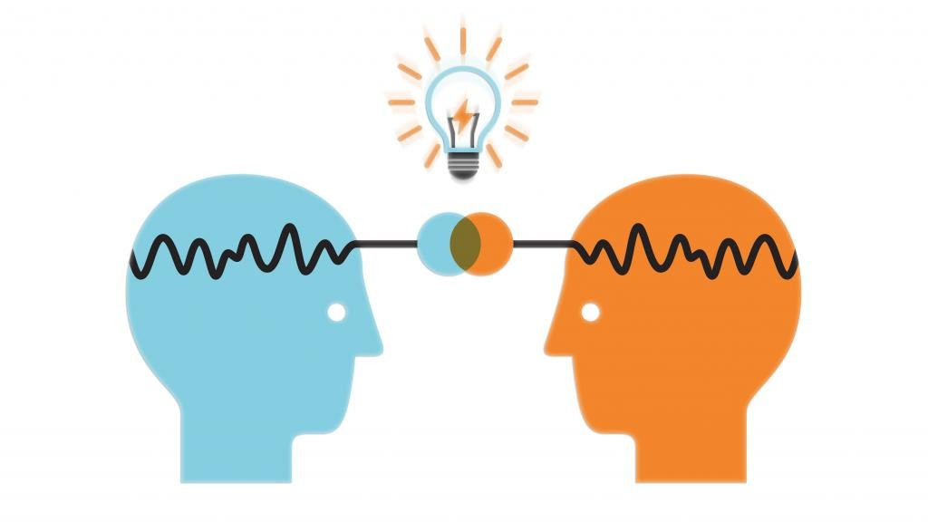
Research Aims
Develop and validate a forced-choice measurement that can be used to measure individuals’ preferences in influencing behaviors
Understand what people would choose to do when trying to influence others
Whether those preferences can be explained by theory and constructs of power (resource control) and influence (capacity for volitional influence)
Working toward the first step of operationalizing the Social Alignment Theory of Power
Potential Future Applications:
Use in organizations to understand team dynamics
For Individuals to understand themselves better in the aspect of influencing behaviors

Slide 4
Overview
Background: SATP (Theory), Influence Tactics
Part I: Development
Part II: Validation
Notes:
Adapt with this structure s

Slide 5
Theory: Social Alignment Theory of Power (SATP)
The perceived availability of power and volitional influence can predict individuals’ influencing behaviors, specifically to use more collaborative strategies, or coercive strategies.
Power
Asymmetric control over valuable resources
Volitional Influence
Perceived ability to produce willful changes in others
(Fast & Overbeck, 2023)
Notes:
According to SATP, The perceived availability of power and volitional influence can predict individuals’ influencing behaviors, specifically to use more collaborative strategies, or coercive strategies.
Some resources, include things like money or financial capital, networks or social capital, and even emotions or psychological capital.

Slide 6
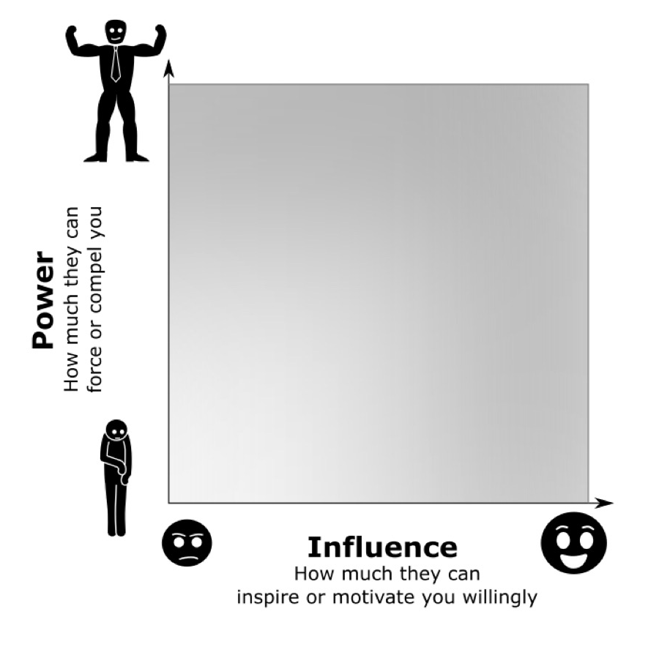
Influence tactics
Influence tactics are mapped onto a 2D space defined by its minimum required power and volitional influence
(Lewis et al, 2023)
Notes:
We use influence tactics as survey answer options in forced-choice measure.
These Influence tactics are mapped onto a 2D space defined by its minimum required power and volitional influence in an empirical study
補充： How much power or volitional influence would be required for an agent to induce them to comply with a request?

Slide 7
Influence tactics
Influence tactics are mapped onto a 2D space defined by its minimum required power and volitional influence
dominance-based strategies
Threaten to give punishment
Draw on a debt
(Lewis et al, 2023)
Notes:
Some tactics may require higher power; more related to dominance-based strategies such as

Slide 8
Influence tactics
Influence tactics are mapped onto a 2D space defined by its minimum required power and volitional influence
dominance-based strategies
Threaten to give punishment
Draw on a debt
Share good news
Ask Politely
prestige-based strategies
(Lewis et al, 2023)
Notes:
Some tactics may require higher volitional influence; related to prestige-based strategies, such as

Slide 9
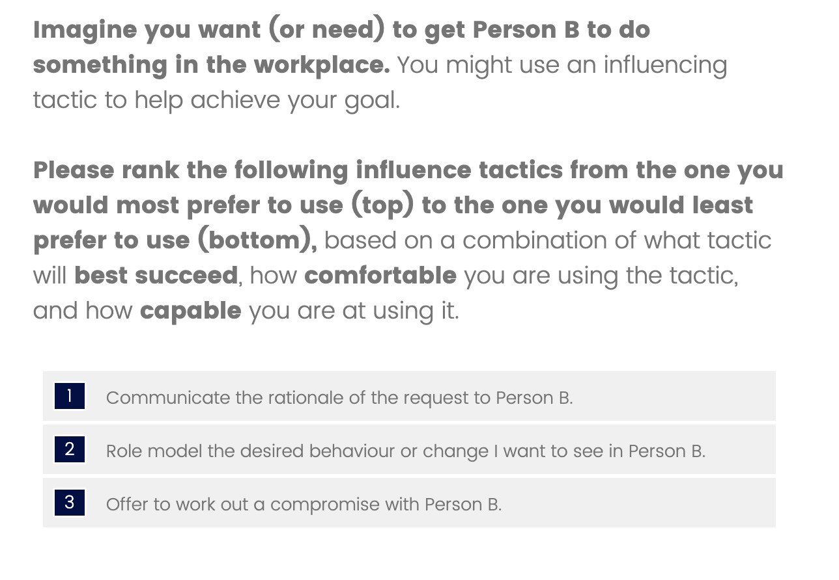
Why a forced-choice (FC) measurement?
Strengths of FC as alternative to Likert scale type method (Watrin et al., 2019):
Prevent response distortions due to individual differences in response style
tend to answer the extreme or midpoint in scale
Allow (pairwise) comparisons between items
Please rank the following influence tactics from the one you would most prefer to use (top) to the one you would least prefer to use (bottom)
Notes:
The figure show an example of the forced-choice question used in the current study.
Participants were asked to rank the influence tactics based on their preferences.
Using this format, there are certain strengths as alterative to single stimulus self report method
For example…
Most importantly, it will allow pairwise comparisons between tactics. Eventually, we are not comparing the data of mean scores for each tactic, but extracting the rank-order responses that reflect what tactics were preferred more often

Slide 10
Part I: Development Journey
1
Refine Influence tactics
2
Pilot: social desirability
3
Facet coding
4
5
Block design (Triplet structure )
Assign items into Blocks
Based on previous forced-choice measure development study (Watrin et al., 2019)
Notes:
I will go through each step

Slide 11
Step 1: refine 96 influence tactics
ID | Tactic_long (original tactic) | Item_ for _survey
1 | ... ask indirectly or hint at what [the agent] wants .For example, Person A says to Person B, "it would be nice if ..."). | Person A asks Person B indirectly or hints at what Person A wants. For example, Person A says to Person B, "It would be nice if this happened."
2 | ... ask directly (politely). | Person A asks Person B directly and politely for what Person A wants. For example, Person A says to Person B, “Would you please do this?”
3 | ... [agent] says or shows that complying is required to be part of the group. | Person A indicates that Person B must do what Person A wants, if Person B wants to be part of the group. For example, Person A says to Person B, “If you’re one of us, you’ll do this.”
4 | ... [agent] refers to, or shows, others who are already doing what is being asked of [the target]. | Person A points out others who are already doing what is being asked of Person B. For example, Person A says to Person B, “Look, Person C is doing it.”
5 | ... increase [the target's] status by publicly giving [the target] credit or complimenting their expertise or credibility). | Person A tries to influence Person B by increasing Person B’s status—perhaps by publicly giving Person B credit or complimenting their expertise or credibility. For example, Person A says to others, “Look at how great Person B is at this task!”
6 | ... be kind or patient. | Person A tries to influence Person B by being kind or patient. For example, Person A says to Person B, “It’s OK if this takes a while—I’ll give you some time.”
7 | ... attempt to inspire or align [the target] through vision or values. | Person A attempts to inspire or align Person B through describing a clear, inspiring vision of what could happen . For example, Person A says to Person B, “Think of how much good we can do for the world if you do this.”
Each tactic: full description + example
Notes:
Example: consistent in context

Slide 12
Step 2: Pilot test for social desirability
Participants (N = 300) were randomly distributed with 20 tactics and rated social desirability for each tactic
from strongly negative (-3) to strongly positive (3)
Obtained mean desirability scores for all 96 tactics.
Notes:
Mean scores for later analysis

Slide 13
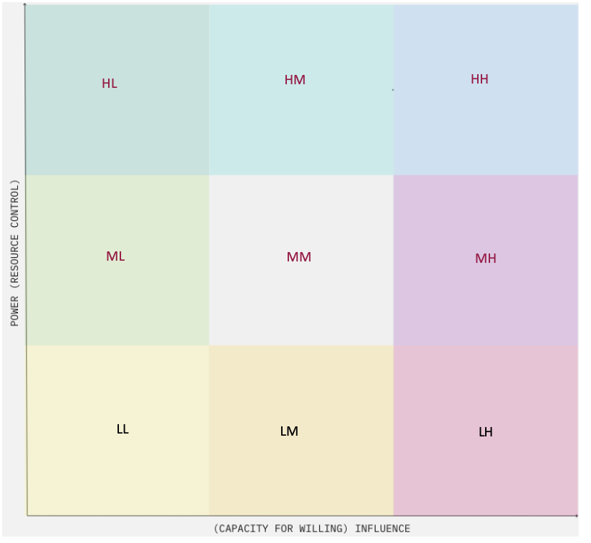
Step 3: Facet Coding
Code 96 tactics to 9 facets based on their corresponding Power and Volitional Influence levels (Low, Medium and High)
E.g. Praise = L_H = Low in Power, High in Volitional Influence (bottom-right corner)
Power
Influence
Notes:
This way, we define the psychological constructs of power and influence in a categorical, rather than continuous variables

Slide 14
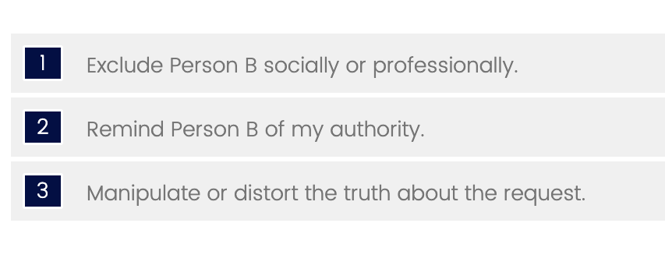
Step 4 & 5
Positive mean social desirability score triplet
Create optimal block design where every facet is compared at least once with all other 5 facets
Assign items (influence tactics) based on their corresponding facet codes
Control mean desirability scores to be consistent in signs (valence) within each block
Negative mean social desirability score triplet
Notes:
4) We design the block in ways that each facet will be compared at least once with the other 5 facets. -> so we can obtain facet-based rank-order responses
5) Then, we assign Influence tactics to those blocks based on their corresponding facet codes while controlling their mean social desirability to be either all positive or all negative within each block,
You can probably sense the desirability differences between the tactics in positive triplet and the negative triplet from the example on the slide; this is why we want to maintain consistent signs for the options within each block, so preferences will not be dominantly affected by their perceived social desirability

Slide 15
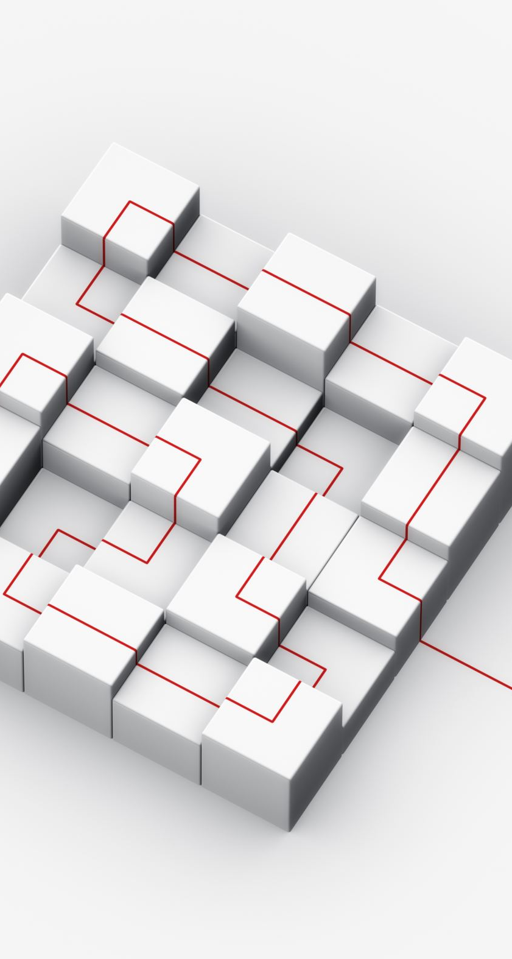
Final Design
The final block design consists of 20 blocks of triplets.
The mean within-triplet desirability difference is 1.10, indicating a relatively balanced distribution of desirability scores.

Slide 16
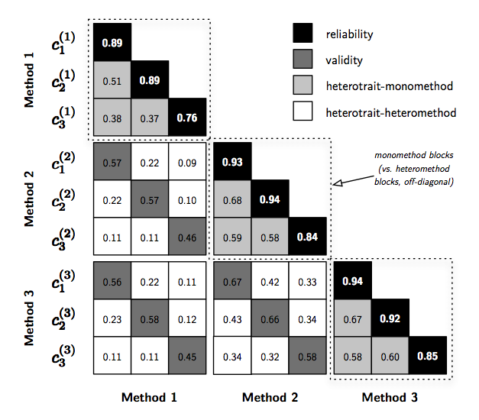
Part II: Validation Method
Sample
Prolific, N = 200
REP, ongoing
Analysis
Multitrait-Multimethod (MTMM) approach: examine the correlations between 4 measures:
Forced-choice (FC) measure for Influence Tactics
Same trait, different method (validity)
Single Stimulus (SS) measure for Influence Tactics (Ketterman & Maner, 2021)
Different trait, same method
Forced-choice (FC) measure for Maladaptive Personality Trait (Guenole et al. 2018)
Different trait, different method
Single Stimulus (SS) measure for Maladaptive Personality Trait (Guenole et al. 2018)
Model fit
CFA for SS measures/ T-IRT for FC measures
Example figure of the MTMM matrix, NOT actual results:
Notes:
To validate the new instrument, we collected samples from Prolific and REP.
We will be using the Multitrait-Multimethod approach, to examine the correlations between 4 measures, which are the new forced-choice measure for influence tactics, the same trait different method Single Stimulus (SS) measure for Influence Tactics, and other 2 measures of a different construct, which are the self-report and forced-choice measures for Maladaptive personality trait.
For model fit statistics, we will use CFA for SS measures, and T-IRT model for FC measures.
We have not completed data analyses yet, so the figure on the left is just an example of the matrix, not actual results from the current study.,
As for the hypothesis, we expected to see mean correlations to be in the order the graph shows. Particularly, we expected to see reliability with the highest correlation (the black squares), followed by the correlation between 2 measures with the same trait, but different methods (the dark grey squares).

Slide 17
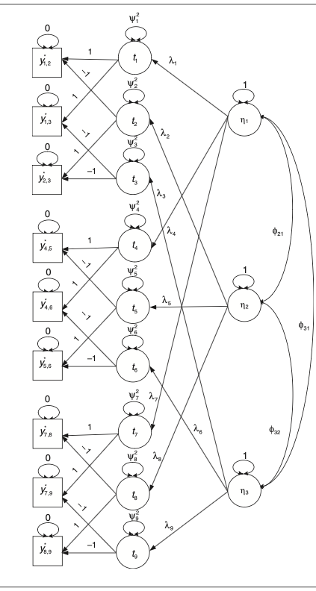
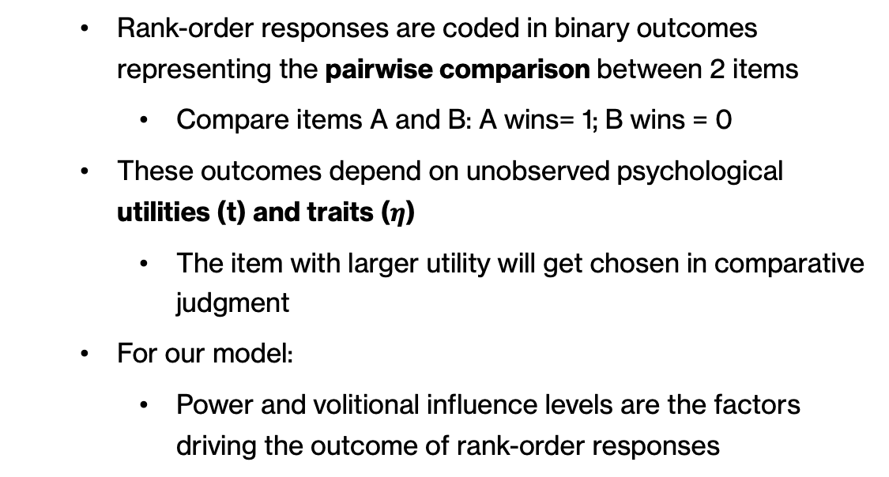
How does T-IRT model fit to forced-choice data?
Rank-order responses are coded in binary outcomes representing the pairwise comparison between 2 items
Compare items A and B: A wins= 1; B wins = 0
These outcomes depend on unobserved psychological utilities (t) and traits ($η$)
The item with larger utility will get chosen in comparative judgment
For our model:
Power and volitional influence levels are the factors driving the outcome of rank-order responses
(Brown & Maydeu-Olivares, 2011)
Notes:
Forced-choice data is rank-order responses, and cannot be specified using classical method such as CFA, so For FC measures, we use Thustonian Item Response Theory Model to examine how well the model fit to data.
IF no time:
This slide explain the theory behind the model but I won’t go into details.
Basically, our model is specified in the way that Power and volitional influence levels are the factors driving the outcome of rank-order responses

Slide 18
Results: Model Fit (1)
Forced-choice (FC) measure for Influence Tactics
The T-IRT model was fit using the WLSMV estimator
The model successfully converged and showed good model fit.
Chi-square: χ² (1635)= 1922.98, p < .001
RMSEA = 0.0298
-> Support the SATP theory: preferences of influencing behaviour can be explained by levels of power and volitional influence
Notes:
T-IRT model was fit to data of the new forced choice measure.
the good model fit results support the SATP theory, in which

Slide 19
Results: Model Fit (2)
Single Stimulus (SS) measure for Influence Tactics [same trait, different method]
2 CFA models (9-factor and 2-factor model) were fit using the WLSMV estimator (Ketterman & Maner, 2021).
Both models showed a generally good fit
Model | X² | df | p | CFI | RMSEA | SRMR
9-factor model | 1233.391 | 1139 | .026 | .992 | .020 | .078
2-factor model | 49.285 | 26 | .004 | .974 | .067 | .088
Notes:
We can compare model fits of the new FC measure to a developed Single Stimulus (SS) measure for Influence Tactics.
For this SS measure, 2 CFA models were fit to data. Both models showed a generally good fit, with the 9-factor model showing a better fit.
The new FC measure has a better fit in the RMSEA index compared to this 2-factor model, which provide good support to the new measurement tool in assessing influencing behaviours.

Slide 20
Thank you for listening

Slide 21
Ongoing…
Example figure of the MTMM matrix, NOT actual results:
We will use CFA and T-IRT models output to to produce MTMM matrix
Expected to see:
reliabilities > validities (mono-trait-hetero-method) > hetero-trait-mono-method > hetero-trait-hetero-method
Notes:
I am still working on the data analysis for MTMM,
As for hypothesis, we expected to see mean correlations to be in the order like the graph show.
Particularly, we expected to see reliability with highest correlation, and followed by correlation between 2 measures with same trait, but different in methods.

Slide 22
Results: Model Fit (3)
Single Stimulus (SS) measure for Maladaptive Personality Trait [different trait, different method]
The CFA model was fit using the WLSMV estimator
Model fit showed similar results to the original model (Guenole et al., 2018)
Model fits are acceptable for both models
Model | X² | df | p | CFI | RMSEA | SRMR
Our Model | 4027.14 | 1695 | <.001 | .862 | .084 | .111
Guenole et al., 2018 | 4857.54 | 1695 | <.001 | .700 | .068 | .107
Notes:
Finally, for the different trait, different method measure of Single Stimulus (SS) measure for Maladaptive Personality Trait, we obtained CFA model fit, which showed similar results to the original model.
O = Compulsiveness
DE = Detachment
NE = Negative Affect
PS = Psychoticism
DI = Disinhibition
AN = Antagonism.

