Slide 1
RNNs
NLP Course
June 2019

Slide 2
Basic NN with single hidden layer
Output: batch_size * #classes
Matrix product; softmax
Hidden: batch_size * # activations
Matrix product; relu
Output
Input: batch_size * #inputs
Hidden
Input

Slide 3
Predicting word 3 using words 1 & 2
NB: layer operations not shown; remember that arrows represent layer operations
word 3 output: vocab size
Single fully connected model
FC2: # activations
word 2 input
FC1: # activations
Output
Hidden
Input
word 1 input: vocab size

Slide 4
Predicting word 4 using words 1, 2 & 3
Input→Hidden
word 4 output: vocab size
Hidden→Output
Hidden→Hidden
FC3: # activations
word 3 input
FC2: # activations
word 2 input
FC1: # activations
word 1 input: vocab size

Slide 5
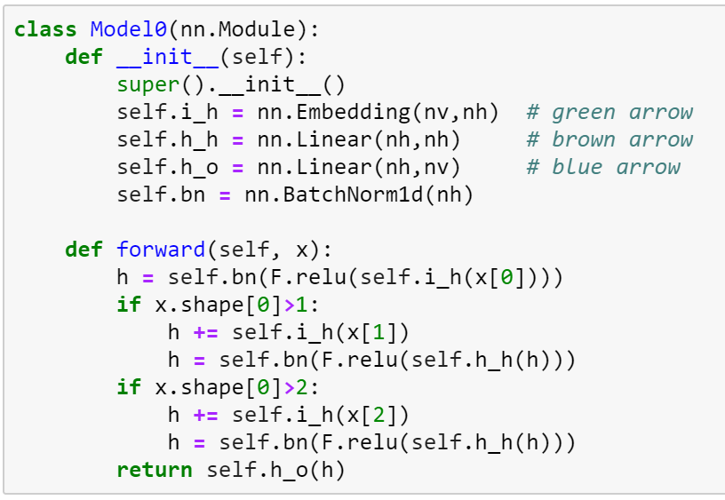
Predicting word 4 using words 1, 2 & 3
Target: “,”
word 3 input
“two”
word 2 input
“,”
“one”

Slide 6
Predicting word n using words 1 to n-1
NB: no hidden/output labels shown
Same thing with a loop
Input→Hidden
Hidden→Output
Hidden→Hidden
word n input
Repeat for 2→n-1
Output
Hidden
Input
word 1 input

Slide 7
Predicting words 2 to n using words 1 to n-1
Multi fully connected model
Input→Hidden
Hidden→Output
Hidden→Hidden
word n input
Repeat for 1→n-1
Output
Hidden
Initialize to zeros
Input

Slide 8
Predicting words 2 to n using words 1 to n-1 using stacked RNNs
Repeat for 1→n-1
word n input
Repeat for 1→n-1
Initialize to zeros
Initialize to zeros

Slide 9
Unrolled stacked RNNs for sequences
word 3 input
word 2 input
word 1 input

