Slide 1

Predicting NHL Playoff Success and Financial Impact
Helena Mabey
BANA 6760-H01 Spring 2025

Slide 2

Setting the Ice
Professional sports are big business, not just for teams but for entire cities
Playoff outcomes can influence revenue
This analysis will show:
Project 2024-2025 Stanley Cup Champion
Projected financial impact to winning team and city
Notes:
Around the world, people are captivated not just by sports, but by the numbers behind them. This dates back as far back as the beginning of baseball in the mid 1800’s. Now, with the explosion of sports betting platforms and real-time, data-driven analysis, we see how analytics now shape every play, every game, every season. As professional sports leagues grow, so does the financial impact — not only for the teams on the ice or on the field, but for the cities that rally behind them. In this analysis, I will use predictive analysis, along with other statistical calculating tools, to predict the National Hockey League (NHL) 2024-2025 Stanley Cup Champion and estimate the potential increased revenue for the team and home city.

Slide 3
Pre-Game Prep
Historical NHL Data 2020-2024
Team Stats, Elo, Playoff results
2024-2025 Team Stats
Revenue Estimates by team and city
Hypothetical AI generated data
Notes:
To complete this analysis, data needed to be acquired and transformed. Historical NHL data is available directly through the league’s API. Since the site did not have clear instructions on how to access the API, a personal GitHub site was found that provided basic coding and data structure. Data from 2020-2025 was pulled in for this analysis as of 4/27/25. Data points used were team name and abbreviation, number of games played, wins and losses, and goals scored and allowed.
In addition to this, I used ChatGPT to write Python code to give Elo ratings to each of the teams over the season. Elo ratings are mostly known in chess, but they work for any two player or team sport. It gives a ranking based on wins and losses with other qualifiers added. I was able to locate a couple examples of Elo ratings and additional information on how they were adjusted for hockey. The Elo rating model used in this analysis was relatively basic, using a base Elo value of 1500 (common in Elo ratings), home-ice advantage, and a K-factor (which is a parameter that determines how quickly ratings should adjust to new results).
The last piece of data used were revenue amounts for both teams and home cities over the review period. This data was AI generated with some basis in previous playoff results.

Slide 4
Power Play Predictions
Modeling attempts
Logistic Regression
Random Forest
Linear Regression
Final model
Linear Regression to predict playoff games
Features
Wins, Elo, Win %, Playoff History
R-squared approx. 68%≈
Notes:
I attempted three different models to attempt and predict the Stanley Cup Champion for this season. Logistic regression and random forest were unsuccessful, mostly due to sample size. Neither provided a potential champion. Using a linear regression model was the most reliable. The goal was to determine which team would potential win the championship based on multiple factors including wins, Elo rating, win %, and playoff history. After adjusting the model and adding in a couple of transformed values, the model was able to get up to an approximate R-squared value of 68%, meaning that there was a moderately strong relationship between the features and the outcome.

Slide 5
Power Play Predictions cont.
Z-Scores
Wins and Elo for current season
Toronto Elo Z-Score +1.80
Correlation Matrix
Elo and Win % > 0.90
Durbin-Watson
2.06 shows little autocorrelation
Skewness and Kurtosis
Both within acceptable ranges
Notes:
I also looked at the Z-score ratings for the teams based on Elo rating and wins. Toronto came out ahead in Elo rating and Winnipeg lead in wins. Both were second place in the other category.
Additional, when reviewing the correlation matrix, Elo rating and win percentage were nearly at 1, showing a strong correlation between those features. Win % goes up, Elo rating goes up.
A quick review of the regression results show that a few key results, skewness, kurtosis, and Durbin-Watson were within acceptable ranges meaning little autocorrelation and a relatively evenly distributed data set. There are a few outlying residuals but that can be expected in sports.

Slide 6
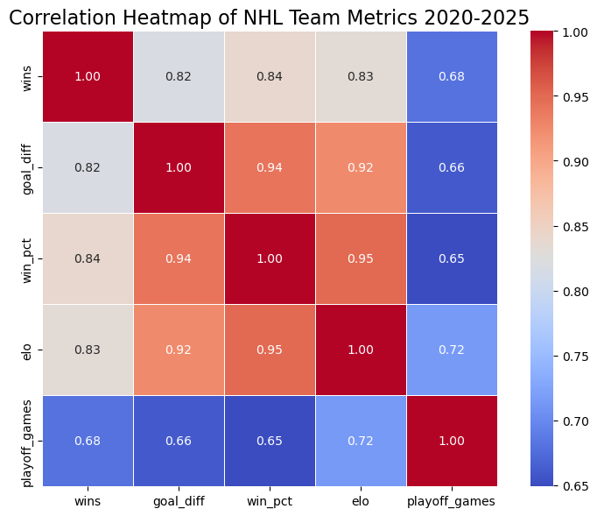
Heatmap of Team Stats
Notes:
A view of the correlation heatmap of the used features (See win % and Elo rating)

Slide 7
Winning the Cup
Top Contenders
Toronto: Strongest Elo & regression score
Winnipeg: Highest win Z-score, strong performance
Outcome
Too Close to Call
Notes:
Because the ratings were strong for the two leading teams, I would call the potential champion to close to call. I personal was hoping for the Avalanche to make it but that was not to be this year.

Slide 8
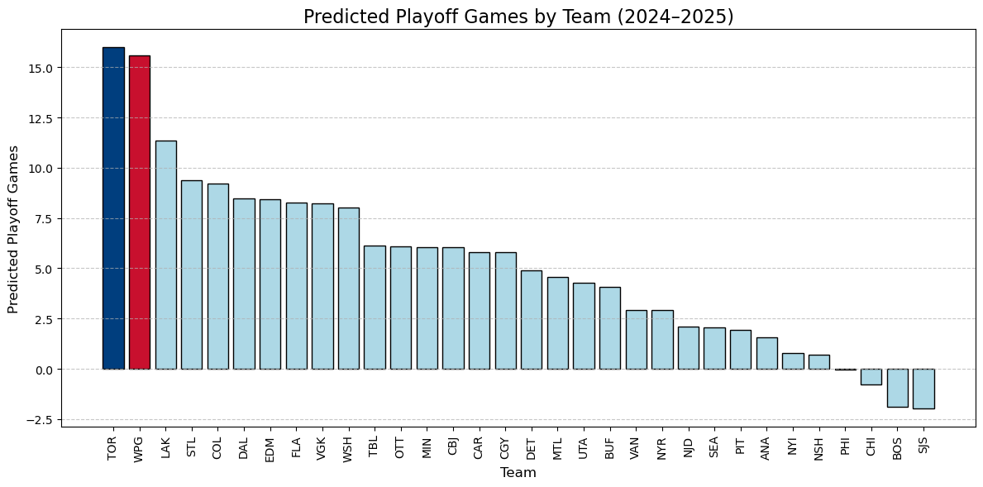
Playoff Games by Team (Projected)
Notes:
A view of the predicted number of playoff games per team. There are some negative numbers which can be seen as outliers since there cannot be negative games played.
Toronto is blue, Winnipeg is red.

Slide 9
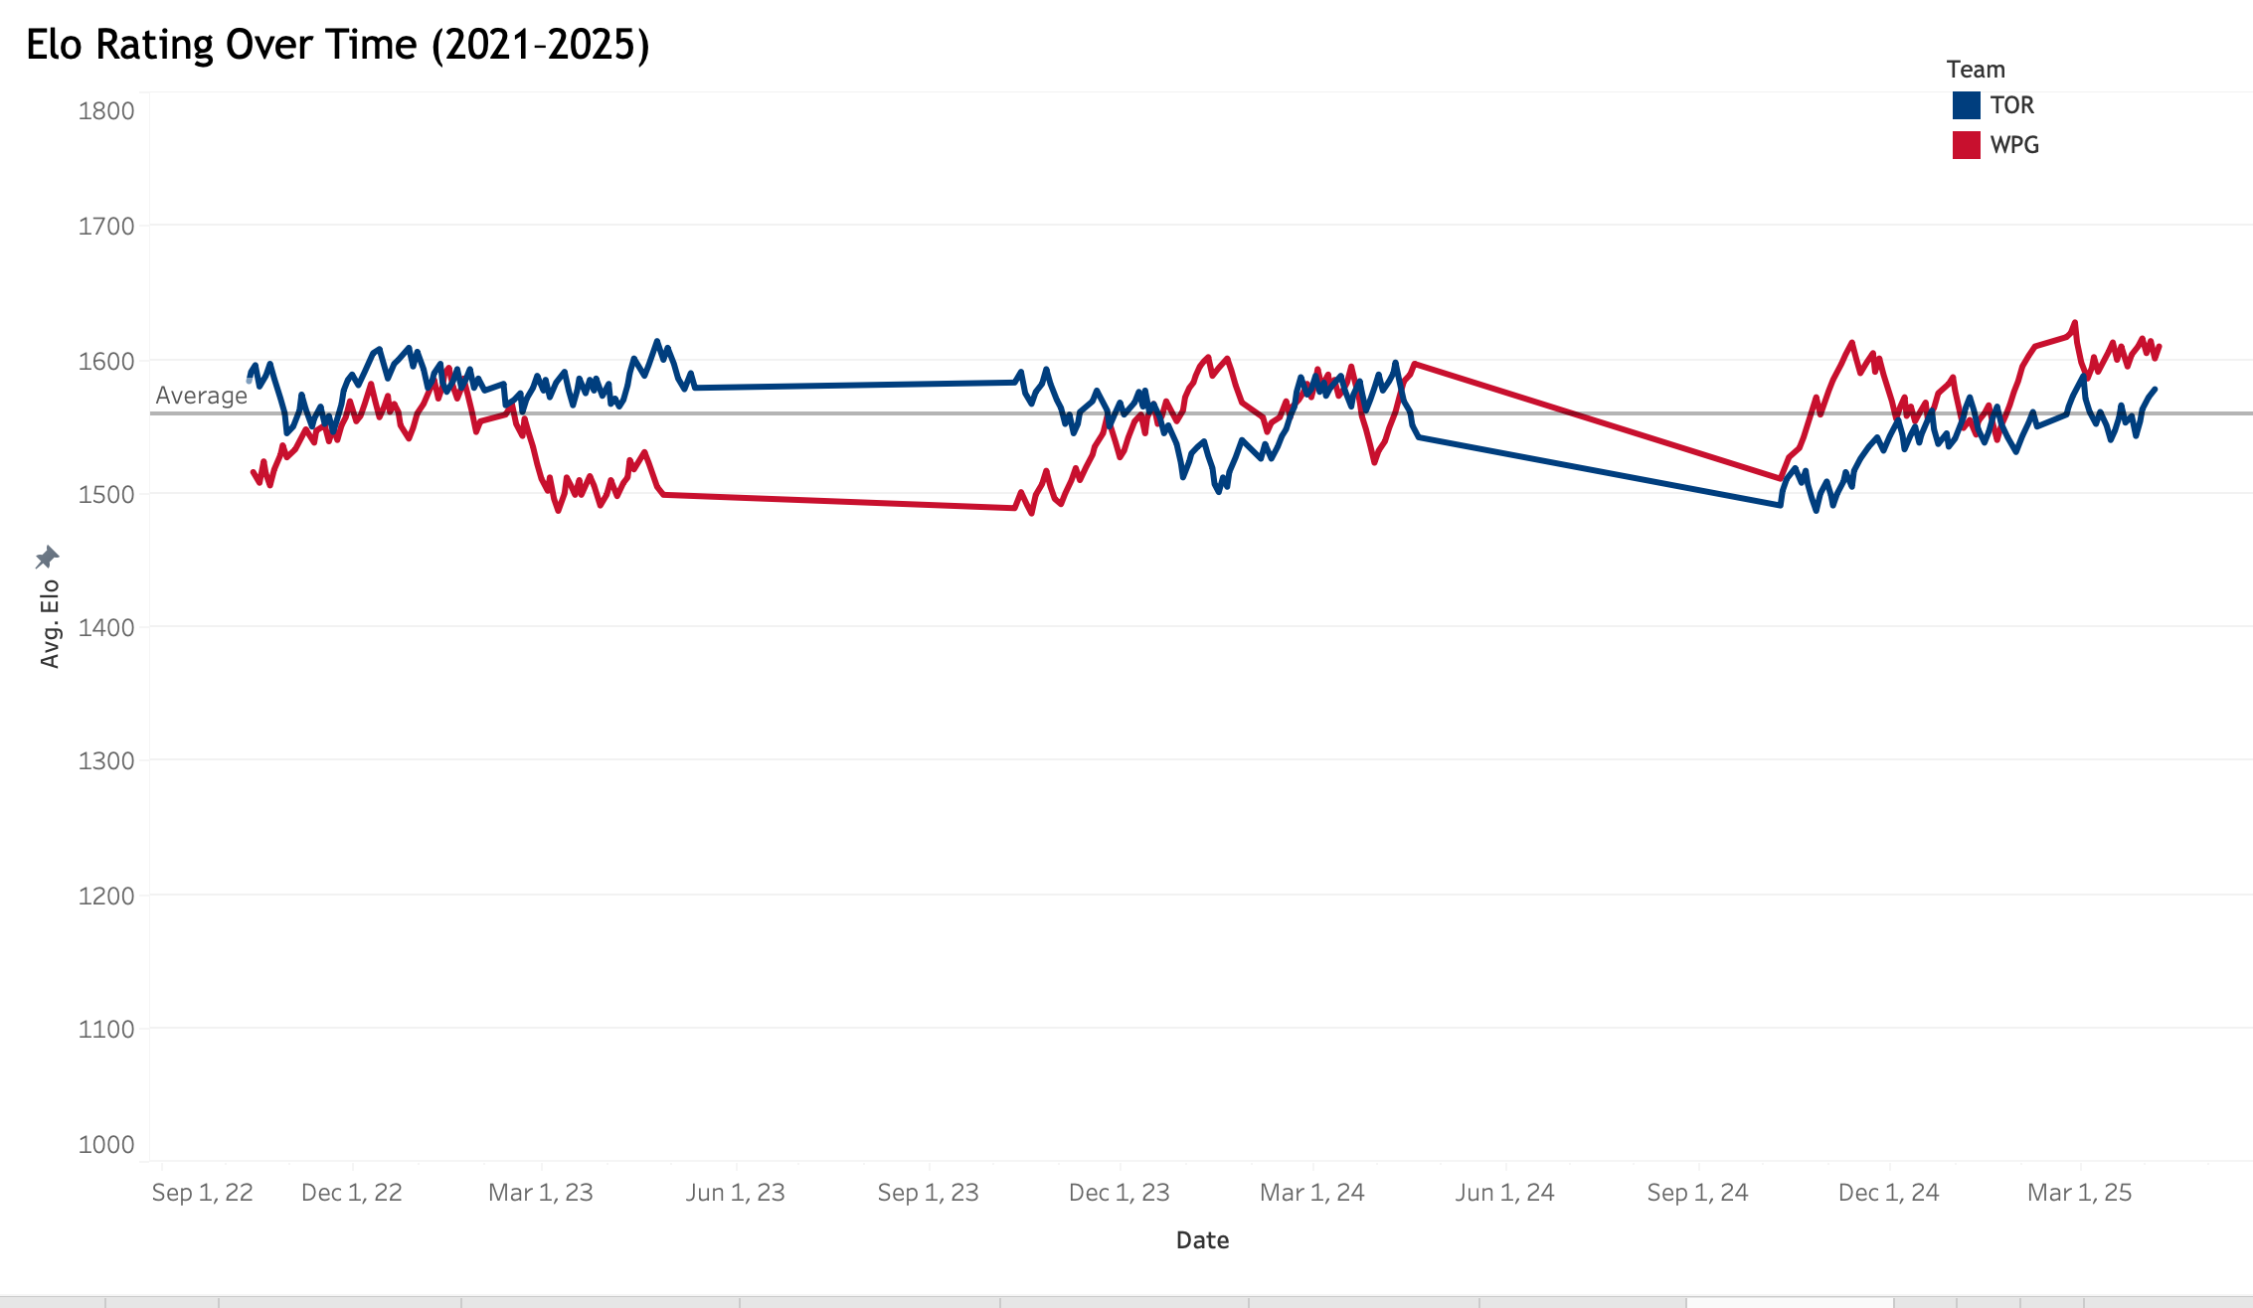
Elo Rating Over Time (TOR & WPG)
Notes:
This is a graph of the two leading teams Elo ratings over time using the basic model created. Both teams hovered around the average Elo rating with Winnipeg performing better in the current season.

Slide 10
The Cup Payoff
Average revenue increases
By team: $10-75M seasonally
By city: up to $15B
Toronto projection
Team:+$75.2M
City: +$15.5B
Winnipeg projection
Team: +$73.3M
City: +$15.1B
Notes:
Reiterate that the financial data was AI generated for this analysis.
As teams participate in more playoff games, revenue increases steadily. If they reach the final Stanley Cup Championship round, revenue skyrockets for both teams and home cities.
Winnipeg has a smaller population, so their projected revenue is a bit lower than Toronto.
In addition to teams and cities, businesses and individuals see financial benefits as teams move forward in the playoffs. More people go out to eat, buy merchandise, and stay in hotels to watch their favorite teams.

Slide 11
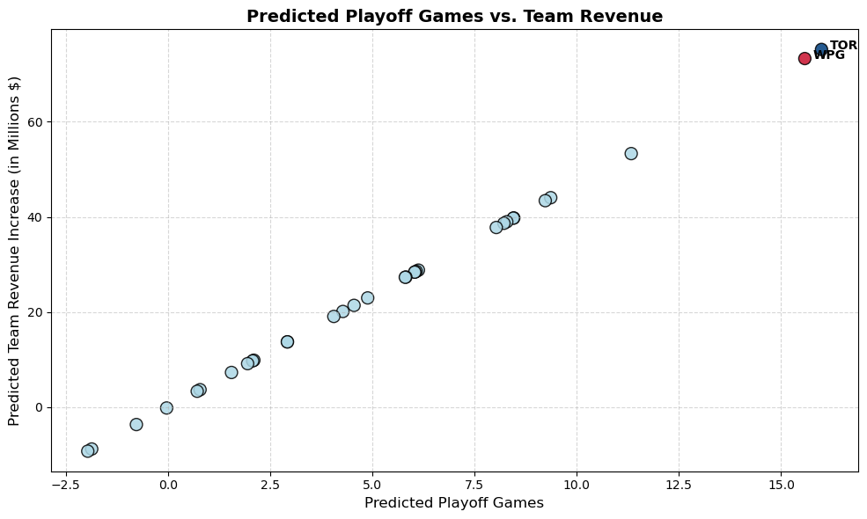
Playoff Games vs. Team Revenue (Predicted)
Notes:
As expected, revenue increases steadily as more playoff games are predicted.

Slide 12
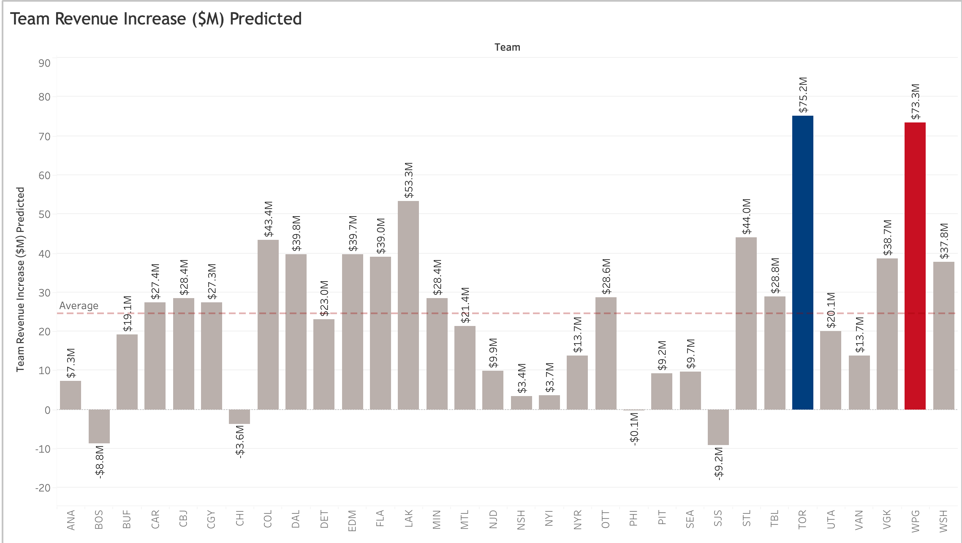
Total Team Revenue Increase ($M)
Notes:
Another view of potential revenue based on predicted games played.

Slide 13
Postgame Analysis
Linear Regression was most reliable tool
High correlation values supported results
Combining team and revenue data analysis allows cities to maximize growth and increase fan loyalty
Notes:
In review:
Linear regression model yielded the best results. Trial and error is common in data analysis.
Highly correlated values add support to the results.
Profession sports grow revenue in home cities throughout the world. They help businesses grow and grow community spirit as fans rally behind their teams.

Slide 14
Overtime Thoughts
Review player level statistics
Datadrivenhockey
Instagram profile that is following the playoffs
Real-world data analysis of local business impact of team playoff performance
Notes:
It would be interesting to add to this analysis at a player level, since that data is available through the NHL API. Seeing how players impact the teams through trades and injury would add value to these predictions.
Datadrivenhockey: On Instagram provides predictions using more data points throughout the season. Toronto and Winnipeg are one and two in their predictions as on 5/8/25.
It would also be interesting to add in actual economic information to have true patterns of economic impact instead of using AI generated information.
Wrap up: Hockey and other sports are part of world culture. Fans share the joy and pain of their favorite teams year after year. Using predictive data analysis allows for teams and cities to maximize their revenue while growing the culture and support of the loyal fans.

Slide 15
Questions & Further Discussion
Thank you for listening!

