Slide 1


Covid-19 impact on unemployment in Australia
By:
Helen Amin
Stephanie Salvona
Heriawan Muhamad
Samantha van Wyngaarden

Slide 2
Introduction – summary
An analysis of the unemployment rates in Australia in 2020.
Our hypothesis is that the COVID-19 Pandemic will have impacted the unemployment rates in Australia. We were interested to see what the effects COVID had, and how it may have impacted different states.
We expect to see an increase in unemployment rates as the COVID cases increase in Australia

Slide 3
Questions
Was there an increase or decrease in unemployment in 2020?
How was unemployment impacted between WA and VIC?
Was there a correlation between infection rates and unemployment in 2020?
Questions we had before we began our analysis

Slide 4
Data sources
We started our research through google and API sites
Meaningful (free) data was not available on any APIs
We contacted some data sources to try and get access to databases
We downloaded our unemployment data from the ABS website in excel
COVID data was manually extracted from the NNDSS website due to data limitations

Slide 5
Data sources
Unemployment Data - ABS https://www.abs.gov.au/statistics/labour/employment-and-unemployment/labour-force-australia-detailed/feb-2021#unemployment
Job Vacancies - ABS https://www.abs.gov.au/statistics/labour/employment-and-unemployment/job-vacancies-australia/feb-2021
COVID Data - NNDSS http://www9.health.gov.au/cda/source/cda-index.cfm

Slide 6
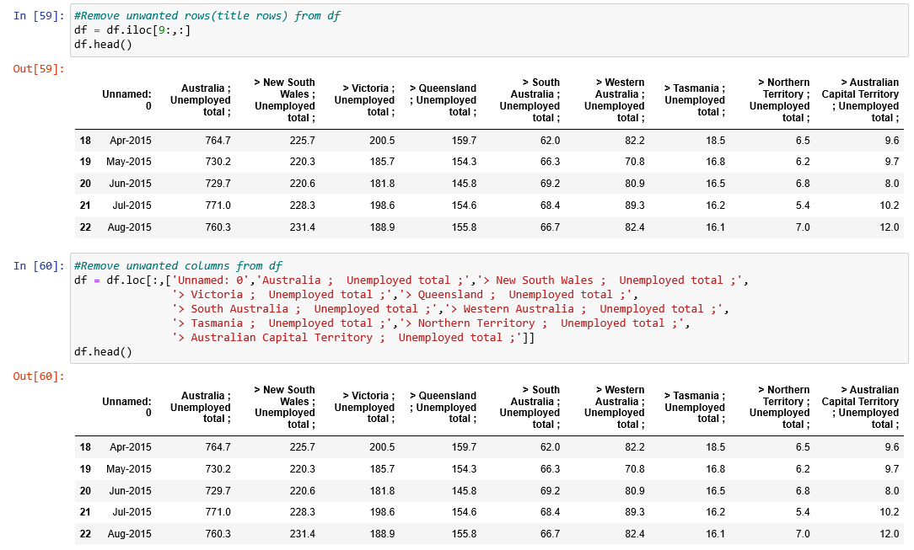
Data Cleaning
There was a lot of additional columns and data that we did not require from the government spreadsheet
We began by filtering down the data frame to the rows and columns we wanted to use
Unemployment data

Slide 7
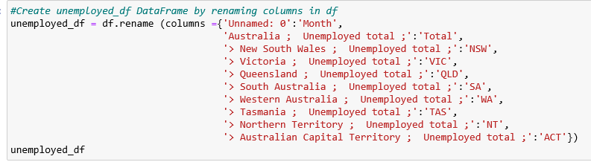
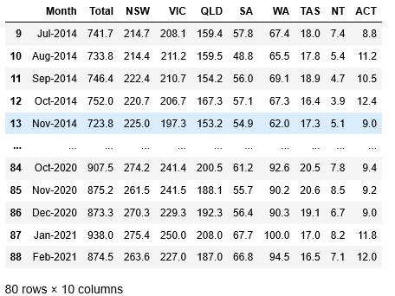
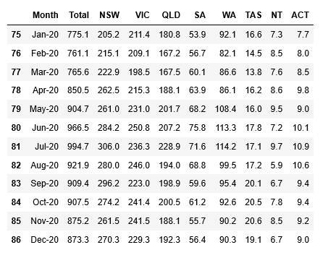

Data Cleaning
Renamed the columns to be more meaningful
Filtered to the date range required
Unemployment data

Slide 8
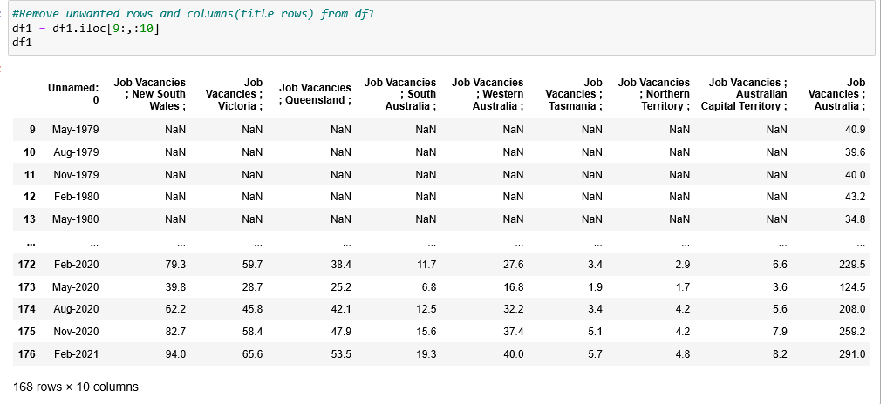
Data Cleaning
There was a lot of additional columns and data that we did not require from the government spreadsheet
We began by filtering down the data frame to the rows and columns we wanted to use
Job Vacancies

Slide 9
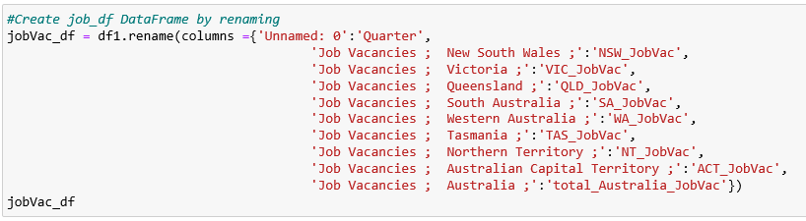
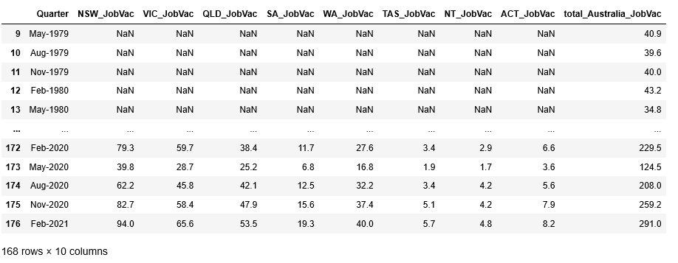
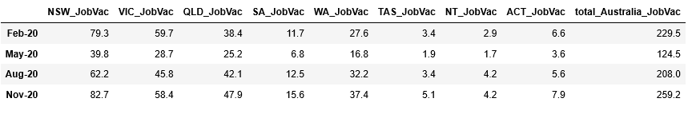
Data Cleaning
Renamed the columns to be more meaningful
Filtered to the date range required
Job Vacancies

Slide 10
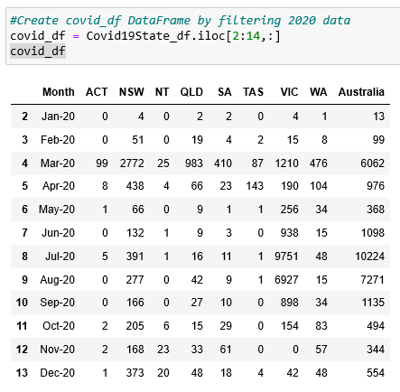
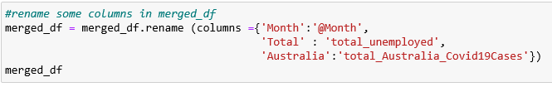

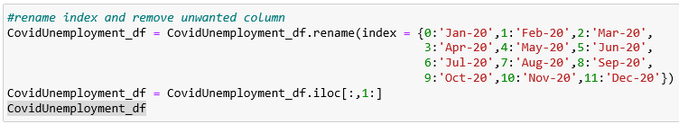
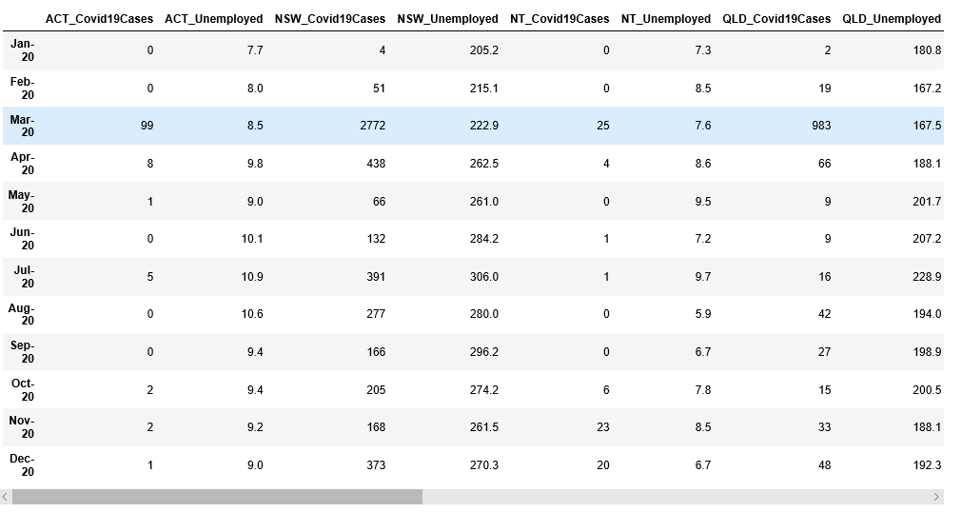
Data Cleaning
Data was mostly cleaned so we filtered to required date range
Merged monthly base dataframe with the unemployment dataframe
COVID Data used for Unemployment Study

Slide 11
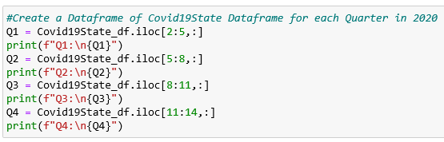
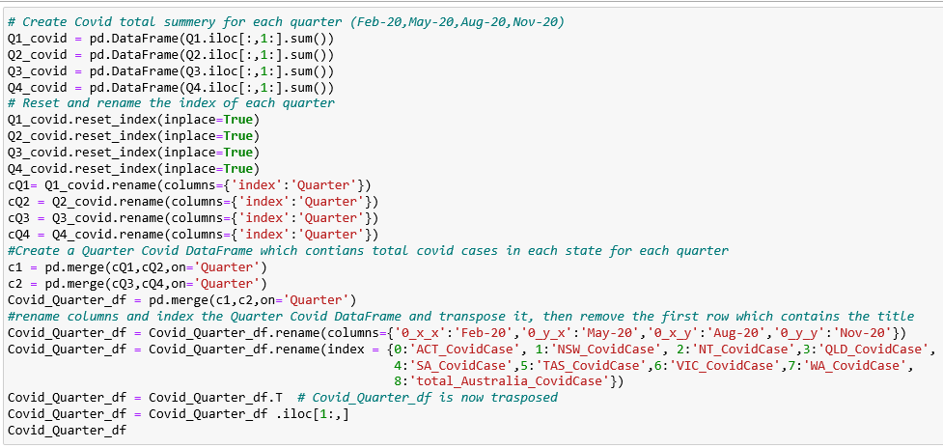
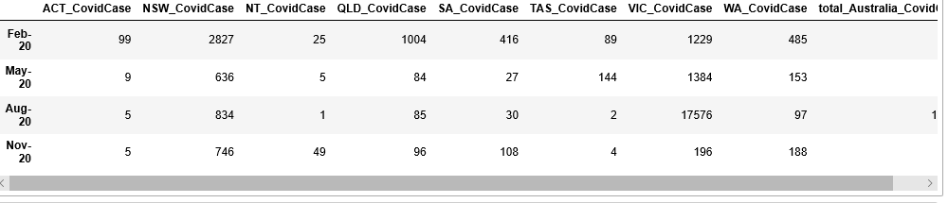
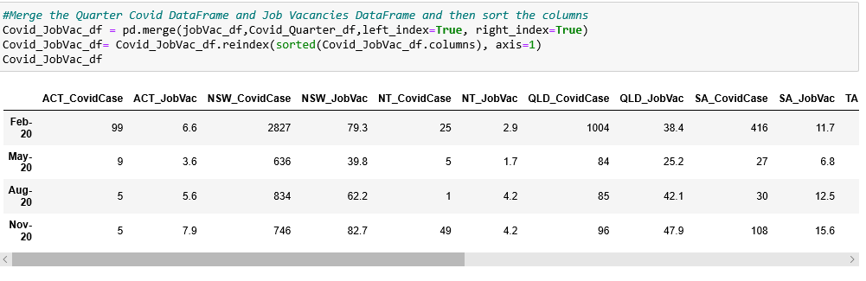
Data Cleaning
Had to create quarterly base covid data to be able to merge it with Job vacancies data set
COVID Data used for Job Vacancies Study

Slide 12

Data Analysis

Slide 13
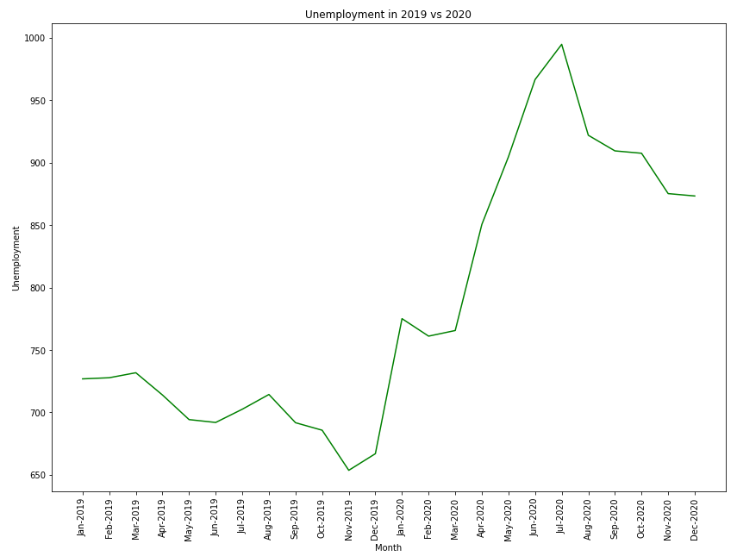
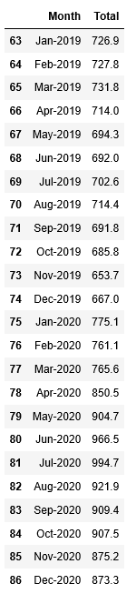
Was there a change in unemployment in 2020?

Slide 14
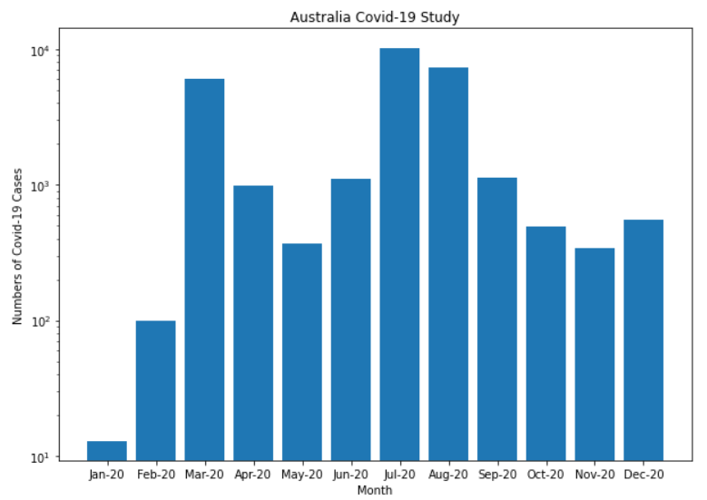
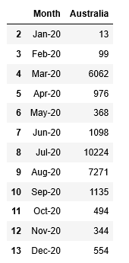
How Covid-19 hit Australia in 2020

Slide 15
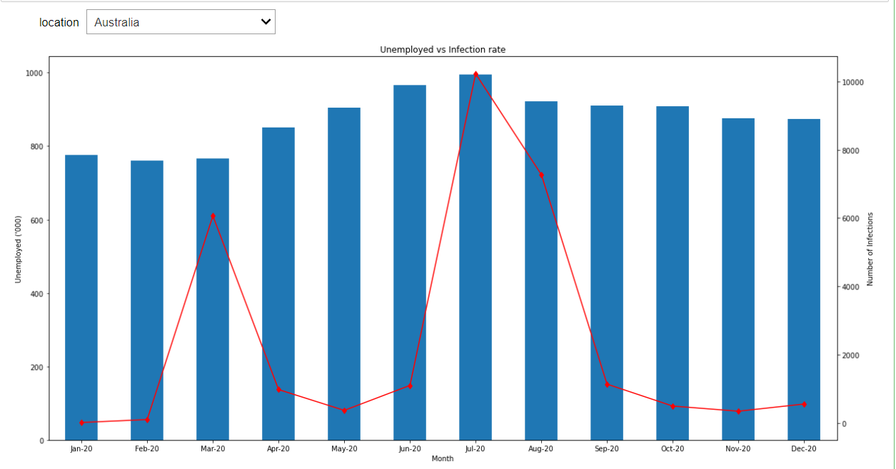
Unemployment vs Infection rate in Australia
Add Unemployment vs infection rate

Slide 16
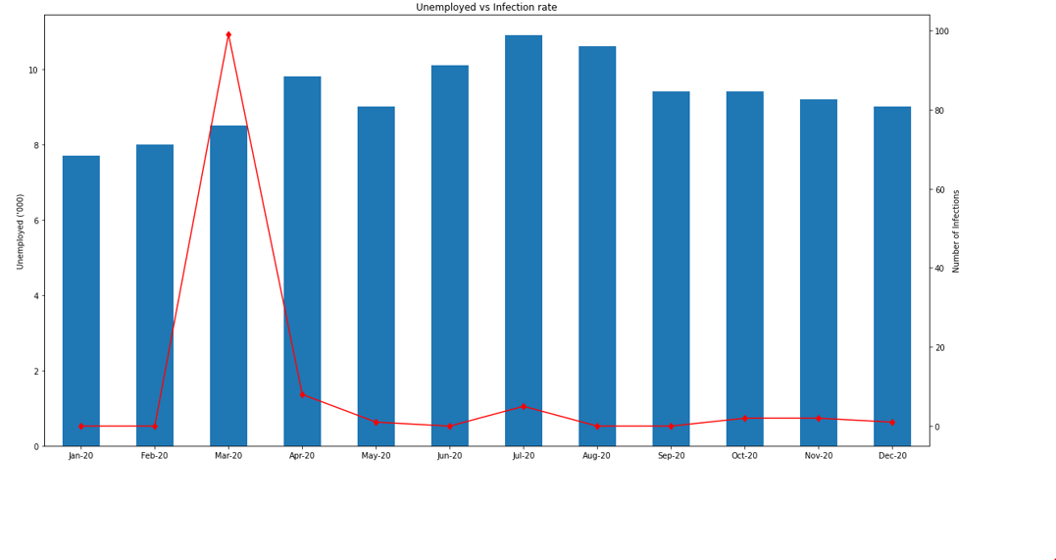
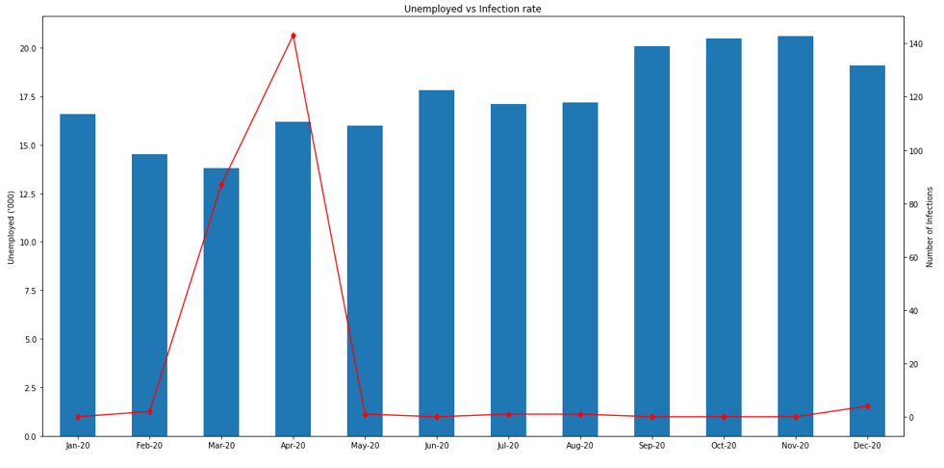
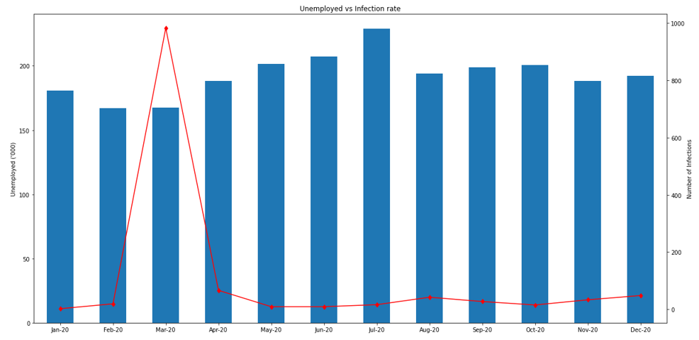
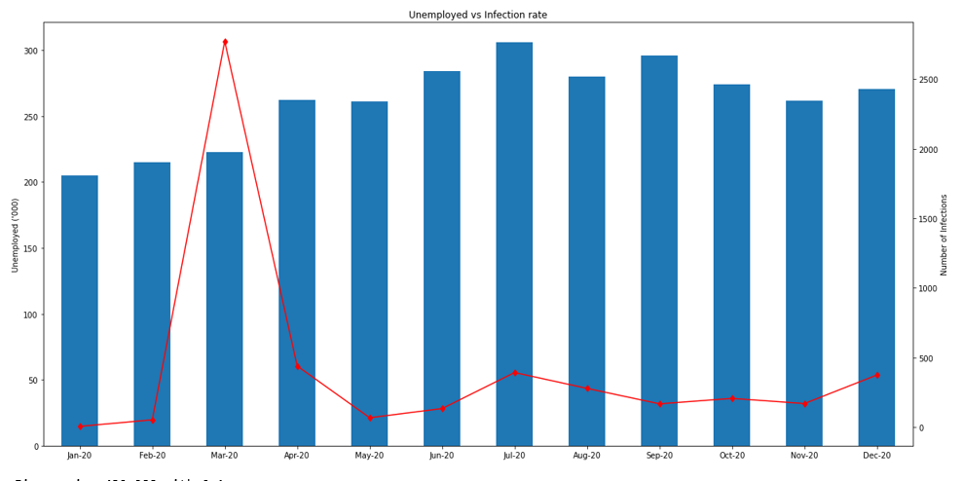
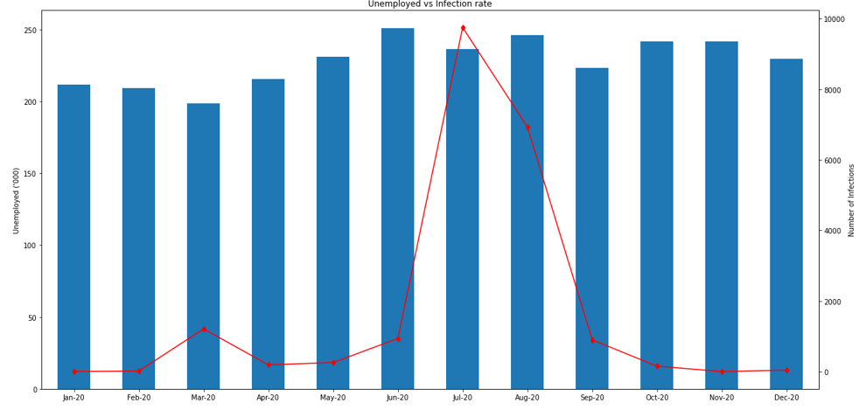
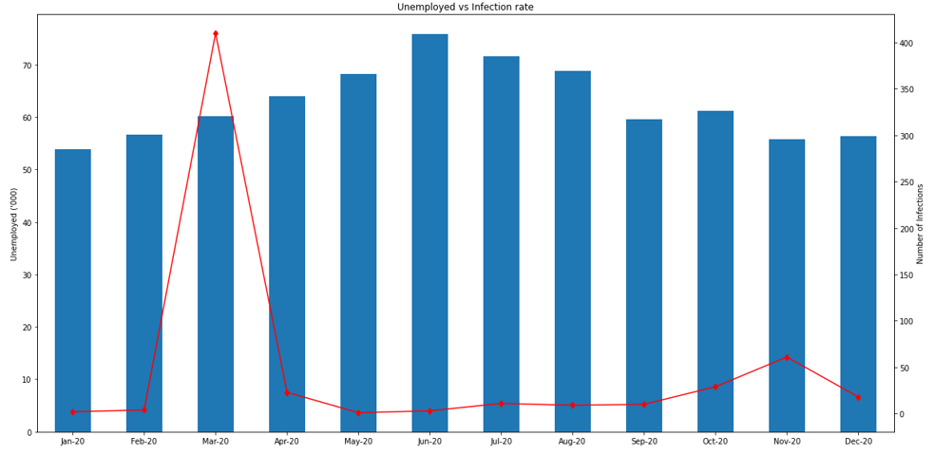
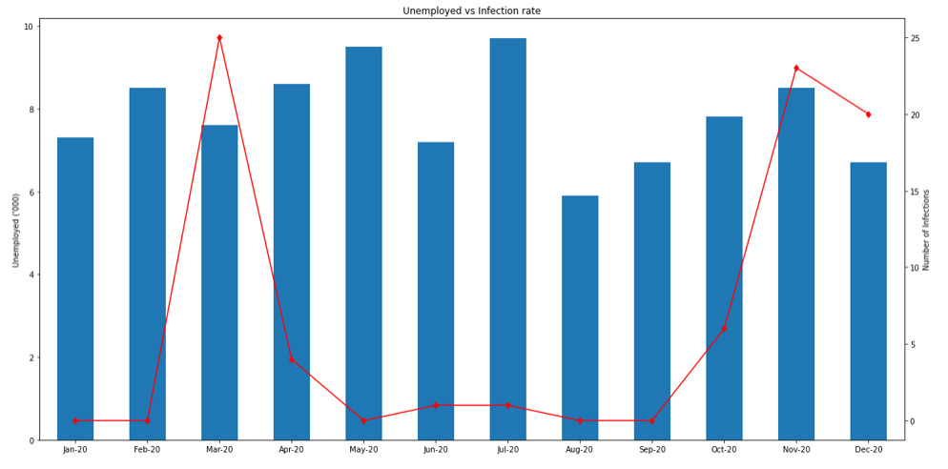
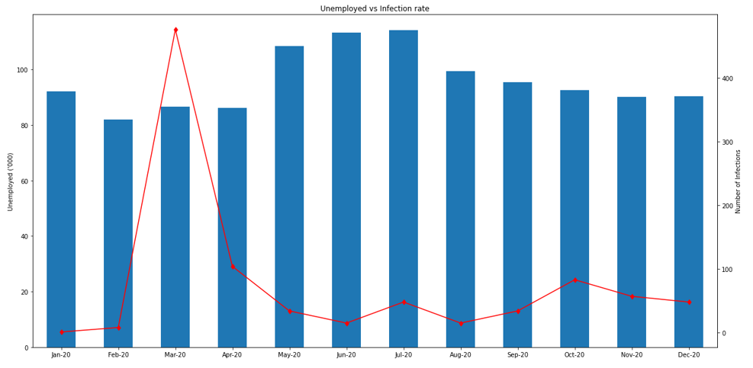
Unemployment vs Infection rate in Australian States
ACT
TAS
QLD
NSW
VIC
SA
NT
WA

Slide 17
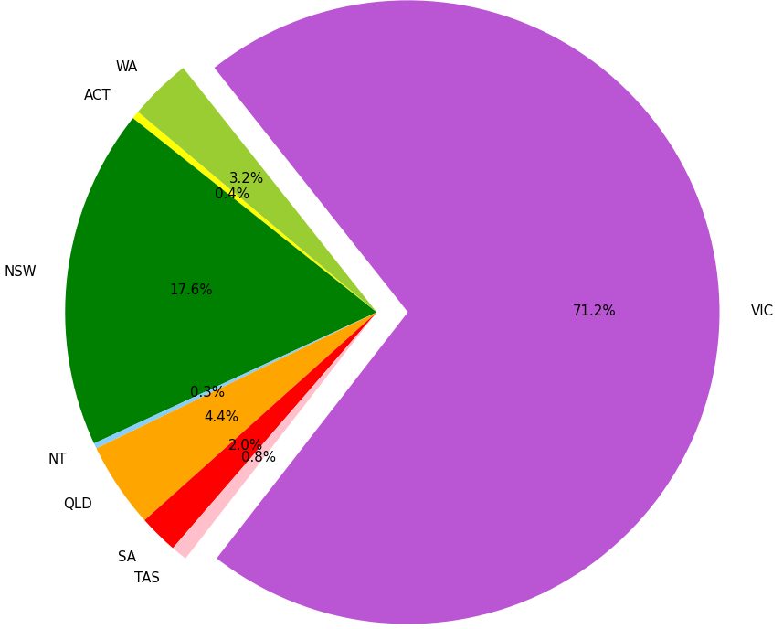
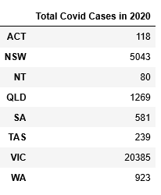
Total distribution of COVID cases for 2020

Slide 18
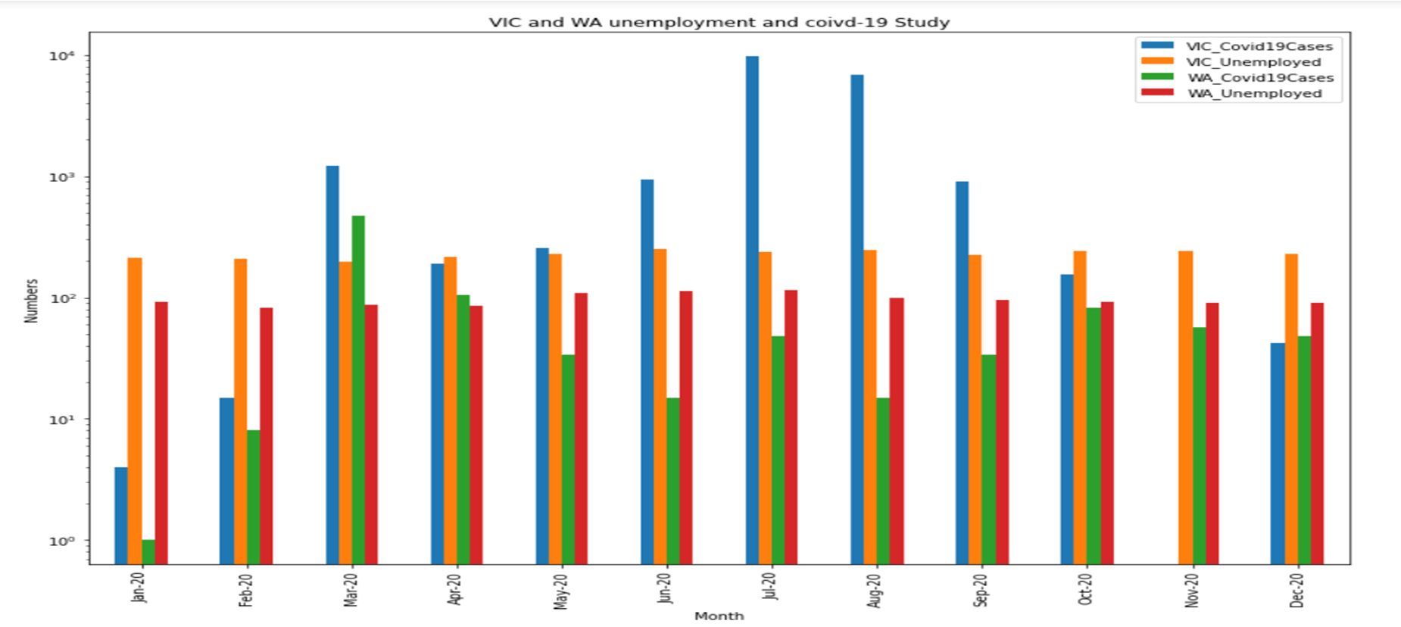
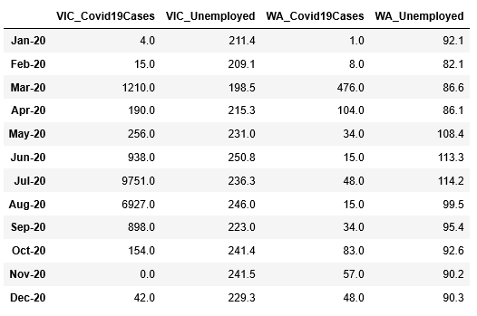
VIC and WA Unemployment Comparison and COVID-19 Impact on them

Slide 19
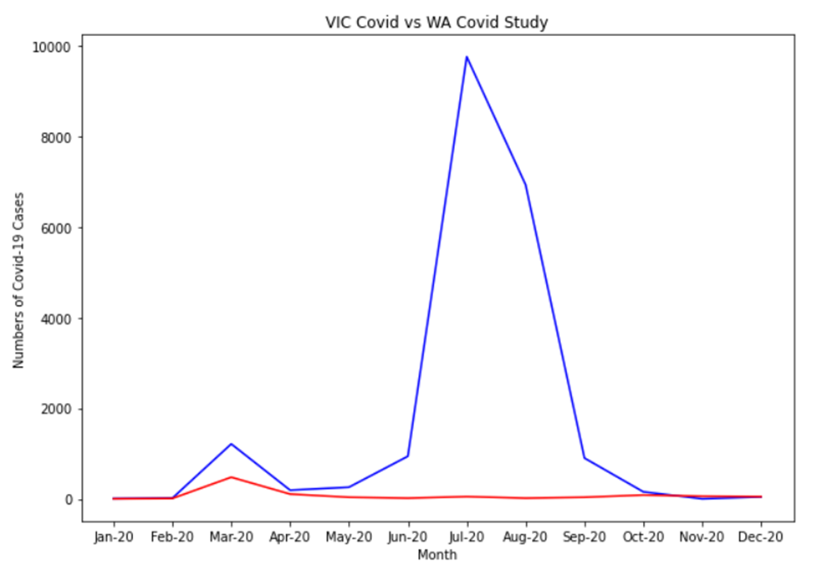
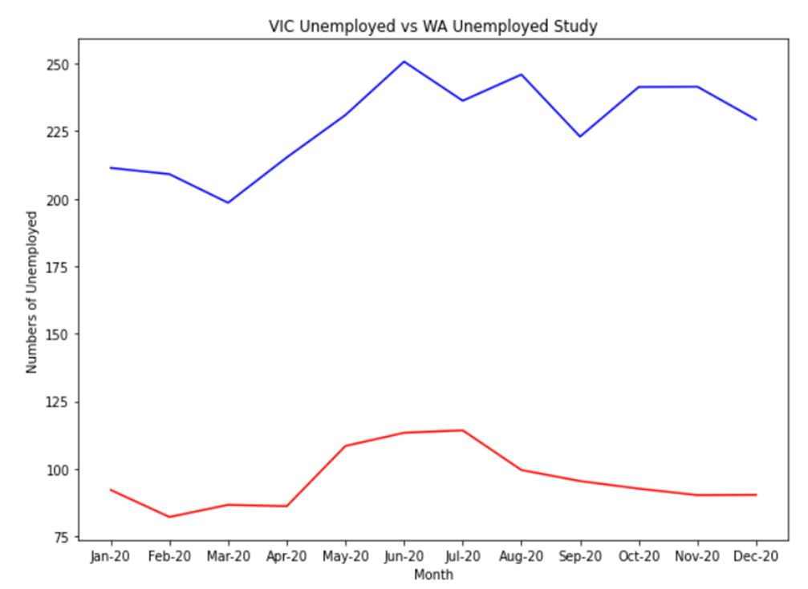
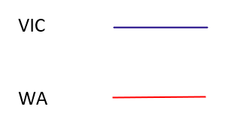
Comparison of COVID cases and Unemployment in WA and VIC

Slide 20
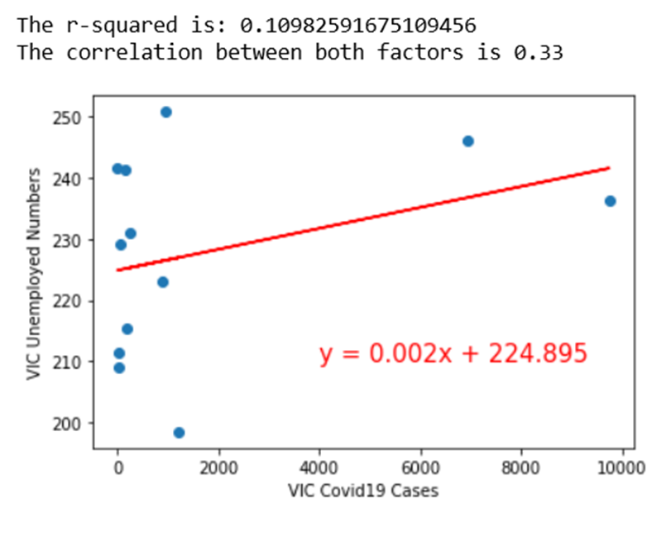
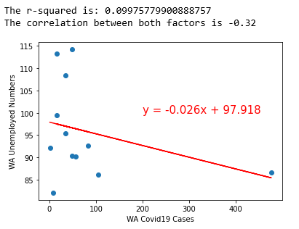
Correlation between Unemployment and COVID in WA and VIC

Slide 21
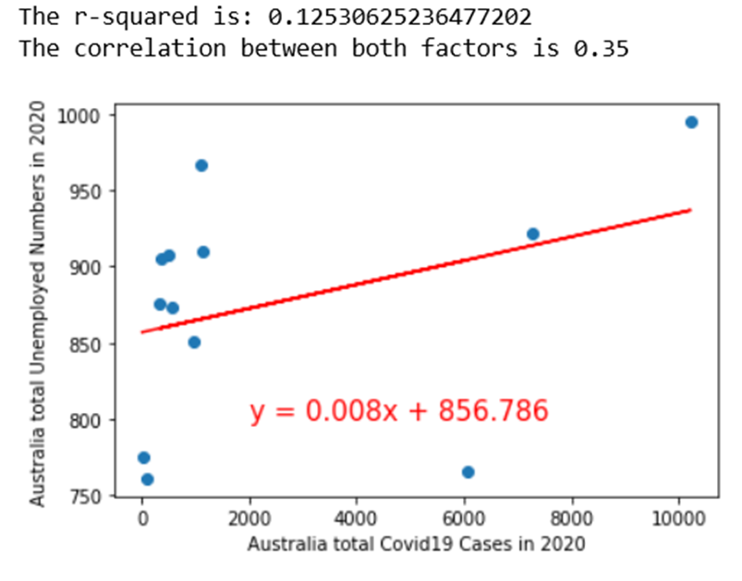
Correlation between Unemployment and COVID cases in Australia in 2020

Slide 22
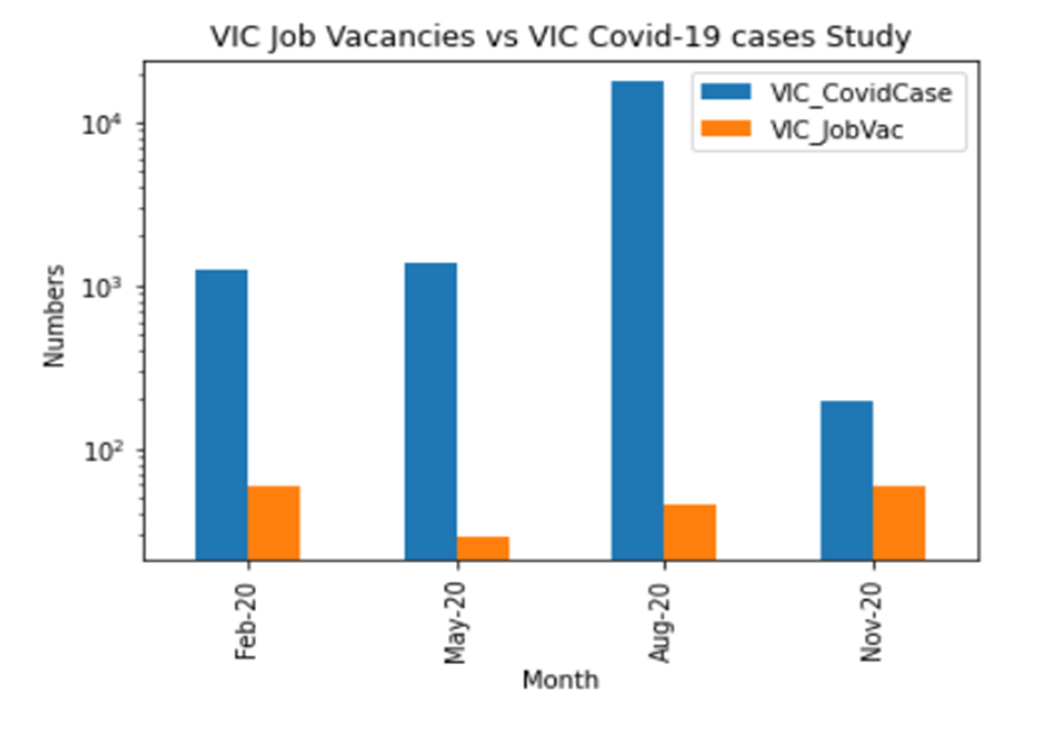
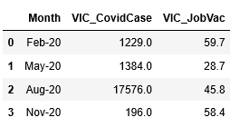
Covid-19 impact on VIC job vacancies

Slide 23
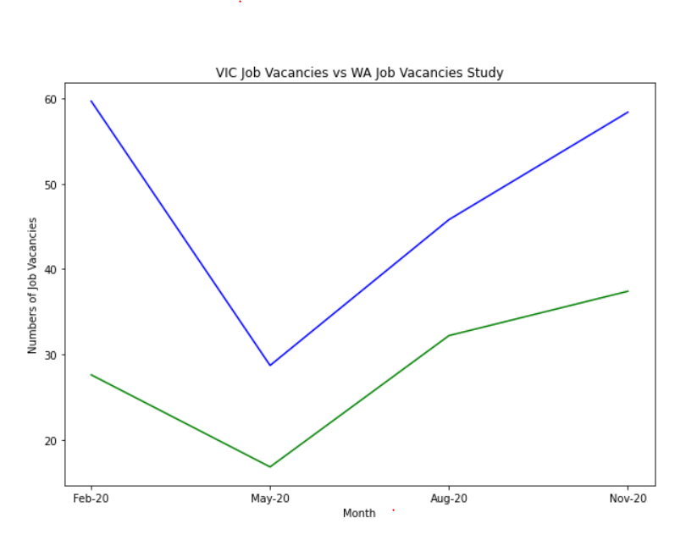
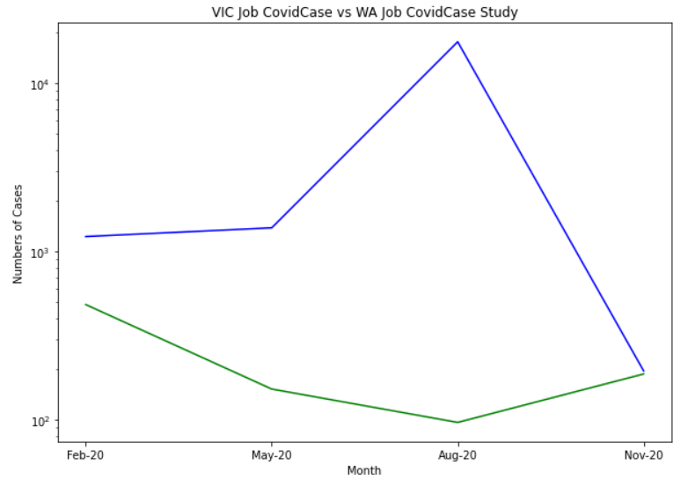
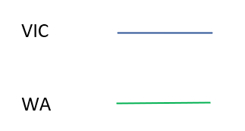
VIC and WA job Vacancies and COVID-19 impact on them

Slide 24
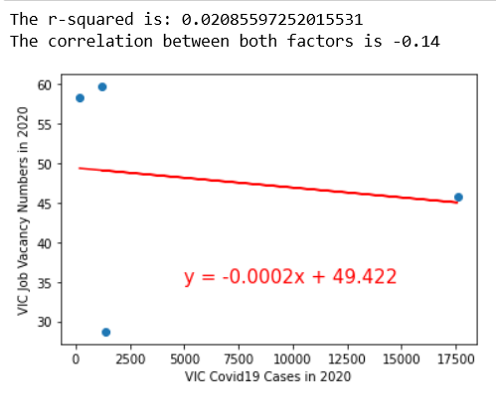
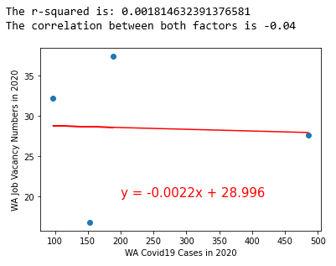
Job Vacancies number and COVID-19 case Correlation in WA and VIC

Slide 25
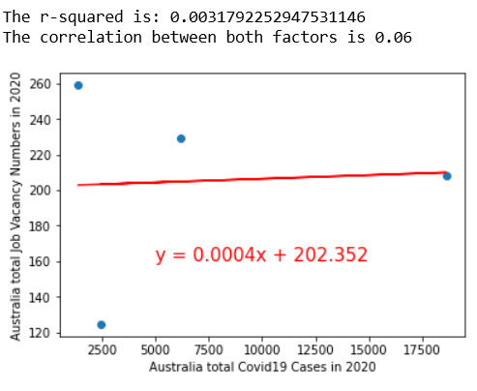
Job vacancies and COVID-19 case correlation in Australia

Slide 26
Summary and Conclusion

Slide 27
Limitations and Further Study
Insufficient raw medical data sources for Australia
Drill down into what industries were affected the most
Causes of impacts are worth while to be studied in the future

Slide 28
Conclusion
News and media led us to believe that the pandemic has a huge impact on loss of employment.
However, based on our analysis on the available data, while there was a visible impact on unemployment, the affect was not as great as we initially hypothesized.
WA was not as affected as VIC was. Possibly to the difference in size and density of the population of both states.

