Slide 1


Covid-19 impact on unemployment in Australia
By:
Helen Amin
Stephanie Salvona
Heriawan Muhamad
Samantha van Wyngaarden

Slide 2
Introduction – summary
An analysis of the unemployment rates in Australia in 2020.
Our hypothesis is that the COVID-19 Pandemic will have impacted the unemployment rates in Australia. We were interested to see what the effects COVID had, and how it may have impacted different states.
We expect to see an increase in unemployment rates as the COVID cases increase in Australia

Slide 3
Questions
Was there an increase or decrease in unemployment in 2020?
How was unemployment impacted between WA and VIC?
Was there a correlation between infection rates and unemployment in 2020?
Questions we had before we began our analysis

Slide 4
Data sources
We started our research through google and API sites
Meaningful (free) data was not available on any APIs
We contacted some data sources to try and get access to databases
We downloaded our unemployment data from the ABS website in excel
COVID data was manually extracted from the NNDSS website due to data limitations

Slide 5
Data sources
Unemployment Data - ABS https://www.abs.gov.au/statistics/labour/employment-and-unemployment/labour-force-australia-detailed/feb-2021#unemployment
Job Vacancies - ABS https://www.abs.gov.au/statistics/labour/employment-and-unemployment/job-vacancies-australia/feb-2021
COVID Data - NNDSS http://www9.health.gov.au/cda/source/cda-index.cfm

Slide 6
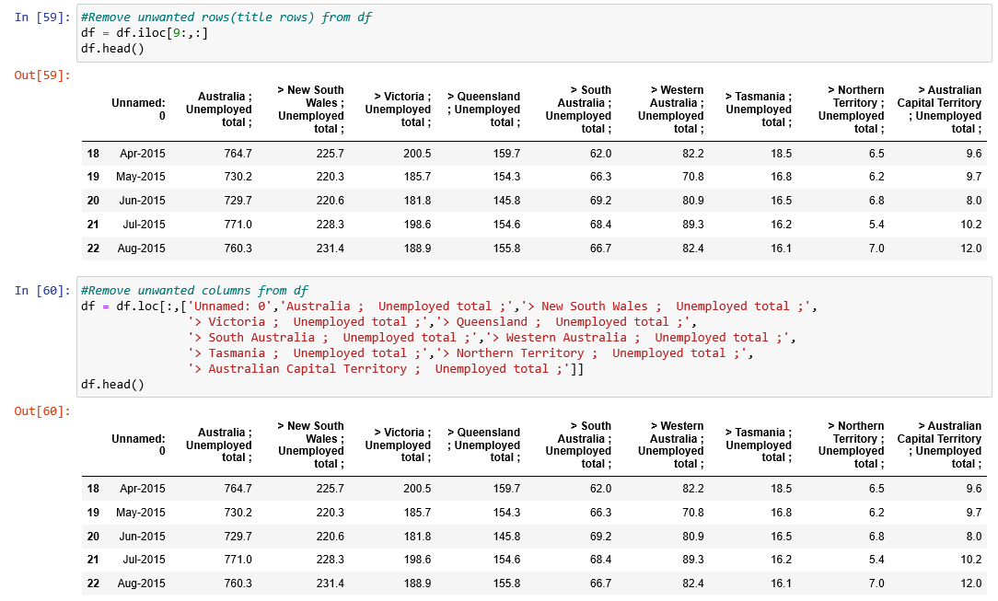
Data Cleaning
There was a lot of additional columns and data that we did not require from the government spreadsheet
We began by filtering down the data frame to the rows and columns we wanted to use
Unemployment data

Slide 7
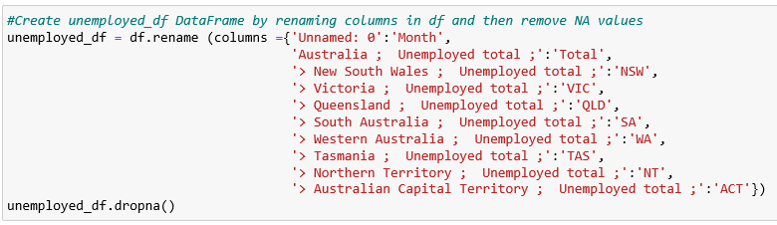
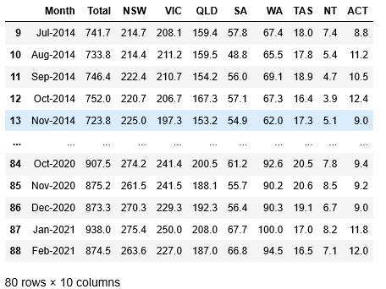
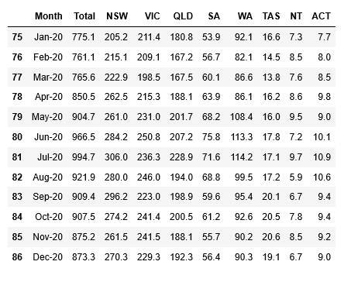

Data Cleaning
Renamed the columns to be more meaningful remove NA values
Filtered to the date range required
Unemployment data

Slide 8
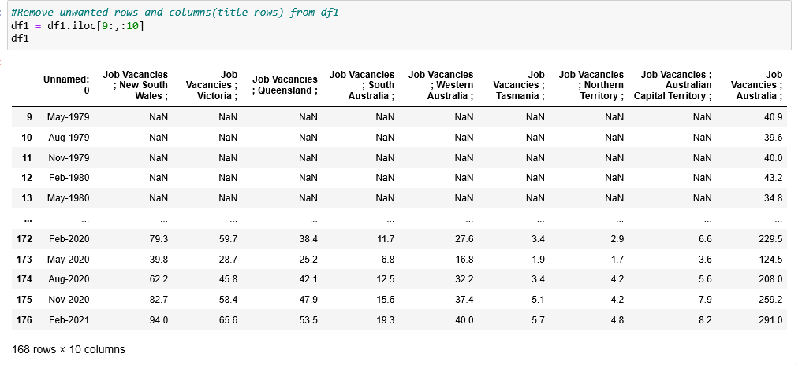
Data Cleaning
There was a lot of additional columns and data that we did not require from the government spreadsheet
We began by filtering down the data frame to the rows and columns we wanted to use
Job Vacancies

Slide 9
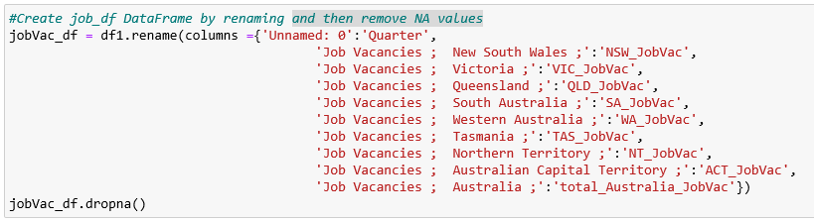
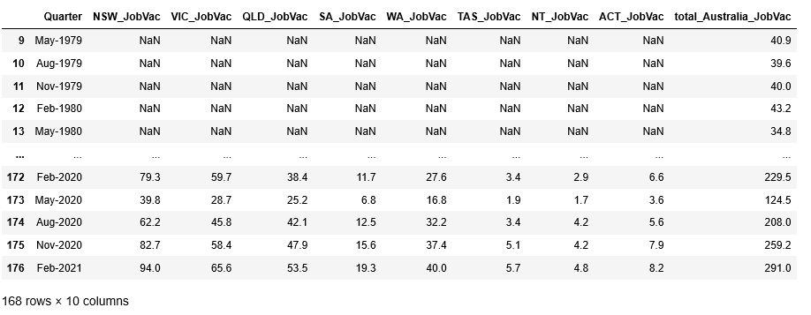
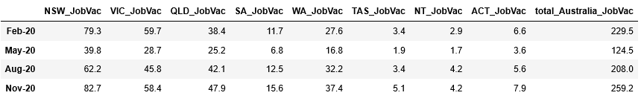
Data Cleaning
Renamed the columns to be more meaningful and dropped NA values
Filtered to the date range required
Job Vacancies

Slide 10

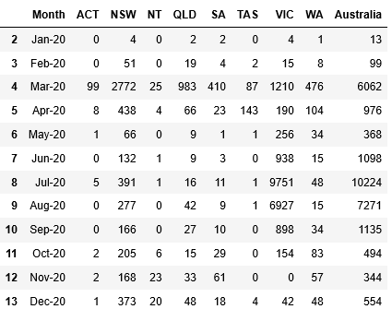
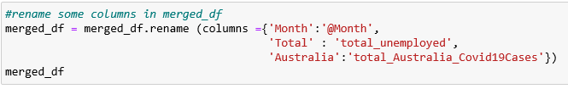

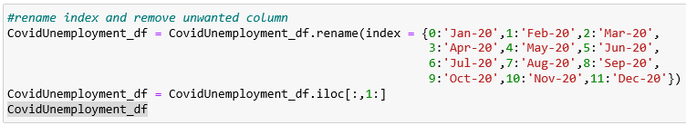
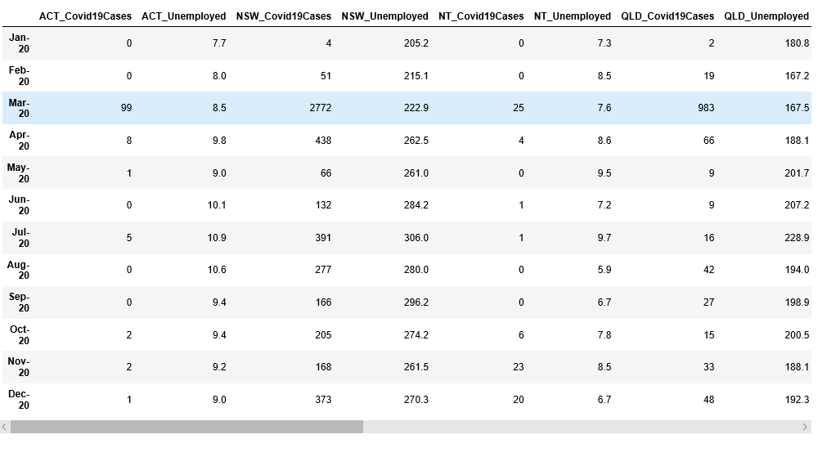
Data Cleaning
Data was mostly cleaned so we filtered to required date range and remove NA values
Merged monthly base dataframe with the unemployment dataframe
COVID Data used for Unemployment Study

Slide 11
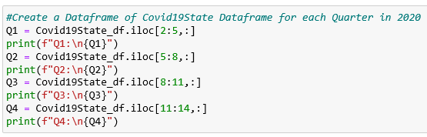
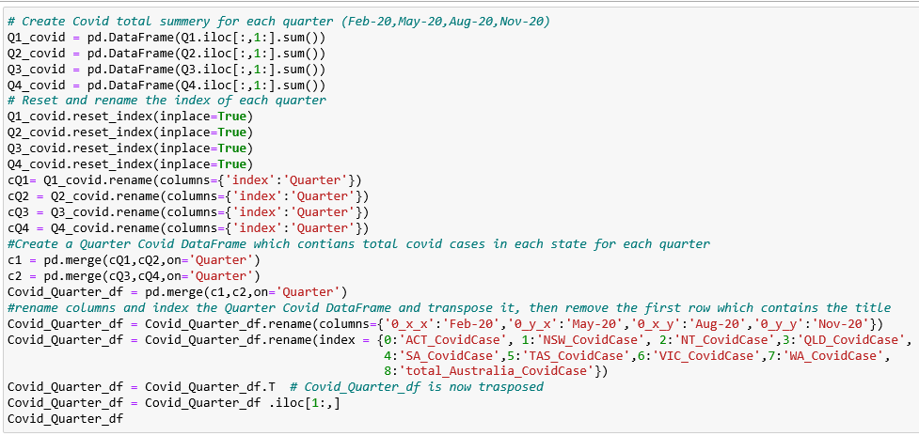
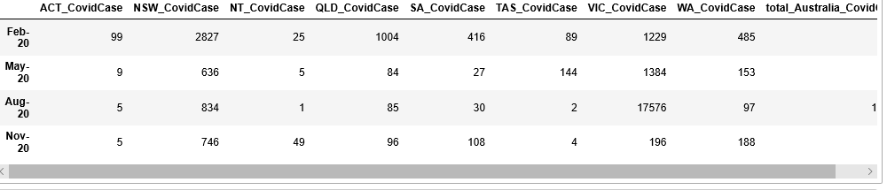
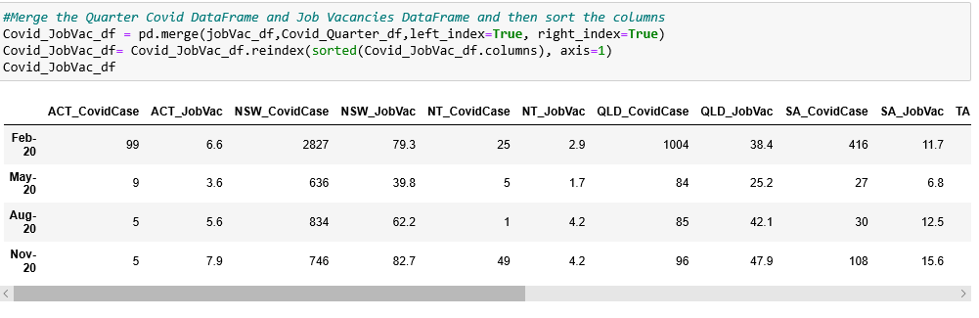
Data Cleaning
Had to create quarterly base covid data to be able to merge it with Job vacancies data set
COVID Data used for Job Vacancies Study

Slide 12

Data Analysis

Slide 13
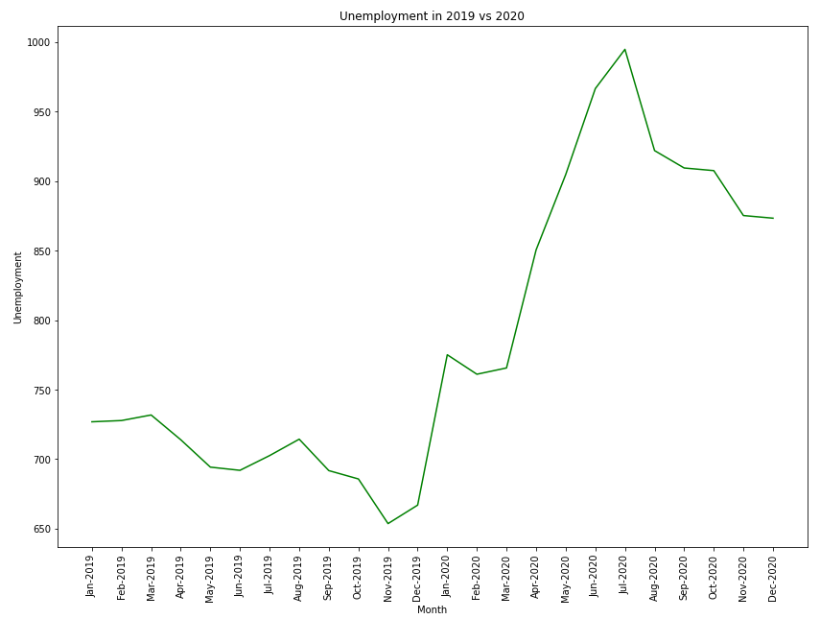
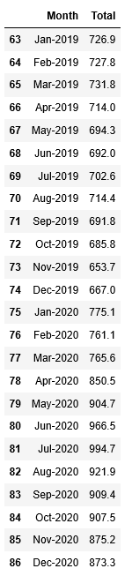
Was there a change in unemployment in 2020?

Slide 14
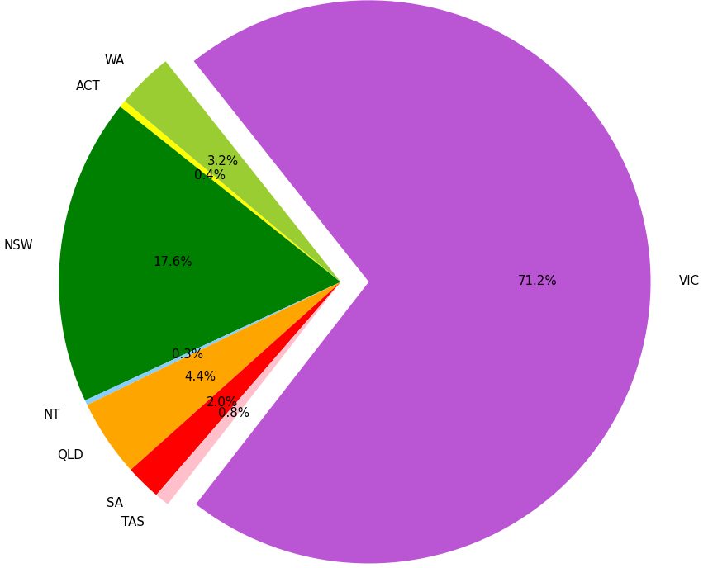
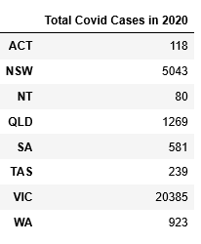
Total distribution of COVID cases for 2020
Notes:
Numbers in the dataframe and % in the pie
Chose to look at VIC and WA

Slide 15
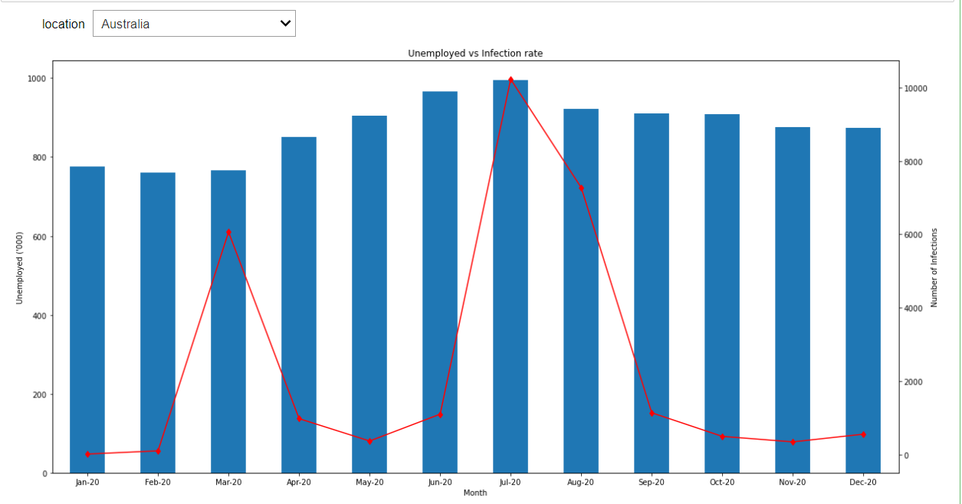
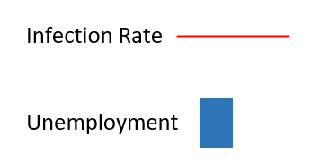
Unemployment vs Infection rate in Australia
Add Unemployment vs infection rate
Notes:
Shows Unemployment and Infection rate trends per month
Can see an increase in Unemployment from March onwards as the infection rates increases

Slide 16
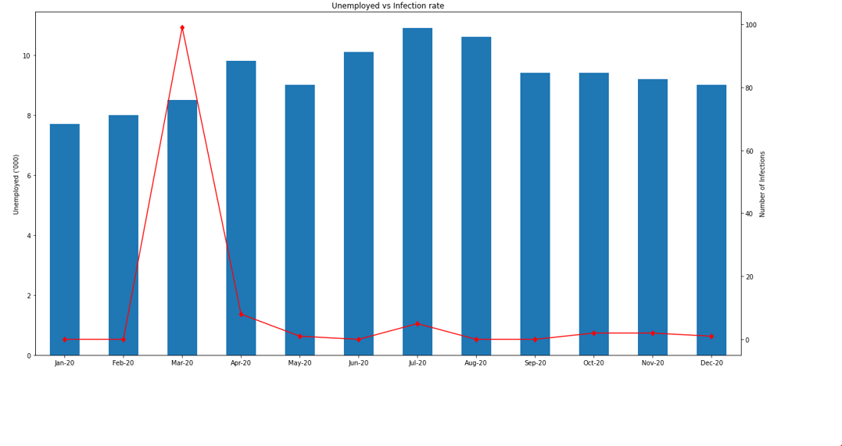
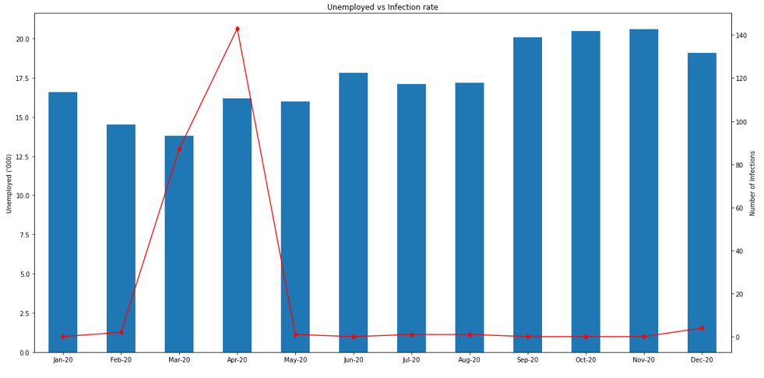
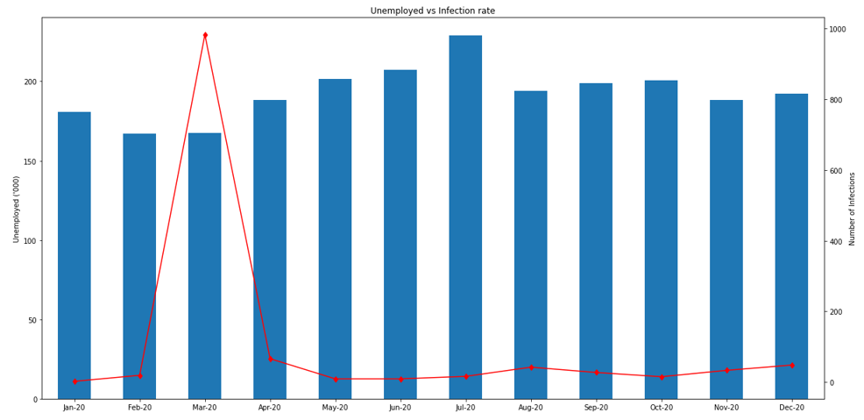
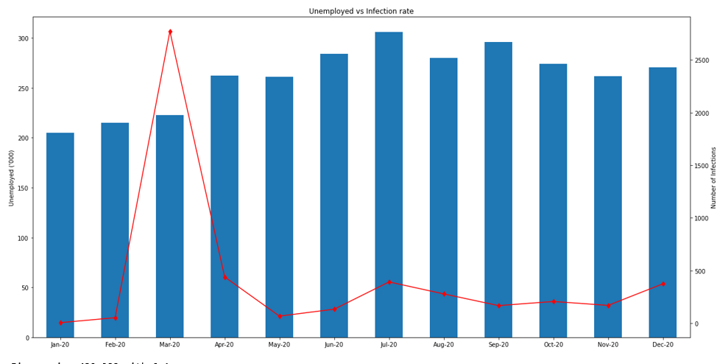
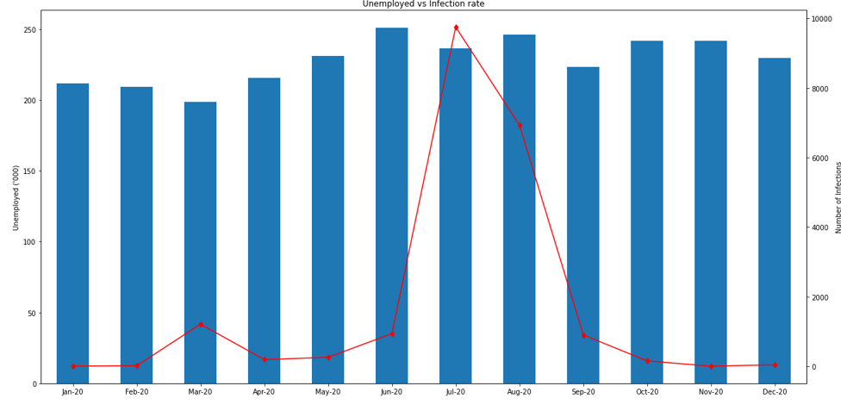
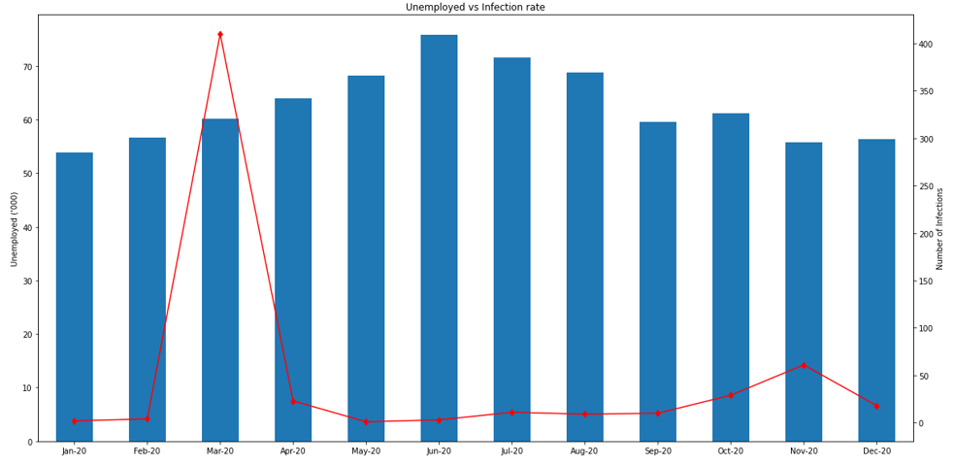
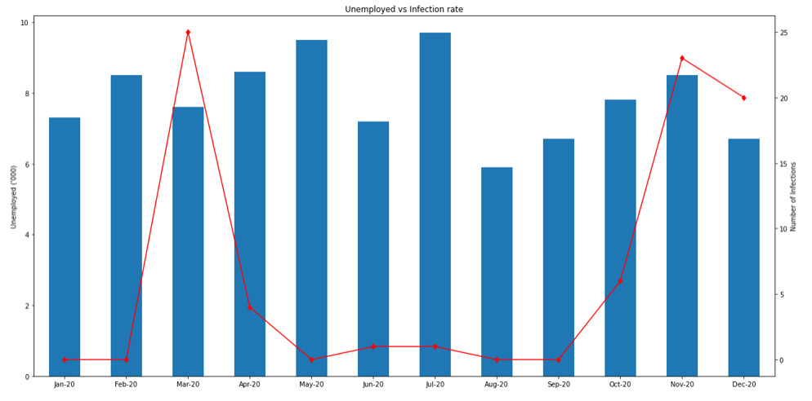
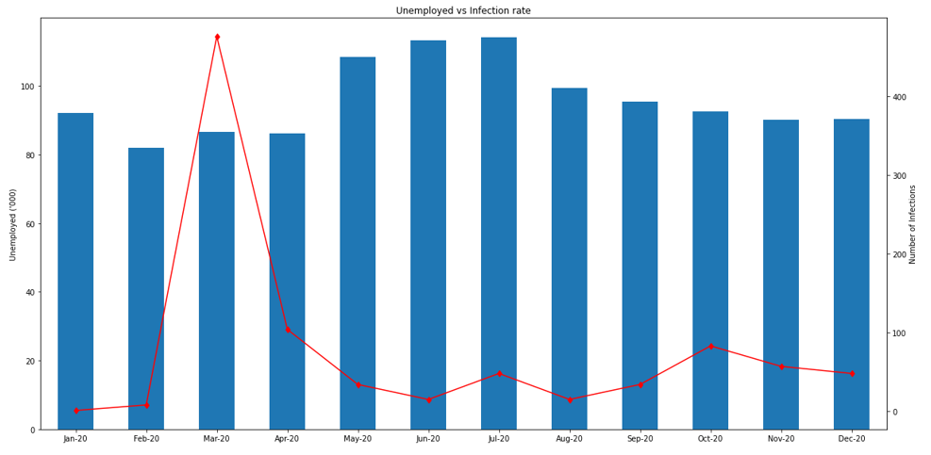
Unemployment vs Infection rate in Australian States
ACT
TAS
QLD
NSW
VIC
SA
NT
WA
Notes:
Snap shot of unemployment vs infection rate per state
We can see that all states peak in March with VIC as the exception

Slide 17
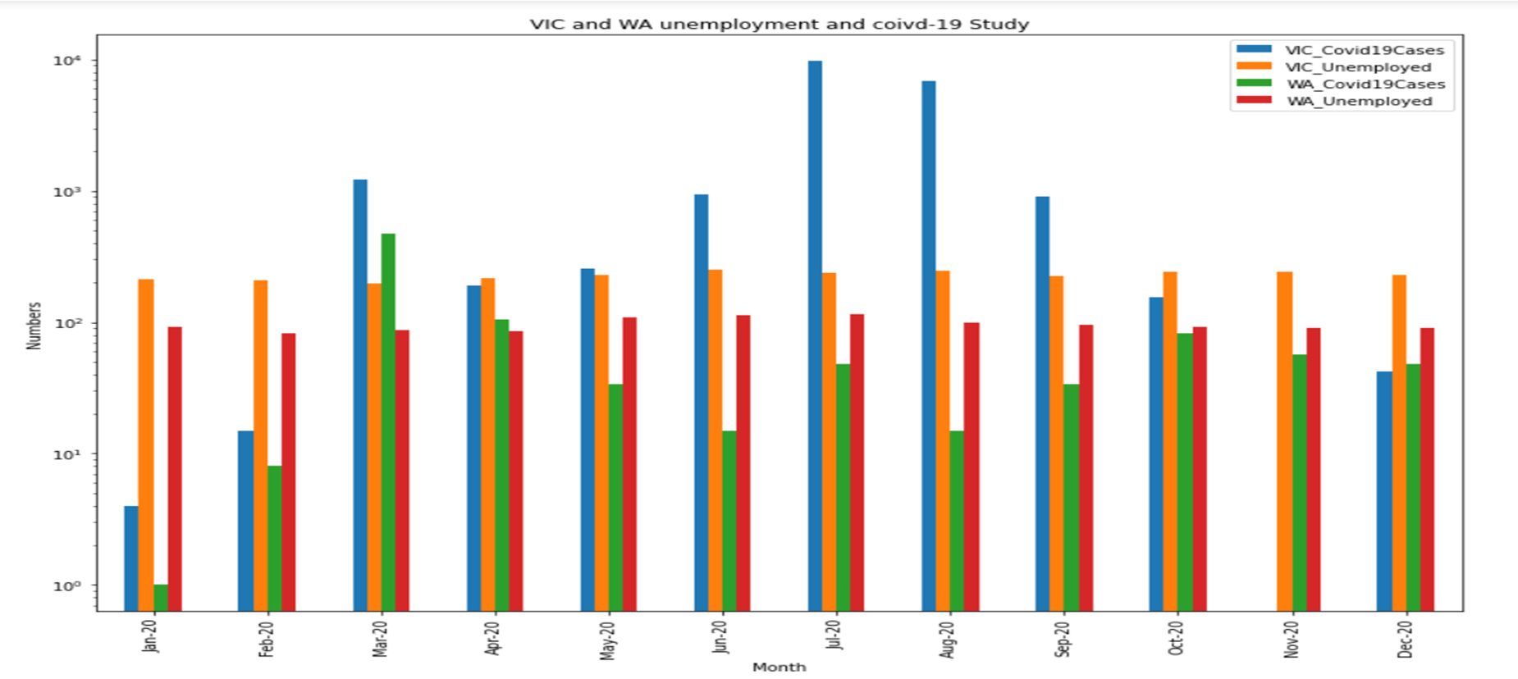
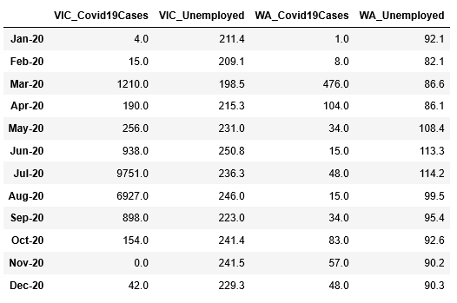
VIC and WA Unemployment Comparison and COVID-19 Impact on them
Notes:
Graph is on a logarithmic scale because of the varying data sets.
The change in unemployment doesn’t look as dramatic as we had anticipated No real increase as COVID hits

Slide 18
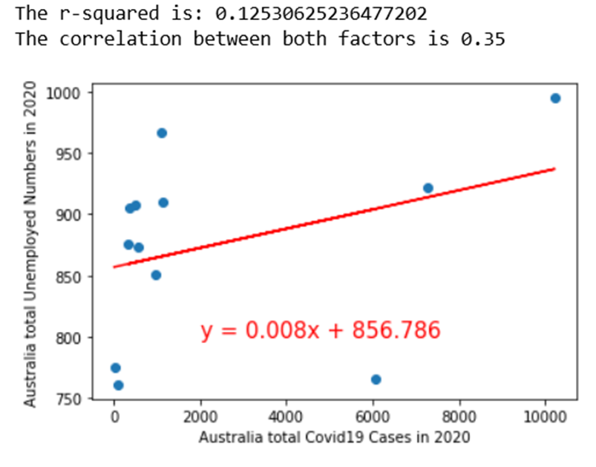
Correlation between Unemployment and COVID cases in Australia in 2020

Slide 19
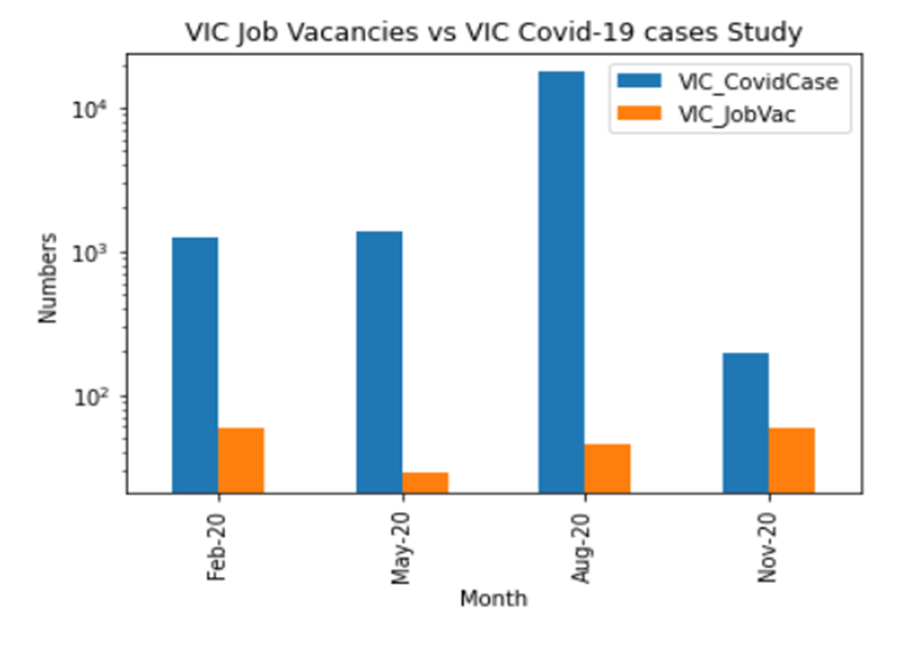
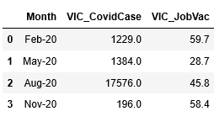
Covid-19 impact on VIC job vacancies
Notes:
Increase as VIC goes back into lockdown
Suspect this could have been impacted by Job keeper
Business adapt New roles created to COVID life

Slide 20
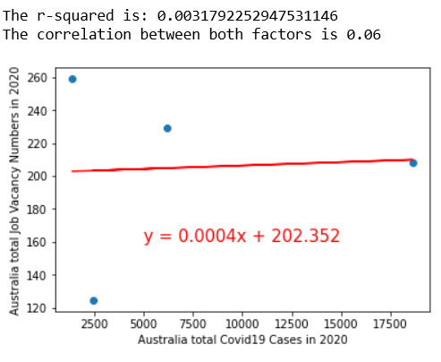
Job vacancies and COVID-19 case correlation in Australia

Slide 21
Summary and Conclusion

Slide 22
Conclusion
News and media led us to believe that the pandemic has a huge impact on loss of employment.
However, based on our analysis on the available data, while there was a visible impact on unemployment, the affect was not as great as we initially hypothesized.
WA was not as affected as VIC was. Possibly to the difference in size and density of the population of both states.

Slide 23
Limitations and Further Study
Insufficient raw medical data sources for Australia
Drill down into what industries were affected the most
Causes of impacts are worth while to be studied in the future

