Slide 1
MPP Project 2025 — Employment Management System (EEMS)
Master’s in Computer Science — MIU
Course: Modern Programming Practices (MPP)
Authors: Helena Pedro, Nuermaimaiti Abulikemu
Date: 10/2025

Slide 2
Overview
Goal: Develop a Java application that calculates project-related costs using clean architecture and repository design. Key Features: • Layered architecture (Controller → Service → Repository → DB) • JDBC-based data access • Functional and stream-based computation • Defensive programming principles

Slide 3
Tasks Summary
Task 1: Calculate HR cost for one project → double totalCost
Task 2: Calculate total HR cost for all projects → double grandTotal
Task 3: Find total allocation of an employee → double allocationPercent
Task 4: Find employees under-allocated (<100%) → List<Employee>
Only Task 1 requires a Sequence Diagram.

Slide 4
Architecture
Layers:
App (Controller) – handles user input and calls service.
Service Layer – contains business logic (e.g., HR cost computation).
Repository Layer – provides abstraction for data access.
Database – stores projects, employees, and allocations. Benefits:
Separation of concerns
Easy testability and maintenance
Clear data flow across layers

Slide 5
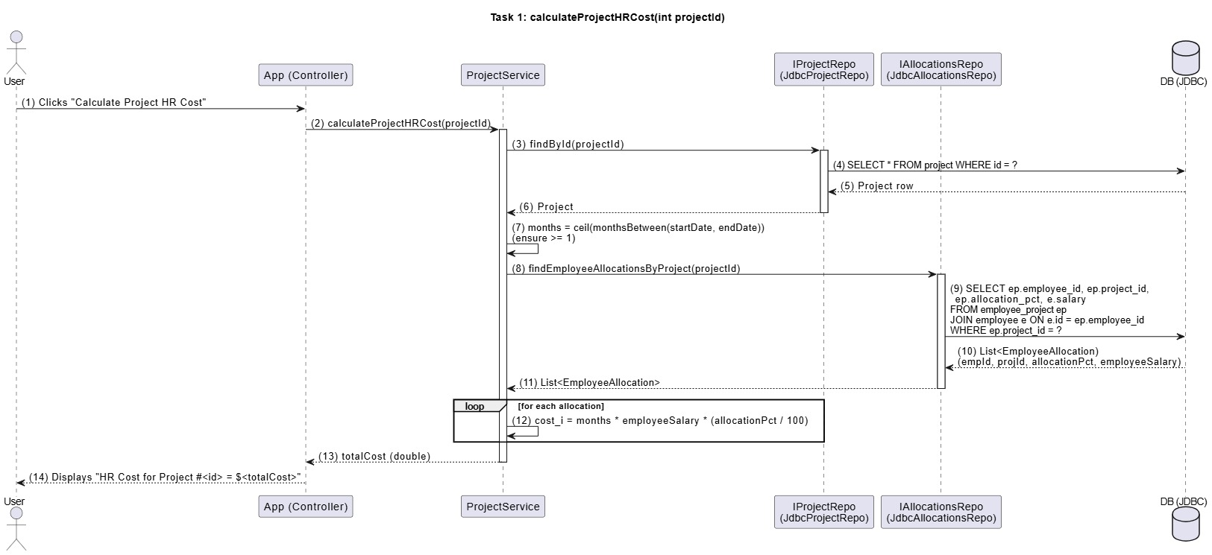
Sequence Diagram (Task 1)

Slide 6
Sequence Diagram (Task 1)
Purpose: Show how the system calculates HR cost for a specific project. Flow Summary: 1. User triggers “Calculate Project HR Cost” 2. Controller calls ProjectService.calculateProjectHRCost(projectId) 3. Service retrieves project data and employee allocations 4. Service computes total cost = months × salary × allocation% 5. Controller displays total result to the user

Slide 7
Core Implementation
@Override public double calculateProjectHRCost(int projectId) { Project p = projects.findById(projectId) .orElseThrow(() -> new IllegalArgumentException( "Project not found: " +
projectId)); long months = ChronoUnit.MONTHS.between( p.startDate().withDayOfMonth(1), p.endDate().withDayOfMonth(1) ) + 1;
if (months <= 0) months = 1; List<EmployeeAllocation> allocations = allocationsRepo
.findEmployeeAllocationsByProject(projectId); return allocations.stream() .mapToDouble(a -> months * a.employeeSalary() * (a.allocationPct() / 100.0)) .sum(); }

Slide 8
Results & Takeaways
Outcomes: • Successfully computed HR costs per project • Implemented clean separation of layers • Used Streams and Optionals for clarity and safety Lessons Learned: • Importance of repository abstraction • Defensive coding in data-driven apps • Value of sequence diagrams for understanding flow

Slide 9

Thank you!
This Photo by Unknown Author is licensed under CC BY-SA

