Slide 1
EDES 301 Digital ClockBuddy Proposal
2/23/2025
Helena Wang

Slide 2
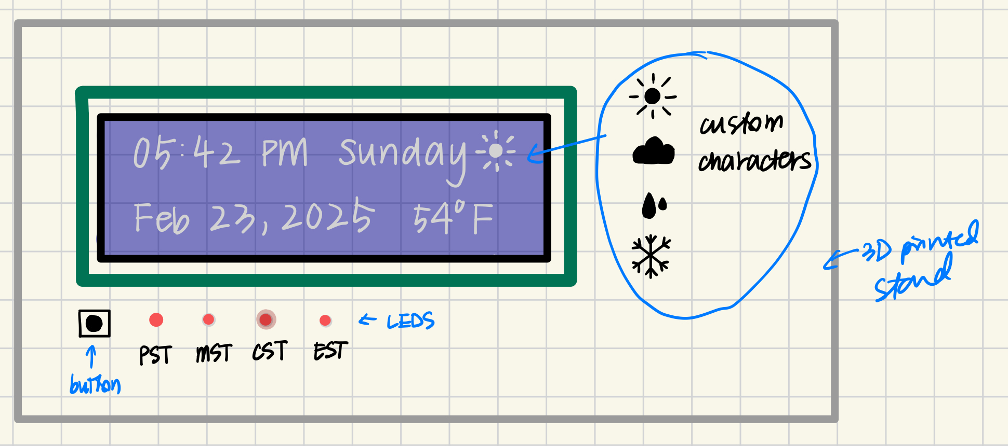
Background Information
I want to make a desk clock that tells you the time and date, temperature, and conditions outside. There will be a button that can toggle between the 4 US time zones with LED indicators. I will also have additional buttons for the user to manually update the display (default will be every hour for temperature and weather and every day for time and date).
There is an Arduino example of a clock project: https://arduinofactory.com/displaying-time-and-date-on-a-screen-with-arduino/
To add to this, I could add another toggle button that switches to a different display of daily reminders, connecting to a personal calendar.

Slide 3
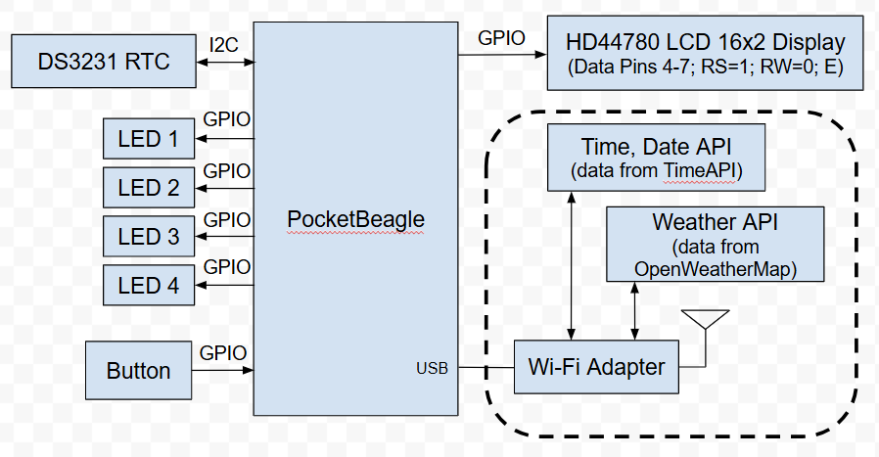
System Block Diagram

Slide 4
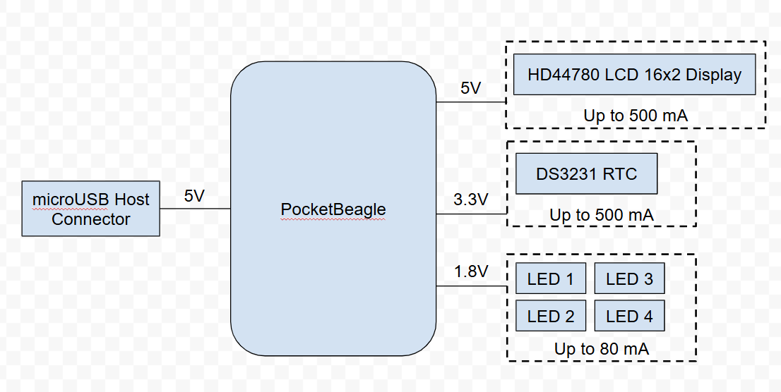
Power Block Diagram

Slide 5
Components / Budget
Component | EDES301 to Buy? | Cost
USB Wi-Fi Adapter | Yes (on EDES301 parts list) | $9.99
Adafruit 16x2 LCD (white on blue) | Yes (on EDES301 parts list) | $9.95
DS3231 RTC | Yes | $13.95
PocketBeagle Microcontroller | No
4 LEDs | No
1 Button for cycling between time zones | No

Slide 6
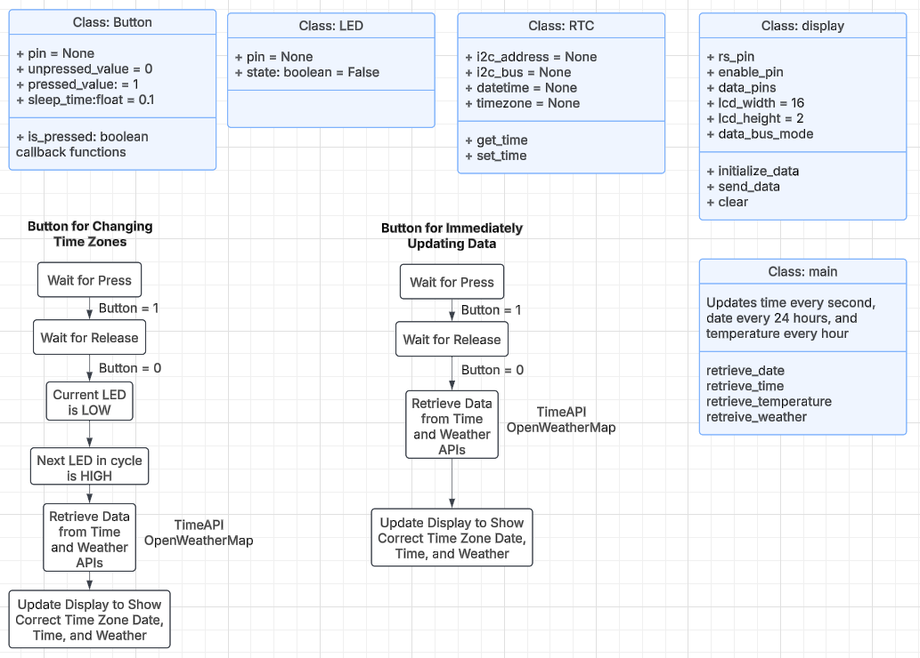
Software Block Diagram

