Slide 1
EDES 301 ClockBuddy PCB Project
Helena Wang
Due 05/06/2025 @ 11:59pm

Slide 2
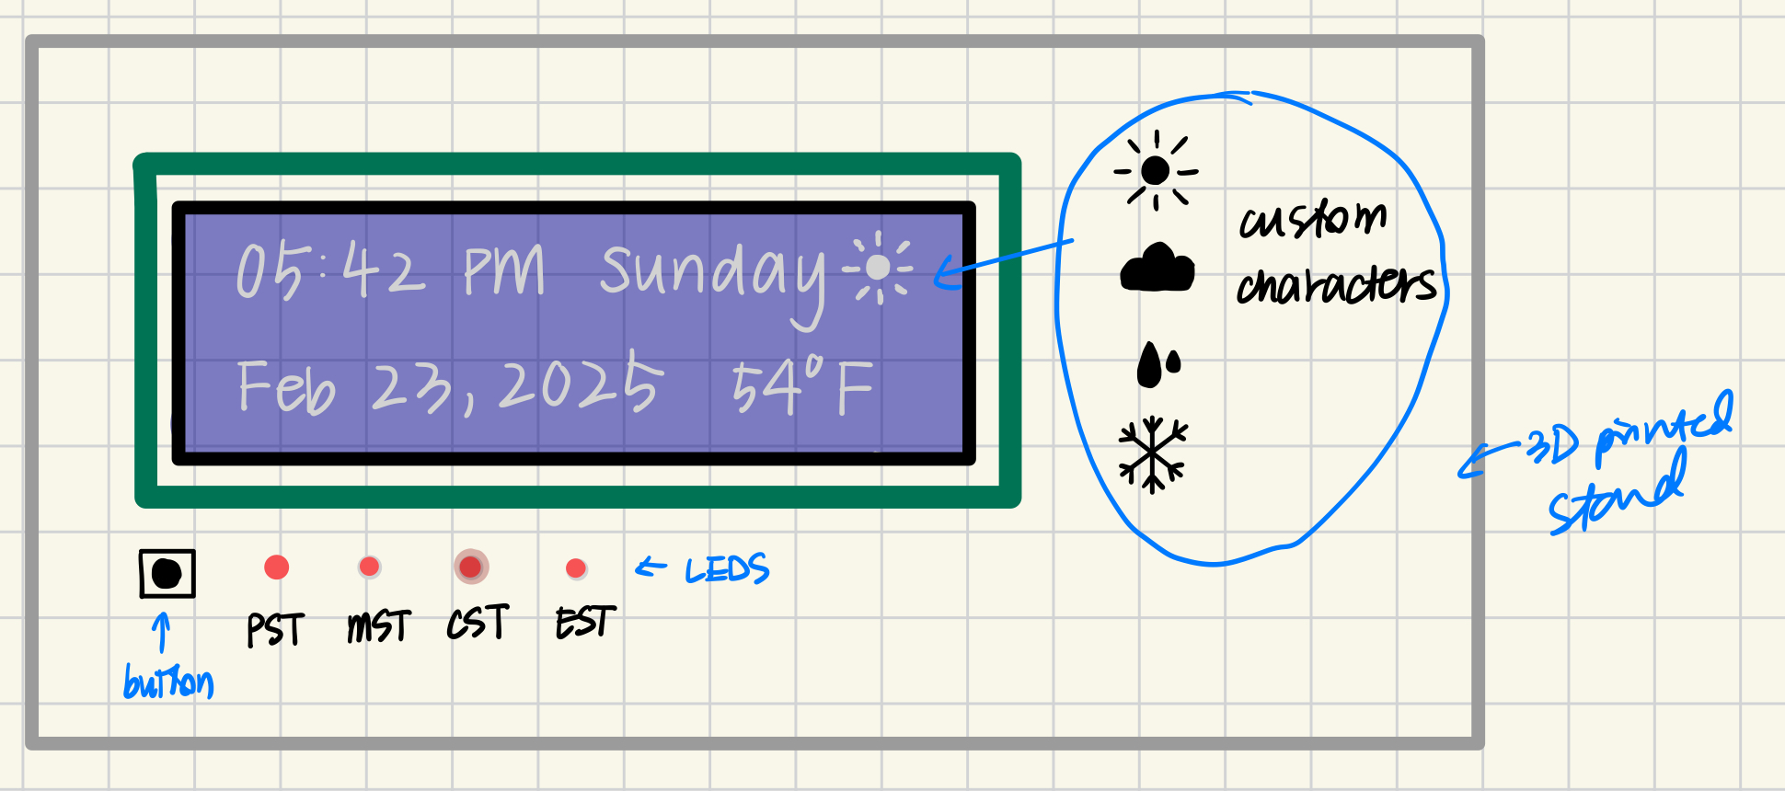
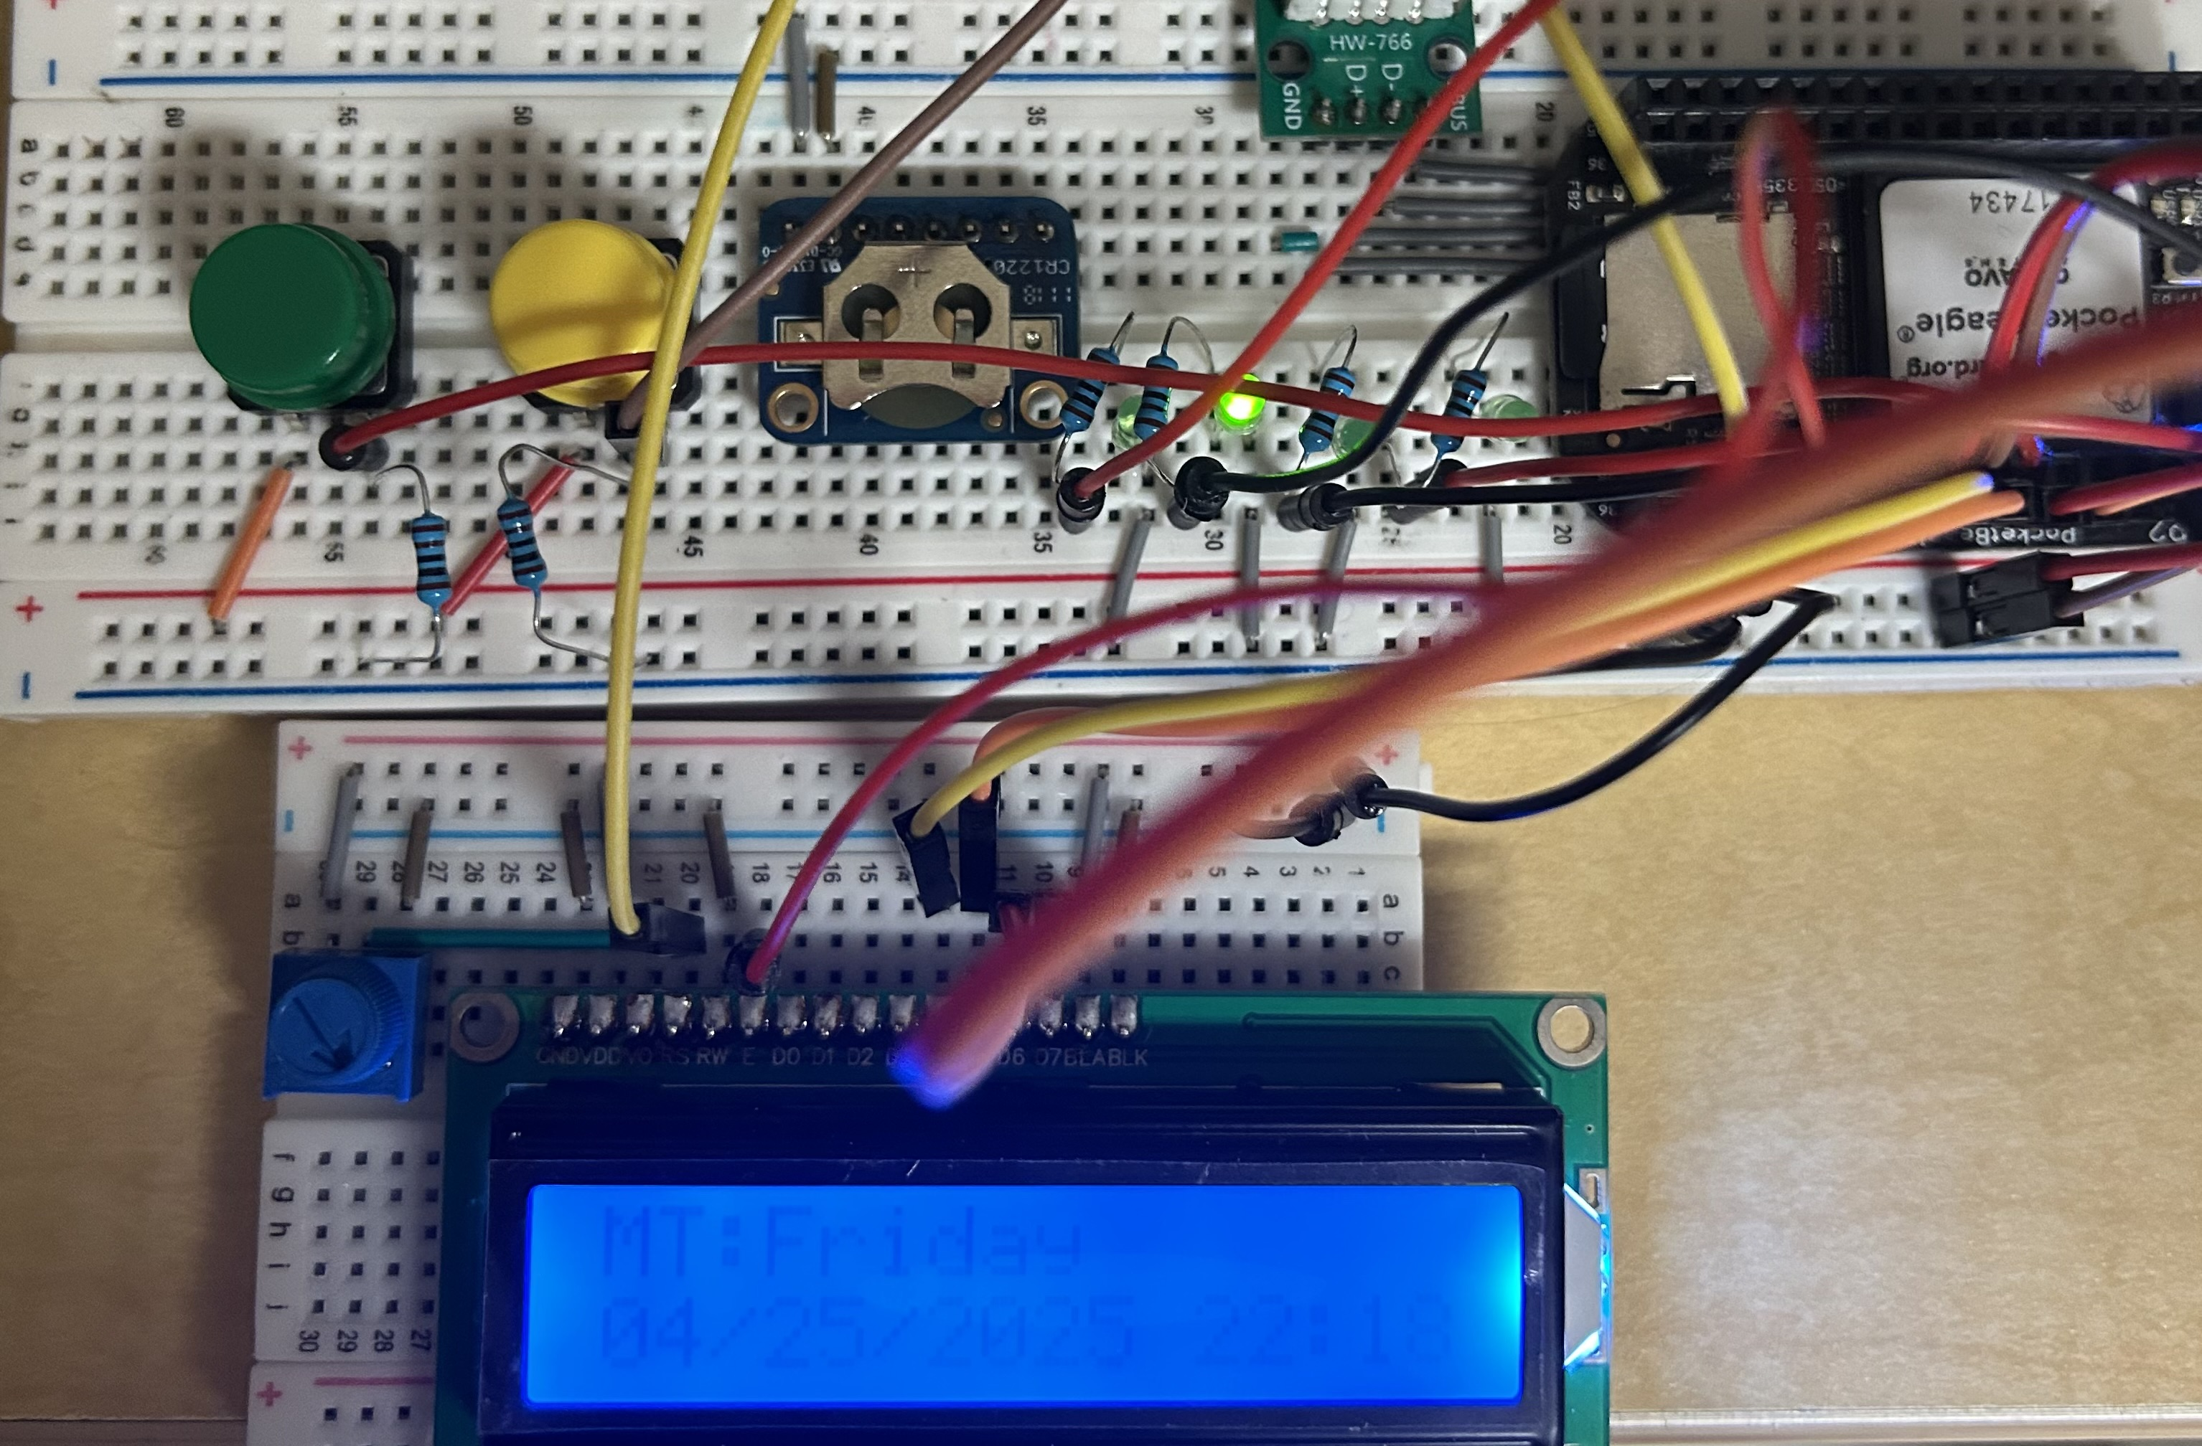
Background Information
Create a PCB for an “Clock Buddy”
Hardware:
16x2 Character LCD
One Potentiometer
Two Buttons (Temperature, Date)
Four LEDs (US time zones)
USB Port (Wi-Fi Adapter)

Slide 3
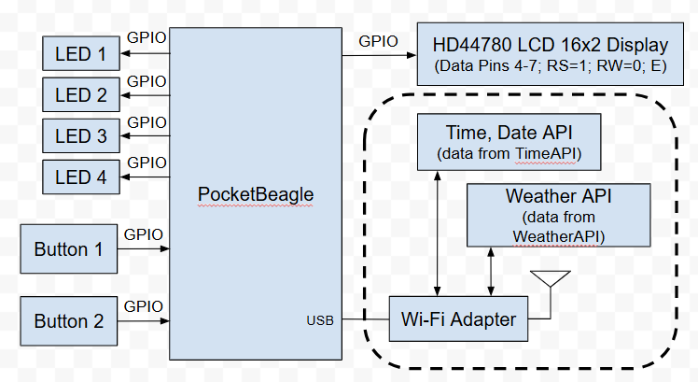
System Block Diagram

Slide 4
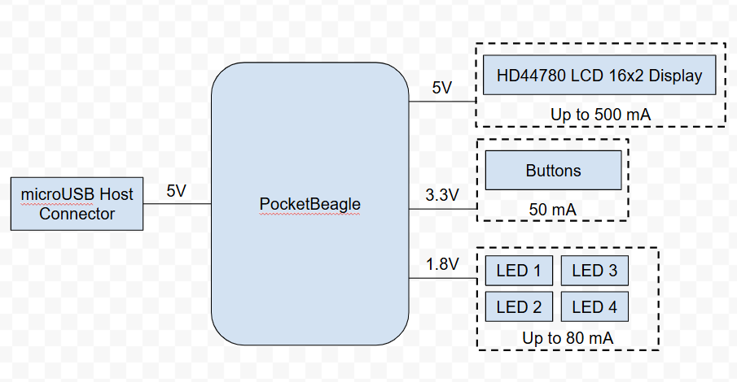
Power Block Diagram

Slide 5
Mechanical Drawing
4.5”
Character LCD
Pocket Beagle
Pot
USB Port
USB
3”
Button
Button
Buzzer
1”
2”
FRONT
BACK

