Slide 1
EDES 301 Digital ClockBuddy Proposal
2/23/2025
Helena Wang

Slide 2
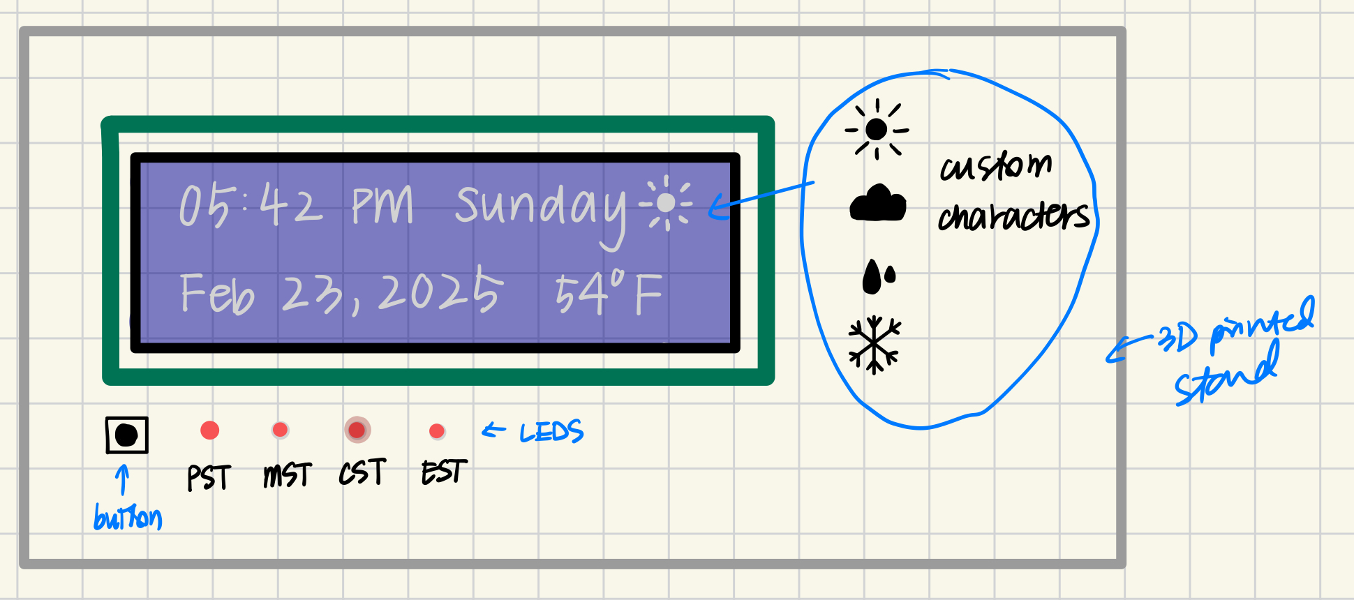
Background Information
I want to make a desk clock that tells you the time and date, temperature, and conditions outside. There will be a button that can toggle between the 4 US time zones with LED indicators.
There is an Arduino example of a clock project: https://arduinofactory.com/displaying-time-and-date-on-a-screen-with-arduino/
To add to this, I could add another toggle button that switches to a different display of daily reminders, connecting to a personal calendar.

Slide 3
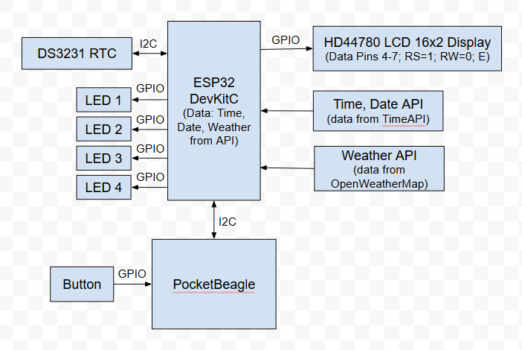
System Block Diagram

Slide 4
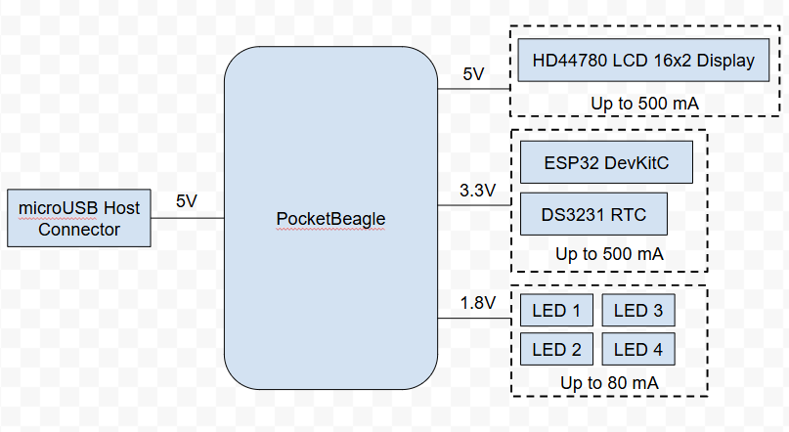
Power Block Diagram

Slide 5
Components / Budget
Component | EDES301 to Buy? | Cost
ESP32 DevKitC SPI | Yes | $9.95
Adafruit 16x2 LCD (white on blue) | Yes (on EDES301 parts list) | $9.95
DS3231 RTC | Yes | $13.95
PocketBeagle Microcontroller | No
4 LEDs | No
1 Button for cycling between time zones | No
See Next Slide for Instructions

