Slide 1
CD19+RAG+DP

Slide 2
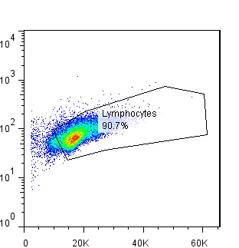
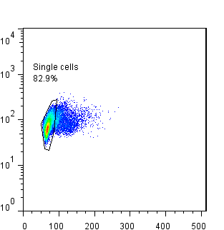
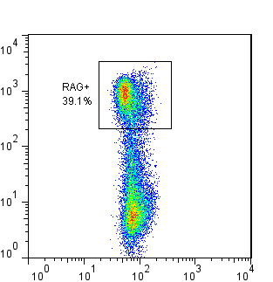
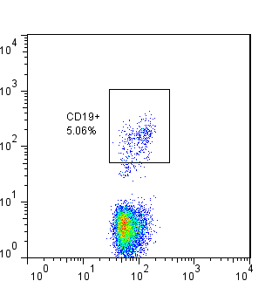
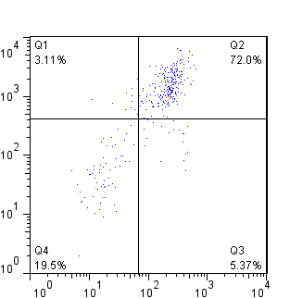
Side Scatter
Side Scatter
RAG
CD19
CD8
Forward Scatter
Pulse Width
Side Scatter
Side Scatter
CD4

