Slide 1
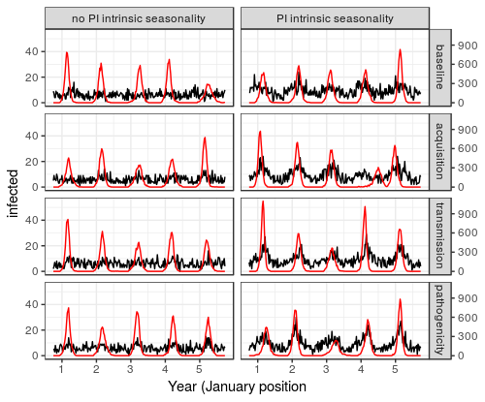
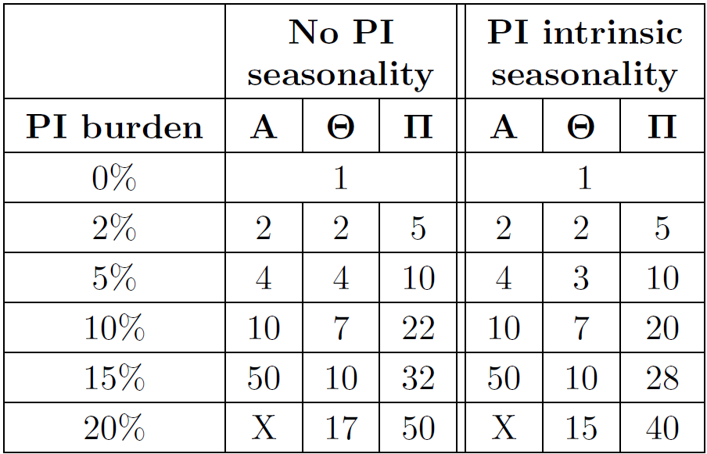
Baseline scenario:
normal transmission, acquisition or pathogenicity of pneumococcus
Legend:
Acquisition-interaction scenario:
increased acquisition for influenza-infected individuals
Completely susceptible individual
Pneumococcus-colonized individual
Influenza-infected individual
Transmission-interaction scenario:
increased transmission for influenza-infected individuals
Risk of pneumococcal infection
Transmission of pneumococcus
Acquisition of pneumococcus
Pathogenicity-interaction scenario:
increased risk of pneumococcal infection for influenza-infected individuals
Thickness of arrows indicates the strength of the corresponding phenomenon

