Slide 1
Figure 1. a) Observed Southern Ocean surface temperature with sea ice extent (light blue shading) and long-term position of the ACC (black lines). b) Southern Ocean of Australia’s East Antarctic Territory showing eddy hotspots (white swirls), the observed position of the Southern Boundary (SB) ACC front in the 1990s (dashed magenta line near Antarctica) and its poleward shift by the 2010s (solid magenta) from Yamazaki et al. (2021). c) Ocean processes near the Antarctic continental margin. Eddies move Circumpolar Deep Water (CDW) across the sloping isopycnals (grey curves) of the Antarctic Circumpolar Current (ACC) and Antarctic Slope Current (ASC).

Slide 2
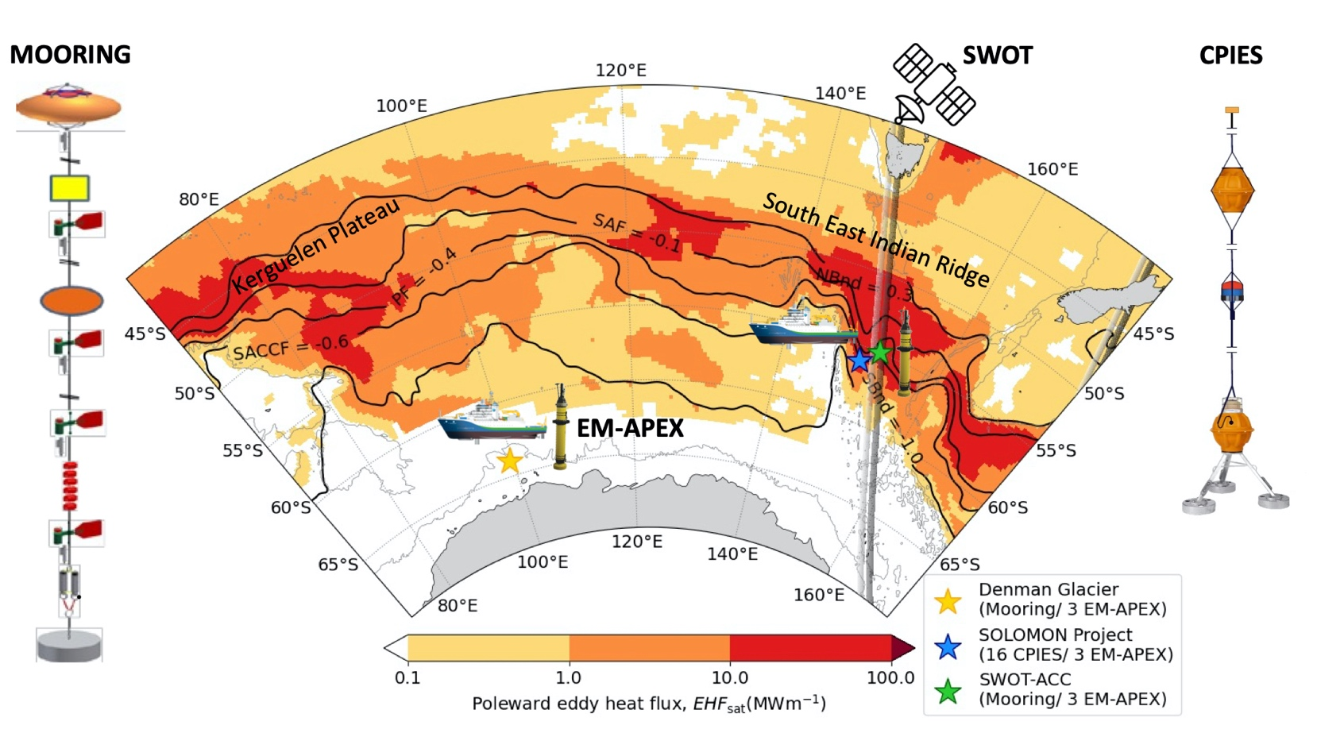
Figure 2. Eddy heat flux (shading, MWm⁻¹) derived from satellite Sea Surface Height (SSH) by Foppert et al. (2017) showing that eddy heat flux increases by two orders of magnitude in topographic hotspots. White space is under sea ice cover or an EHF below 0.1 MWm⁻¹. The black contours show the ACC fronts by their characteristic SSH. The thin grey lines show 2500m depth. This proposal capitalizes on approved field campaigns (coloured stars) and the overpass of the new SWOT SSH satellite launched in 2022 that coincides with the SWOT-ACC field program (grey swaths). Side panes show advanced in-situ instruments to be deployed: tall mooring, CPIES and EM-APEX.

Slide 3
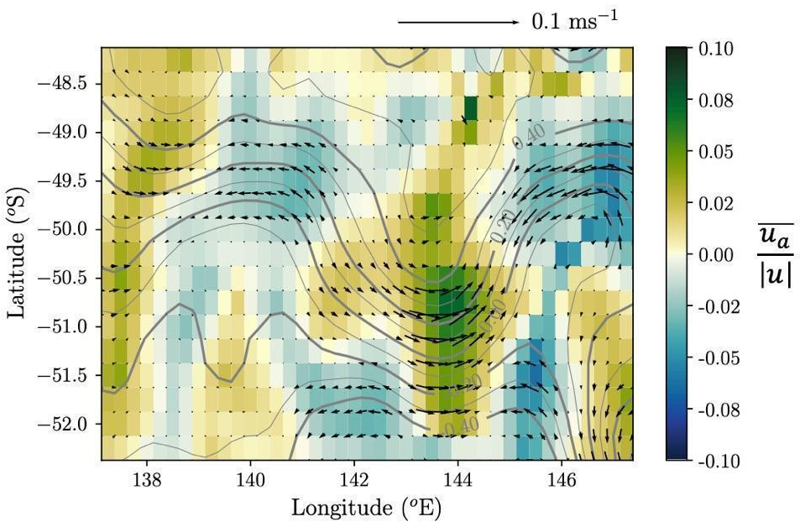
Figure 3. Snapshot of ageostrophic velocity from satellite sea surface height (vectors) and proportion of ageostrophic flow to the total gradient wind (shading) in an ACC meander. The ageostrophic component accelerates the flow in the crest (green shading) and retards it in the trough (blue). From Meijer et al. (2022).

Slide 4
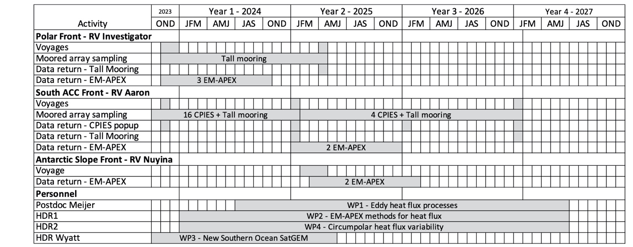
DP24: Antarctica’s leaky defence to poleward ocean heat transport
Aims
Quantify localized cross-frontal heat and salt transports from observations collected during funded field campaigns and corroborate them with next-generation, high-resolution ocean model simulations.
Apply theoretical and numerical advances to fuse satellite and subsurface observations to create a new circumpolar dataset of cross-frontal heat and salt fluxes.
Quantify decadal trends, seasonal and interannual variability of Southern Ocean poleward heat and salt fluxes from observations and model simulations.

Slide 5
A/Prof Phillips (CI, 0.2 FTE) is an observational physical oceanographer with expertise in measuring, quantifying and understanding the oceanic processes that control the movement of heat and other properties across the Southern Ocean. Her PhD work provided an observational benchmark for poleward eddy heat flux across the ACC that is a fundamental reference for current observational and modelling studies and she is an international leader in investigation of ocean dynamics using EM-APEX profiling floats. She will lead the overall project and take responsibility for coordinating communications from the project. She will co-lead WP1 with Meijer and WP2 with Foppert, contribute to WP3 and WP4, lead supervision of HDR1 and co-supervise Wyatt and HDR2. Phillips has 53 high quality publications in leading discipline journals (28 in the last 5 years). Phillips’s h-index is 25/22 with 1789/1168 total citations and 238/190 citations per year.
Dr Foppert (CI, 0.2 FTE) is an early career physical oceanographer, with a keen focus and expertise in understanding Southern Ocean dynamics and circulation. She is a sea-going, observational oceanographer and is the Deputy Chief Scientist for the SWOT voyage in year 0 of this project. Foppert is an expert in using a large suite of observational platforms to study large-scale currents and mechanisms for heat fluxes across the Southern Ocean. Foppert and PI Watts have long-standing collaborations that have resulted in step-change in understanding of eddy heat fluxes across the Southern Ocean (Figure 2). Collaborations between Foppert, Phillips and Bindoff and Postdoc Meijer have contributed to the theoretical advances that are crucial for WP2 and WP3. Foppert will co-lead the WP2 development of eddy heat flux from EM-APEX and co-supervise HDR students, contributing to all work packages. Foppert’s h-index is 7/6 with 164/113 total citations and 75/56 citations per year.
Prof Bindoff (CI, 0.1 FTE) is an expert in the analysis of observations (altimetry, hydrographic data, gravest empirical modes, water mass transformation and dynamics of the Southern Ocean) and their comparison to simulations. He has extensive knowledge of the Earth system models (CMIP5/6) and their application to detection and attribution to human influence. He will lead the development of WP3 (GEM climatology) and contribute comparison of observations with simulations and trends in poleward heat flux of WP4. He will participate in deployment and recovery of the instruments and their analysis (WP1 and WP2). Bindoff is highly awarded for his climate work, has h-index of 65/47 with 55,864/11,213 total citations and 5327 citations per year. Bindoff has a total of 125 peer reviewed publications, 34 in the last 5 years.
A/Prof Spence (CI, 0.1 FTE) is an expert in ocean dynamics and leading developer of high-resolution ocean, ice simulations. Spence is an ARC Future Fellow and CI on the 2016 and 2020 ARC Linkage grants behind the formation of the Consortium for Ocean-Sea Ice Modeling in Australia (https://cosima.org.au/). COSIMA provides world leading coupled ocean, ice model configurations, simulation data and analysis tools for the benefit of the Australian and global scientific community. Spence will contribute his experience in ocean dynamics and provide next generation ACCESS-OM3 ocean modelling tools to this team. Spence’s h-index is 29/26 with 3719//2708 total citations and 521/444 citations per year.

Slide 6
Prof Watts (PI, 0.1 FTE) is an expert in deep ocean deployments to measure eddy heat fluxes and small-scale processes in energetic current systems including the ACC. Watts and Foppert developed the satellite proxy method for estimating eddy heat flux and unique instrumentation methods. He is co-leading the collaboration with Prof Park to the Southern ACC Front array south of Tasmania (Figure 2) that is one of the observational experiments central to this project. Watts will also contribute to methods used by Foppert, Phillips, Bindoff and Spence. Watts is highly awarded for his ocean circulation work in 118 peer-reviewed publications. He is a Fellow of the American Meteorological Society for his contribution to oceanography. His h-index is 44/32 with 6011/3477 total citations and 296/197 per year.
Dr Girton (PI, 0.1 FTE) is a physical oceanographer and expert in the measurement of finescale ocean processes. His group is the world-leader in the development and use of EM-APEX floats, including their application to Antarctica, and holds most of the data collected outside of Australia. Dr Girton and his team have been funded by the US Office of Naval Research to deploy a global array of 50 EM-APEX enhanced with temperature microstructure, three of which are included in this project. He will contribute to WP1 and WP2. Girton's h-index is 26/23 with 2911/2073 total citations and 312/198 citations per year.
Prof Park (PI, 0.1 FTE) is a physical oceanographer with decades of experience in observing strong current systems with CPIES and tall moorings. He will work on fluxes from the moored array and contribute to comparison of these with the EM-APEX estimates and model simulation in WP1 and WP2. Park’s metrics from Scopus are h-index of 24 with 2030 total citations and more than 238 citations per year.
Postdoctoral Fellow Jan Jaap Meijer (1.0 FTE) is a physical oceanographer with expertise in ocean modelling, in situ and satellite observations, and their analysis. He has a strong background in fluid dynamics and has proposed a new mechanism for interpreting satellite altimetry to quantify vertical motion and cross-stream fluxes that are amplified in hot spots for poleward fluxes. Dr Meijer will co-lead WP1 with Phillips, contribute to the other work packages and contribute to the mentoring and supervision of PhD students.
Mr Wyatt (current UTAS HDR, 1.0 FTE) is cosupervised by Bindoff, Foppert and Phillips. He will work on implementing new theory and observations to update the Satellite Gravest Empirical Model climatology of Meijers et al. (2011), which will be a contribution to WP3. His PhD will be submitted in 2025.
HDR1 (1.0FTE) will have primary supervision by Foppert and Phillips and co-supervision from Spence, Bindoff and Meijer. They will work on the development and analysis of heat fluxes from observations in WP2.
HDR2 (1.0 FTE) will have primary supervision by Spence in the development of ACCESS-OM3 and high-resolution simulations. They will contribute to the calculation and analysis of simulated fluxes in WP4, co-supervised by all CIs and Meijer.
Dr Kaihe Yamazaki

Slide 7
Work Packages
The overarching aim of this project is to derive the Southern Ocean poleward eddy heat and salt flux and quantify trends, seasonal and interannual variability. We will accomplish this within 4 work packages:
WP1: Regional investigation of processes that drive eddy heat flux (Lead Phillips/Postdoc Meijer)
Conduct field experiments at the Polar Front and Southern ACC Front in the SEIR eddy hotspot and Antarctic Slope Front in the region of the Denman Glacier (stars, Figure 2, Table 1). These field experiments will provide contemporaneous EM-APEX, shipboard, and moored time series measurements of temperature, salinity and velocity. All three field experiments include tall moorings for well-tested estimates of eddy fluxes to refine the heat flux calculation from EM-APEX floats. Deployment voyages are: 1) SWOT-ACC – RV Investigator (confirmed, Nov-Dec 2023), 2) Southern ACC Front – RV Icebreaker Araon (Korea, voyage confirmed, early 2025 dates to be decided) and 3) Denman voyage – RSV Nuyina (confirmed, Feb-Apr 2025).
Examine processes that lead to phase-locking of 3-dimensional ocean velocity with surface meander patterns. We will quantify the relationships between surface properties - e.g. front curvature, vorticity balance terms and ageostrophic motions, building on Meijer et al. (2022) - and subsurface rotation of horizontal velocity with depth and the resultant vertical motion and poleward fluxes, building on Phillips and Bindoff (2014), using in situ and satellite observations and high-resolution ocean models.
Expand knowledge of submesoscale processes measured by the EM-APEX floats through complementary analysis of the new SWOT sea surface height product and the 1/40° ACCESS-OM3 simulations.
WP2: Poleward heat flux from EM-APEX data (Lead CI Foppert/Phillips, HDR1)
Develop the method to calculate eddy heat flux vectors from EM-APEX data. We will use the method of Watts et al. (2016) to isolate the dynamically important, divergent component of velocity, the deep barotropic velocity and use the vertical shear from SatGEM in WP3 to extend EM-APEX velocities to full-depth profiles. The resulting flux estimates will be compared rigorously with contemporaneous CPIES- and tall mooring-based heat flux estimates from our field experiments and with ACCESS-OM3 simulations.
Apply the new best-practice methods to calculate eddy fluxes in the Southern Ocean EM-APEX collection.

Slide 8
WP3: Construct a new Southern Ocean SatGEM (Lead CI Bindoff, HDR Wyatt)
Create a circumpolar Southern Ocean GEM climatology using all available temperature and salinity profiles in the Southern Ocean - including delayed-mode quality-controlled profiles from the Argo, SOCCOM, and seal observer arrays and shipboard data from publicly accessible, online repositories. This update will have >300,000 more profiles than the original GEM of Meijers et al. (2011).
Update the SatGEM methodology to incorporate the influence of gradient wind balance. Gradient wind balance will be applied throughout the water column using the GEM to project the sea surface height field at the surface into dynamic height surfaces through the full ocean depth. The temperature profiles in the GEM will be adjusted based on the divergence-driven cross-frontal flows and GEM temperature fields.
Validate the SatGEM velocities using velocity profiles from EM-APEX floats and moored instruments and test the velocity reconstruction using ACCESS-OM3 simulations.
Implement the updated methodology to deliver a new SatGEM of time-varying, full-depth temperature, salinity and velocity fields over the 30-year satellite era.
WP4: Circumpolar poleward heat flux – mean, trends and variability (Lead CI Spence/Foppert, HDR2)
Calculate the 30-year time series of eddy heat and salt flux using the updated SatGEM.
Using standard approaches (e.g. Dufour et al. 2015), calculate eddy heat and salt flux from the ACCESS-OM3 simulations with interannual atmospheric forcing spanning 1958-present day and future climate scenarios.
Quantify the mean, trends, seasonality and interannual variability of poleward eddy fluxes in observations and model simulations.

Slide 9
Training
HDR James Wyatt: (Supervisory team: Nathan, Annie, Steve, Helen)
Implementing new theory and observations to update the Satellite Gravest Empirical Model climatology of Meijers et al. (2011), which will be a contribution to WP3.
PhD submission in 2025.
HDR1: (Supervisory team: Annie +)
will have primary supervision by Foppert and Phillips and co-supervision from Spence, Bindoff and Meijer.
development and analysis of heat fluxes from observations in WP2.
PhD submission 2028.
HDR2: (Supervisory team: )
will have primary supervision by Spence in the development of ACCESS-OM3 and high-resolution simulations.
contribute to the calculation and analysis of simulated fluxes in WP4, co-supervised by all CIs and Meijer..
PhD submission 2028.

