Slide 1
Process and Thread Affinity with MPI/OpenMP
5th Workshop on Coupling Technologies for Earth System Models (CW2020)
September 25, 2020
Yun (Helen) He
Lawrence Berkeley National Laboratory

Slide 2
CPU Architecture Trend
Multi-socket nodes with rapidly increasing core counts
Memory per core decreases
Memory bandwidth per core decreases
Network bandwidth per core decreases
Applications often use a hybrid programming model with three levels of parallelism
MPI between nodes or sockets
Shared memory (such as OpenMP) on the nodes/sockets
Increase vectorization for lower level loop structures

Slide 3
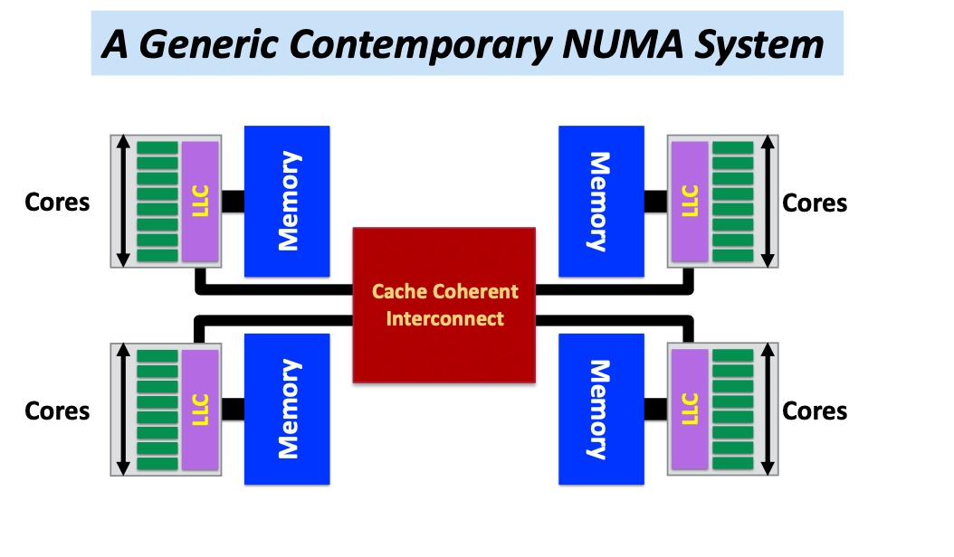
NUMA Systems
Most systems today are Non-Uniform Memory Access (NUMA)
Accessing memory in remote NUMA is slower than accessing memory in local NUMA
Accessing High Bandwidth Memory is faster than DDR
Each core may have multiple hyperthreads
Also possible on-package high bandwidth memory on the node
Diagram courtesy Ruud van der Pas

Slide 4
Process / Thread / Memory Affinity (1)
Process Affinity: also called "CPU pinning", binds processed (MPI tasks, etc.) to a CPU or a ranges of CPUs on a node
It is important to spread MPI ranks evenly onto cores in different NUMA domains
Thread Affinity: further binding threads to CPUs that are allocated to their parent process
Thread affinity should be based on achieving process affinity first
Threads forked by a certain MPI task have thread affinity binding close to the process affinity binding of their parent MPI task
Do not over schedule CPUs for threads

Slide 5
Process / Thread / Memory Affinity (2)
Memory Locality: allocate memory as close as possible to the core on which the task that requested the memory is running
Applications should use memory from local NUMA domain as much as possible
Cache Locality: reuse data in cache as much as possible
Our goal is to promote OpenMP standard settings for portability
OMP_PLACES and OMP_PROC_BIND are preferred to vendor specific settings
Correct process, thread and memory affinity is the basis for getting optimal performance. It is also essential for guiding further performance optimizations.

Slide 6
Tools to Check Compute Node Information (1)
numactl: controls NUMA policy for processes or shared memory
numactl -H: provides NUMA info of the CPUs
Haswell node example
32 cores, 2 sockets
% numactl -H
available: 2 nodes (0-1)
node 0 cpus: 0 1 2 3 4 5 6 7 8 9 10 11 12 13 14 15 32 33 34 35 36 37 38 39 40 41 42 43 44 45 46 47
node 0 size: 64430 MB
node 0 free: 63002 MB
node 1 cpus: 16 17 18 19 20 21 22 23 24 25 26 27 28 29 30 31 48 49 50 51 52 53 54 55 56 57 58 59 60 61 62 63
node 1 size: 64635 MB
node 1 free: 63395 MB
node distances:node 0 1
0: 10 21
1: 21 10
*Haswell: 16-core Intel® Xeon™ Processor E5-2698 v3 at 2.3 GHz

Slide 7
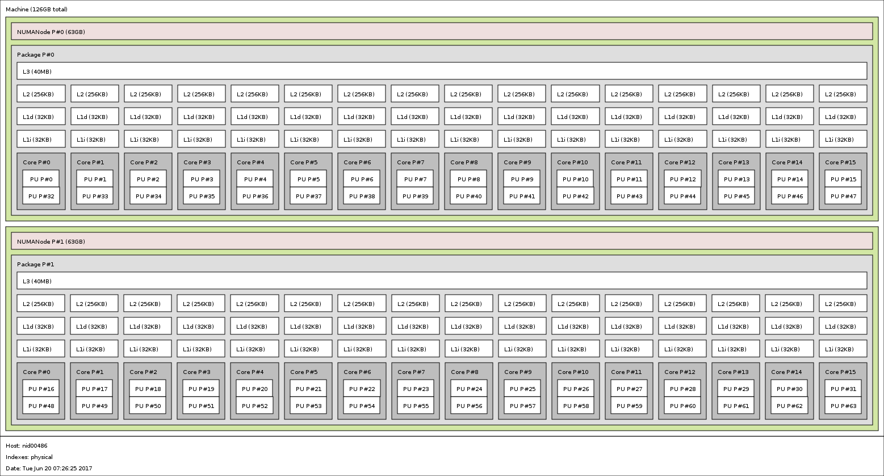
Tools to Check Compute Node Information (2)
Portable Hardware Locality (hwloc)
hwloc-ls and lstopo: provides a text and graphical representation of the system topology, NUMA nodes, cache info, and the mapping of procs.
Haswell node example
32 cores, 2 sockets

Slide 8
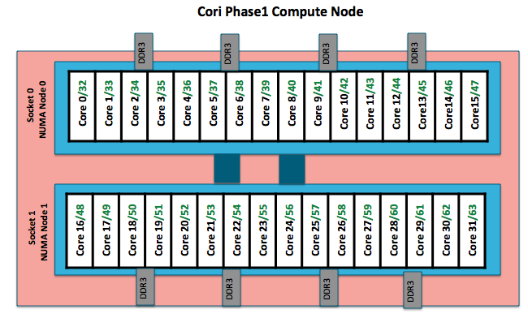
Haswell Compute Nodes Example
To obtain processor info:
Get on a compute node:
% salloc -N 1 -C …
Then:
% numactl -H
or % cat /proc/cpuinfo
or % hwloc-ls
Each Haswell node has 2 Intel Xeon 16-core Haswell processors
2 NUMA domains (sockets) per node, 16 cores per NUMA domain. 2 hardware threads per physical core.
NUMA Domain 0: physical cores 0-15 (and logical cores 32-47) NUMA Domain 1: physical cores 16-31 (and logical cores 48-63)
Memory bandwidth is non-homogeneous among NUMA domains

Slide 9
MPI Process Affinity: Selected Slurm srun Options
--cpu-bind=threads
Automatically generate masks binding tasks to threads
--cpu-bind=cores
Automatically generate masks binding tasks to cores
--cpu-bind=sockets
Automatically generate masks binding tasks to sockets
--cpu-bind=map_cpu:<cpulist>
Bind by setting CPU masks on tasks (or ranks)
--cpu-bind=map_ldom:<NUMA_domain_list>
Bind by mapping NUMA locality domain IDs to tasks
(ldom means logical domain)

Slide 10
Use numactl Command Line Tool
numactl is a Linux tool to investigate and handle NUMA
Can be used to request CPU or memory binding
Use “numactl <options> ./myapp” as the executable (instead of “./myapp”)
CPU binding example:
% numactl --cpunodebind 0,1 ./code.exe
only use cores of NUMA nodes 0 and 1
Memory binding example:
% numactl --membind 1 ./code.exe
only use memory in NUMA nodes 1, such as the MCDRAM (High Bandwidth Memory) in KNL quad,flat mode

Slide 11
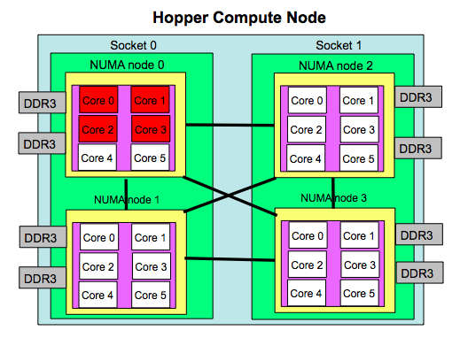
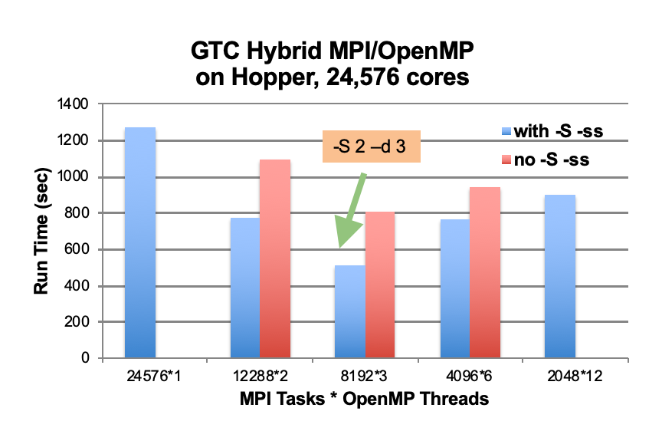
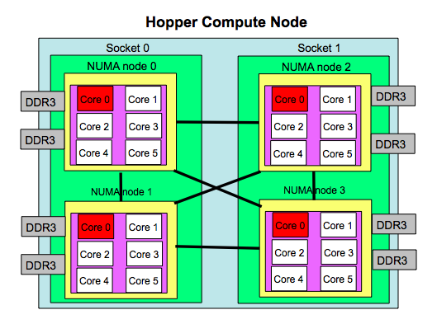
MPI Process Affinity Example: aprun “-S” Option
Important to spread MPI ranks evenly onto different NUMA nodes
Use the “-S” option: specify #MPI_tasks per NUMA domain
The example below was from an XE6 system (NERSC Hopper)
aprun –n 4 –d 6
aprun –n 4 –S 1–d 6

Slide 12
OpenMP Thread Affinity
Three main concepts:
Hardware
Abstraction
Mapping Strategy
OpenMP
Threads
OMP_PROC_BIND
Environment Variable
or
proc_bind() clause
of parallel region
OMP_NUM_THREADS
Environment Variable
or
num_threads() clause
of parallel region
OMP_PLACES
Environment Variable
(e.g. threads, cores, sockets)
Courtesy of Oscar Hernandez, ORNL

Slide 13
Runtime Environment Variable: OMP_PLACES
OMP_PLACES environment variable
controls thread allocation
defines a series of places to which the threads are assigned
It can be an abstract name or a specific list
threads: each place corresponds to a single hardware thread
cores: each place corresponds to a single core (having one or more hardware threads)
sockets: each place corresponds to a single socket (consisting of one or more cores)
a list with explicit place values of CPU ids, such as:
export OMP_PLACES=“ {0:4:2},{1:4:2}” (equivalent to “{0,2,4,6},{1,3,5,7}”)
Examples:
export OMP_PLACES=threads
export OMP_PLACES=cores

Slide 14
Runtime Environment Variable: OMP_PROC_BIND (1)
Controls thread affinity within and between OpenMP places
Allowed values:
true: the runtime will not move threads around between processors
false: the runtime may move threads around between processors
close: bind threads close to the master thread
spread: bind threads as evenly distributed (spreaded) as possible
master: bind threads to the same place as the master thread
The values master, close and spread imply the value true
Examples:
export OMP_PROC_BIND=spread
export OMP_PROC_BIND=spread,close (for nested levels)

Slide 15
Runtime Environment Variable: OMP_PROC_BIND (2)
Prototype example: 4 cores total, 2 hyperthreads per core, 4 OpenMP threads
none: no affinity setting
close: Bind threads as close to each other as possible
spread: Bind threads as far apart as possible
master: bind threads to the same place as the master thread
Node | Core 0 |  | Core 1 |  | Core 2 |  | Core 3
 | HT1 | HT2 | HT1 | HT2 | HT1 | HT2 | HT1 | HT2
Thread | 0 | 1 | 2 | 3
Node | Core 0 |  | Core 1 |  | Core 2 |  | Core 3
 | HT1 | HT2 | HT1 | HT2 | HT1 | HT2 | HT1 | HT2
Thread | 0 |  | 1 |  | 2 |  | 3

Slide 16
Affinity Clauses for OpenMP Parallel Construct
The num_threads and proc_bind clauses can be used
The values set with these clauses take precedence over values set by runtime environment variables
Helps code portability
Examples:
C/C++:
#pragma omp parallel num_threads(2) proc_bind(spread)
Fortran:
!$omp parallel num_threads (2) proc_bind (spread)
…
!$omp end parallel

Slide 17
Various Methods to Set Number of Threads
1) Use num_threads clause #pragma omp parallel num_threads (4) {
int ID = omp_get_thread_num(); pooh(ID,A); }
3) Set runtime environment
export OMP_NUM_THREDS=4 #pragma omp parallel { int ID = omp_get_thread_num(); pooh(ID,A); }
2) Call omp_set_num_threads API omp_set_num_threads(4); #pragma omp parallel { int ID = omp_get_thread_num(); pooh(ID,A); }
4) Do none of the three above.
Code will use an implementation
dependent default number of threads
defined by the compiler.
Precedence: 1) > 2) > 3) > 4)
You may get fewer threads than you requested, check with omp_get_num_threads()

Slide 18
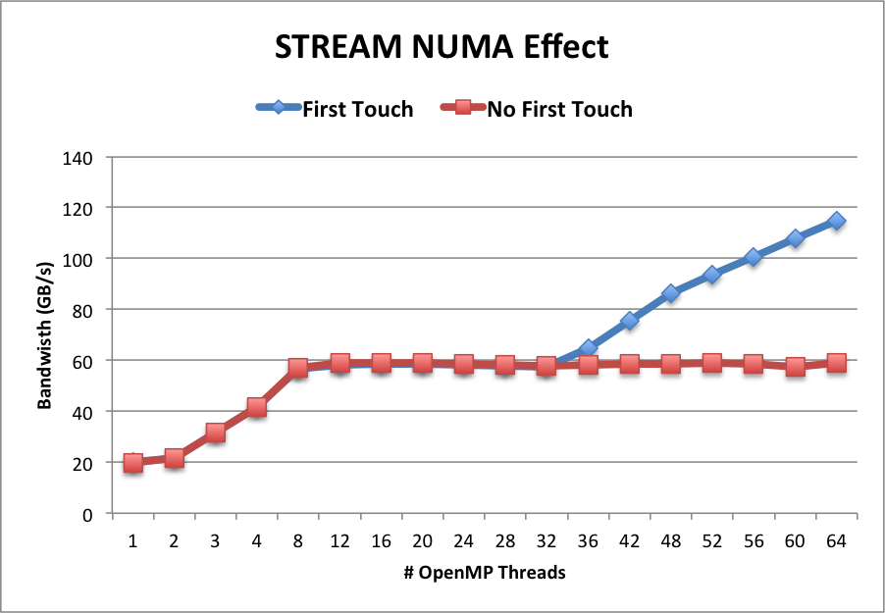
Memory Affinity: “First Touch” memory
Memory affinity is not defined when memory was allocated, instead it will be defined at initialization.
Memory will be local to the thread which initializes it. This is called first touch policy.
Hard to do “perfect touch” for real applications. General recommendation is to use number of threads fewer than number of CPUs (one or more MPI tasks) per NUMA domain.
Step 1.1 Initialization
by master thread only
for (j=0; j<VectorSize; j++) {
a[j] = 1.0; b[j] = 2.0; c[j] = 0.0;}
Step 1.2 Initialization
by all threads
#pragma omp parallel for
for (j=0; j<VectorSize; j++) {
a[j] = 1.0; b[j] = 2.0; c[j] = 0.0;}
Step 2 Compute
#pragma omp parallel for
for (j=0; j<VectorSize; j++) {
a[j]=b[j]+d*c[j];}
Red: step 1.1 + step 2. No First Touch
Blue: step 1.2 + step 2. First Touch
OMP_PROC_BIND=close

Slide 19
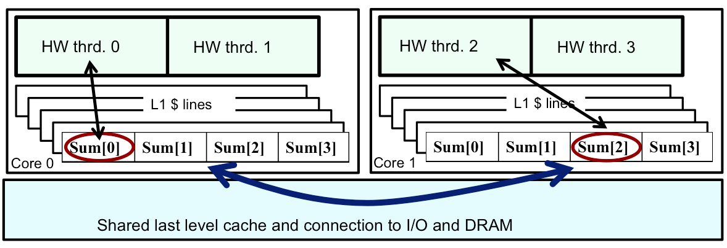
Cache Coherence and False Sharing
ccNUMA node: cache-coherence NUMA node.
Data from memory are accessed via cache lines.
Multiple threads hold local copies of the same (global) data in their caches. Cache coherence ensures the local copy to be consistent with the global data.
Main copy needs to be updated when a thread writes to local copy.
Writes to same cache line from different threads is called false sharing or cache thrashing, since it needs to be done in serial. Use atomic or critical or private variables to avoid race condition.

Slide 20
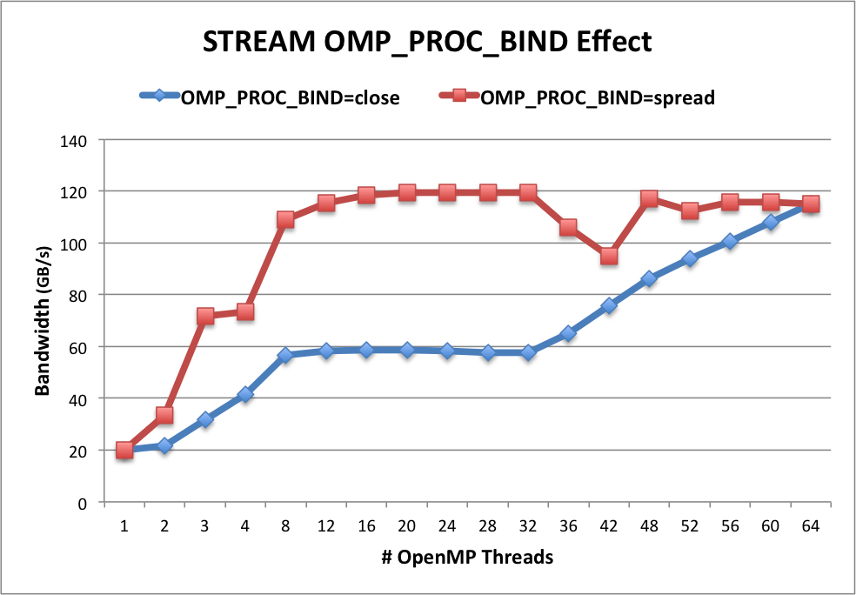
OMP_PROC_BIND Choices for STREAM Benchmark
OMP_NUM_THREADS=32
OMP_PLACES=threads
OMP_PROC_BIND=close
Threads 0 to 31 bind to CPUs 0,32,1,33,2,34,…15,47. All threads are in the first socket. The second socket is idle. Not optimal.
OMP_PROC_BIND=spread
Threads 0 to 31 bind to CPUs 0,1,2,… to 31. Both sockets and memory are used to maximize memory bandwidth.
Blue: OMP_PROC_BIND=close
Red: OMP_PROC_BIND=spread
Both with First Touch

Slide 21
Sample Nested OpenMP Program
#include <omp.h>
#include <stdio.h>
void report_num_threads(int level)
{
#pragma omp single {
printf("Level %d: number of threads in the team: %d\n", level, omp_get_num_threads());
}
}
int main()
{
omp_set_dynamic(0);
#pragma omp parallel num_threads(2) {
report_num_threads(1);
#pragma omp parallel num_threads(2) {
report_num_threads(2);
#pragma omp parallel num_threads(2) {
report_num_threads(3);
}
}
}
return(0);
}
% ./a.out
Level 1: number of threads in the team: 2
Level 2: number of threads in the team: 1
Level 3: number of threads in the team: 1
Level 2: number of threads in the team: 1
Level 3: number of threads in the team: 1
% export OMP_NESTED=true
% export OMP_MAX_ACTIVE_LEVELS=3
% ./a.out
Level 1: number of threads in the team: 2
Level 2: number of threads in the team: 2
Level 2: number of threads in the team: 2
Level 3: number of threads in the team: 2
Level 3: number of threads in the team: 2
Level 3: number of threads in the team: 2
Level 3: number of threads in the team: 2
Level 0: P0
Level 1: P0 P1
Level 2: P0 P2; P1 P3
Level 3: P0 P4; P2 P5; P1 P6; P3 P7

Slide 22
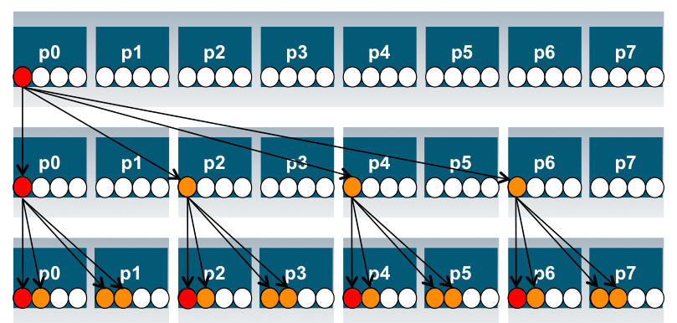
Process and Thread Affinity in Nested OpenMP
A combination of OpenMP environment variables and runtime flags are needed for different compilers and different batch schedulers on different systems
Use num_threads clause in source codes to set threads for nested regions
For most other non-nested regions, use OMP_NUM_THREADS environment variable for simplicity and flexibility
#pragma omp parallel proc_bind(spread)
#pragma omp parallel proc_bind(close)
Illustration of a system with:
2 sockets, 4 cores per socket,
4 hyper-threads per core
Example: Use Intel compiler with SLURM on Cori Haswell:
export OMP_NESTED=true
export OMP_MAX_ACTIVE_LEVELS=2
export OMP_NUM_THREADS=4,4
export OMP_PROC_BIND=spread,close
export OMP_PLACES=threads
srun -n 4 -c 16 --cpu_bind=cores ./code.exe
initial
spread
close

Slide 23
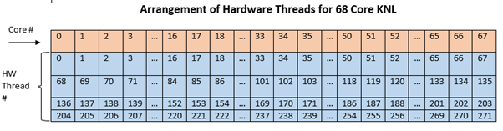
KNL Compute Nodes Example
A Cori KNL node has 68 cores/272 CPUs, 96 GB DDR memory, 16 GB high bandwidth on package memory (MCDRAM)
A quad,cache node (default setting) has only 1 NUMA node with all CPUs on the NUMA node 0 (DDR memory). MCDRAM is hidden from the “numactl -H” result since it is a cache.
A quad,flat node has only 2 NUMA nodes with all CPUs on the NUMA node 0 (DDR memory). NUMA node 1 has MCDRAM only
A snc2,flat node has 4 NUMA domains with DDR memory and all CPUs on NUMA nodes 0 and 1

Slide 24
Can We Just Do a Naive srun?
Example: 16 MPI tasks x 8 OpenMP threads per task on a single 68-core KNL quad,cache node:
% export OMP_NUM_THREADS=8
% export OMP_PROC_BIND=spread (other choice are “close”,”master”,”true”,”false”)
% export OMP_PLACES=threads (other choices are: cores, sockets, and various ways to specify explicit lists, etc.)
% srun -n 16 ./xthi |sort -k4n,6n or % mpirun –n 16 ./xthi
Hello from rank 0, thread 0, on nid02304. (core affinity = 0)
Hello from rank 0, thread 1, on nid02304. (core affinity = 144) (on physical core 8)
Hello from rank 0, thread 2, on nid02304. (core affinity = 17)
Hello from rank 0, thread 3, on nid02304. (core affinity = 161) (on physical core 25)
…
Hello from rank 1, thread 0, on nid02304. (core affinity = 0)
Hello from rank 1, thread 1, on nid02304. (core affinity = 144)
It is a mess! e.g., thread 0 for rank 0, and thread 1 for rank 1 are on same physical core 0

Slide 25
Example mpirun or srun Commands: Fix the Problem
The reason is #MPI tasks is not divisible by 68!
Each MPI task is getting 68x4/#MPI tasks of logical cores as the domain size
MPI tasks are crossing tile boundaries
Let’s set number of logical cores per MPI task manually by wasting extra 4 cores on purpose, which is 256/#MPI tasks
Cray MPICH with Aries network using native SLURM
% srun -n 16 -c 16 --cpu_bind=cores ./code.exe
Notes: Here the value for -c is also set to number of logical cores per MPI task, i.e., 256/#MPI tasks.
Intel MPI with Omni Path using mpirun:
% export I_MPI_PIN_DOMAIN=16
% mpirun -n 16 ./code.exe

Slide 26
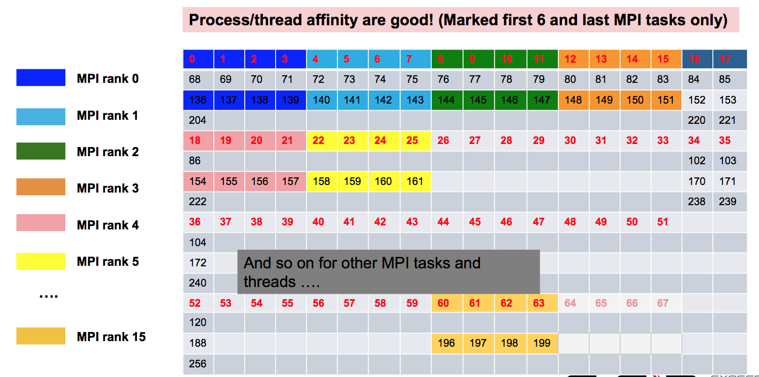
Now It Looks Good!

Slide 27
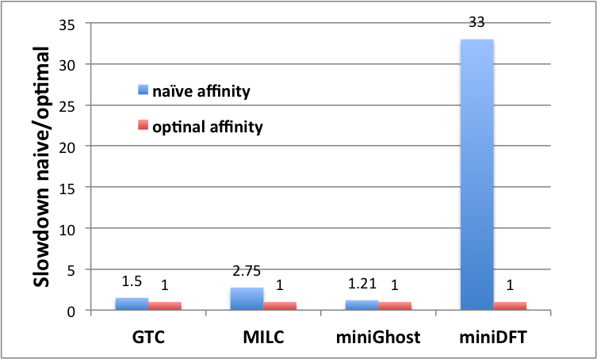
Naïve vs. Optimal Affinity
Application Benchmark Performance on Cori

Slide 28
OpenMP task-to-data Affinity (in OpenMP 5.0)
Affinity hints can be provided for OpenMP tasks, resulting data to be closer to tasks
Useful for multi-socket systems
void task_affinity() {
double* B;
#pragma omp task shared(B) affinity(A[0:N])
B = init_B_and_important_computation(A);
#pragma omp task firstprivate(B) affinity(B[0:N])
important_computation_too(B);
#pragma omp taskwait
}

Slide 29
Affinity Verification Methods
NERSC provides pre-built binaries from a Cray code (xthi.c) to display process thread affinity
% srun -n 32 -c 8 --cpu-bind=cores check-mpi.intel.cori | sort -nk 4
Hello from rank 0, on nid02305. (core affinity = 0,1,68,69,136,137,204,205)
Hello from rank 1, on nid02305. (core affinity = 2,3,70,71,138,139,206,207)
Use portable OpenMP environment variables OMP_DISPLAY_AFFINITY and OMP_AFFINITY_FORMAT (in OpenMP 5.0)
Automatically displays affinity info when OMP_DISPLAY_AFFINITY=true
Can set custom OMP_DISPLAY_AFFINITY_FORMAT
Also has runtime APIs such as omp_display_affinity and omp_capture_affinity

Slide 30
OMP_AFFINITY_FORMAT Fields
Short Name | Long name | Meaning
L | thread_level | from omp_get_level()
n | thread_num | from omp_get_thread_num()
a | thread_affinity | the numerical identifiers of the processors the current thread is binding to, in the format of a comma separated list of OpenMP thread places
h | host | host or node name
p | process_id | process id used by the implementation (such as the process id for the MPI process)
N | num_threads | from omp_get_num_threads()
A | ancestor_tnum | from omp_get_ancestor_thread_num(). One level up only.
% export OMP_DISPLAY_AFFINITY=true
% export OMP_AFFINITY_FORMAT="host=%h, pid=%p, thread_num=%n, thread affinity=%a”
host=nid02496, pid=150147, thread_num=0, thread affinity=0
host=nid02496, pid=150147, thread_num=1, thread affinity=4
% export OMP_AFFINITY_FORMAT="Thread Affinity: %0.3L %.10n %.20{thread_affinity} %.15h”
Thread Affinity: 001 0 0-1,16-17 nid003
Thread Affinity: 001 1 2-3,18-19 nid003

Slide 31
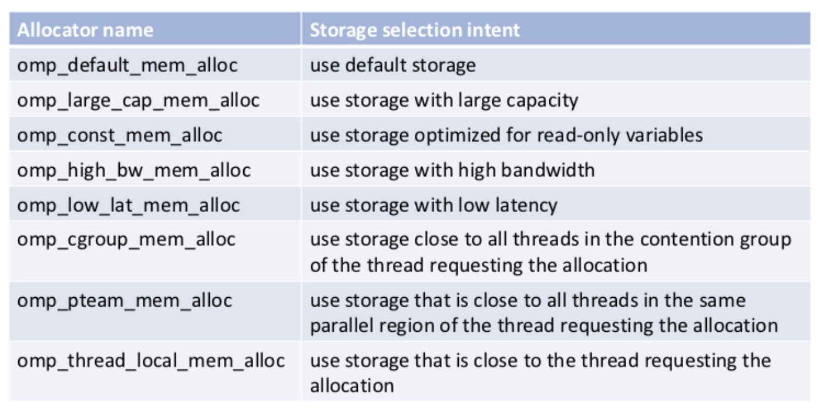
Memory Allocators (in OpenMP 5.0)
Support versatile types of memory available on current and future systems: DDR, High-Bandwidth Memory (HBM), non-volatile memory, constant memory
Memory allocators define types of memory that variables can be allocated to, such as large capacity, low latency, cgroup, thread local, etc.
‹#›
Notes:
HH note: mention LBL requested this feature. TR5 complicated. TR7 (as in OpenMP5.0) much simpler

Slide 32
Using Memory Allocators
void allocator_example(omp_allocator_t *my_allocator) {
int a[M], b[N];
#pragma omp allocate(a) allocator(omp_high_bw_mem_alloc)
#pragma omp allocate(b) // use default OMP_ALLOCATOR
double *p = (double *) omp_alloc(N*M*sizeof(*p), my_allocator);
#pragma omp parallel private(a) allocate(omp_low_lat_mem_alloc:a)
{
some_parallel_code();
}
omp_free(p);
}
‹#›
Notes:
HH note: mention LBL requested this feature. TR5 complicated. TR7 (as in OpenMP5.0) much simpler

Slide 33
Process and Thread Affinity Best Practices
Achieving best data locality, and optimal process and thread affinity is crucial in getting good performance with MPI/OpenMP, yet it is not straightforward to do so
Understand the node architecture with tools such as “numactl -H” first
Set correct cpu-bind and OMP_PLACES options
Always use simple examples with the same settings for your real application to verify affinity first or check with OMP_DISPLAY_AFFINITY
Optimize code for memory affinity
Avoid false sharing
Exploit first touch data policy, or use at least 1 MPI task per NUMA domain
Compare performance with put threads close or far apart (spread)
Use omp_allocator
Use numactl -m option to explicitly request memory allocation in specific NUMA domain

Slide 34
Thank You

