Slide 1
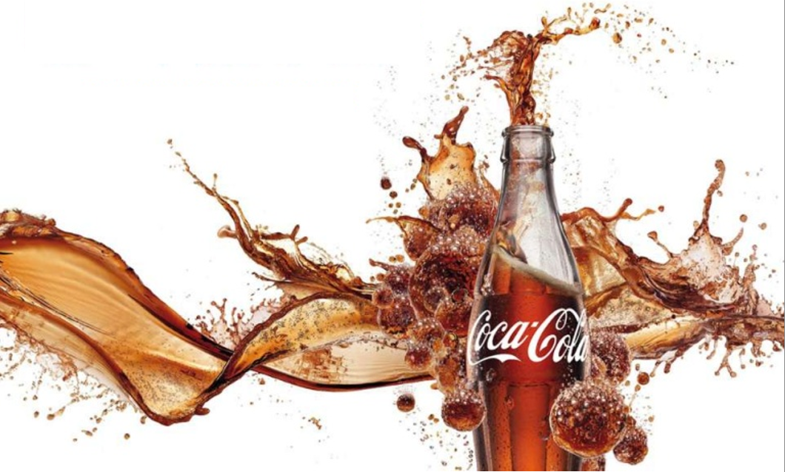
Coke Marketing Experiment
Through A/B/C Test
-- Will Label/Package Influence People’s Judgement?
Helen Xiaoqin Yi
Dinesh Hemnani
Sabnam Pandey

Slide 2

Agenda
Overview
Experimental Design
Execution
Analysis
Results
Key Takeaways
Acknowledgement

Slide 3
Overview
Business Question
Does visual manipulations influence people’s judgement?
Treatment
A/B/C tests
Setting
Field test. On the side walk next to Drexel Dragon
Response measure
Their ability to correctly identify Coca-Cola with wrong label and no label
Unit of Analysis
Each group of person who take the test
Subjects
90 people on the street
Assignment
Random

Slide 4
Project Gantt Chart
In order to make sure our project be on time, on budge and with good quality, we made Gantt Chart with Responsibility Matrix and Milestone to make sure every member knows what should he/she do at certain time.

Slide 5
Execution
This is the time line for each step of conducting experiment and analysis. Everybody read this time line again before starting experiment.
Step 1
Step 3
Step 5
Setup a table next to Drexel Dragon
Hand out survey sheet and soda sample
Create a spreadsheet of data collected
Ask every passerby if they would like to participate
Keep track of time and change groups accordingly
Run data through R and analyze the results
Step 2
Step 4
Step 6
$
Thursday
14:00 to 17:00
6.60

Slide 6
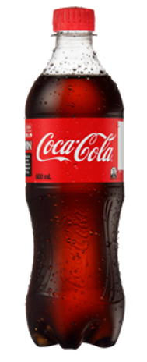

Experimental Design
Group 1
Group 2
Group 3
Coca Cola in Pepsi’s Bottle
Coca Cola in Bottle w/o Label
Coca Cola in Original Bottle
Details that are critical for designing a relatively unbiased experiment:
All test givers received training before conduction of the Test and should not release unnecessary information that will influence the judgement of test receivers
Tests were conducted within on day
Changed group for every 15 minutes
We hided the other 2 cokes in the box under the table, so nobody can see it
All test receivers were found on street randomly
No discussion when receiving the test

Slide 7
Design Specifications
Assumption
40% Correctly identify Coke’s Brand
Desired width: 30% of difference
Desired Power 85% with Confidence Level 90%
Sample Size Planning

Slide 8
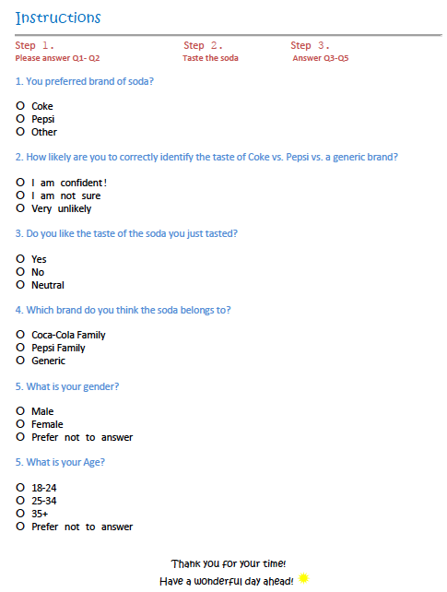
Survey Sheet

Slide 9
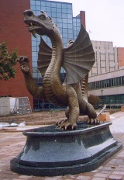



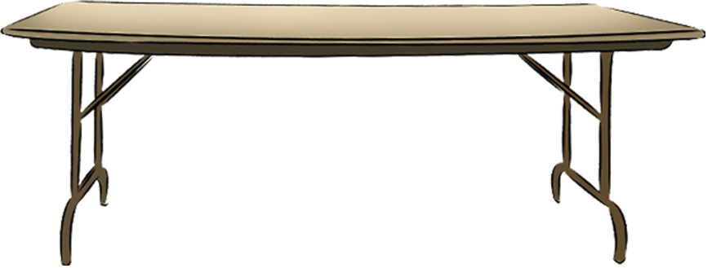
Survey Process
1. You preferred brand of soda?
Coke
Pepsi
Other
3. Do you like the soda you tasted?
Yes
No
Neutral
2. How likely are you to correctly identify the taste of Coke vs. Pepsi vs. a generic brand?
I am confident
I am not sure
Very unlikely
4. Which brand do you think the soda belongs to?
Coca-Cola Family
Pepsi Family
Generic
Taste Coke
DUDE, WANT A FREE COKE?
5. What is your gender?
Male
Female
Prefer not to answer
6. What is your Age?
18-24
25-34
35+
Prefer not to answer

Slide 10

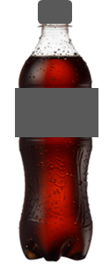
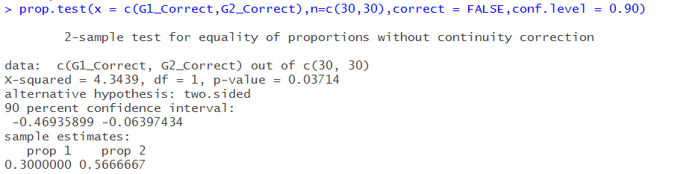
Frequency Table and T-Test
From T-Test result, only group 1 and group 2 are significantly different.

Slide 11
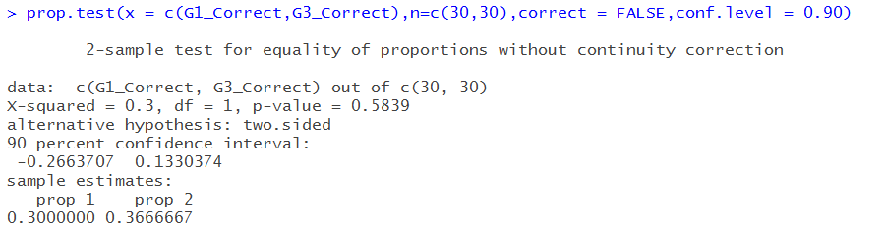
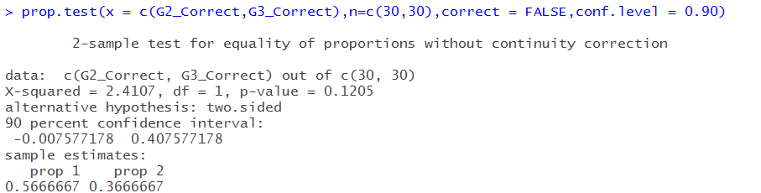
T-Test

Slide 12
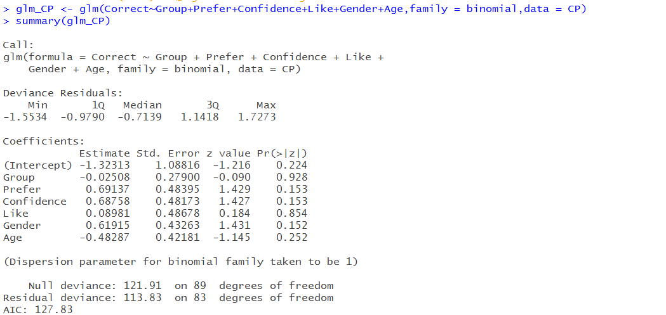
Logistic Regression
We tried to run Logistic Regression to exploit if there is any factors significant for the result. Unfortunately, none of the factors is significant.

Slide 13
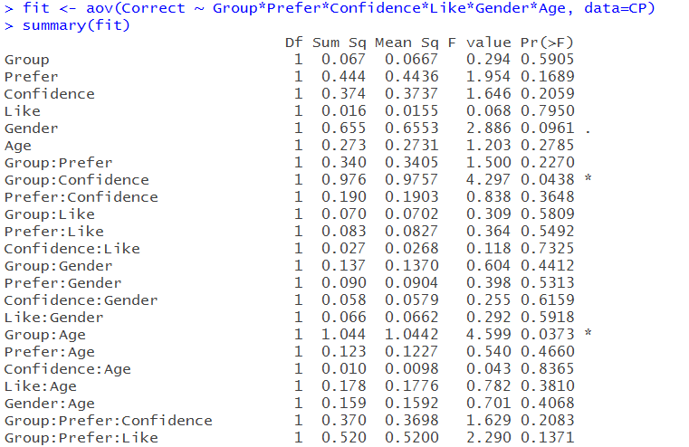
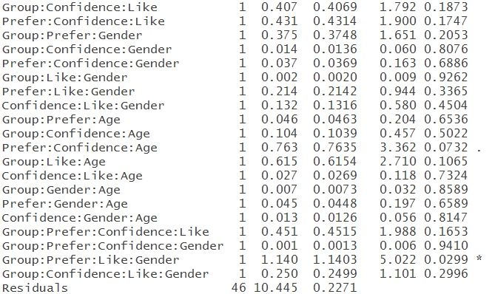


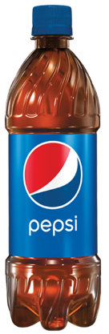
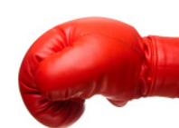
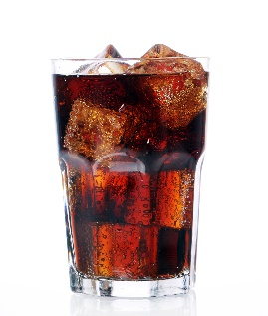

ANOVA
We found some groups of interaction that are significant for the output
Group*Confidence
Group*Age
Group*Confidence*Like*Gender

Slide 14
Results
From all analysis above, we conclude: it’s more likely for people to correctly identify Coke’s brand without the influences of any outside factors.
Unless you already know the correct answer, think independently that you are more likely to find the truth.

Slide 15
Key Takeaways
Experiment might lack strong external validity.
Because the limitation of time, samples, test takers and budge, it doesn’t have very strong predictive indications.

Slide 16
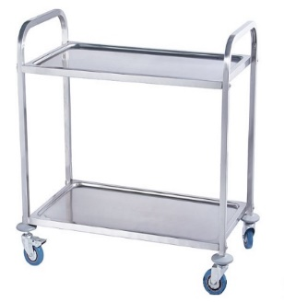

Special Acknowledgement
Appreciate Prof. Eleanor Feit for her lectures and guidance. You added an important tool in our toolbox for our future career/research.
We would like to thank Ms. Lori Miceli’s sponsorship for lending us a trolley on the test day, so that we didn’t have to put drinks and questionnaires on ground.
We would also appreciate all people who were willing to risk their lives to receive the tests, although your parents always tell you “Don’t take the food/drink from strangers”.

Slide 17
Questions?

