Slide 1

Dinesh Hemnani Helen Xiaoqin Yi
Rebalancing Indego Bike Share Stations

Slide 2
Why Important?
Missing link between public transportation systems
Keeping the user healthy and reducing the environmental pollution
Keeping the bike sharing system optimized is necessary to keep it running smoothly

Slide 3
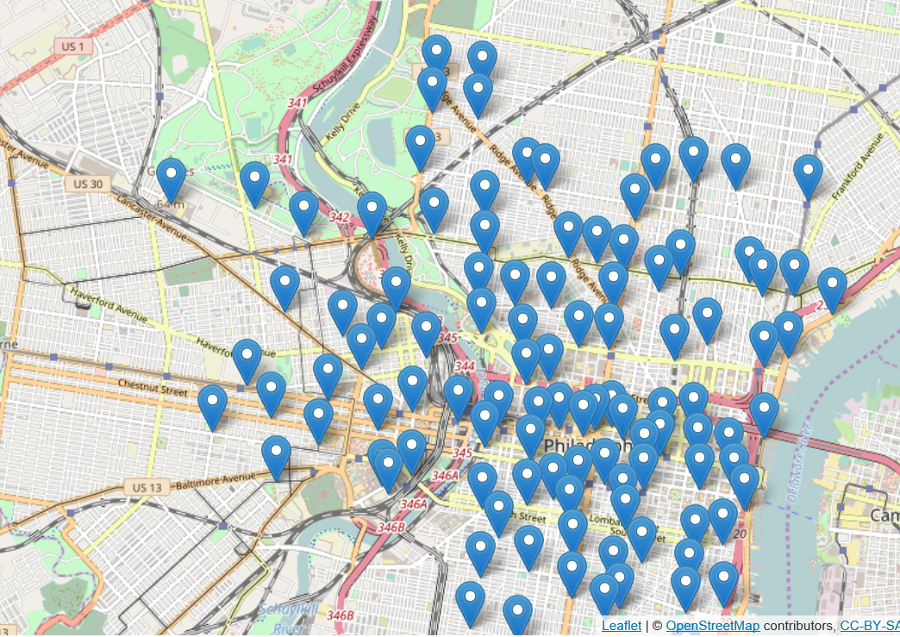
Station Distribution

Slide 4
City of Philadelphia's Indego Bike Share Program
Situation
105 Stations
Over 900 Bikes
Over 2000 Docks
Goal
Minimum possible distance to be covered by a balancing truck to balance all stations

Slide 5
City of Philadelphia's Indego Bike Share Program
Features
Real-Time Optimization
Distance based on Google Map
Highly Automatic
Plot on Map – Easy to Visualize
Limitation
Google Map API Limitation on Daily Value Volume*
*Can be fixed if you buy premium service

Slide 6
