Slide 1
Author: Horstmann Title: Big Java Late Objects
“This material is reproduced with permission of John Wiley & Sons, Inc.”).

Slide 2

5
CHAPTER
METHODS
Slides by Donald W. Smith
TechNeTrain.com
Final Draft
10/29/2011

Slide 3
Chapter Goals
To be able to implement methods
To become familiar with the concept of parameter passing
To develop strategies for decomposing complex tasks into simpler ones
To be able to determine the scope of a variable
To learn how to think recursively (optional)
In this chapter, you will learn how to design and implement your own methods. Using the process of stepwise refinement, you will be able to break up complex tasks into sets of cooperating methods.

Slide 4

Contents
Methods as Black Boxes
Implementing Methods
Parameter Passing
Return Values
Methods without Return Values
Problem Solving:
Reusable Methods
Stepwise Refinement
Variable Scope
Recursive Methods (optional)

Slide 5
5.1 Methods as Black Boxes
A method is a sequence of instructions with a name
You declare a method by defining a named block of code
You call a method in order to execute its instructions
public static void main(String[] args)
{
double result = Math.pow(2, 3);
. . .
}
A method packages a computation consisting of multiple steps into a form that can be easily understood and reused.

Slide 6
What is a method?
Some methods you have already used are:
Math.pow()
String.length()
Character.isDigit()
Scanner.nextInt()
main()
They have:
May have a capitalized name and a dot (.) before them
A method name
Follow the same rules as variable names, camelHump style
( ) - a set of parenthesis at the end
A place to provide the method input information

Slide 7
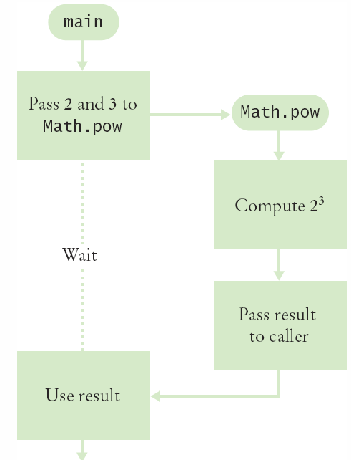
Flowchart of Calling a Method
public static void main(String[] args)
{
double result = Math.pow(2, 3);
. . .
}
One method ‘calls’ another
main calls Math.pow()
Passes two arguments
2 and 3
Math.pow starts
Uses variables (2, 3)
Does its job
Returns the answer
main uses result

Slide 8
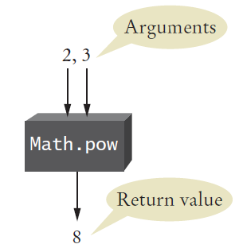
Arguments and Return Values
public static void main(String[] args)
{
double result = Math.pow(2,3);
. . .
}
main ‘passes’ two arguments (2 and 3) to Math.pow
Math.pow calculates and returns a value of 8 to main
main stores the return value to variable ‘result’

Slide 9
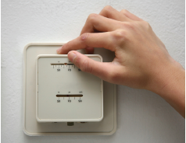
Black Box Analogy
A thermostat is a ‘black box’
Set a desired temperature
Turns on heater/AC as required
You don’t have to know how it really works!
How does it know the current temp?
What signals/commands does it send to the heater or A/C?
Use methods like ‘black boxes’
Pass the method what it needs to do its job
Receive the answer

Slide 10
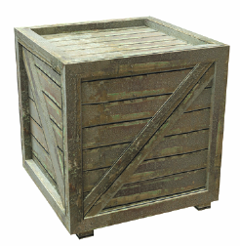
5.2 Implementing Methods
A method to calculate the volume of a cube
What does it need to do its job?
What does it answer with?
When writing this method:
Pick a name for the method (cubeVolume).
Declare a variable for each incoming argument
(double sideLength) (called parameter variables)
Specify the type of the return value ( double )
Add modifiers such as public static
(see Chapter 8)
When declaring a method, you provide a name for the method, a variable for each argument, and a type for the result
public static double cubeVolume(double sideLength)

Slide 11
Inside the Box
Then write the body of the method
The body is surrounded by curly braces { }
The body contains the variable declarations and statements that are executed when the method is called
It will also return the calculated answer
public static double cubeVolume(double sideLength)
{
double volume = sideLength * sideLength * sideLength;
return volume;
}

Slide 12
Back from the Box
The values returned from cubeVolume are stored in local variables inside main
The results are then printed out
public static void main(String[] args)
{
double result1 = cubeVolume(2);
double result2 = cubeVolume(10);
System.out.println("A cube of side length 2 has volume
" + result1);
System.out.println("A cube of side length 10 has volume
" + result2);
}

Slide 13
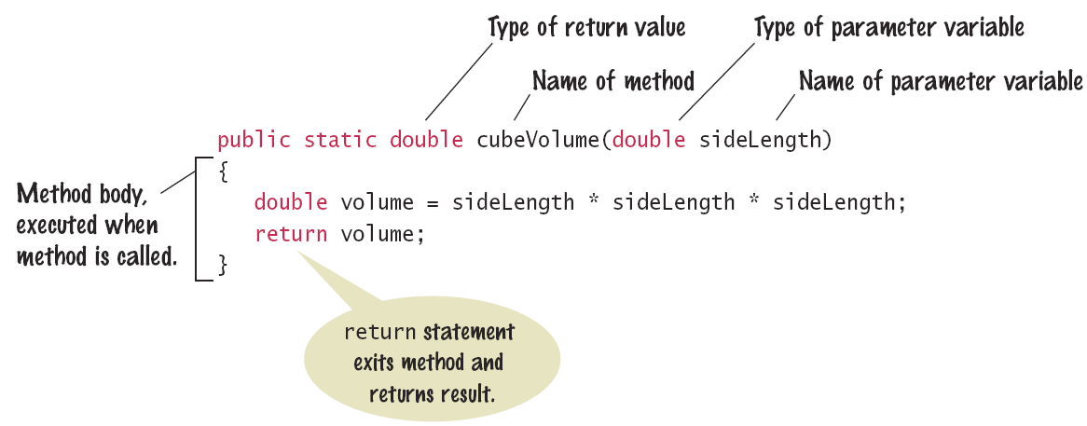
Syntax 5.1: Method Declaration

Slide 14
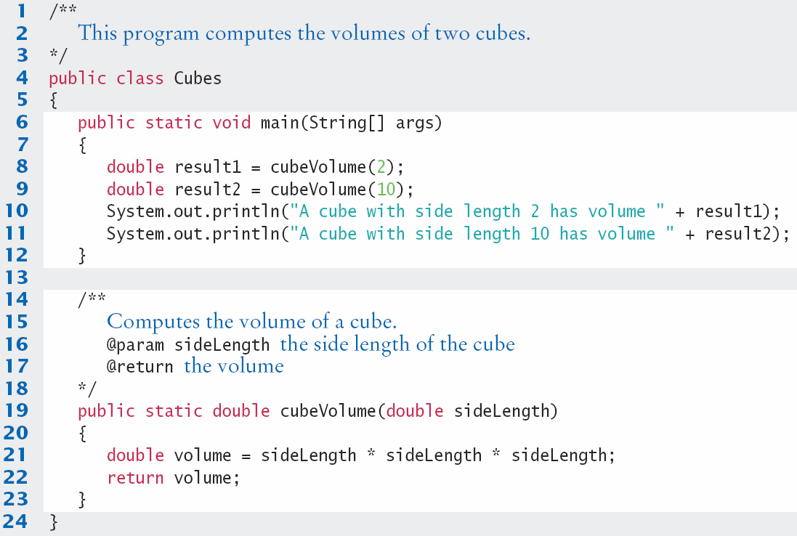
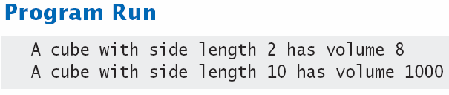
Cubes.java

Slide 15

Method Comments
Write a Javadoc comment above each method
Start with /**
Note the purpose of the method
@param Describe each parameter variable
@return Describe the return value
End with */
/**
Computes the volume of a cube.
@param sideLength the side length of the cube
@return the volume
*/
public static double cubeVolume(double sideLength)

Slide 16
5.3 Parameter Passing
Parameter variables receive the argument values supplied in the method call
They both must be the same type
The argument value may be:
The contents of a variable
A ‘literal’ value (2)
aka. ‘actual parameter’ or argument
The parameter variable is:
Declared in the called method
Initialized with the value of the argument value
Used as a variable inside the called method
aka. ‘formal parameter’
Calling Method
out
Argument value
Parameter variable
in
Called Method

Slide 17




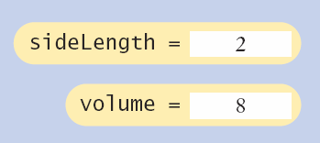
Parameter Passing Steps
public static void main(String[] args)
{
double result1 = cubeVolume(2);
. . .
}
public static double cubeVolume(double sideLength)
{
double volume = sideLength * sideLength * sideLength;
return volume;
}

Slide 18

Common Error 5.1
Trying to Modify Arguments
A copy of the argument values is passed
Called method (addTax) can modify local copy (price)
But not original
in calling method
total
public static void main(String[] args)
{
double total = 10;
addTax(total, 7.5);
}
total
10.0
copy
public static int addTax(double price, double rate)
{
double tax = price * rate / 100;
price = price + tax; // Has no effect outside the method
return tax;
}
price
10.75

Slide 19
5.4 Return Values
Methods can (optionally) return one value
Declare a return type in the method declaration
Add a return statement that returns a value
A return statement does two things:
Immediately terminates the method
Passes the return value back to the calling method
return type
public static double cubeVolume (double sideLength)
{
double volume = sideLength * sideLength * sideLength;
return volume;
}
The return value may be a value, a variable or a calculation
Type must match return type
return statement

Slide 20
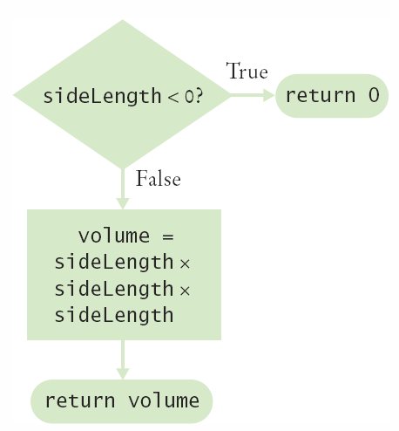
Multiple return Statements
A method can use multiple return statements
But every branch must have a return statement
public static double cubeVolume(double sideLength)
{
if (sideLength < 0)
{
return 0;
}
return sideLength * sideLength * sideLength;
}

Slide 21
Common Error 5.2
Missing return Statement
Make sure all conditions are handled
In this case, x could be equal to 0
No return statement for this condition
The compiler will complain if any branch has no return statement
public static int sign(double x)
{
if (x < 0) { return -1; }
if (x > 0) { return 1; }
// Error: missing return value if x equals 0
}

Slide 22
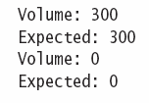
Implementing a Method: Steps
Describe what the method should do.
Determine the method’s “inputs”.
Determine the types of parameter values and the return value.
Write pseudocode for obtaining the desired result.
Implement the method body.
Test your method.
Design test cases and code
public static double pyramidVolume(double height, double baseLength)
{
double baseArea = baseLength * baseLength;
return height * baseArea / 3;
}

Slide 23

5.5 Methods without Return Values
Methods are not required to return a value
The return type of void means nothing is returned
No return statement is required
The method can generate output though!
...
boxString(“Hello”);
...
public static void boxString(String str)
{
int n = str.length();
for (int i = 0; i < n + 2; i++)
{ System.out.print("-"); }
System.out.println();
System.out.println("!" + str + "!");
for (int i = 0; i < n + 2; i++)
{ System.out.print("-"); }
System.out.println();
}

Slide 24
Using return Without a Value
You can use the return statement without a value
In methods with void return type
The method will terminate immediately!
public static void boxString(String str)
{
int n = str.length();
if (n == 0)
{
return; // Return immediately
}
for (int i = 0; i < n + 2; i++) { System.out.print("-"); }
System.out.println();
System.out.println("!" + str + "!");
for (int i = 0; i < n + 2; i++) { System.out.print("-"); }
System.out.println();
}

Slide 25
5.6 Problem Solving: Reusable Methods
Find Repetitive Code
May have different values but same logic
int hours;
do
{
System.out.print("Enter a value between 1 and 12: ");
hours = in.nextInt();
}
while (hours < 1 || hours > 12);
int minutes;
do
{
System.out.print("Enter a value between 0 and 59: ");
minutes = in.nextInt();
}
while (minutes < 0 || minutes > 59);
1 - 12
0 - 59

Slide 26
Write a ‘Parameterized’ Method
/**
Prompts a user to enter a value in a given range until the user
provides a valid input.
@param low the low end of the range
@param high the high end of the range
@return the value provided by the user
*/
public static int readValueBetween(int low, int high)
{
int input;
do
{
System.out.print("Enter between " + low + " and " + high + ": ");
Scanner in = new Scanner(System.in);
input = in.nextInt();
}
while (input < low || input > high);
return input;
}
1, 12
0, 59
8

Slide 27
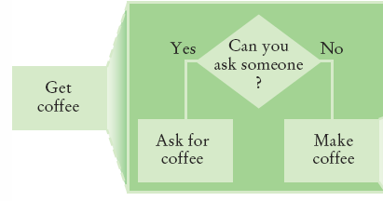
5.7 Problem Solving
Stepwise Refinement
To solve a difficult task, break it down into simpler tasks
Then keep breaking down the simpler tasks into even simpler ones, until you are left with tasks that you know how to solve

Slide 28
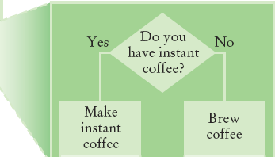
Get Coffee
If you must make coffee, there are two ways:
Make Instant Coffee
Brew Coffee

Slide 29
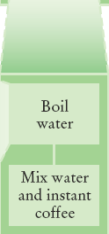
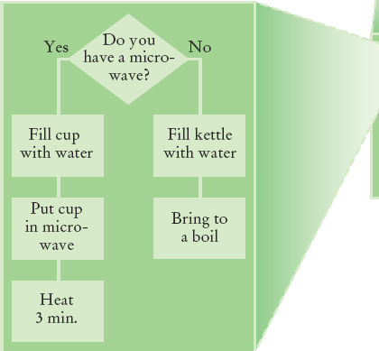
Instant Coffee
Two ways to boil water
1) Use Microwave
2) Use Kettle on Stove

Slide 30
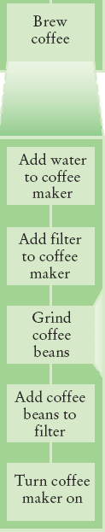
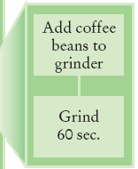
Brew Coffee
Assumes coffee maker
Add water
Add filter
Grind Coffee
Add beans to grinder
Grind 60 seconds
Fill filter with ground coffee
Turn coffee maker on
Steps are easily done

Slide 31
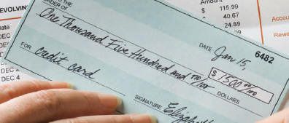
Stepwise Refinement Example
When printing a check, it is customary to write the check amount both as a number (“$274.15”) and as a text string (“two hundred seventy four dollars and 15 cents”). Write a program to turn a number into a text string.
Wow, sounds difficult!
Break it down
Let’s take the dollar part (274) and come up with a plan
Take an Integer from 0 – 999
Return a String
Still pretty hard…

Slide 32
Stepwise Refinement Example
Take it digit by digit (2, 7, 4) – left to right
Handle the first digit (hundreds)
If empty, we’re done with hundreds
Get first digit (Integer from 1 – 9)
Get digit name (“one”, “two ”, “three”…)
Add the word “ hundred”
Sounds easy!
Second digit (tens)
Get second digit (Integer from 0 – 9)
If 0, we are done with tens… handle third digit
If 1, … may be eleven, twelve.. Teens… Not easy!
Let’s look at each possibility left (1x-9x)…

Slide 33
Stepwise Refinement Example
If second digit is a 0
Get third digit (Integer from 0 – 9)
Get digit name (“”, “one”, “two”…) … Same as before?
Sounds easy!
If second digit is a 1
Get third digit (Integer from 0 – 9)
Return a String (“ten”, “eleven”, “twelve”…)
If second digit is a 2-9
Start with string “twenty”, “thirty”, “forty”…
Get third digit (Integer from 0 – 9)
Get digit name (“”, “one”, “two”…) … Same as before
Sounds easy!

Slide 34
Name the Sub-Tasks
digitName
Takes an Integer from 0 – 9
Return a String (“”, “one”, “two”…)
tensName (second digit >= 20)
Takes an Integer from 0 – 9
Return a String (“twenty”, “thirty”…) plus
digitName(third digit)
teenName
Takes an Integer from 0 – 9
Return a String (“ten”, “eleven”…)

Slide 35
Write Pseudocode
part = number (The part that still needs to be converted)
name = "" (The name of the number)
If part >= 100
name = name of hundreds in part + " hundred"
Remove hundreds from part.
If part >= 20
Append tensName(part) to name.
Remove tens from part.
Else if part >= 10
Append teenName(part) to name.
part = 0
If (part > 0)
Append digitName(part) to name.
Identify methods that we can use (or re-use!) to do the work.

Slide 36
Plan The Methods
Decide on name, parameter(s) and types and return type
String digitName (int number)
Return a String (“”, “one”, “two”…)
String tensName (int number)
Return a String (“twenty”, “thirty”…) plus
Return from digitName(thirdDigit)
String teenName (int number)
Return a String (“ten”, “eleven”…)

Slide 37
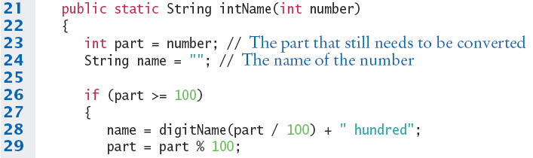
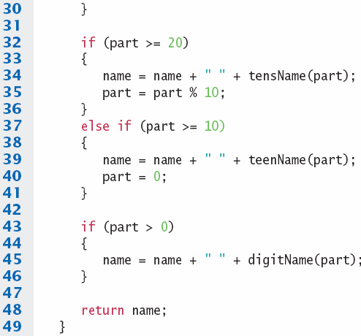
Convert to Java: intName method
main calls intName
Does all the work
Returns a String
Uses methods:
tensName
teenName
digitName

Slide 38
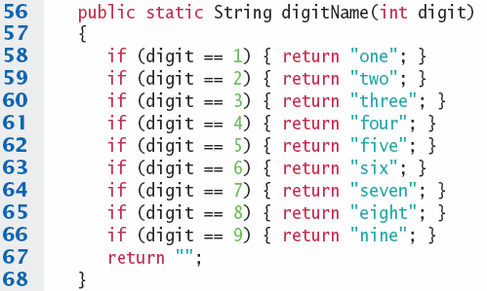
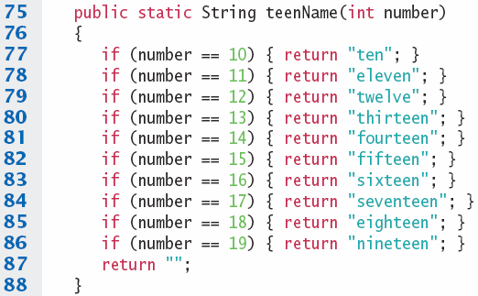
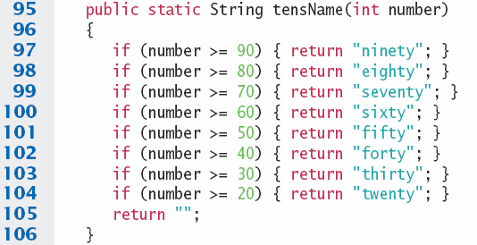

digitName, teenName, tensName

Slide 39
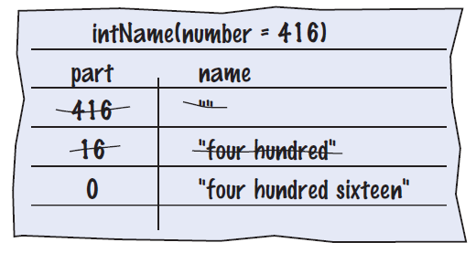

Programming Tips
Keep methods short
If more than one screen, break into ‘sub’ methods
Trace your methods
One line for each step
Columns for key variables
Use Stubs as you write larger programs
Unfinished methods that return a ‘dummy’ value
public static String digitName(int digit)
{
return "mumble";
}

Slide 40
5.8 Variable Scope
The scope of a variable is the part of the program in which
it is visible.
Variables can be declared:
Inside a method
Known as ‘local variables’
Only available inside this method
Parameter variables are like local variables
Inside a block of code { }
Sometimes called ‘block scope’
If declared inside block { ends at end of block }
Outside of a method
Sometimes called ‘global scope’
Can be used (and changed) by code in any method
How do you choose?

Slide 41
Examples of Scope
sum is a local variable in main
square is only visible inside the for loop block
i is only visible inside the for loop
public static void main(String[] args)
{
int sum = 0;
for (int i = 1; i <= 10; i++)
{
int square = i * i;
sum = sum + square;
}
System.out.println(sum);
}
sum
i
square
The scope of a variable is the part of the program in which
it is visible.

Slide 42
Local Variables of Methods
Variables declared inside one method are not visible to other methods
sideLength is local to main
Using it outside main will cause a compiler error
public static void main(String[] args)
{
double sideLength = 10;
int result = cubeVolume();
System.out.println(result);
}
public static double cubeVolume()
{
return sideLength * sideLength * sideLength; // ERROR
}

Slide 43
Re-using names for local variables
Variables declared inside one method are not visible to other methods
result is local to square and result is local to main
They are two different variables and do not overlap
public static int square(int n)
{
int result = n * n;
return result;
}
public static void main(String[] args)
{
int result = square(3) + square(4);
System.out.println(result);
}
result
result

Slide 44
Re-using names for block variables
Variables declared inside one block are not visible to other methods
i is inside the first for block and i is inside the second
They are two different variables and do not overlap
public static void main(String[] args)
{
int sum = 0;
for (int i = 1; i <= 10; i++)
{
sum = sum + i;
}
for (int i = 1; i <= 10; i++)
{
sum = sum + i * i;
}
System.out.println(sum);
}
i
i

Slide 45
Overlapping Scope
Variables (including parameter variables) must have unique names within their scope
n has local scope and n is in a block inside that scope
The compiler will complain when the block scope n is declared
public static int sumOfSquares(int n)
{
int sum = 0;
for (int i = 1; i <= n; i++)
{
int n = i * i; // ERROR
sum = sum + n;
}
return sum;
}
Local n
block scope n

Slide 46
Global and Local Overlapping
Global and Local (method) variables can overlap
The local same will be used when it is in scope
No access to global same when local same is in scope
public class Scoper
{
public static int same; // ‘global’
public static void main(String[] args)
{
int same = 0; // local
for (int i = 1; i <= 10; i++)
{
int square = i * i;
same = same + square;
}
System.out.println(same);
}
}
same
same
Variables in different scopes with
the same name will compile, but
it is not a good idea

Slide 47
5.9 Recursive Methods (optional)
A recursive method is a method that calls itself
A recursive computation solves a problem by using the solution of the same problem with simpler inputs
For a recursion to terminate, there must be special cases for the simplest inputs

Slide 48
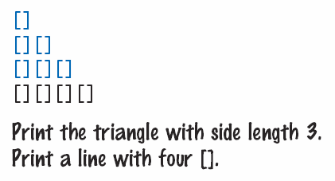
Recursive Triangle Example
public static void printTriangle(int sideLength)
{
if (sideLength < 1) { return; }
printTriangle(sideLength - 1);
for (int i = 0; i < sideLength; i++)
{
System.out.print("[]");
}
System.out.println();
}
Special Case
Recursive Call
The method will call itself (and not output anything) until sideLength becomes < 1
It will then use the return statement and each of the previous iterations will print their results
1, 2, 3 then 4

Slide 49
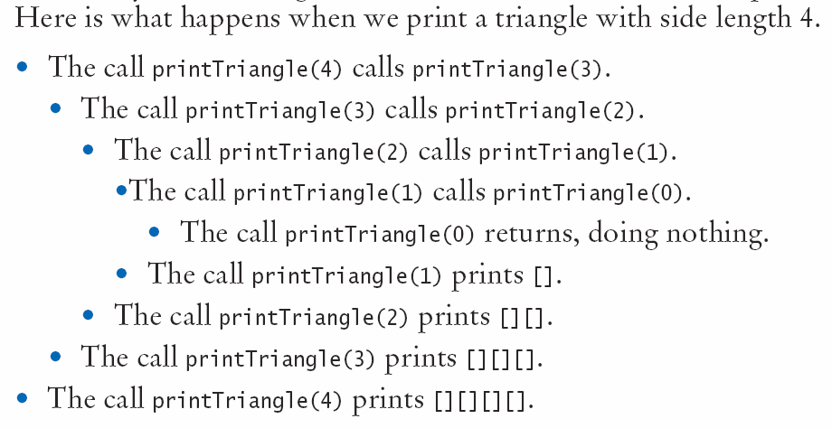
Recursive Calls and Returns

Slide 50
Summary: Methods
A method is a named sequence of instructions.
Arguments are supplied when a method is called. The return value is the result that the method computes.
When declaring a method, you provide a name for the method, a variable for each argument, and a type for the result.
Method comments explain the purpose of the method, the meaning of the parameters and return value, as well as any special requirements.
Parameter variables hold the arguments supplied in the method call.

Slide 51
Summary: Method Returns
The return statement terminates a method call and yields the method result.
Turn computations that can be reused into methods.
Use a return type of void to indicate that a method does not return a value.
Use the process of stepwise refinement to decompose complex tasks into simpler ones.
When you discover that you need a method, write a description of the parameter variables and return values.
A method may require simpler methods to carry out its work.

Slide 52
Summary: Scope
The scope of a variable is the part of the program in which it is visible.
Two local or parameter variables can have the same name, provided that their scopes do not overlap.
You can use the same variable name within different methods since their scope does not overlap.
Local variables declared inside one method are not visible to code inside other methods

Slide 53
Summary: Recursion
A recursive computation solves a problem by using the solution of the same problem with simpler inputs.
For a recursion to terminate, there must be special cases for the simplest inputs.
The key to finding a recursive solution is reducing the input to a simpler input for the same problem.
When designing a recursive solution, do not worry about multiple nested calls. Simply focus on reducing a problem to a slightly simpler one.

