Slide 1
Object Oriented Programming 3
Section 2: Collections
Unit 5: the JCF, Collections and Sets
Unit 6: Iterators, Comparators and SortedSets
Unit 7: Lists and Queues
Unit 8: Maps
Notes:
OOP3Slides2 Collections. A nic G

Slide 2
Unit 5: The Java Collections Framework (JCF), Collections and Sets
At the end of this unit, you should be able to:
Explain the role of each of the 3 features of the JCF (interfaces, implementations and algorithms)
Name the core collection interfaces and give the principal differences between them.
Explain the importance of the <E> in the header of the Collection interfaces, for example
  public interface Collection<E>
List the basic operations of Collection
List the bulk operations of Collection
Name two JCF Set implementations
Write java code to declare, create, add items to, display and process in other ways a HashSet.
Slide <number>
Notes:
OOP3Slides2 Collections. A nic G

Slide 3
Sample Programs
Person.java
PreJava5FriendsList.java
GenericFriendsList1.java
NameSet.java
PersonSet.java
Player.java
Note: this unit assumes familiarity with the ArrayList class (material covered in OOP2)
Slide <number>
Notes:
OOP3Slides2 Collections. A nic G

Slide 4
Collections
A collection — sometimes called a container — is an object that groups multiple elements into a single unit.
Collections are used to store, retrieve, manipulate, and communicate aggregate data. Typically, they represent data items that form a natural group such as:
  a poker hand (a collection of cards)
  a grades folder (a collection of grades)
  a telephone directory (a mapping of names to phone numbers)
Slide <number>
Notes:
OOP3Slides2 Collections. A nic G

Slide 5
Collections Frameworks
The Java Collections Framework (JCF) is a unified approach to working with groups of objects in Java. It is based on the following:
  An Interface Hierarchy
  A Class Hierarchy of Implementations
  Common Algorithms
The algorithms are said to be polymorphic: that is, the same method can be used on many different implementations of the appropriate collection interface.
Slide <number>
Notes:
OOP3Slides2 Collections. A nic G

Slide 6
The Interface Hierarchy
Interfaces are abstract data types.
A hierarchy implies a common relation between all the members.
The Collections Framework (java.util) has two main interface hierarchies:
  Collection (Collection, Set, List, Queue), for grouping single values
  Map (Map, SortedMap) for representing sets of key – value pairs.
Slide <number>
Notes:
OOP3Slides2 Collections. A nic G

Slide 7
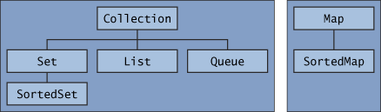
The core collection interface hierarchy
A Set is a special kind of Collection, a SortedSet is a special kind of Set, and so forth.
The hierarchy consists of two distinct trees — a Map is not a true Collection.
Slide <number>
Notes:
OOP3Slides2 Collections. A nic G

Slide 8
The core collection interfaces:
Collection (methods common to all, no implementation provided)
Set and SortedSet (no duplicates)
List (ordered, duplicates allowed)
Queue (list which supports ops like
  addFirst, addLast, push, pop )
Map and SortedMap (key – value pairs)
Slide <number>
Notes:
OOP3Slides2 Collections. A nic G

Slide 9
An Interface..
is a reference data type (you can declare things to be of this type)
includes only constants and abstract methods.
An abstract method has only the method header, no method body
The abstract methods of an interface define a behaviour
We cannot create an instance of an interface
Slide <number>
Notes:
OOP3Slides2 Collections. A nic G

Slide 10
Difference between an Interface and an Implementation:
List is an interface.
List<Person> friends; // ok
/*‘friends’ is a reference to an object of some class which implements the List interface */
You cannot instantiate a List in a program. The following will not compile:
friends = new List<Person>( ); // not ok
ArrayList is a concrete implementation of List:
friends = new ArrayList<Person>( ); // ok
friends.add(new Person(“John”,15,’m’));
Slide <number>
Notes:
OOP3Slides2 Collections. A nic G

Slide 11
Why use the interface type in the declaration?
Using the interface type in the declaration
  List myList;
implies the code should work with any underlying class which implements the interface, thus allows maximum flexibility.
We can later change the underlying class by altering only the “ = new” line:
  myList = new LinkedList(); instead of
  myList = new ArrayList();
Slide <number>
Notes:
OOP3Slides2 Collections. A nic G

Slide 12
Implementations: Class Hierarchy
The JCF provides a hierarchy of abstract and concrete classes which implement the Collection interfaces:
Interface Implementation
Set: HashSet
TreeSet (also implements SortedSet)
List ArrayList
LinkedList (also implements Queue)
Map HashMap
TreeMap (also implements SortedMap)
There is no implementation for Collection.
Slide <number>
Notes:
OOP3Slides2 Collections. A nic G

Slide 13
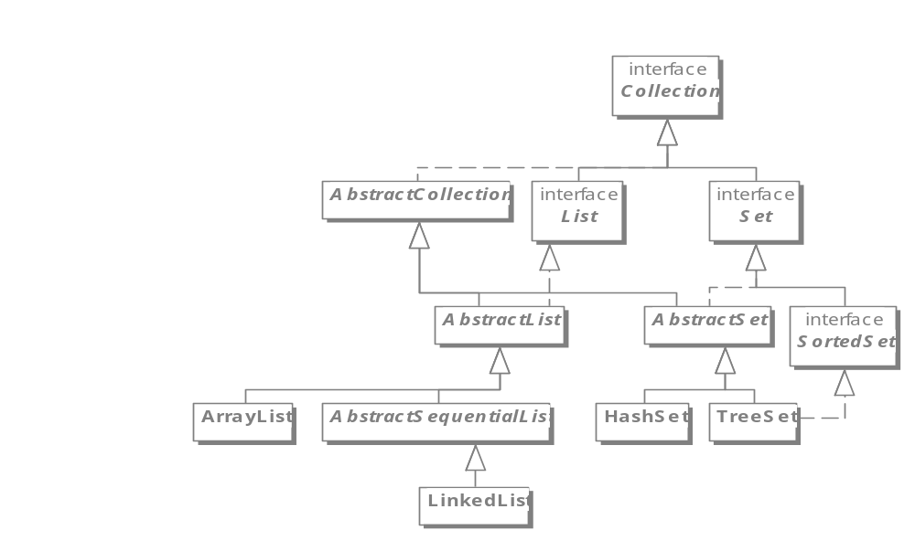
The Java Collection Classes
Slide <number>
Notes:
OOP3Slides2 Collections. A nic G

Slide 14
Common Algorithms
The JCF guarantees algorithms for a common set of operations, such as ‘add’, ‘remove’, ‘size’, ‘contains’, ‘clear’
The algorithms are polymorphic: the same method can be used on many different implementations of the appropriate collection interface
This reduces programming effort and fosters software reuse
Using the standard methods also increases program speed
Slide <number>
Notes:
OOP3Slides2 Collections. A nic G

Slide 15
The core collection interfaces are generic
This is the declaration of the Collection interface:
public interface Collection<E>...
The <E> syntax tells you that the interface is generic: this means it can be applied to any type of object.
When you declare a Collection instance you can and should specify the type of object contained in the collection: eg
  Collection<String> names
  Set<Person> friends
Slide <number>
Notes:
OOP3Slides2 Collections. A nic G

Slide 16
Generic Types were introduced in Java 1.5
When using a collection (e.g. ArrayList), we generally have a single type E of element that we store in it (e.g., Integer, String, Person)
Before 1.5, when extracting an element, we had to cast it to E before we could invoke E's methods
The compiler could not check that the cast was correct at compile-time, since it didn't know what E was
Inconvenient and unsafe, could fail at runtime
Slide <number>
Notes:
OOP3Slides2 Collections. A nic G

Slide 17
Extract from a pre-1.5 program
// from class PreJava5FriendsList.java
List friends = new ArrayList( );
// populate the list
person = new Person("jane", 10, 'F');
friends.add( person );
person = new Person("jack", 6, 'M');
friends.add( person );
person = new Person("jill", 8, 'F');
friends.add( person );
Slide <number>
Notes:
OOP3Slides2 Collections. A nic G

Slide 18
Extract, continued
// display the list
for (int i = 0; i<friends.size(); i++){
person = (Person) (friends.get( i));
System.out.println( person.getName( ) );
}
Compiler gives this warning message:
  “Note: H:\AOOP2\Ch10FriendsList0.java uses unchecked or unsafe operations.
  Note: Recompile with -Xlint:unchecked for details.”
<compile at the command line including the above switch to get the details: javac MyProgram.java -Xlint:unchecked >
Slide <number>
Notes:
OOP3Slides2 Collections. A nic G

Slide 19
Using a ‘generic’ collection
Generics provide a way to communicate E, the type of elements in a collection, to the compiler
Compiler can check that you have used the collection consistently
Result is safer and more efficient code
<E> is read, “of E”
For example: ArrayList<Person> is read “Array list of Persons”
Slide <number>
Notes:
OOP3Slides2 Collections. A nic G

Slide 20
Generic Version of extract
// code from GenericFriendsList0.java
List<Person> friends =
new ArrayList<Person>( );
// populate the list (not changed), then display
for (int i = 0; i<friends.size(); i++){
person = friends.get( i);
System.out.println( person.getName( ) );
}
Because the list contains only Persons, the compiler knows that ‘get’ must return an Person, so no need for a (Person) typecast
Compiler gives no warning message.
Slide <number>
Notes:
OOP3Slides2 Collections. A nic G

Slide 21
Abstract Classes
An interface provides only method headers, and cannot be instantiated.
An abstract class which implements the interface provides bodies for some, but not all, of the interface methods: it includes the word ‘abstract’ in its header.
It cannot be instantiated, but concrete classes which extend it will inherit the methods for which it does have bodies.
Slide <number>
Notes:
OOP3Slides2 Collections. A nic G

Slide 22
toString() for Collections
AbstractCollection is an abstract class which provides implementations of all the Collection methods except size() and iterator().
In particular, it defines a toString() method for a complete collection.
The implementation classes of the JCF are all subclasses of AbstractCollection, so it is possible to write
System.out.println(myCollection);
for any Collection, Set, List etc
Slide <number>
Notes:
OOP3Slides2 Collections. A nic G

Slide 23
The toString() method for Collections:
public String toString()
  Returns a string representation of the collection.
  Consisting of a list of the collection's elements in the order they are returned by its iterator, enclosed in square brackets ("[]").
  Adjacent elements are separated by the characters ", " (comma and space).
  Elements are converted to strings by the element’s own toString() method
Slide <number>
Notes:
OOP3Slides2 Collections. A nic G

Slide 24
ArrayList display, using toString()
List<Person> friends =
new ArrayList<Person>( );
// populate the list.. (see earlier extract)
// display as follows (no loop needed)
System.out.println( friends );
Gives the following useful but unstructured output (see GenericFriendsList0):
[Jane 10 F, Jack 6 M, Jill 8 F, John 14 M]
This is not possible using an array
Slide <number>
Notes:
OOP3Slides2 Collections. A nic G

Slide 25
‘Collection’ (java.util)
A collection represents a group of objects known as its elements.
The Collection interface is the least common denominator that all collections implement and is used to pass collections around and to manipulate them when maximum generality is desired.
The Java platform doesn't provide any direct concrete implementations of Collection.
Slide <number>
Notes:
OOP3Slides2 Collections. A nic G

Slide 26
Features of Collection
The interface does what you'd expect given that a Collection represents a group of objects. It has methods:
to tell you how many elements are in the collection
  size(), isEmpty()
to check whether a given object is in the collection
  contains(), containsAll()
to provide an iterator over the collection
  iterator()
to add and remove an element from the collection
  add(), remove()
Slide <number>
Notes:
OOP3Slides2 Collections. A nic G

Slide 27
java.util.Collection<E> basic methods
public int size( );
  Return number of elements in collection
public boolean isEmpty( );
  Return true iff collection holds no elements
public boolean add (E x);
  Make sure the collection includes x; returns true if collection has changed (some collections allow duplicates, some don’t)
public boolean contains (Object x);
  Returns true iff collection contains x (uses equals( ) method)
public boolean remove (Object x);
  Removes a single instance of x from the collection; returns true if collection has changed
public Iterator<E> iterator ( );
  Returns an Iterator that steps through elements of collection
note: iff means ‘if and only if’
Slide <number>
Notes:
OOP3Slides2 Collections. A nic G

Slide 28
Adding and removing elements
The add method is defined generally enough to make sense for collections that allow duplicates as well as for those that don't.
It guarantees that the Collection will contain the specified element after the call completes, and returns true if the Collection changes as a result of the call.
The remove method is designed to remove a single instance of the specified element from the Collection, assuming that it contains the element.
It returns true if the Collection was modified as a result.
Slide <number>
Notes:
OOP3Slides2 Collections. A nic G

Slide 29
Collection: Bulk methods
// Bulk operations
boolean containsAll(Collection<?> c);
boolean addAll(Collection<? extends E> c);
//optional
boolean removeAll(Collection<?> c);
//optional
boolean retainAll(Collection<?> c);
//optional
void clear();
Remember that all interface methods are public by default
Slide <number>
Notes:
OOP3Slides2 Collections. A nic G

Slide 30
Array Methods of Collection
public Object[ ] toArray ( )
  Returns a new array containing all the elements of this collection
public <T> T[ ] toArray (T[ ] dest)
  Returns an array containing all the elements of this collection; uses dest as that array if it can
Slide <number>
Notes:
OOP3Slides2 Collections. A nic G

Slide 31
Collection Interface Methods: again
boolean add(Object)
boolean addAll(Collection) // optional
void clear()
boolean contains(Object)
boolean containsAll(Collection)
boolean isEmpty()
Iterator iterator()
Slide <number>
Notes:
OOP3Slides2 Collections. A nic G

Slide 32
Collection Interface Methods, again (more)
boolean remove(Object)
boolean removeAll(Collection)
boolean retainAll(Collection)
int size()
Object[] toArray()
Object[] toArray(Object[] a)
“optional”
Slide <number>
Notes:
OOP3Slides2 Collections. A nic G

Slide 33
What’s Missing?
All the methods that use indexes:
  boolean add(int, Object)
  boolean addAll(int, Collection)
  Object get(int)
  int indexOf(Object)
  Object set(int, Object)
Why?
  Sets (HashSet, TreeSet) don’t use an index. ArrayList and LinkedList have these methods, since they are…lists.
Slide <number>
Notes:
OOP3Slides2 Collections. A nic G

Slide 34
Collection ‘conversion’ constructors
Interfaces don’t have constructors, but:
By convention all general-purpose collection implementations have a constructor that takes a Collection argument.
This constructor, known as a conversion constructor, initializes the new collection to contain all of the elements in the specified collection, whatever its type.
In other words, it allows you to convert the collection's type.
Slide <number>
Notes:
OOP3Slides2 Collections. A nic G

Slide 35
Conversion Constructor example
If you have
Collection<String> c
where c is a Set, or any other kind of Collection
Create a new ArrayList containing all the elements in c as follows:
List <String> list;
list = new ArrayList<String>(c);
Slide <number>
Notes:
OOP3Slides2 Collections. A nic G

Slide 36
Set
A set is a collection that cannot contain duplicate elements.
This interface models the mathematical set abstraction and is used to represent sets, such as
  the cards comprising a poker hand
  the courses making up a student's schedule
  the processes running on a machine
The methods of Set are the same as the methods of Collection
Slide <number>
Notes:
OOP3Slides2 Collections. A nic G

Slide 37
java.util.Set<E> (an interface)
Set extends Collection
  Set inherits all its methods from Collection
A Set contains no duplicates
  If you attempt to add( ) an element twice then the second add( ) will return false (i.e. the Set has not changed)
Slide <number>
Notes:
OOP3Slides2 Collections. A nic G

Slide 38
Set Implementations
java.util.HashSet<E> (a hashtable)
Constructors
  public HashSet ( );
  public HashSet (Collection<? extends E> c);
  public HashSet (int initialCapacity);
java.util.TreeSet (a sorted set)
Constructors
  public TreeSet ( );
  public TreeSet (Collection<? extends E> c);
Slide <number>
Notes:
OOP3Slides2 Collections. A nic G

Slide 39
Which Set implementation to use?
Use HashSet for most purposes.
  If efficiency is important, the objects in the collection will need to override the hashcode() method. Most standard java objects do this.
Use TreeSet if you need to extract the elements in a sorted manner.
  For this to work, the objects in the collection must implement the interface Comparable (see next unit). String and all the Wrapper types (Integer, Double, Boolean etc) do this.
Slide <number>
Notes:
OOP3Slides2 Collections. A nic G

Slide 40
Example: a Set of names
public class NameSet {
public static void main (String args[]){
// declare the Set: note the generic declaration
Set<String> names = new HashSet<String>();
// populate it
names.add("Bernadine");
names.add("Elizabeth");
names.add("Gene");
names.add("Elizabeth");
names.add("Clara");
// display the contents: note no duplicates
System.out.println(names);
} }
Slide <number>
Notes:
OOP3Slides2 Collections. A nic G

Slide 41
Exercise
Take any program which contains a List of objects (eg GenericFriendsList1) and add some duplicate objects
Add a line of code which uses the HashSet conversion constructor to create a HashSet containing the same objects as the list
  HashSet mySet = new HashSet(friends);
Display the HashSet using toString(): there should only be one copy of each object
This will only work correctly if the .equals() method has been defined for the objects of the type contained in the List
Slide <number>
Notes:
OOP3Slides2 Collections. A nic G

