Slide 1
Unit 8: Maps
At the end of this unit, you should be able to:
Explain the difference between a Map and a Collection, and give examples of each
Explain the role of the ‘put’ and ‘get’ methods of Map
Name a JCF class which implements Map and one which implements SortedMap
Write code to declare, populate and query Maps including displaying the contents of the Map in a structured form
Write code to construct Sets of keys and/or of values from Maps
Name some of the utility methods provided by the classes Arrays and Collections
Slide <number>
Notes:
OOP3Slides2 Collections. A nic G

Slide 2
Sample Programs
SubjectCatalog.java
ModuleMap.java
SubjectReferenceMap.java
For the problems, Gift, Player, ComparePlayerNames and ComparePlayerScores
Slide <number>
Notes:
OOP3Slides2 Collections. A nic G

Slide 3
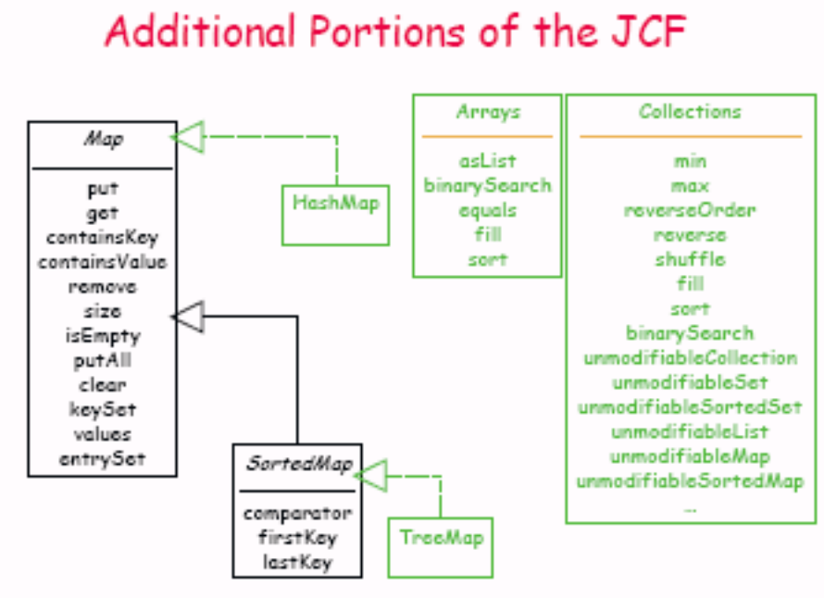
Slide <number>
Notes:
OOP3Slides2 Collections. A nic G

Slide 4
JCF Maps
JCF includes the Map interface that supports methods to maintain a collection of objects (key, value) pairs called map entries.
key
value
k₀
v₀
one entry
k₁
v₁
.
.
.
.
.
.
k_{n}
v_{n}
Slide <number>
Notes:
OOP3Slides2 Collections. A nic G
We can add to, remove from, and retrieve objects in a given list.
A list does not have a set limit to the number of objects we can add to it.

Slide 5
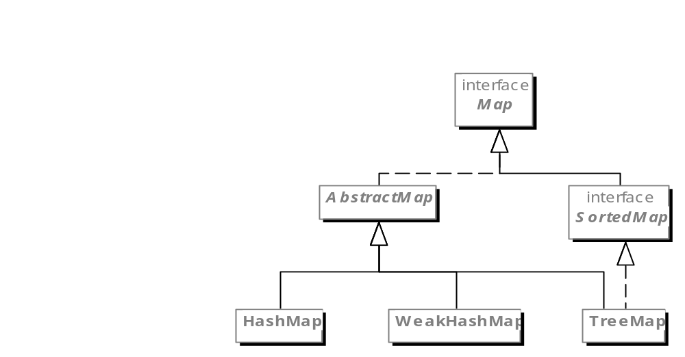
The Java Map Hierarchy
Slide <number>
Notes:
OOP3Slides2 Collections. A nic G

Slide 6
Map
A map is an object that maps keys to values.
A map cannot contain duplicate keys
Each key can map to at most one value
Examples:
  phone directory
  primary database key and database record
Slide <number>
Notes:
OOP3Slides2 Collections. A nic G

Slide 7
java.util.Map<K,V> (an interface)
Map does not extend Collection
public V put (K key, V value);
  Associates value with key in the map;
  returns the old value associated with key or null if the key did not previously appear in the map
public V get (Object key);
  Returns the object to which this key is mapped or null if there is no such key
Slide <number>
Notes:
OOP3Slides2 Collections. A nic G

Slide 8
More methods from Map
iff = if and only if
public boolean containsKey (Object key);
  True iff Map contains a pair using the given key
public boolean containsValue (Object value);
  True iff there is at least one pair with this value
public V remove (Object key);
  Removes any mapping for the key; returns old value associated with key, or null if not found
public int size ( );
  Returns the number of key/value pairs in the Map
public boolean isEmpty ( );
  True iff Map holds no pairs
Slide <number>
Notes:
OOP3Slides2 Collections. A nic G

Slide 9
And still more…
Bulk methods
public void putAll (Map<? extends K, ? extends V> otherMap);
  Puts all the mappings from otherMap into this map
public void clear ( );
  Removes all mappings
Sets/Collections derived from a Map
public Set<K> keySet ( );
  Returns a Set whose elements are the keys of this map
public Collection<V> values ( );
  Returns a Collection whose elements are all the values of this map
public Set<MapEntry> entrySet ( );
  Returns a Set of elements that implement the Map.Entry interface
  Map.Entry has methods getKey() and getValue()
Slide <number>
Notes:
OOP3Slides2 Collections. A nic G

Slide 10
Using Maps
To use a map in a program, we must create an instance of a class that implements the Map interface.
Two classes implement the Map interface:
  HashMap
  TreeMap (sorted by key)
Slide <number>
Notes:
OOP3Slides2 Collections. A nic G

Slide 11
Sample Map Usage
Example of manipulating a map:
// from SubjectCatalog.java
Map <String,String> catalog;
catalog = new TreeMap<String,String>( );
catalog.put("CS101", "Intro Java Programming");
catalog.put("CS301", "Database Design");
catalog.put("CS413", "Software Design for Mobile Devices");
if (catalog.containsKey("CS101")) {
System.out.println("We teach Java this semester");
} else {
System.out.println("No Java courses this semester");
}
Notes:
OOP3Slides2 Collections. A nic G
The (key, value) pair for this sample map is the course number and the course title, respectively.

Slide 12
further example: ModuleMap
public class ModuleMap {
public static void main (String args[]){
// declare a map to hold module names and lecturer names
// keys are modules, values are lecturers
Map<String, String> map = new HashMap<String, String>();
// populate the map, and display it
map.put("OOP3",“John");
map.put("OOP2",“Ano");
map.put("Database 1","Catherine");
map.put("Database 2",“Peter");
map.put("Network Basics", "Fergus");
System.out.println(map);
Slide <number>
Notes:
OOP3Slides2 Collections. A nic G

Slide 13
Generating a list of the modules and of the lecturers
Set<String> moduleList = map.keySet();
System.out.println(moduleList);
// lecturer names, allowing duplicates
System.out.println(map.values());
// get a unique list of lecturers
Set<String> lecturerNames =
new HashSet<String>(map.values());
System.out.println(lecturerNames);
Slide <number>
Notes:
OOP3Slides2 Collections. A nic G

Slide 14
Displaying the map contents nicely
Iterator it = map.entrySet().iterator();
while (it.hasNext()){
Map.Entry entry = (Map.Entry) it.next();
System.out.println(entry.getValue()+
" will teach " + entry.getKey());
}
We can only call next() once for each element of entrySet()
This gives a Map.Entry object, with methods getKey() and getValue()
Slide <number>
Notes:
OOP3Slides2 Collections. A nic G

Slide 15
Other map processes
Changing the value associated with a key
map.put("Network Basics", "Gene");
Dropping a key-value pair:
map.remove(“OOP3”);
Queries: do we have a lecturer for OOP2?
if (map.containsKey("OOP2"))
System.out.println(map.get("OOP2")+" will teach
OOP2 ");
else
System.out.println("No-one assigned to OOP2");
Slide <number>
Notes:
OOP3Slides2 Collections. A nic G

Slide 16
SortedMap
A SortedMap is a Map that maintains its mappings in ascending key order.
This is the Map analog of SortedSet.
Sorted maps are used for naturally ordered collections of key/value pairs, such as dictionaries and telephone directories.
Slide <number>
Notes:
OOP3Slides2 Collections. A nic G

Slide 17
java.util.SortedMap<K,V> (an interface)
Extends the Map contract: requires that keys are sorted
The iterators for keySet( ), values( ), and entrySet( ) all return items in order of the keys
Methods (in addition to those inherited from Map):
public Comparator<? super K> comparator ( );
  Returns the comparator used to compare keys for this map; null is returned if the natural order is being used
public K firstKey ( );
  Returns the first (lowest value) key in this map
public K lastKey ( );
  Returns the last (highest value) key in this map
Slide <number>
Notes:
OOP3Slides2 Collections. A nic G

Slide 18
Map and SortedMap Implementations
java.util.HashMap (a class; implements Map)
Constructors
  public HashMap ( );
  public HashMap (Map<? extends K, ? extends V> map);
  public HashMap (int initialCapacity);
  public HashMap (int initialCapacity, float loadFactor);
java.util.TreeMap (a class; implements SortedMap)
Constructors
  public TreeMap ( );
  public TreeMap (Map<? extends K, ? extends V> map);
  public TreeMap (Comparator<? super K> comp);
Slide <number>
Notes:
OOP3Slides2 Collections. A nic G

Slide 19
Summary of JCF Interfaces & Classes
Interfaces
Collection
Set (no duplicates)
SortedSet
List (duplicates OK)
Queue
Map (i.e., Dictionary)
SortedMap
Iterator
Iterable
ListIterator (gives you part of a list)
Classes
HashSet
TreeSet
ArrayList
LinkedList
Stack
HashMap
TreeMap
Slide <number>
Notes:
OOP3Slides2 Collections. A nic G

Slide 20
Additional JCF Interfaces & Classes
java.util.Queue<E>
An interface
Has peek( ) op
Implemented by
  LinkedList
  PriorityQueue
Legacy classes
java.util.Hashtable
java.util.Vector
java.util.Stack
java.util.PriorityQueue<E>
A class
Heap-based PQ using table-doubling
Ordering is based on natural order or on a Comparator
  To use a Comparator, it must be specified in the constructor
Implements Queue
Slide <number>
Notes:
OOP3Slides2 Collections. A nic G

Slide 21
Arrays and Collections utility classes
java.util contains two classes which provide useful static methods for working with groups of objects:
Methods from java.util.Arrays work with arrays (sorting, searching etc)
java.util.Collections provides the same methods for Collections, as well as methods for legacy classes like Vector
Slide <number>
Notes:
OOP3Slides2 Collections. A nic G

Slide 22
java.util.Arrays Utility Class
Provides useful static methods for dealing with arrays
sort
binarySearch
equals
fill
These methods are overloaded to work with
arrays of each primitive type
arrays of Objects
sort and binarySearch can use the natural order, but there are versions that can use a Comparator
For searching to work, the entity class must include a .equals() method
There is also a method for viewing an array as a List:
  static List asList (Object[ ] a);
The resulting List is backed by the array (i.e., changes in the array are reflected in the List)
Slide <number>
Notes:
OOP3Slides2 Collections. A nic G

Slide 23
java.util.Collections utility class (similar to Arrays, but methods work with Collections)
public static Object min (Collection c);
public static Object min (Collection c, Comparator comp);
public static Object max (Collection c);
public static Object max (Collection c, Comparator comp);
public static Comparator reverseOrder ( ); // Reverse of natural order
public static void reverse (List list); // Reverse the list
public static void shuffle (List list); // Randomly shuffle the list
public static void fill (List list, Object x); // List is filled with x’s
public static void sort (List list); // Sort using natural order
public static void sort (List list, Comparator comp);
public static void binarySearch (List list, Object key);
public static void binarySearch (List list, Object key, Comparator comp);
Slide <number>
Notes:
OOP3Slides2 Collections. A nic G

