Slide 1
ArrayList
ArrayList is a collection class in the Java collections framework
ArrayList and LinkedList implement the List interface
List interface represents an ordered collection of objects
See Container taxonomy diagram in Chapter 11 of TIJ3
Notes:
See the following for class diagrams:
http://www.agilemodeling.com/style/
http://www.agilemodeling.com/style/classDiagram.htm
There are two ways to indicate that a class or component implements an interface: the lollipop notation used with the Serializable interface and the realization line (the dashed line with a closed arrowhead) used with the PersistentObject interface.

Slide 2
ArrayList is a class defined in java.util package
ArrayList is backed by an array – default size is 10
ArrayLists store references to Objects
ArrayList is like an array except it can dynamically grow or shrink at execution time
If an ArrayList needs to grow, it grows by an increment you specify or by a default value

Slide 3
ArrayList<String> list = new ArrayList();
list.add(“Bob”);
//add 9 more items – no problem
Add 11th item:
list.add(“Sue”); => array must grow

Slide 4
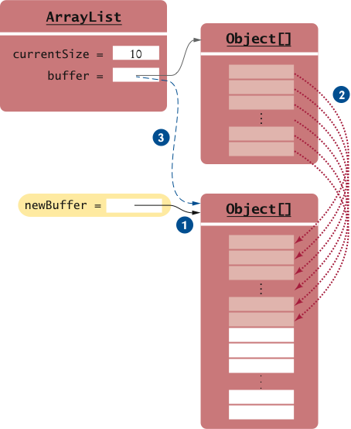
ArrayList is backed by an array that can grow:

Slide 5
ArrayList overcomes the limitations of the fixed size array
But resizing requires much shifting of elements
Both structures are inefficient at inserting and deleting items in the list
Insertion and deletion operations require shifting elements back and forth within the array
If your list requires these operations, a linked list is a better data structure

Slide 6
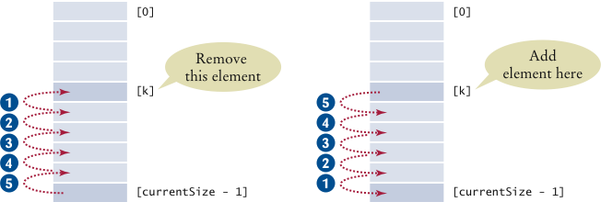
When removing or adding an element at position k, the elements with higher index values need to move

Slide 7
Generic Classes
ArrayList is a generic class (as of Java 5)
It has been defined with a type variable T
The type variable denotes the element type
public class ArrayList<T>
{
..
public void add(T element) {…}
}

Slide 8
To use generic ArrayList:
List<String> names = new ArrayList();
Note use of List interface here
If you decide you want to change your implementation, all you need to do is change it at the point of creation, like this:
List<String> names = new LinkedList();
This is an example of the general principle:
“Program to an interface, not an implementation”

Slide 9
To add to the list:
names.add(new String(“Harry”);
names.add(new String(“Tony”);
This adds elements at the end of the list
Can also add (and delete) in the middle of the list – look up other add method
But this method is not very efficient – why?

Slide 10
To access elements of the ArrayList:
int index = …;
String name = names.get(index);
The number of elements in the list is:
names.size()

Slide 11
Advantages of generic classes
When you retrieve an item from a generic class, you do not have to cast the return value
If you attempt to insert the wrong type, you will receive a compilation error
Can still use non-generic ArrayList but generic version is the preferred one
Notes:
The non-generic ArrayList achieves genericity by using inheritance. They store objects of any class deriving from Object, but need casting when retrieving.
With non-generic ArrayList, would receive a ClassCast exception at runtime when retrieving a e.g. String from a list that should contain only e.g.Employee

Slide 12
Enhanced for loop (as of Java 5)
e.g.
ArrayList<Employee> staff = new ArrayList();
staff.add(new Employee(“Harry Hacker”,..);
staff.add(new Employee(“Tony Tester”, …);
…
for (Employee e : staff)
process e
Notes:
int [] list = {……};
sum = 0;
for (int n : list)
sum += n;

Slide 13
This for loop is only for processing the whole list
Use the ordinary for loop, if you do not want to process the whole list

