Slide 1
Dynamic Reduction of Query Result Sets for Interactive Visualization
Leilani Battle (MIT)
Remco Chang (Tufts)
Michael Stonebraker (MIT)

Slide 2

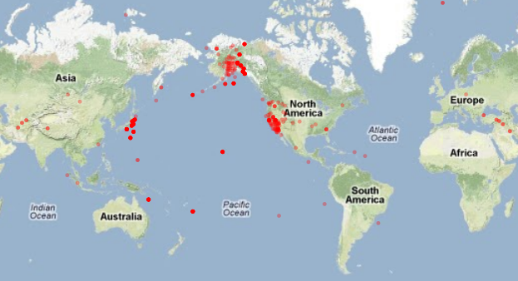
Context
Visualization System
query
Database
result
Notes:
Have a database with lots of data
Want a visual overview (i.e. stats plots like scatterplot, heatmap, etc.)
Want visualizations to be interactive (I.e. pan and zoom)

Slide 3
Problems with Most VIS Systems
Scalability
Most InfoVis systems assume that memory stay in-core
Out-of-core systems assume locality and/or structure in data (e.g. grid).
Database-driven systems leverage operations specific to the application (e.g. column-store for business analytics)
Over-plotting
Makes visualizations unreadable
Waste of time/resources

Slide 4



The Problem We Want to Solve
Visualization on a
Commodity Hardware
Large Data in a
Data Warehouse

Slide 5
Apporach: Trading Accuracy For Speed
In the Vis community
Common practice, e.g.
Based on Data: Elmqvist and Fekete (TVCG, ’10)
Based on Display: Jerding and Stasko (TVCG, ‘98)
In the Database community
Less common, e.g.
Stratified Sampling: Chaudhuri et al. (TOD, ’07)
(BlinkDB) Bounded Errors and Response Time: Agarwal et al. (Eurosys ‘13)
Online Aggregation: Hellerstein et al. (SIGMOD ‘97), Fisher et al. (CHI ‘12)

Slide 6

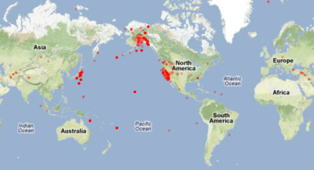
Our Solution: Resolution Reduction
Visualization System
query
Resolution Reduction Layer
queryplan query
modified query
queryplan result
reduced result
Database
Notes:
When query will return too much data, reduce it
Aggregate, sample, filter, etc.
“Too big” means:
Will slow down the vis system
Will cause over-plotting

Slide 7
Our Implementation: ScalaR
Back-end database: SciDB
An array-based database for scientific data
Front-end visualization: javascript + D3
Middleware:
Named ScalaR
Written as a web-server plugin
“Traps” queries from the front-end and communicates with the back-end

Slide 8
Query Plan and Query Optimizer
(Almost) All database systems have a query compiler
Responsible for parsing, interpreting, and generating an efficient execution plan for the query
Query optimizer
Responsible for improving query performance based on (pre-computed) meta data.
Designed to be super fast
Continues to be an active area of DB research

Slide 9
Example Query Plan / Optimizer
Given a database with two tables:
dept (dno, floor)
emp (name, age, sal, dno)
Consider the following SQL query:
select name, floor
from employ, dept
where employ.dno = dept.dno
and employ.sal > 100k
Example taken from “Query Optimization” by Ioannidis, 1997

Slide 10
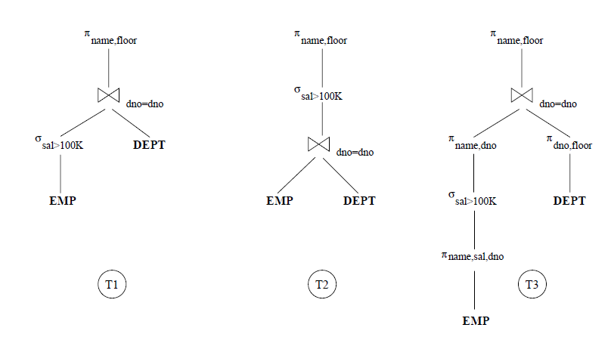
Possible Query Plans

Slide 11
Cost of the Query
For a database with 100,000 employees (stored across 20,000 page files), the three query plans can have significantly different execution time (in 1997):
T1: <1 sec
T2: >1 hour
T3: ~1 day

Slide 12
Query Plan Exposed – SQL EXPLAIN
The “EXPLAIN” command
Exposes (some of) the computed results from the Query Optimization process
Not in SQL-92
The results are DBMS-specific
Usage:
explain select * from myTable;

Slide 13
Example EXPLAIN Output from SciDB
Example SciDB the output of (a query similar to)
Explain SELECT * FROM earthquake
[("[pPlan]:
schema earthquake
<datetime:datetime NULL DEFAULT null,
magnitude:double NULL DEFAULT null,
latitude:double NULL DEFAULT null,
longitude:double NULL DEFAULT null>
[x=1:6381,6381,0,y=1:6543,6543,0]
bound start {1, 1} end {6381, 6543}
density 1 cells 41750883 chunks 1
est_bytes 7.97442e+09
")]
The four attributes in the table ‘earthquake’
Notes that the dimensions of this array (table) is 6381x6543
This query will touch data elements from (1, 1) to (6381, 6543), totaling 41,750,833 cells
Estimated size of the returned data is 7.97442e+09 bytes (~8GB)

Slide 14
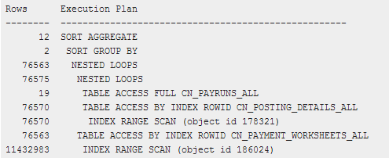
Other Examples
Oracle 11g Release 1 (11.1)

Slide 15
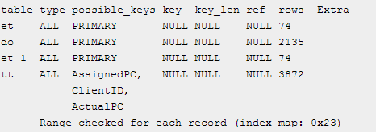
Other Examples
MySQL 5.0

Slide 16
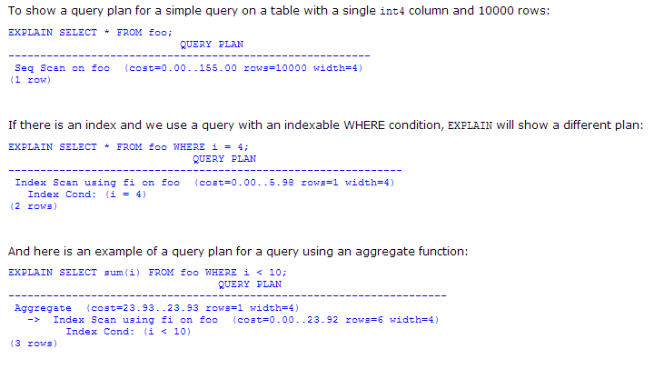
Other Examples
PostgreSQL 7.3.4

Slide 17
ScalaR with Query Plan
The front-end tells ScalaR its desired resolution
Can be based on the literal resolution of the visualization (number of pixels)
Or desired data size
Based on the query plan, ScalaR chooses one of three strategies to reduce results from the query

Slide 18
Reduction Strategies in ScalaR
Aggregation:
In SciDB, this operation is carried out as
regrid (scale_factorX, scale_factorY)
Sampling
In SciDB, uniform sampling is carried out as
bernoulli (query, percentage, randseed)
Filtering
Currently, the filtering criteria is user specified
where (clause)

Slide 19
Example
The user launches the visualization, which shows the overview of the data
Resulting in launching the query:
select latitude, longitude from quake
As shown earlier, this results in over 41 million values

Slide 20
Example
Based on the user’s resolution, using Aggregation, this query is modified as:
select avg(latitude), avg(longitude)
from (select latitude, longitude
from quake)
regrid 32, 33
Using Sampling, this query looks like:
select latitude, longitude
from bernoulli (select latitude, longitude from quake), 0.327, 1)

Slide 21
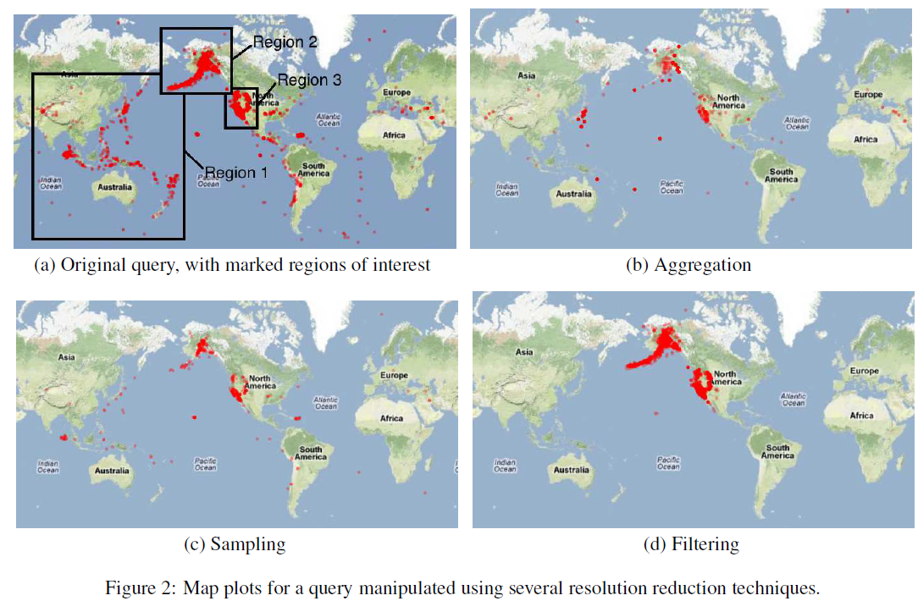
Strategies for Real Time DB Visualization

Slide 22
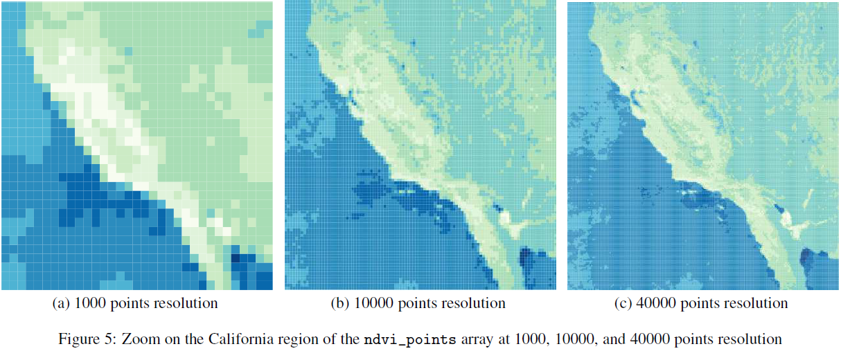
Using SciDB

Slide 23
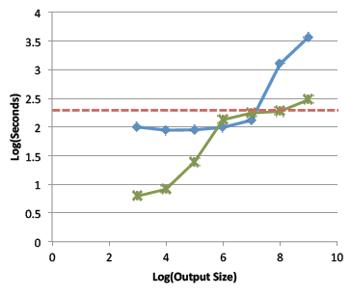

Performance Results
Dataset: NASA MODIS
Size: 2.7 Billion data points
Storage: 209GB in database (85GB compressed), across 673,380 SciDB chunks
Baseline:
select * from ndsil

Slide 24
Benefits of ScalaR
Flexible!
Works on all visualizations and (almost) all databases
As long as the database has an EXPLAIN function
No Learning Curve!
Developers can just write regular SQL queries, and
do not have to be aware of the architecture
Adaptive!
Easily swap in a different DBMS engine, different visualization, or different rules / abilities in ScalaR.
Efficient!
The reduction strategy can be based on perceptual constraint (resolution) or data constraint (size)

Slide 25
Discussion
Efficient operations are still DB dependent
SciDB: good for array-based scientific data
Efficient aggregation (e.g., “regrid”)
OLAP: good for structured multidimensional data
Efficient orientation (e.g., “pivot”)
Column-Store: good for business analytics
Efficient attribute computation (e.g., “avg (column1)”)
Tuples (NoSQL), Associative (network), etc., Multi-value DB (non-1NF, no-joins), etc.
How does ScalaR know which operation to use?
One possible way is to “train” ScalaR first – give it a set of query logs (workload) to test the efficiency of different strategies

Slide 26
Thank you!!
Questions?
Leilani Battle (MIT) leibatt@mit.edu
Remco Chang (Tufts) remco@cs.tufts.edu
Mike Stonebraker (MIT) stonebraker@csail.mit.edu

