Slide 1
Welcome! Class will begin at 1:05.
Notes:
This class will not be recorded
I will send out a handout and a link to the class evaluation after our session
Slides are available upon request
I will take questions after each section, but feel free to post them in the chat at any time
My email: helenmary@pitt.edu

Slide 2

Hands-On GitHub for Version Control
Helenmary Sheridan, Data Services Librarian
helenmary@pitt.edu

Slide 3
Data Services @ HSLS
HSLS Data Services offers support, consultations, and customized trainings to help you:
Organize your research data before, during, and after collection
Write a data management plan (DMP)
Use electronic research notebooks
Preserve your data for long-term use
Use data effectively
Create effective data visualizations
Locate existing datasets for reuse
Cite datasets accurately
Share your research data
Comply with data sharing policies
Identify appropriate data repositories
Prepare datasets for sharing with documentation and metadata
Increase the reproducibility of your research
Create READMEs, data dictionaries, and code annotations
Manage code with version control
Select licenses for your code and datasets
Adopt principles of open science and join a community of open science practitioners

Slide 4
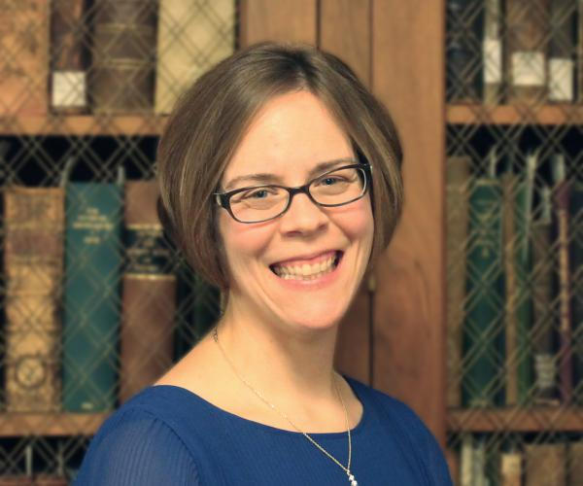

Data Services @ HSLS
Melissa Ratajeski, Asst. Dir. for Data and Scholarly Publishing
Helenmary Sheridan, Data Services Librarian
Data Services Libguide: https://hsls.libguides.com/data
Email contact: hslsdata@pitt.edu

Slide 5
Topics for this workshop
Definitions
What is Github and Git?
What is version control?
What is Github good (and not so good) at?
Q & A break
Hands-on session
Navigation
Initializing a repository
Forking and branching
Collaboration

Slide 6


Definitions
GitHub is a web service that provides version control for files stored in its system. It uses Git to track changes to files and offers additional project management features.
Git is a command-line-based version control system. You can use Git without GitHub. Using GitHub is a way of using Git without interacting with the command line.

Slide 7
Definitions (2)
Version control is “a system that records changes to a file or set of files over time so that you can recall specific versions later.” (Chacon and Straub, Pro Git Book 2nd edition (Apress, 2014))
A good version control system should be able to express the history of a file including specific changes made, who made them, when they were made, and the relationship of the resulting different versions.
Not conceptually essential, but useful: the ability to compare different files and expose the differences between them

Slide 8
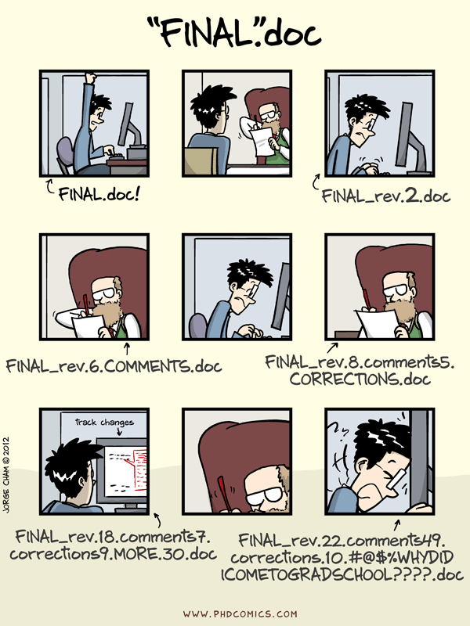
Approaches to version control
Version history can be captured in filenames
PLOSManuscriptv001
PLOSManuscriptv002
PLOSManuscriptv003…
At right, “Piled Higher and Deeper,” webcomic by Jorge Cham: http://www.phdcomics.com

Slide 9
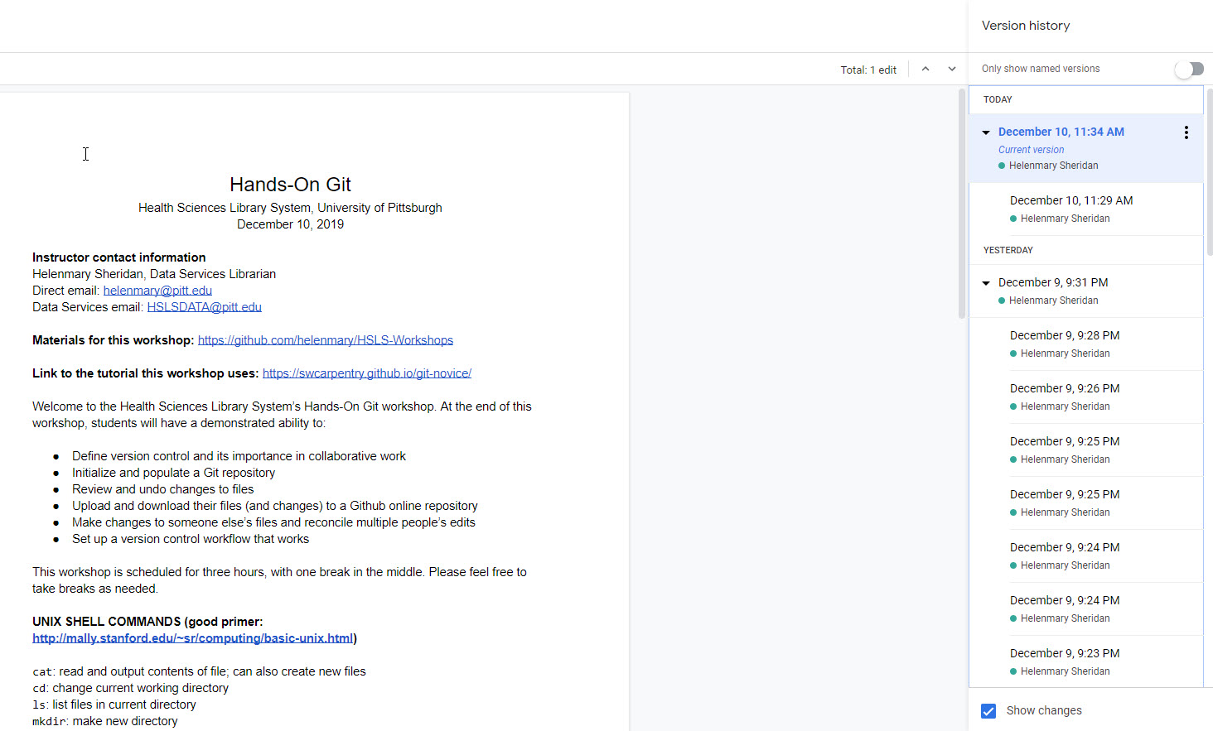
Approaches to version control (2)
Auto-saved versions of the document

Slide 10
Approaches to version control (3)
What GitHub does better than other methods:
Allows you to choose which changes merit a new version through commits
Includes a summary/reason for changes with each commit
Automatically records who made each commit and when
Stores “alternate universe” versions of a file with their own separate histories through branching
Allows those alternate versions to come together again by merging and resolving conflicts (after highlighting differences, or diffing)

Slide 11
Ben writes a new section
Aiko writes a draft
She makes edits
They all edit together
Carla adds figures

