Slide 1

Sample 1
WHY MLOPS? – A COHESIVE ENVIRONMENT THAT ENABLES…
MACHINE LEARNING
DATA ACQUISITION
BUSINESS UNDERSTANDING
MACHINE LEARNING METHODOLOGIES
MACHINE LEARNING • DEVELOPMENT • OPERATIONS
DEVELOPMENT
CONTINUOUS INTEGRATION
MODELING + TESTING
DEPLOYMENT EFFICIENCY
OPERATIONS
CONTINUOUS DELIVERY
DATA FEEDBACK LOOP
MODEL MONITORING

Slide 2






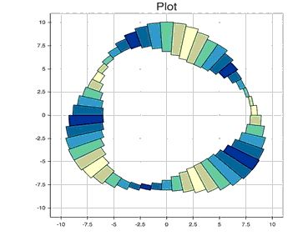
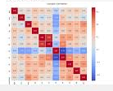
OUR APPROACH
DATA IS CURATED AND COLLECTED FROM A RT SOURCE
REPORTS
Storage
1
CUBEFLOW & KUBERNETES FOR CONTINUOUS DEPLOYMEMT
File Drop
2
File Drop
3
MODEL RESULTS HISTORY SAVED IN DB
DATA SCIENCE AND ML WORKSTATION

Slide 3


DASHBOARDS
MLOPS REPORTS EXAMPLES
STABILITY METRICS & REPORTS
PSI – POPULATION STABILITY INDEX
DIVERGENCE INDEX
PERFORMANCE METRICS & REPORTS
K-S, RMSE, AUC-ROC, R-SQUARED, CONFUSION MATRIX WITH COST
OPERATIONS METRICS & REPORTS
ML AND PIPELINE HEALTH

