Slide 1

Data Analytics & AI (with Bayo) Winter 2025

Slide 2
Hi, I am Helen (DA21051).
I love collecting and keeping track of data, including personal data. I train in multiple sports and end up with a lot of information about my workouts and performance. I want to make sense of all this data so I can use it to improve how I train.
This project is Step 1 of a larger personal project: building an agent that can combine multiple data sources and help me make better decisions to enhance my performance.

Slide 3
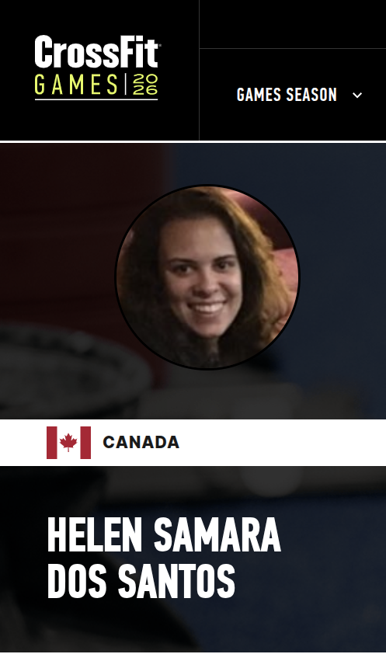
For this capstone project, I use a dataset of CrossFit workouts. I clean and analyze the data, and then set up an agent through Claude so I can chat with the data and ask questions like: “Am I overtraining?”

Slide 4
The project’s big picture:
DATA LAYER
└─ workouts.csv
└─ loader.py
└─ cleaned DataFrame
ANALYSIS LAYER
└─ DataFrame
└─ attendance.py
└─ sentiment.py
└─ performance.py
└─ ml_models.py
AGENT LAYER
└─ tools.py (wraps analysis functions as Claude tools)
└─ agent.py (Claude tool-use loop)
└─ app.py (Streamlit web interface the user talks to)

Slide 5
DATA LAYER └─ workouts.csv
The SugarWOD CSV has one row per workout session.
The important columns are:
date — when the workout happened
title — workout name (e.g. "Fran", "Back Squat")
description — the full workout description (contains prescribed weights like "135/95 lbs")
best_result_raw — the raw numeric score (a weight, a rep count, a time in seconds, or an AMRAP decimal)
best_result_display — how the score looks to a human (e.g. "7+14")
score_type — what kind of score it is: "Load", "Reps", "Rounds + Reps", "Time", etc.
barbell_lift — if it's a lift, the lift name (e.g. "Back Squat")
notes — my personal notes about how the session felt or what scaled option I did
rx_or_scaled — whether you did it "RX" (as prescribed) or "SCALED"
pr — "PR" if you set a personal record, blank otherwise

Slide 6
DATA LAYER └─ workouts.csv └─ loader.py └─ cleaned DataFrame
Loading and Cleaning the Data
This is the foundation of the whole project. It reads the raw SugarWOD export (a CSV file) and transforms it into a clean, structured table that every other module can use reliably. It runs once at startup and caches the result.
Reads data/workouts.csv
Cleans + normalizes
Returns a DataFrame

Slide 7
Loads the SugarWOD CSV using pandas.
Parses and standardizes the date (converts date column into real datetimes)
Sorts by date and resets index
Fills missing values (with safe defaults, for example, with an empty string when “notes” were blank)
Adds derived columns (for example: is_pr (True if pr == 'PR'))
Parses scores based on score_type:
Load → score_load (numeric weight)
Reps/Calories/Feet/Meters → score_reps (numeric count)
Time → score_seconds (numeric seconds)
Rounds + Reps → splits into:
score_amrap_rounds
score_amrap_reps
Returns a clean DataFrame ready for all analysis tools and the UI.

Slide 8
ANALYSIS LAYER └─ DataFrame └─ attendance.py └─ sentiment.py └─ performance.py └─ ml_models.py
attendance.py — consistency & rest gaps
sentiment.py — mood from notes
performance.py — PRs, RX rate, strength
ml_models.py — clustering, anomalies, forecasts

Slide 9
attendance.py
1) Monthly workout volume (monthly_chart)
Groups workouts by month, counts sessions per month
Builds a bar chart showing sessions per month
Highlights:
Best month (green)
Worst month (red)
Average line (amber)
Annotates large gaps in training (>= 30 days) on the chart
Returns:
fig (matplotlib figure)
summary dict: best/worst month + counts + average

Slide 10
2) Weekly trend (weekly_trend)
Groups workouts by week, counts sessions per week
Calculates a 4-week rolling average
Creates a line chart + shaded area
Adds same gap annotation overlays (>= 30 days)
Returns fig
3) Day-of-week patterns (day_of_week)
Computes session frequency per weekday (Mon–Sun)
Computes RX rate (%) per weekday
Returns a figure with:
Left: bar chart of total sessions per weekday
Right: bar chart of RX % per weekday

Slide 11
4) Gap detection (detect_gaps)
Finds multi-day breaks in training
Default threshold: > 7 days
Returns a list of {start, days} for each gap
5) Annotating gaps on plots (_annotate_gaps)
For gaps longer than 30 days, it:
Shades the gap region
Places a small “X d gap” label on the plot
6) Summary output for the agent (summary)
Combines:
Monthly stats from monthly_chart
Total sessions
List of gaps > 7 days
Date range of the dataset
Returns a dict the agent can reference for quick answers

Slide 12
sentiment.py
1) Sentiment scoring (per workout note)
Defines positive words (e.g., “fun”, “strong”, “proud”, “amazing”)
Defines negative words (e.g., “hard”, “tired”, “sore”, “failed”)
score_sentiment(text)
Converts the note to lowercase
Counts how many positive vs negative words appear
Returns a score from -1 (very negative) to +1 (very positive)
Returns None if no sentiment words are found

Slide 13
2) Enriching the dataset (enrich(df))
Adds three new columns to the DataFrame:
sentiment: the numeric sentiment score (-1..+1 or None)
pos_hits: list of positive words found in the note
neg_hits: list of negative words found in the note

Slide 14
3) Charts / visualizations
a) Sentiment over time (sentiment_over_time)
Groups data by month and averages sentiment
Plots: bar chart (positive months green, negative months red) & 3-month rolling trend line (purple)
b) Word frequency (word_frequency)
Finds the most common positive and negative words across notes
Plots two bar charts: Top positive words used & Top negative words used
c) Sentiment vs performance (sentiment_vs_performance)
Compares average monthly sentiment to RX rate (percent of workouts done RX)
Plots: Sentiment bars (purple) & RX rate line (green)
Returns the correlation coefficient between sentiment and RX rate

Slide 15
4) Summary for the agent (summary)
Returns a dictionary with:
Number of notes that had sentiment signal
Average sentiment score
Sentiment vs RX correlation (r value)
Top 3 most positive sessions (date/title/score)
Top 3 most negative sessions (date/title/score)

Slide 16
performance.py
1) RX rate over time (rx_rate_over_time)
Computes % of sessions done RX each month
Plots monthly RX % with a 3-month trend line
Marks training gaps (using the same gap shading logic from attendance)
Shows a 50% reference line

Slide 17
2) Strength progression by lift (strength_progression)
Filters sessions where score_type == 'Load' and barbell_lift is defined
Picks the top 6 most frequent lifts (deadlift, front and back squat, clean & jerk, snatch and power snatch)
For each lift:
Plots the weight logged over time
Marks PR sessions with a star
Plots a running best (cummax) line (“best ever”)
Produces a 2×3 grid of lift progression charts

Slide 18
3) Lift correlation heatmap (lift_correlation)
Creates a pivot table of max weight per lift per date
Calculates the correlation matrix between all lifts
Displays as a heatmap (which lifts tend to improve together)
4) Scaling ratio vs RX (uses Claude for weights) (scaling_ratio)
Focuses on sessions labeled SCALED
Parses the prescribed RX weight from the workout description (e.g., “95/115 lbs”)
Uses Claude Haiku to extract the actual working weight from notes
Builds a “ratio” = actual weight / prescribed RX weight
Plots those ratios over time and fits a trend line
Returns stats like average ratio and trend slope

Slide 19
5) PR timeline (pr_timeline)
Finds workouts marked as PR (is_pr)
Plots them on a time axis as stars
Annotates each dot with the workout title
6) Summary for the agent (summary)
Returns a dict used by the chat agent with:
Total PR count
Total RX sessions
Total scaled sessions
RX rate percentage
Scaling ratio statistics (from scaling_ratio)

Slide 20
ml_models.py
This file adds three machine learning features to my workout data:
workout archetype clustering,
anomaly detection, and
PR forecasting.

Slide 21
1) KMeans clustering of workouts (cluster_workouts)
Builds binary/boolean features for each session:
RX? PR? Strength? Timed? AMRAP? Barbell? Sentiment score?
Standardizes these features and runs KMeans (k=4) to cluster sessions.
Labels each cluster with a human-friendly name like:
“Strength / Lifting”
“AMRAP Metcon”
“Timed Metcon”
“Accessory / Mixed”
Returns:
The DataFrame with a cluster and cluster_name
A profile summary per cluster (rates, counts)
A bar chart of “workout archetypes” frequency

Slide 22
2) Anomaly detection on strength sessions (detect_anomalies)
Filters to strength sessions (load + barbell lift)
Uses IsolationForest to flag unusual strength sessions based on:
weight lifted (load)
day of week
days since last session
Returns:
A list of anomalous sessions (date/title/load/lift)
A scatter chart of normal vs anomaly points

Slide 23
3) PR forecasting with regression (forecast_prs)
Key ideas:
Works per score type: Load (lbs), Rounds + Reps, Reps, and Time.
For each top lift/title:
Turns performance into a numeric “score”
Tracks a running best (PR curve)
Detects current training block (improving vs plateau; plateau if ≥6 sessions without improvement)
Fits a recency‑weighted linear regression on that block (180‑day half‑life)
Projects forward 90 days
Estimates days until the next PR from the forecast curve
Output:
Forecast stats per lift (e.g., next PR in X days, current best, projected best)
Plot showing actual scores + running best + forecast trend

Slide 24
4) Utilities
_build_features() helps generate the binary flags used in clustering
_detect_block_start() identifies the start of the current improvement/plateau block
_FORECAST_CFG defines how different score types are interpreted:
Pick the correct numeric column
Group workouts the right way
know if improvement means “higher” or “lower”
format charts/labels correctly
decide what counts as a meaningful PR change
(this is a small configuration dictionary that tells the PR-forecast logic how to interpret each type of workout score, for example: whether higher is better (higher_is_better): True for Load/Reps/Rounds+Reps (more is better), and False for Time (lower is better))

Slide 25
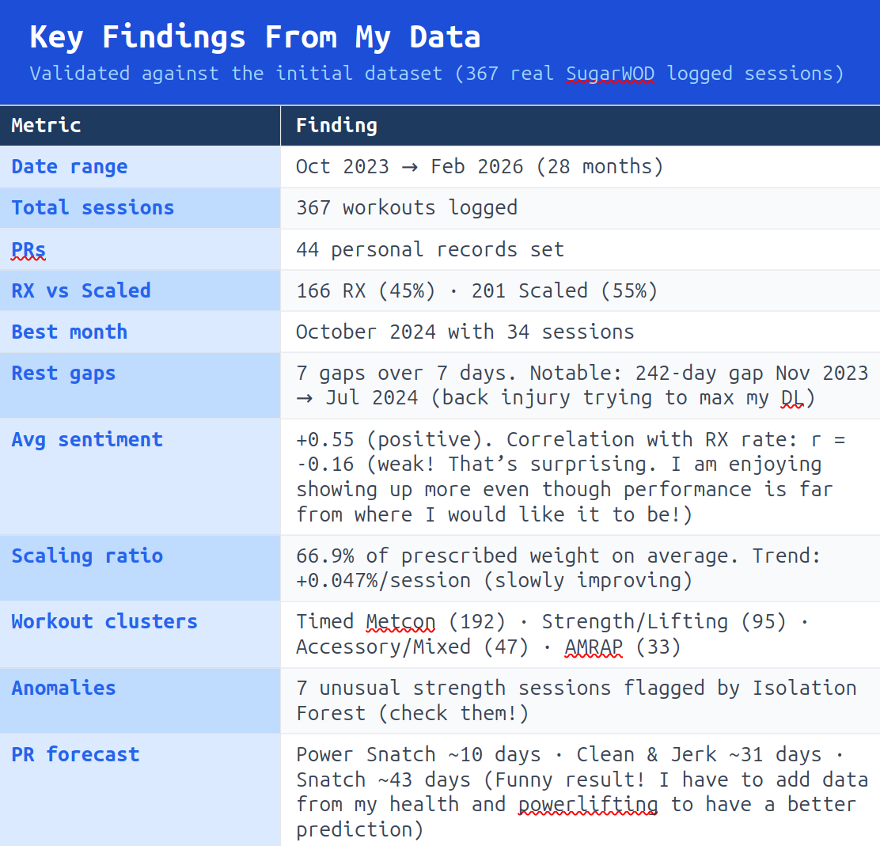

Slide 26
AGENT LAYER └─ tools.py └─ agent.py └─ app.py
tools.py
Wraps analysis functions into callable tools
Used by the agent to run analytics
agent.py:
Claude agent loop
Chooses tools, runs them, returns answers
App.py
Streamlit chat UI
Displays charts + responses
.env (secret)
Contains ANTHROPIC_API_KEY
Not commited to GitHub

Slide 27
CAPABILITIES
Analyze workout history
Ask questions in natural language
See charts + insights
LET’S SEE HOW IT LOOKS LIKE:

Slide 28
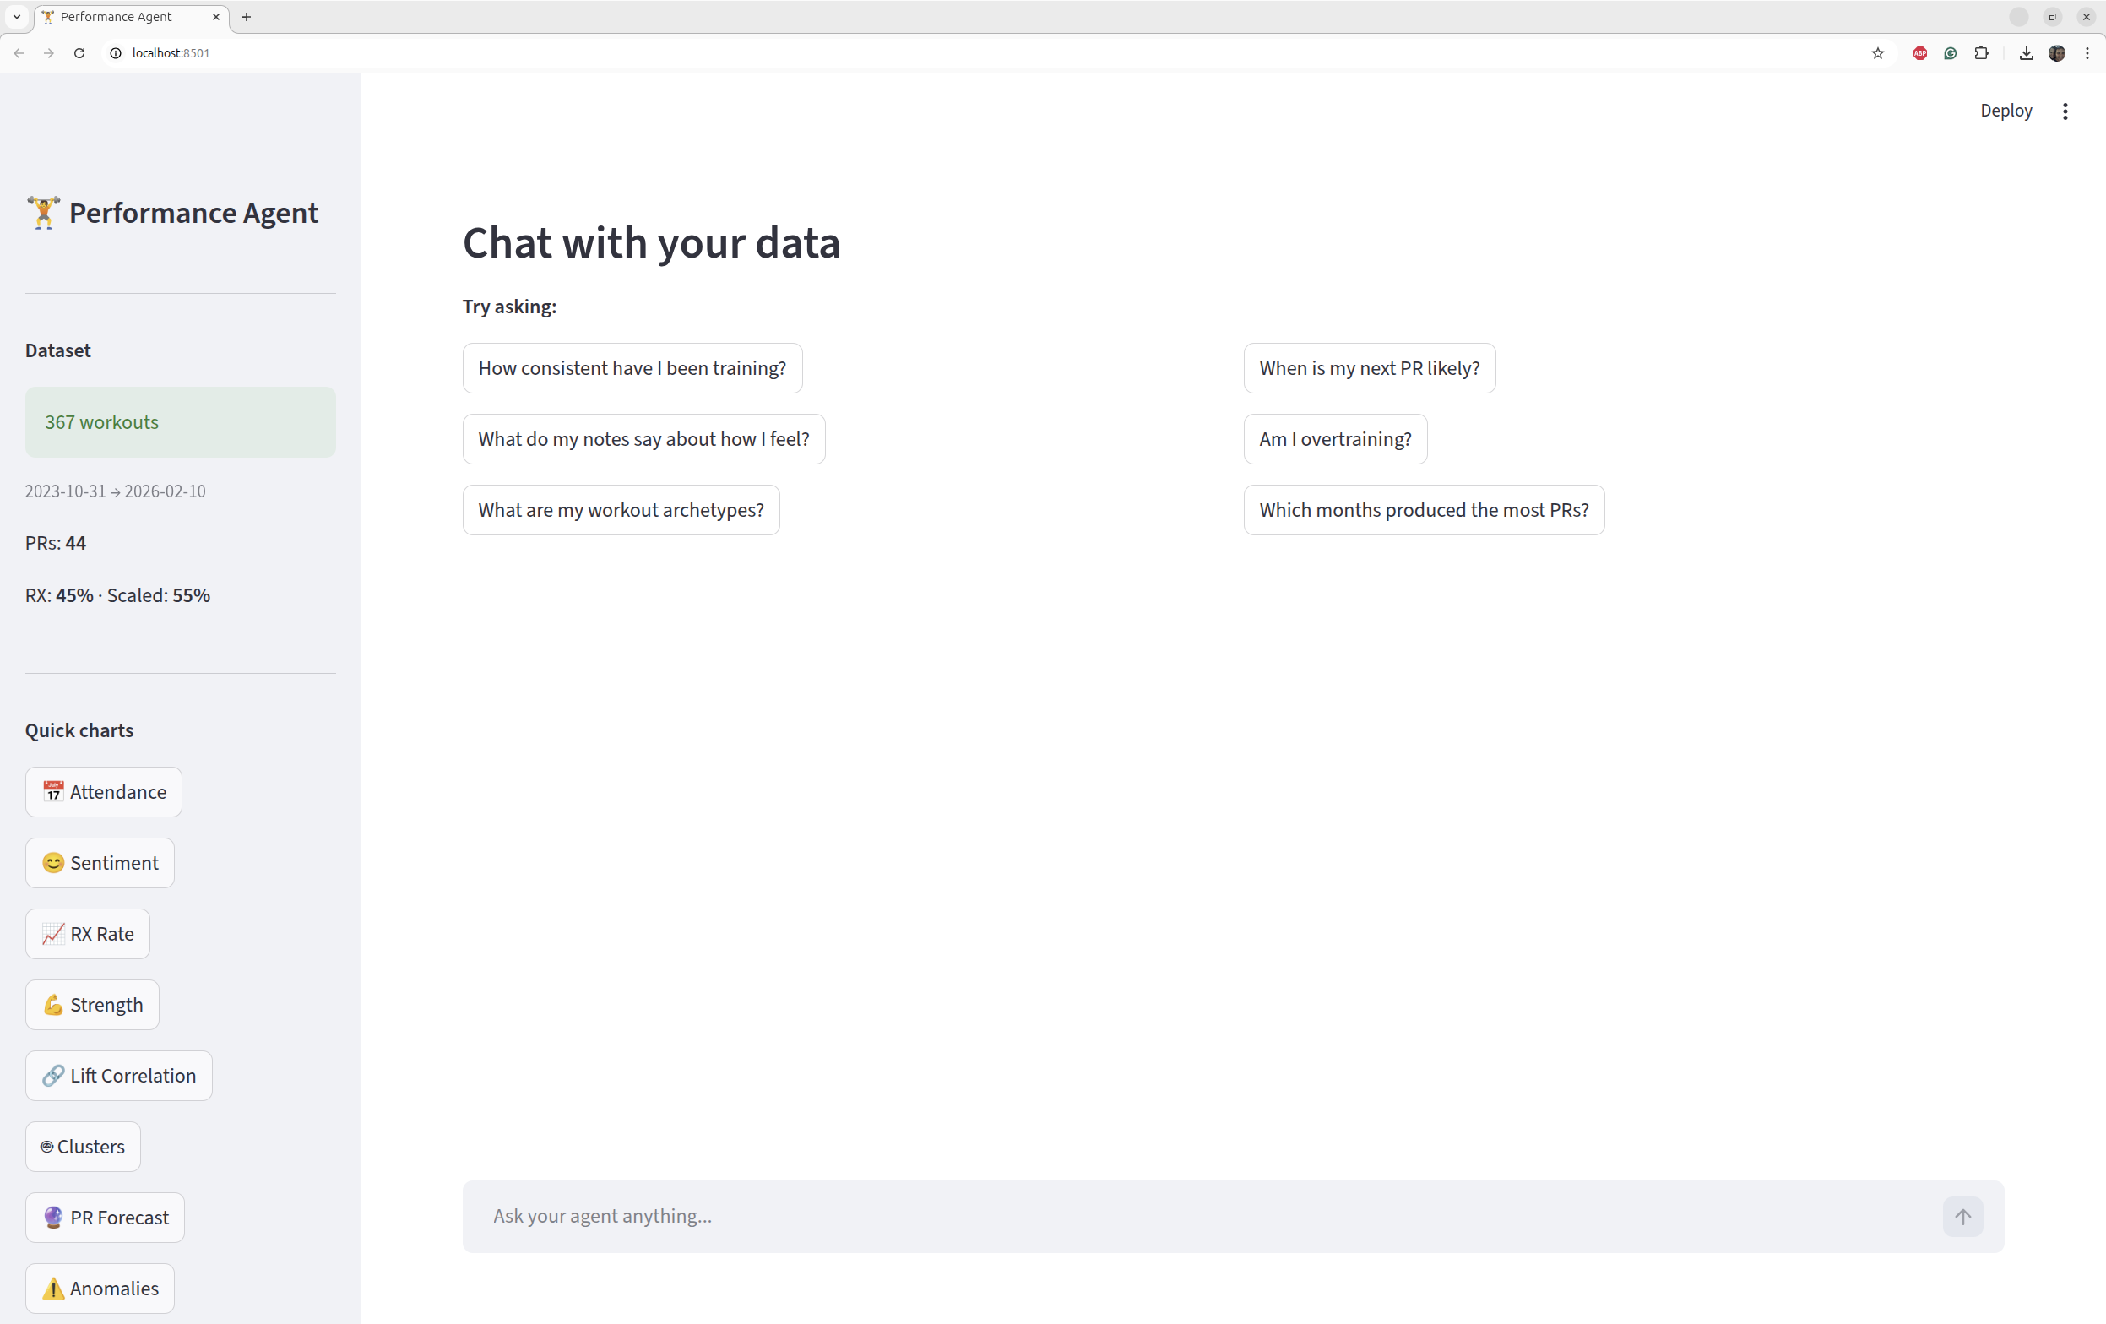

Slide 29
Another relevant files:
capstone_written_responses.docx
agent_walkthrough.docx
project_plan_skillsforhire.docx

Slide 30

Thank you

