Slide 1

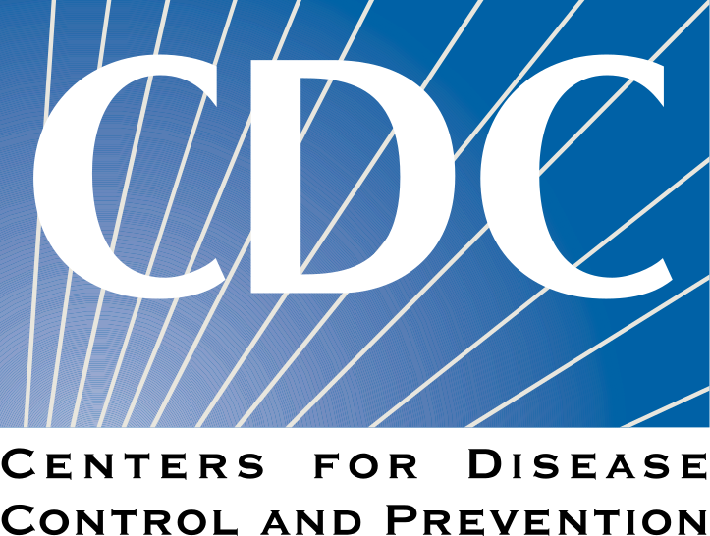

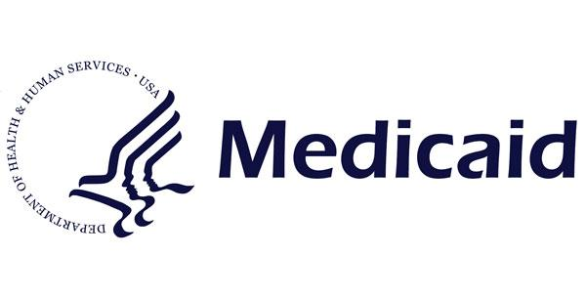
Group 6
CDC Opioid Death Review: 2015 - 2019
Rohan, Josh, Catharine, Helen, Henok, Chris

Slide 2
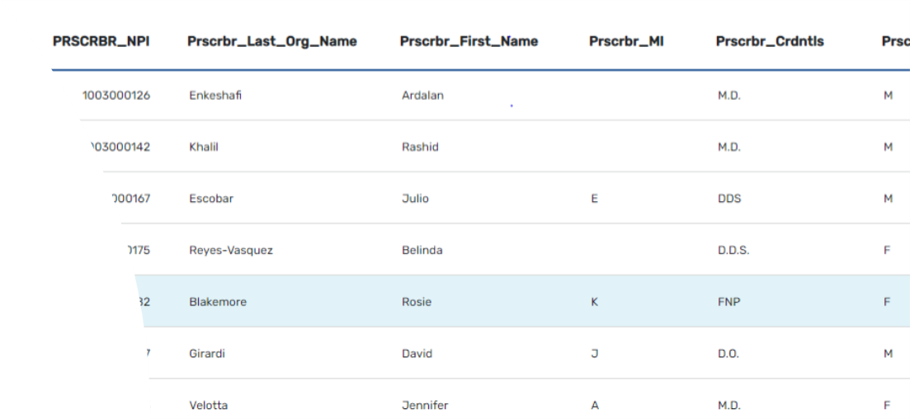
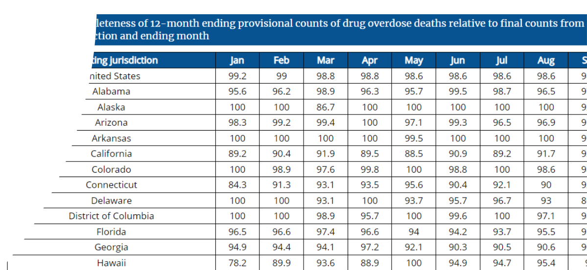
Source Data Review
Data sources:
CDC:
12 month – ending provisional count & Percent Change of Drug Overdose Death.
12 month – ending provisional Number & Percent Change of Drug Overdose Death
Medicare/Medicaid:
Medicare Part D Opioid Prescribing Rates by state (2013 – 2019)
Medicaid Opioid Prescriptions by state (2013 -2019)
•Business Case: Attempting to find correlation of Drug overdose Opioid Deaths to Prescription Rates.
•Approach: From each data source extract each data set then, clean and filter all data to an equal row count. One completed Merge the Medicare and Medicaid data.
• Challenges and Opportunities:
•Merging data
•Reducing the data set to a small subset
•Plotting against each data set
•Data Limitations:
•Data only reflect Prescribe opioids

Slide 3
Google Heatmaps
Used Google Heatmaps to show regional hotspots of overdose deaths in the country
Largest rate of increase of overdose deaths occured in the eastern Midwest region and Florida
California has had a consistently large number of overdose deaths relative to the rest of the country

Slide 4
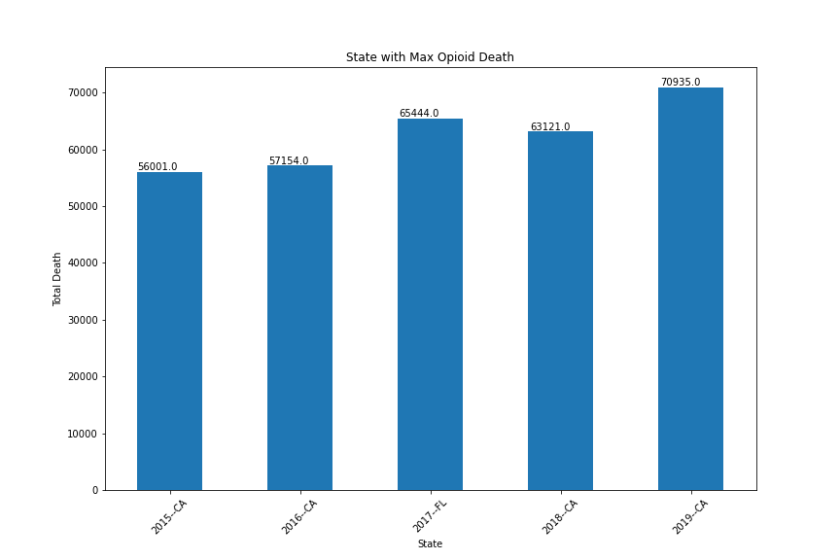
States with Highest Opioid Drug Overdose Deaths
The state of California has the highest opioid overdose deaths in 2015, 2016, 2018, and 2019.
However in 2017, the state of Florida has the highest opioid overdose deaths.

Slide 5
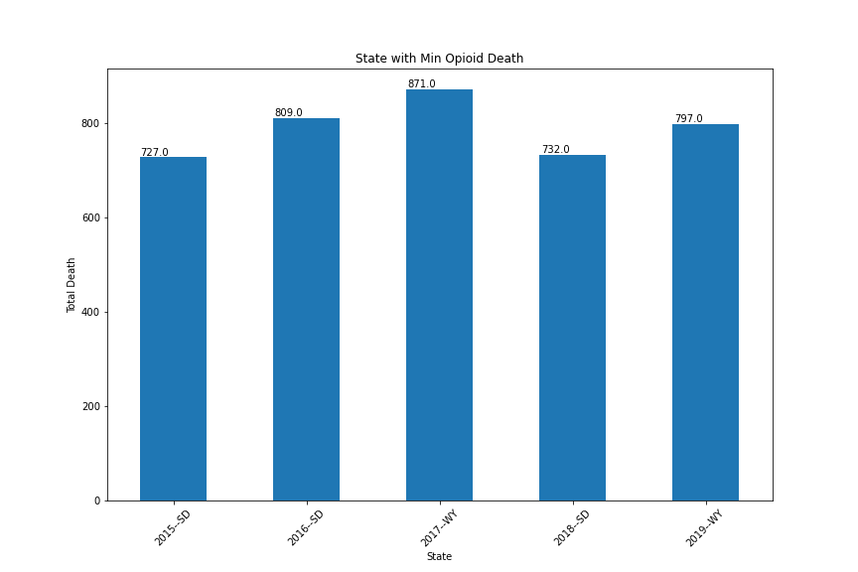
States with Lowest Opioid Drug Overdose Deaths
South Dakota has the lowest drug overdose deaths in 2015, 2016, and 2018.
Wyoming has the lowest drug overdose deaths in 2017 and 2019.

Slide 6
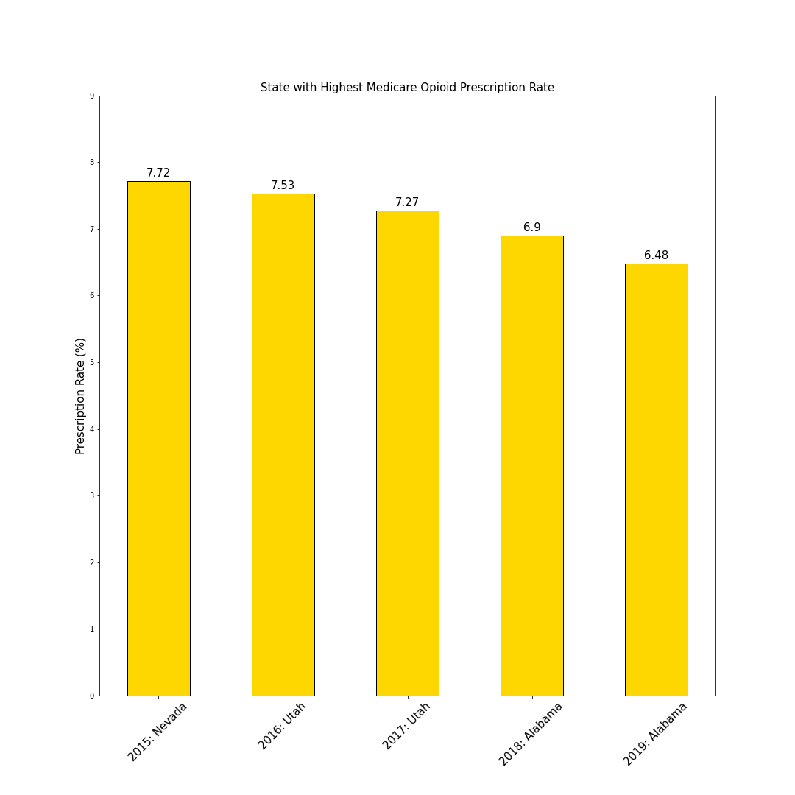
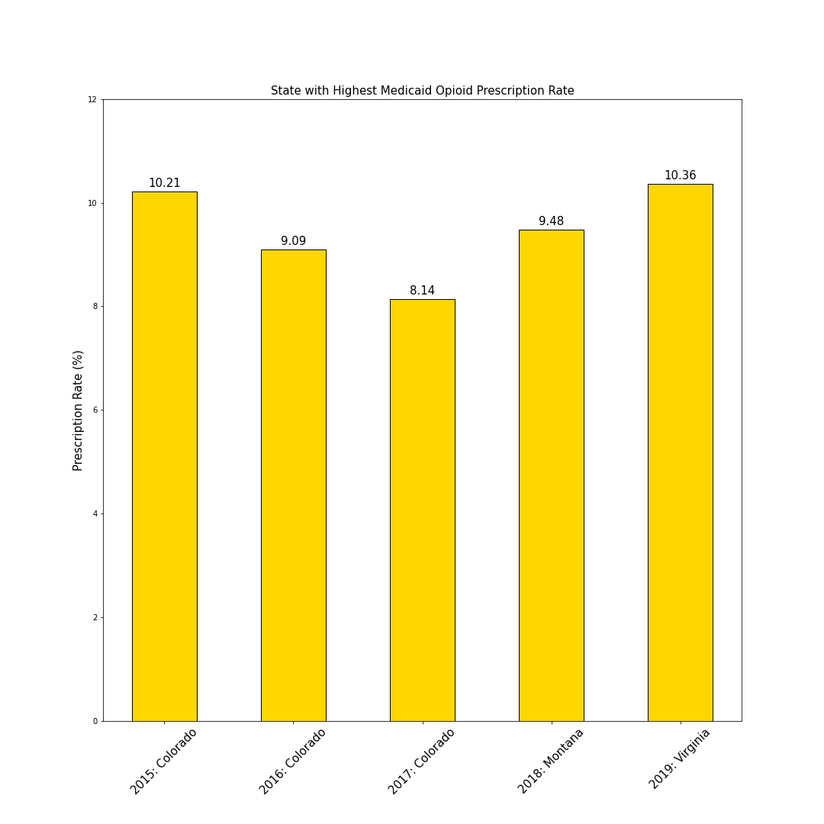
Highest Medicare and Medicaid Opioid Prescription Rates
The highest prescription rates for Medicare were Nevada in 2015, Utah in 2016 and 2017, and Alabama in 2018 and 2019
The highest prescription rates of Medicaid were Colorado in 2015, 2016, and 2017 Montana in 2018 and Virginia in 2019

Slide 7
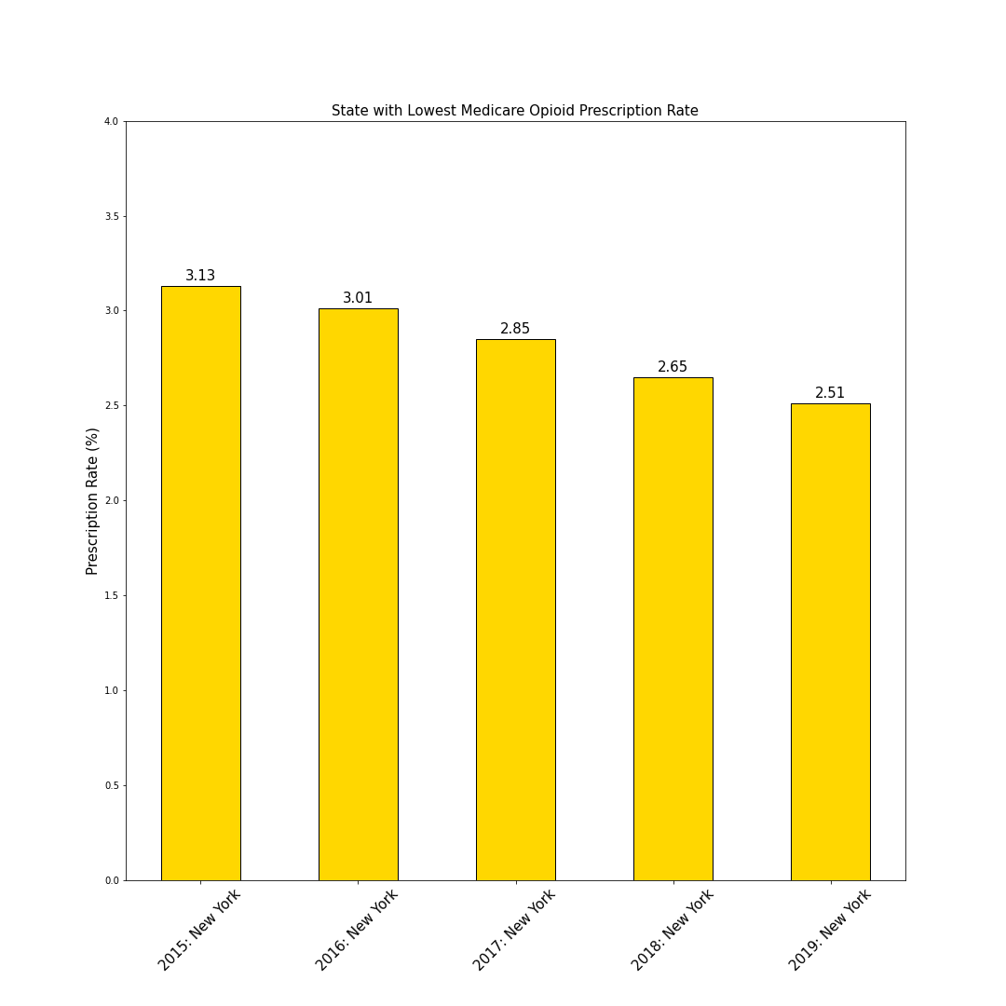
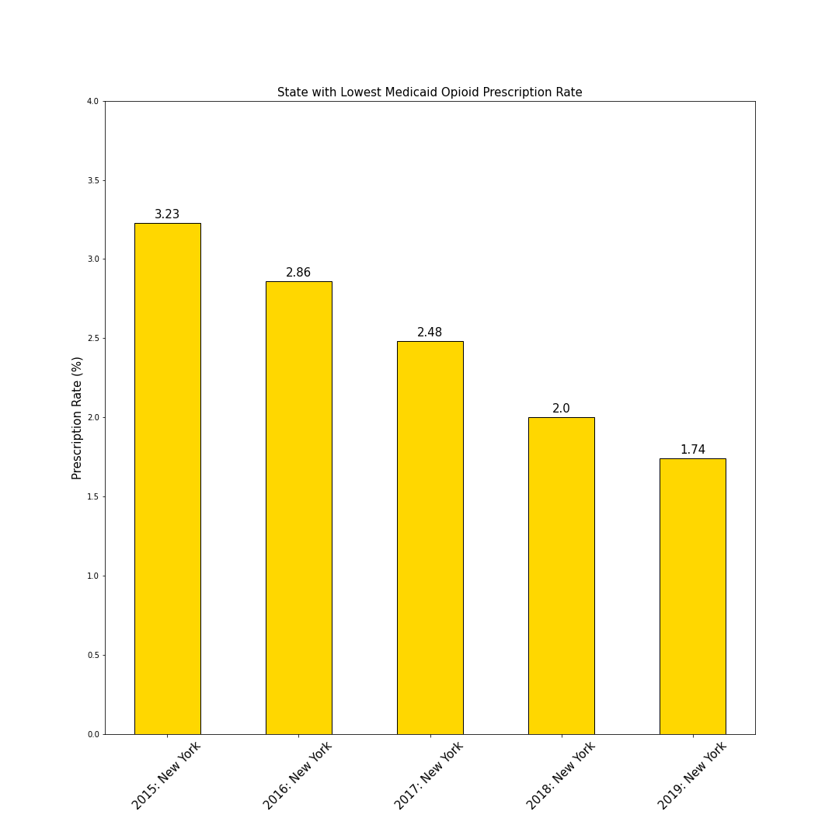
Lowest Medicare and Medicaid Opioid Prescription Rates
The lowest prescription rates for Medicare AND Medicaid were all found in New York (2015 - 2019)

Slide 8
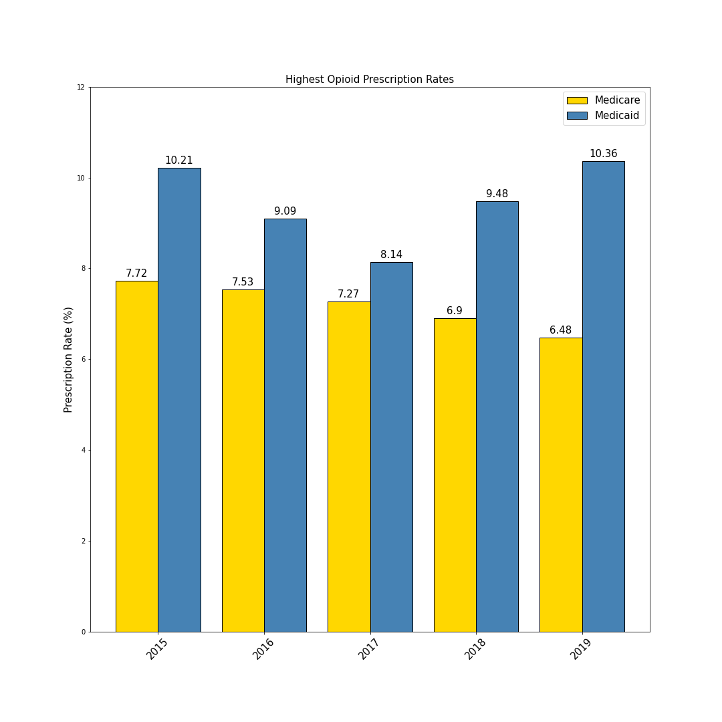
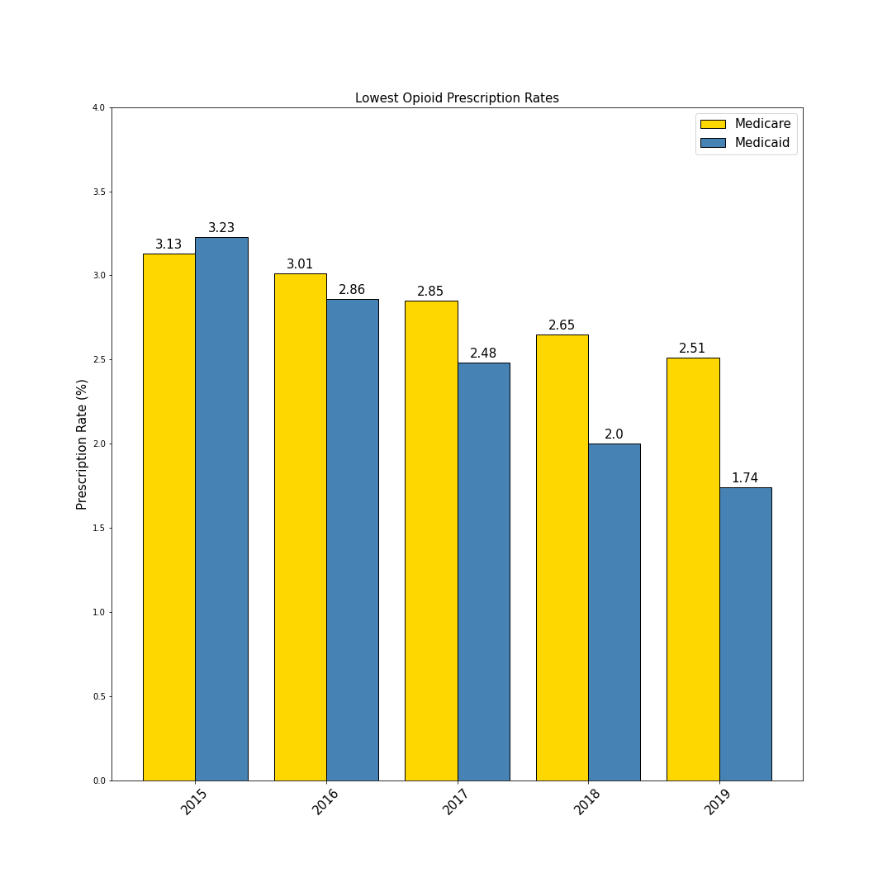
Direct Comparison of Medicare versus Medicaid High/Low
The highest prescription rates for Medicare (yellow) consistently declined, while the Medicaid (blue) values fluctuated
The lowest prescription rates for Medicare slowly decreased, while the Medicaid values more strongly decreased

Slide 9
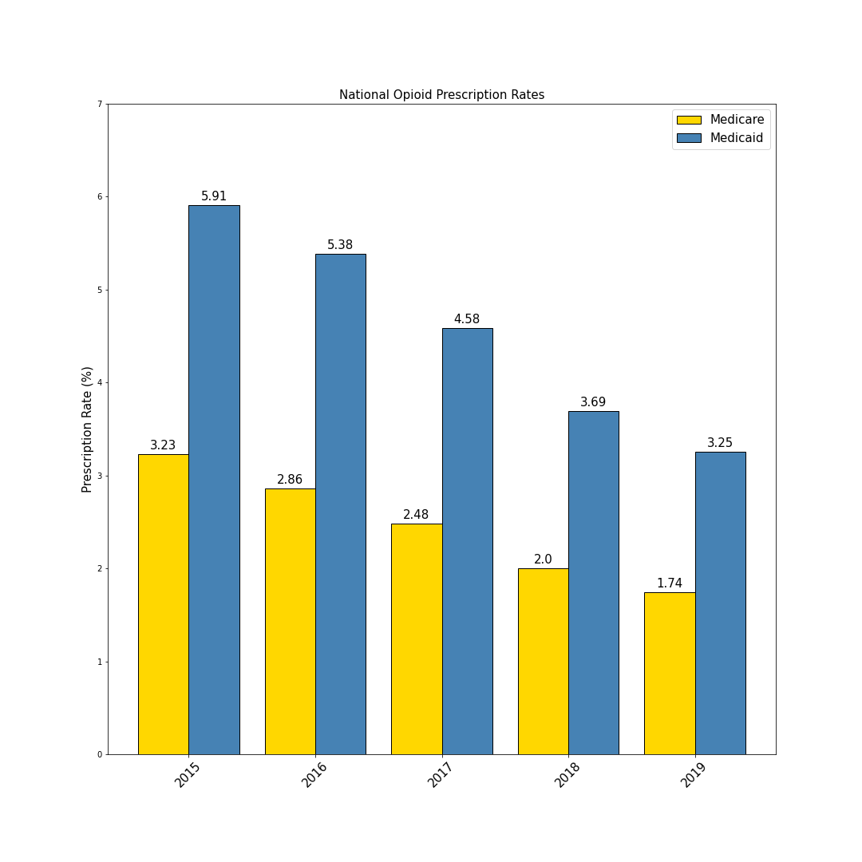
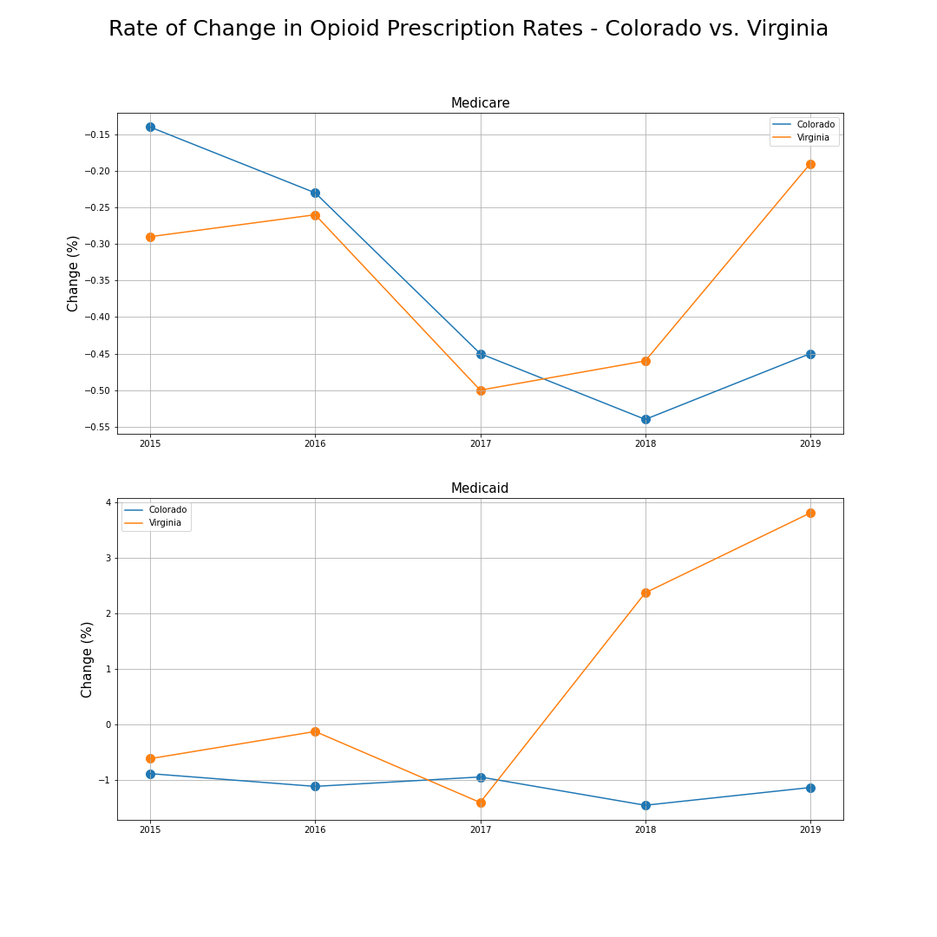
Comparison of Prescription Rates

Slide 10
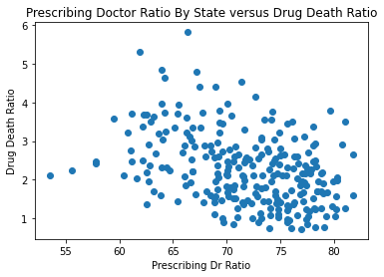
Doctors Prescribing Opioids Ratio vs Opioid Death Rate
Does a higher ratio of Doctors Prescribing Opioids in a given state have a correlation with a higher opioid overdose death rate?
=
=
Lowest Ratio of Doctors Prescribing New York 2019: 53.52%
Highest Ratio of Doctors Prescribing North Carolina 2015: 81.76%
No Correlation found between Prescription Rate and Opioid Death Ratio
Drs Prescribing Opioids Ratio
Doctors Prescribing Opioids
All Prescribing Doctors
Overdose Death Ratio
Overdose Deaths for a given state
All Deaths for given State

Slide 11
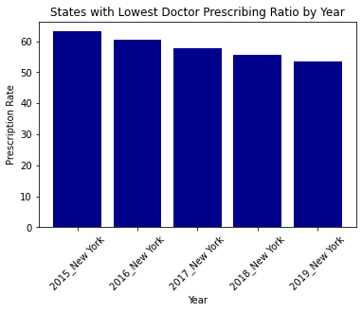
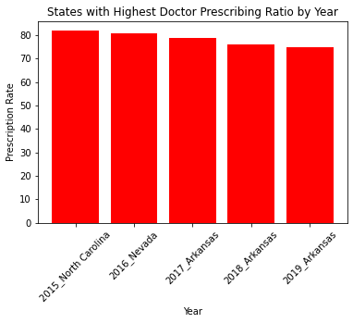
Doctor Prescribing Opioids Ratio
Similar to the decrease in Prescription Rates, the ratio of Doctors prescribing Opioids overall was lowest in New York State all 5 years, and fell each year. The highest Prescribing Ratio by year was held by multiple states, with Arkansas taking the highest position for the last 3 years of the dataset.

Slide 12
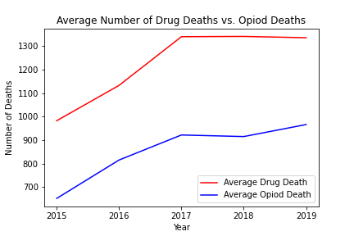
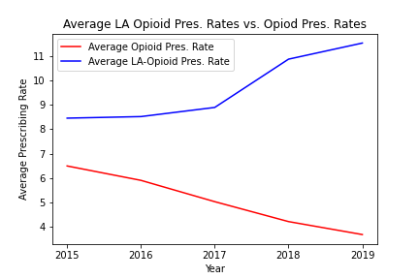
Average Deaths & Average Prescribing Rates
Notes:
~ From the medicaid, state federal program that provides health insurance to folks that are low-income
~ Long-Acting Opioids include: Fentanyl patch (Duragesic), Methadone (Dolophine), Morphine (Kadian), Oxycodone controlled-release (OxyContin)
These are slow-release long-term pain,
~ Looking at overall years, the average number of death rates increased throughout the years, with a peak in 2017 & sort of plateau the next two.
~ Which was the same year the US Dept of Health & Human Services declared a public health emergency on the Opioid Crisis.
~ Similarly, opioid deaths rose as well
~ Interestingly, LA-Opioids pres. rates increased, and saw 2% jump in 2018,
~ Can help with long, enduring pain, experience less highs & lows [withdrawls] from short-acting

Slide 13
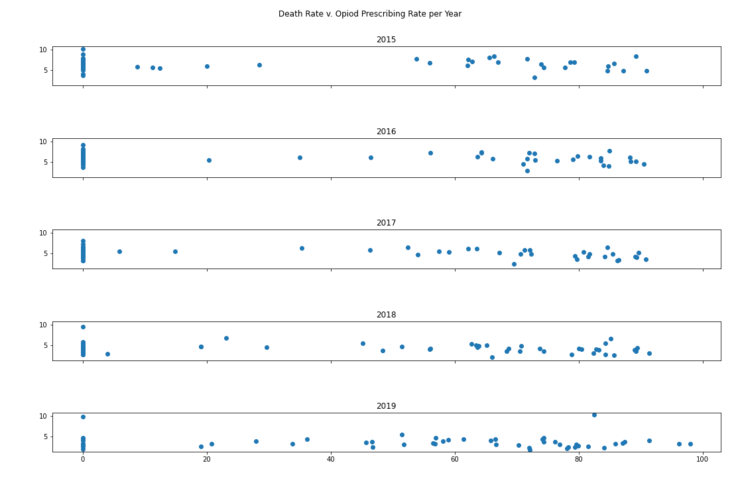
State Death Rate vs Opioid Prescribing Rate Per Year
Visually–state death rates increased throughout this 5-year period, whereas Opioid Prescribing rates decreased.
Notes:
~ Not visually the best, but in terms of looking at the way prescribing rates decreased, meanwhile deaths continued to increase, following in line with the previous conclusion that medicare opioid prescribing rates and death rates aren’t strongly correlated.
~ Could be due the state/federal regulations on opioid prescription rates due to Purdue pharma & stuff

Slide 14
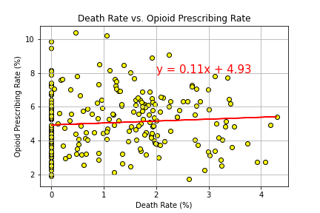
State Death Rate vs Opioid Prescribing Rate
R-squared value:
The r-squared is: 0.006
Suggesting there is not a strong correlation between State Death Rate vs Opioid Prescribing Rate
Notes:
Are Medicaid Opioid Prescribing Rate and State Death Rates Correlated?
~ ~ This is a scatter plot comparing the state and year death rates and Opioid Prescribing Rates
~ Includes all Opioid types

Slide 15
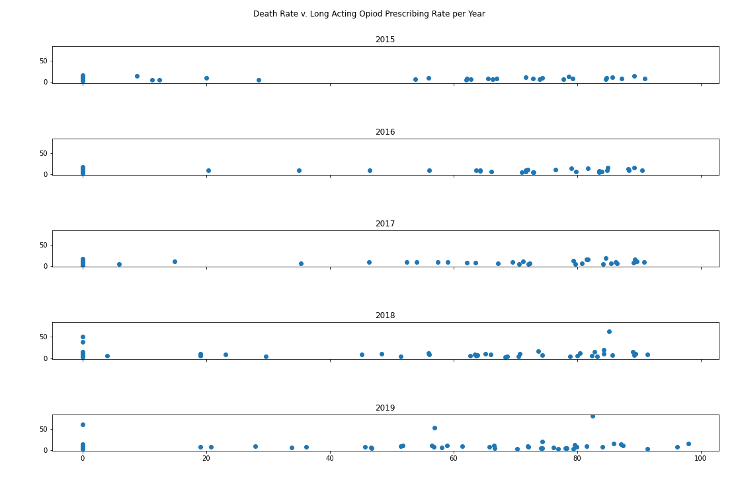
State Death Rate vs LA Opioids Prescribing Rate Per Year
Visually–state death rates increased throughout this 5-year period, whereas LA Opioid Prescribing rates remained relatively the same.
Notes:
~ Not visually the best, but in terms of looking at the way prescribing rates remained relatively low, meanwhile deaths continued to increase, following in line with the previous conclusion that prescribing rates and death rates aren’t strongly correlated.

Slide 16
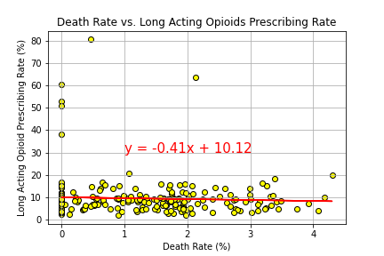
State Death Rate vs Long Acting Opioids Prescribing Rate
R-squared value:
The r-squared is: 0.003
Suggesting there is no correlation between State Death Rate vs Medicaid LA Prescribing Rate
Notes:
Are Medicaid LA Prescribing Rate and State Death Rates Correlated?
~ This is a scatter plot comparing the state and year death rates and LA-Opioid Prescribing Rates
~ From the medicaid, state federal program that provides health insurance to folks that are low-income
~ Long-Acting Opioids include: Fentanyl patch (Duragesic), Methadone (Dolophine), Morphine (Kadian), Oxycodone controlled-release (OxyContin)
These are slow-release long-term pain
~ Note: Zero values are present and represent states that reported no deaths and some states reported no data.

