Slide 1
Stock Analysis
Team Member:
Chris, Helen, Khantapob

Slide 2
Questions and Motivations
We purposely chose 3 stocks
AAPL – Apple Stock
TSLA – Tesla
HMNY - Helios and Matheson Analytics Inc (Big Data technology and Advanced Analytics) acquired Movie pass
We want to find out if the stock historical trend is more accurate or Twitter sentiment is more accurate in predicting the future value

Slide 3
Core Hypothesis
1
For Tesla, Twitter data should be more accurate to predict
2
For Apple, the opening trend should be more accurate to predict
3
For HMNY, there should be no strong correlation

Slide 4
Where the data came from
Data Source
Stock Data: https://iextrading.com/developer/docs/#chart (stock data)
Twitter Data: [‘@elonmusk’, ‘@tesla’, '@HMNYHQ1', '@tim_cook’, ]

Slide 5
Data exploration and Cleanup
1
We got the last 3 month of 3 stock closing data and get the moving average of 7day
2
We found that HMNY is really close to $0 now.
HMNY = summary.loc[(summary["Ticker"] == "HMNY")]
HMNY = summary.loc[(summary["Moving Average"] <= .04)]
HMNY = HMNY.reset_index(drop=True)

Slide 6
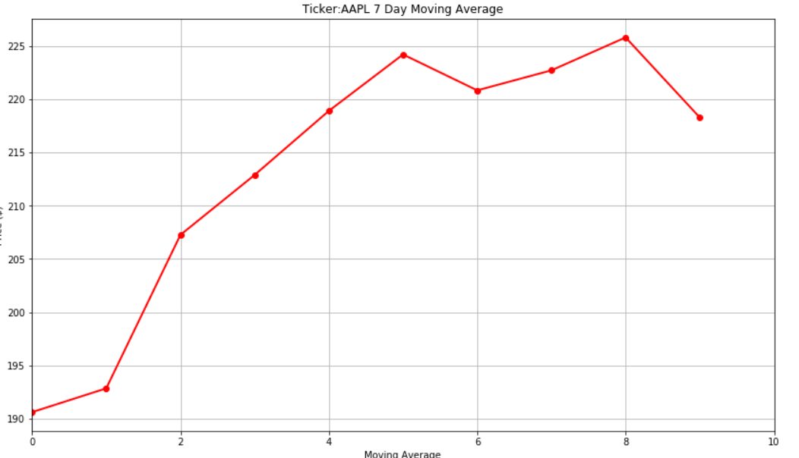
Describe the analysis process
Show Graph (AAPL)

Slide 7
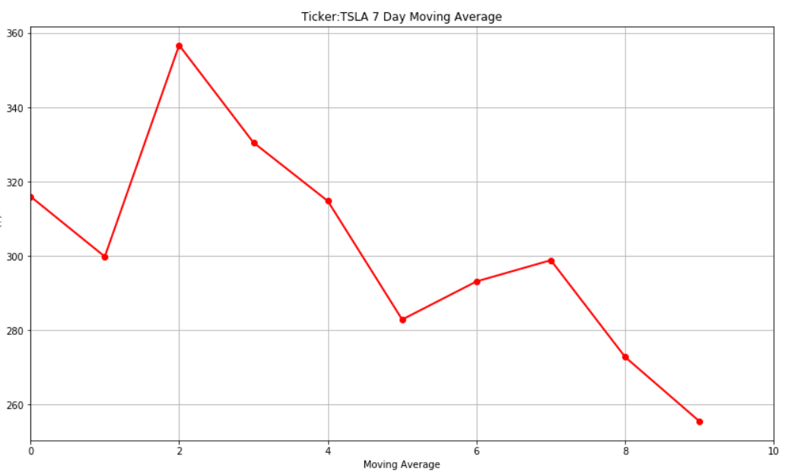
Graph (TSLA)

Slide 8
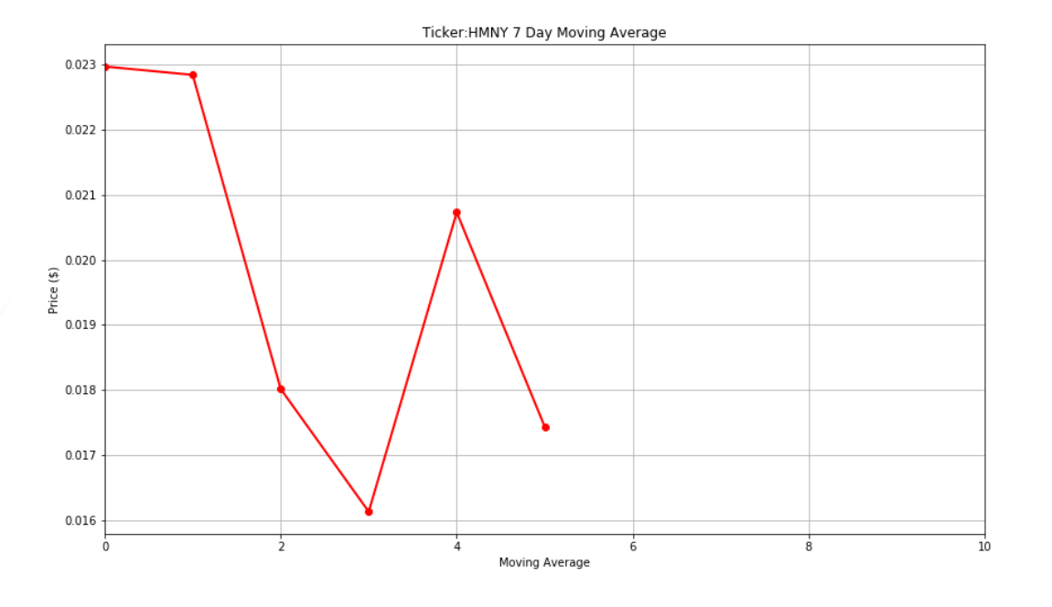
Graph (HMNY)

Slide 9
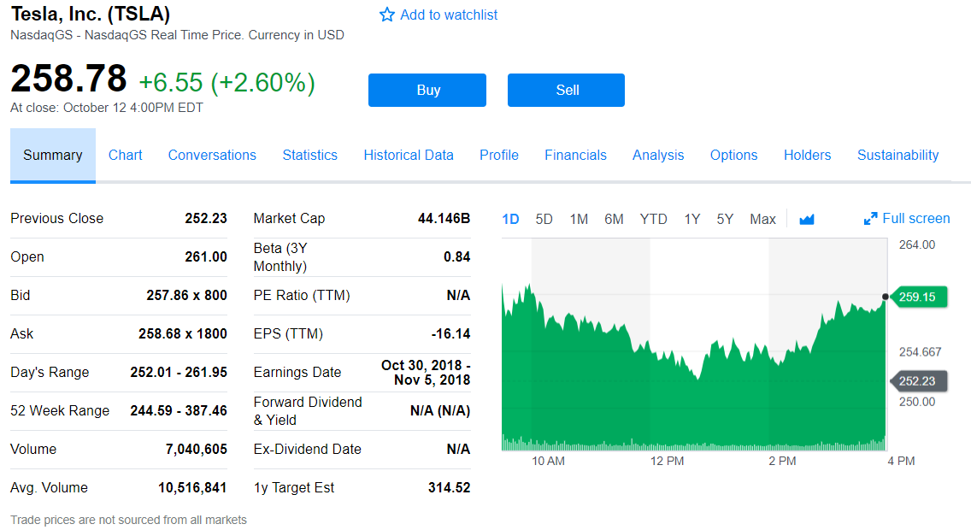
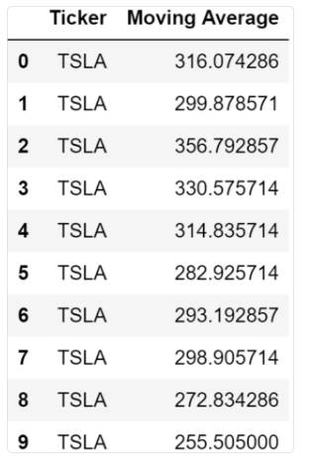
Moving Average (TSLA)

Slide 10
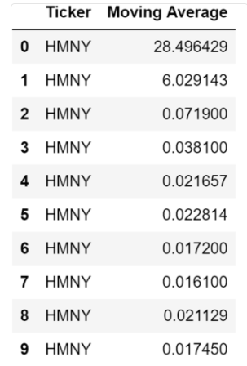
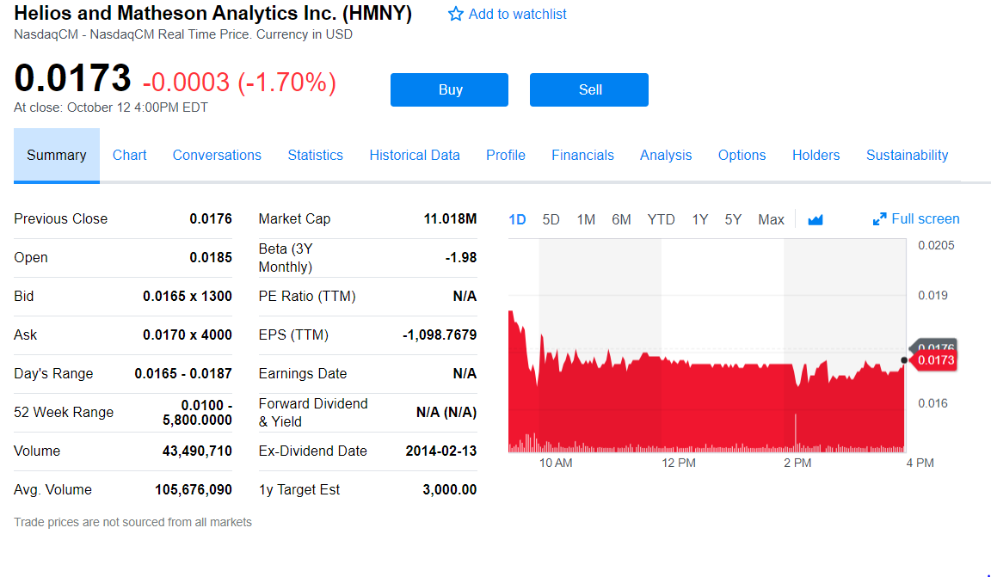
Moving Average (HMNY)

Slide 11
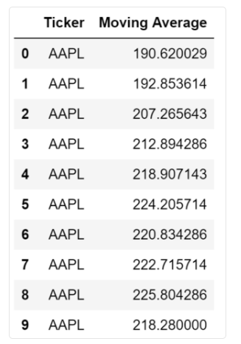
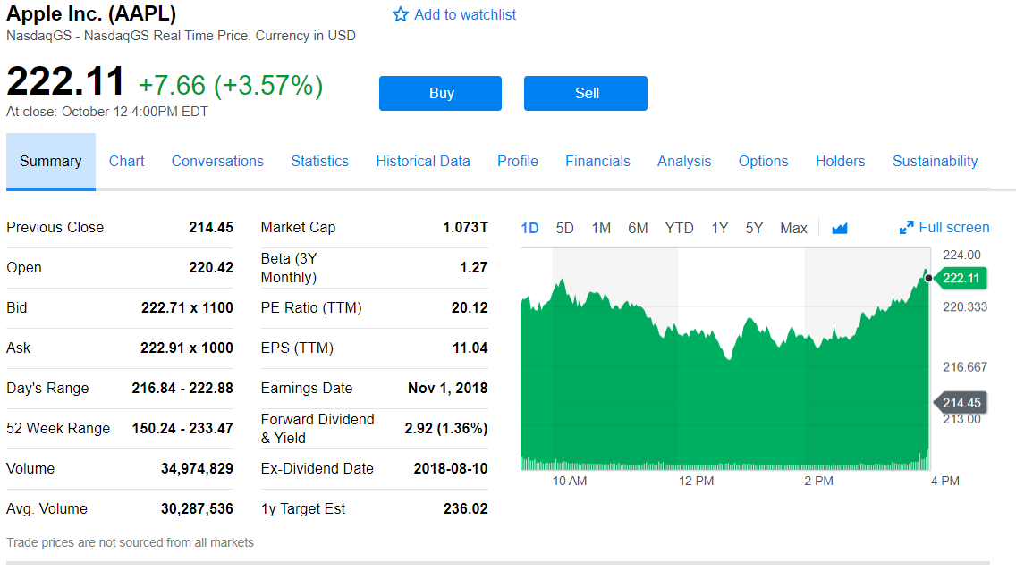
Moving Average (APPL)

Slide 12
Discuss the implications findings
For 10/11
TSLA: both twitter and prediction is correct
AAPL: twitter is correct and prediction is wrong
HMNY: both twitter and prediction is wrong
For 10/12
TSLA: both twitter and prediction is wrong
AAPL: both twitter and prediction is wrong
HMNY: both twitter and prediction is correct

Slide 13
Conclusion
Stocks are a gamble

Slide 14
Q and A
Notes:
In Slide Show mode, select the arrows to visit links.

