Slide 1
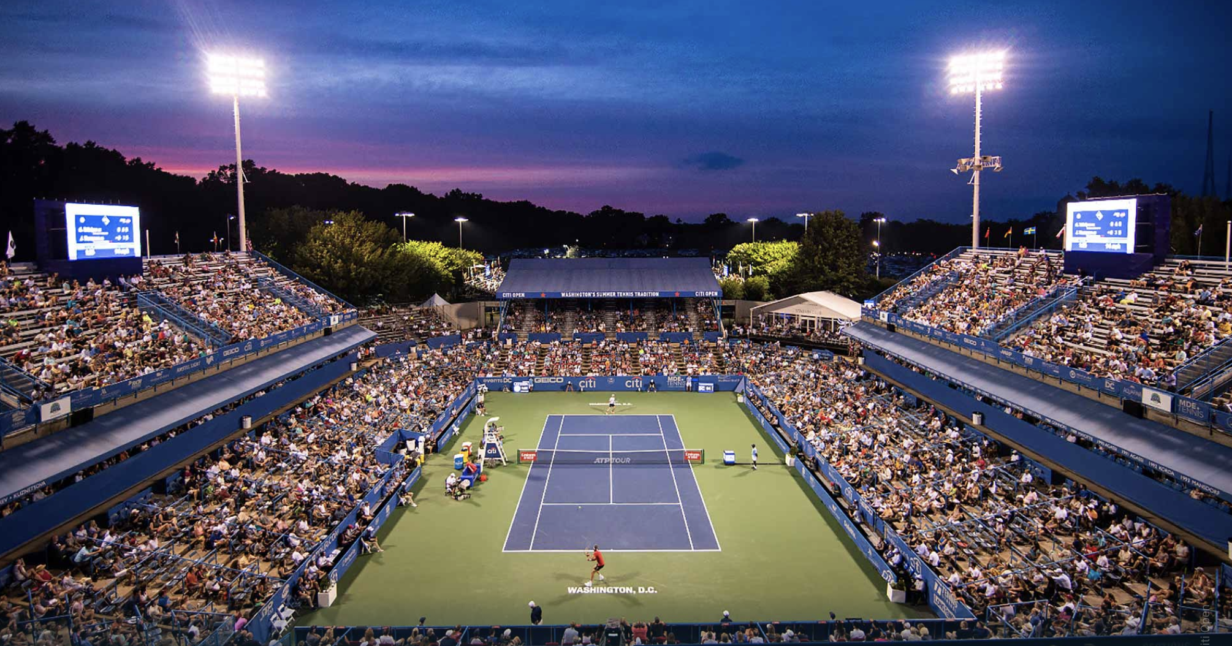
IDS 702 Team Project
Grey Team
(Nick Carroll, Jiaxin Ying, Emmanuel Ruhamyankaka, Song Young Oh)

Slide 2
Agenda
Background
Methods
Results
Conclusion
Notes:
Minda go through agenda, “housekeeping” There is a lot to learn when you begin a graduate program in a new school. We don’t want to overwhelm you with EVERYTHING you need to know to succeed here. Instead we are going to “chunk it up” in (somewhat) easily digestible bites. We anticipate you will still have questions about a variety of things at the end of this session and that is ok. We have a plan for some of those questions, maybe not all of them, but it is in no one’s best interest to keep you in the dark. We ask that you be patient when we tell you that information is coming and if we don’t know the answer, we will tell you that and do our best to find out as soon as we can and get back to you.
A little “housekeeping” - please stay on mute during the session. We will pause at certain points and ask if there are questions. If you are comfortable unmuting yourself to ask your question, do that. You can also raise your hand and post in the chat. There will be time at the end for Q&A as well.
We will take a 5 minute “bio” break as close to 11 as possible. And, we will record this for those who couldn’t be here today or if you need to leave the session for some reason.

Slide 3
Background
Text
Text
Notes:
Need to stress the importance of staying in touch this semester, especially the importance of reading your emails.
JSM
How we communicate with you and how we expect you to communicate with us
Office hours
Slack

Slide 4
Methods
Text
Text
Notes:
Need to stress the importance of staying in touch this semester, especially the importance of reading your emails.
JSM
How we communicate with you and how we expect you to communicate with us
Office hours
Slack

Slide 5
Results
Text
Text
Notes:
Need to stress the importance of staying in touch this semester, especially the importance of reading your emails.
JSM
How we communicate with you and how we expect you to communicate with us
Office hours
Slack

Slide 6
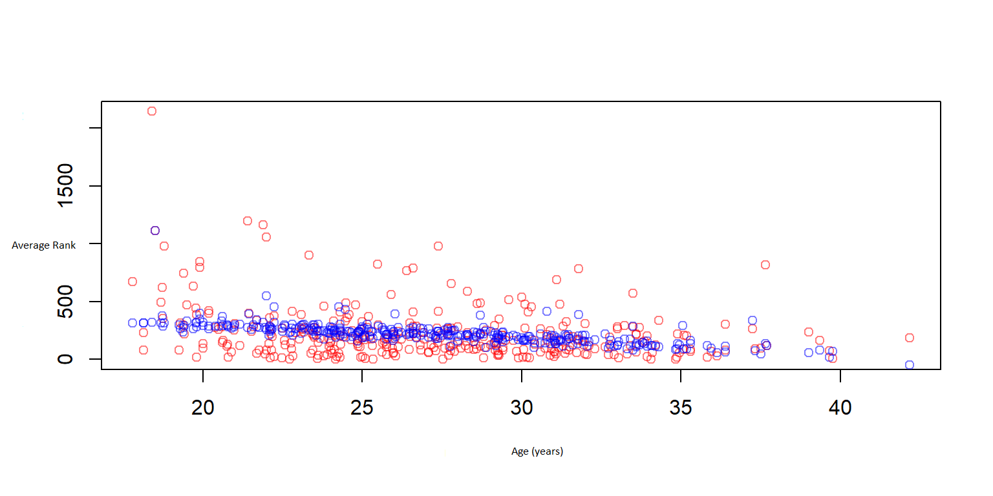
Results
Term | Estimate | Standard Error | Statistic | p-value
Height | -3.8556 | 1.9081 | -2.0207 | 0.0442
Age | -11.3301 | 2.5613 | -4.4237 | 0.0000
Hand: Right | ------- | ------- | ------- | -------
Hand: Left | -37.9741 | 34.7338 | -1.0933 | 0.2751
Region: North America | ------- | ------- | ------- | -------
Region: Africa | 211.1458 | 85.2622 | 2.4764 | 0.0138
Region: Asia | -3.7804 | 58.0921 | -0.0651 | 0.9482
Region: Australia | 16.7798 | 58.0895 | 0.2889 | 0.7729
Region: Europe | -28.9559 | 38.3149 | -0.7557 | 0.4504
Region: Middle East | 139.1449 | 115.1752 | 1.2081 | 0.2279
Region: South America | -3.2483 | 49.5387 | -0.0656 | 0.9478
Significant Predictors: Height, Age, African Nationality
R-Squared: less than 15%
Average Rank vs. Age (predictions vs. actual)
Notes:
Need to stress the importance of staying in touch this semester, especially the importance of reading your emails.
JSM
How we communicate with you and how we expect you to communicate with us
Office hours
Slack

Slide 7
Term | Odds Estimate | Log Odds Estimate | Statistic | p-value
Height (Lower Rank) | 0.866 | -0.1437 | -1.1285 | 0.2591
Age (Lower Rank) | 1.524 | 0.4216 | 2.2236 | 0.0262
Tournamnet: Standard | 1 | ------- | ------- | -------
Tournament: Finals | 0.139 | -1.9744 | -0.0008 | 0.9993
Tournament: Grand Slam | 0.006 | -5.1621 | -0.8645 | 0.3873
Tournament: Master’s | 0.000 | -8.8214 | -2.2213 | 0.0263
Tournament Size | 1.065 | 0.0633 | 1.2796 | 0.2007
Match Surface: Hard |  | ------- | ------- | -------
Match Surface: Clay | 11.837 | 2.4712 | 1.2379 | 0.2158
Match Surface: Grass | 0.559 | -0.5811 | -0.1283 | 0.8979
Tournament Date | 1.002 | 0.0024 | 0.8496 | 0.3956
Tournament Seed (Lower Rank) | 2.056 | 0.7209 | 2.7221 | 0.0065
Hand: Right (Lower Rank) | 1 | ------- | ------- | -------
Hand: Left (Lower Rank) | 0.080 | -2.5274 | -1.1016 | 0.2706
Hand: Right (Higher Rank) | 1 | ------- | ------- | -------
Hand: Right (Higher Rank) | 0.220 | -1.5162 | 0.5115 | 0.6090
Height (Higher Rank) | 1.184 | 0.1687 | 1.3920 | 0.1639
Age (Higher Rank) | 1.075 | 0.0722 | 0.5482 | 0.5836
Round: of 64 | 1 | ------- | ------- | -------
Round: Quarter Final | 190.281 | 5.2485 | 1.8691 | 0.0616
Round: of 16 | 51.403 | 3.9397 | 1.4485 | 0.1475
Round: of 32 | 29.415 | 3.3815 | 0.8164 | 0.4143
Round: Round Robin | 0.715 | -0.3350 | -0.0425 | 0.9661
Round: Semi-Final | 1903.977 | 7.5517 | 2.1583 | 0.0309
Rank (Lower Rank) | 1.232 | 0.2089 | 2.5872 | 0.0097
Results
Significant Predictors: Master’s Tournament, Grass Surface, Age (Lower Rank)
95% Accuracy
 | FALSE | TRUE
FALSE | 98 | 4
TRUE | 3 | 42
Notes:
Need to stress the importance of staying in touch this semester, especially the importance of reading your emails.
JSM
How we communicate with you and how we expect you to communicate with us
Office hours
Slack

Slide 8
Conclusion
The variables from our data are effective to understand the factors that impact an upset, but insufficient to predict a player's average rank for a season based on player's attributes.

Slide 9
Reason: There is substantial variability in a player’s average rank , it cannot be explained by the player's attributes alone.
Limitations: We did not consider two key points for predicting a player's rank:
1. Our analysis is based on a player's average rank for the season, but a season lasts several months and can have unexpected events such as injuries that are not included in dataset.
2. This analysis has only regressed a player’s average rank based on the player’s attributes, we did not consider the player's skills.
A player's skills are more impactful than their height and age on their game performance
Potential factors of performance which are not captured in dataset:
1. serve speed 2. lateral speed 3. reaction time
Notes:
Need to stress the importance of staying in touch this semester, especially the importance of reading your emails.
JSM
How we communicate with you and how we expect you to communicate with us
Office hours
Slack

Slide 10
After analyzing the factors that impact the likelihood of an upset for players, tournament type, match surface, and player ages are all strong indicators for predicting the likelihood of an upset.
Limitations:
Underlying confounding variables which impact the likelihood of an upset:
1. While age can be an indicator of maturity, it would be reasonable to believe that there is a mental component to an upset that is not accurately captured in our dataset
2. Tournament type and match surface are both external variables, so this analysis indicates that players have little ability to impact the likelihood of an upset on their own. This is one-sided, because in fact other internal factors of the player should also be taken into account.
Further research:
Exploring how a player's skills, psychological status, or recent performance can impact the likelihood of an upset.

Slide 11
Thank You!

