Slide 1
Identify drug target by maximizing information flow
Helen zhou
Research Science Institute
Bioinformatics Division and Center for Synthetic and Systems Biology
Tsinghua university
July 25,2015

Slide 2
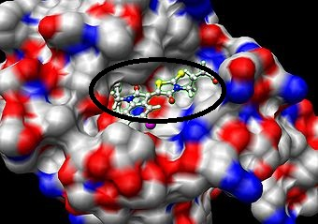
Drug target
Native protein in the body whose activity is modified by a drug resulting in a specific effect
small molecule (drug)
protein(target)

Slide 3
Application
Identify new drugs target
New applications of existing drugs/create new drugs
Understand side effects and toxicity

Slide 4
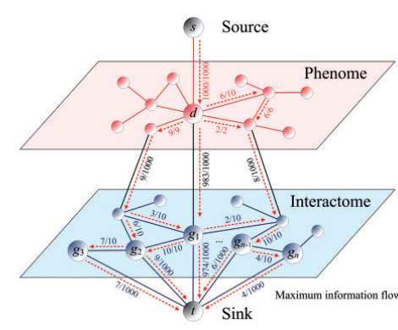

Network
Drug target
Drug
Yong Chen et al.(2011)
Uncover disease genes by maximizing information flow in the phenome–interactome network ISMB,2011,i167–i176

Slide 5
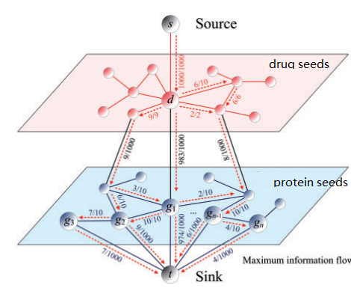
Assumption
molecules with higher similarity have stronger association(standard of association)
Yong Chen et al.(2011)Uncover disease genes by maximizing information flow in the phenome–interactome network ISMB,2011,i167–i176

Slide 6
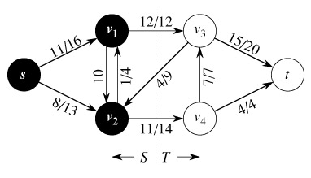
MAXIF
Maximizing information flow
Drug
Protein
capacity
flow

Slide 7
Acknowledgement
my comentor Mr.Zu and labmates
Ms.Ana and Mr.Chris
RSI
Tsinghua

Slide 8

Thank you for your attention

