Slide 1












Financial Fraud in Canada (2021–2025)
Data Analysis & Predictive Modeling
Mariia-Olena Zhupnyk
May 2025

Slide 2




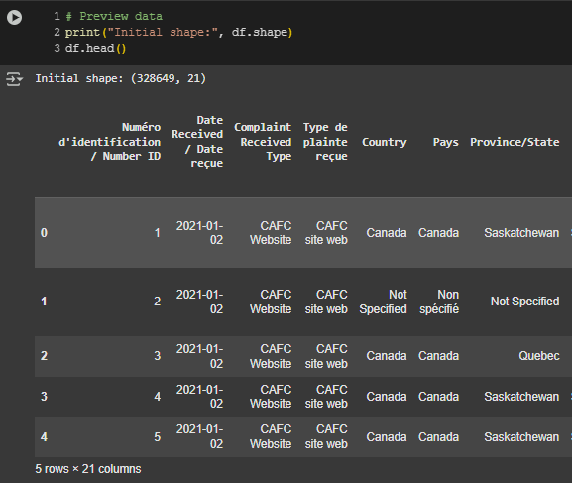


Data Source & Tools
Source: Government of Canada - Open Data
Period Covered: Jan 2021 – Mar 2025
Scope: Fraud type, reported losses, dates, location, demographics
Tools: Python (Pandas, NumPy, Matplotlib, Seaborn, Scikit-learn, Plotly)
Jupyter Notebook, GoogleColab

Slide 3

Project Objective
Understand patterns in fraud complaints
Identify high-risk groups and fraud methods
Analyze financial loss trends
Explore patterns in fraud reports and build predictive models to identify whether a reported incident involved a victim who lost money.
Why It Matters:
Fraud affects thousands of Canadians annually—this analysis helps reveal where and when it's happening most.

Slide 4
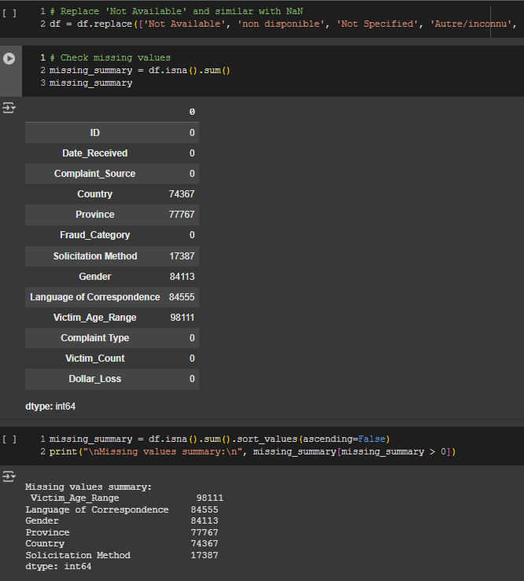
Data Cleaning & Preparation
Remove Duplicate Columns (Keep English only)
Rename columns for clarity,
Removing extra characters and whitespace,
Converting Dollar_Loss to numeric,
Converting Date_Received to the correct format
Standardizing age ranges and other categorical values,
Handling missing or unspecified entries properly.

Slide 5
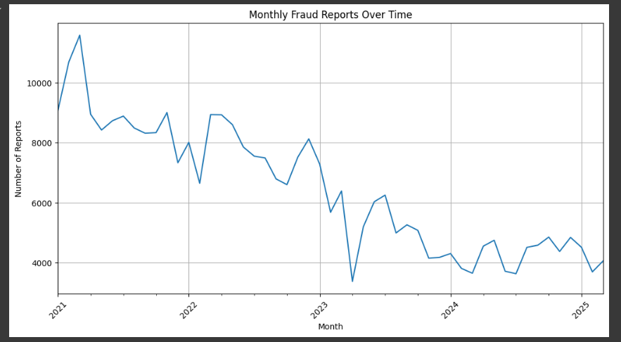

Exploratory Data Analysis
How is Financial Fraud Changing Over Time?
The line chart shows a steady decline in reported financial fraud cases from 2021 to early 2025.
Reports peaked in early 2021 at over 11,000 per month.
By 2024, the number of monthly reports stabilized at a much lower level, around 4,000 to 5,000 cases.
This decline may reflect increased public awareness, better fraud prevention strategies, or changes in reporting behavior.

Slide 6
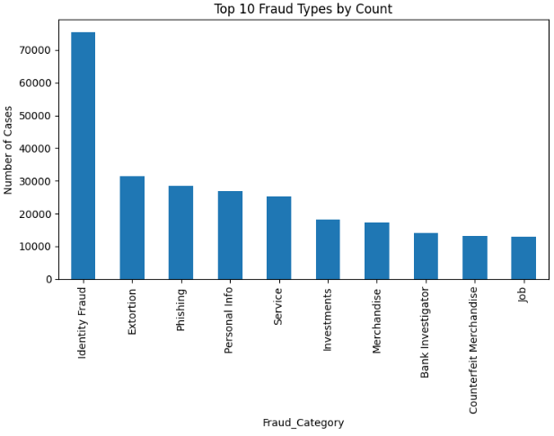
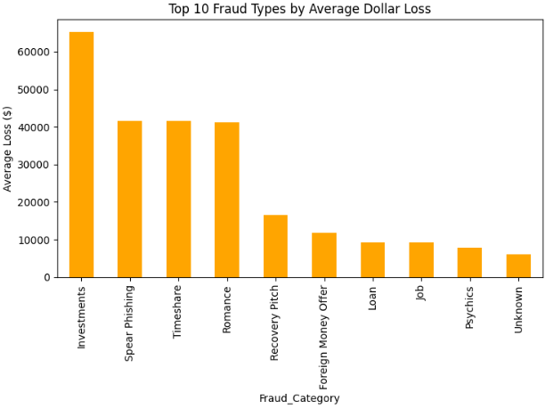
Top Fraud Categories
Frequent scams aren't always the most damaging: high-volume frauds tend to have lower average losses.
Low-frequency scams like Investment and Romance frauds, although less common, cause severe financial harm per victim. This calls for targeted awareness and prevention efforts.

Slide 7
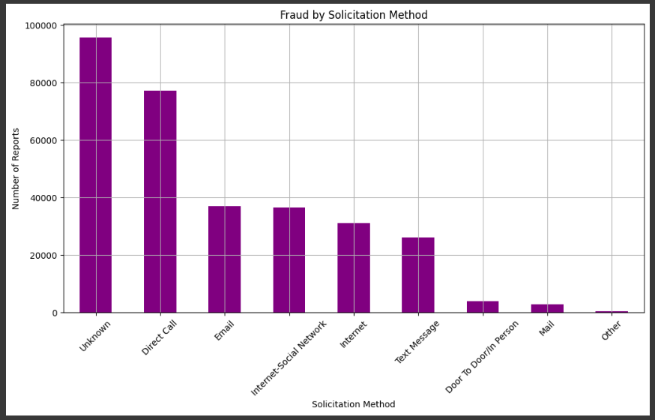
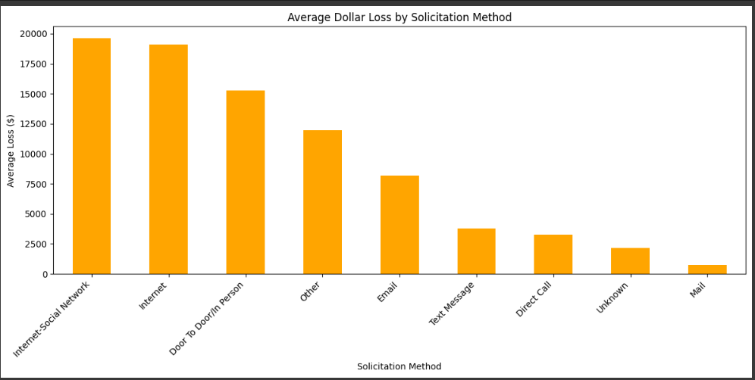
Solicitation Methods by Frequency
The most frequent solicitation method is Direct Call, followed by Email and Internet-based methods. However, Email and Social Media tend to result in higher average dollar losses, suggesting more successful scams.
A large portion of records is still classified as Other/unknown, indicating room for improving fraud categorization and reporting.

Slide 8
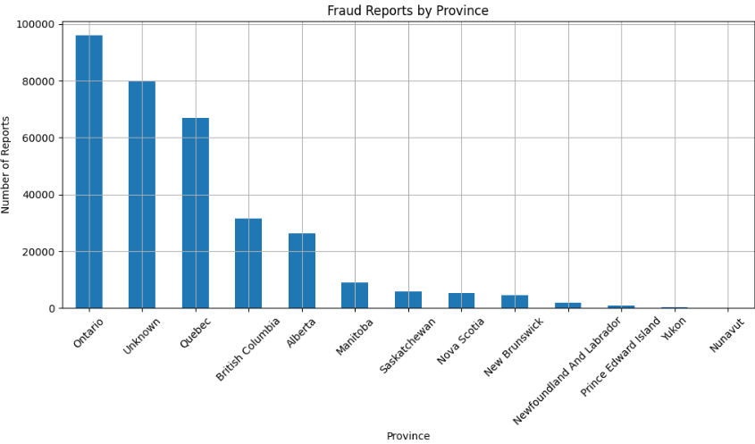
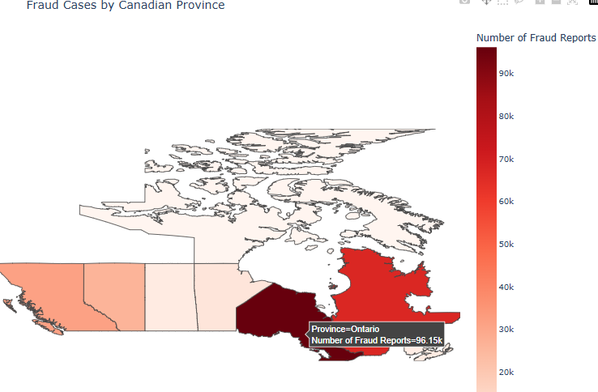
Regional Distribution of Fraud in Canada
Fraud activity appears to be more concentrated in the most populous provinces, likely due to higher population density and more digital/financial activity.

Slide 9
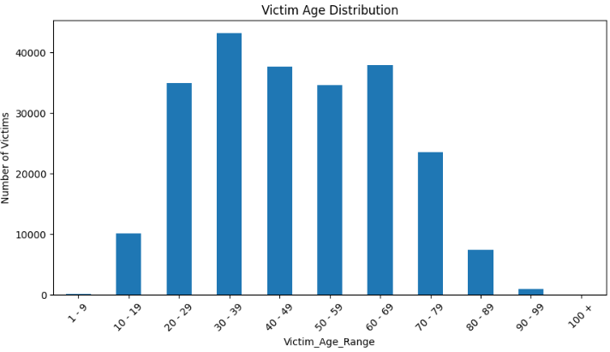
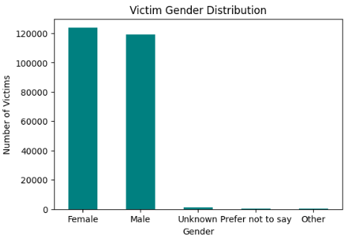

Demographics Distribution
Adults aged 30–69 are the most frequently targeted group, likely due to higher financial activity and online presence.
Young adults (20–29) and seniors (60–79) are also major targets.
Very few cases in children (1–9) and centenarians (100+).
This suggests a need for fraud prevention messaging tailored to working-age adults and seniors, with extra attention to digital literacy for youth and elderly groups.

Slide 10
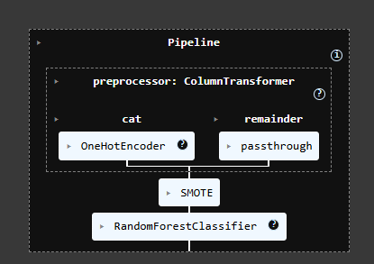
Predictive Modeling
Build models to predict whether a fraud report led to financial loss.
Models Used:
Logistic Regression
Decision Tree
Random Forest
Why these models?
Interpretable (Logistic, Tree)
Handles complexity & non-linearity (Random Forest)

Slide 11
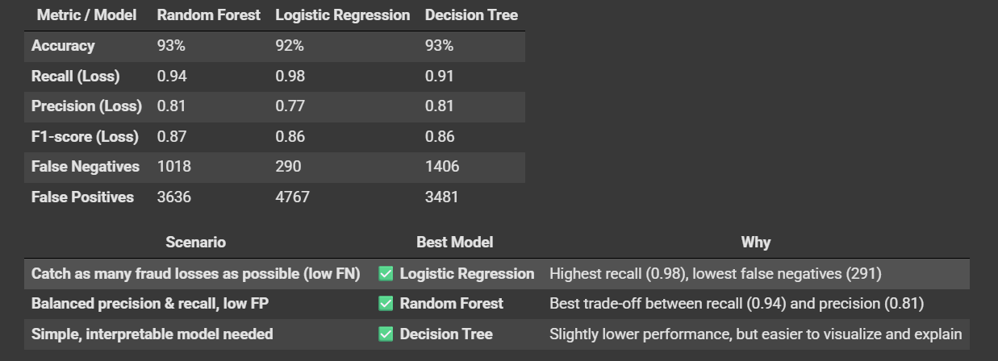
Model Performance Comparison
Random Forest: Best balance of recall and precision
Logistic Regression: Best for minimizing false negatives
Decision Tree: Most interpretable, but slightly lower performance

Slide 12
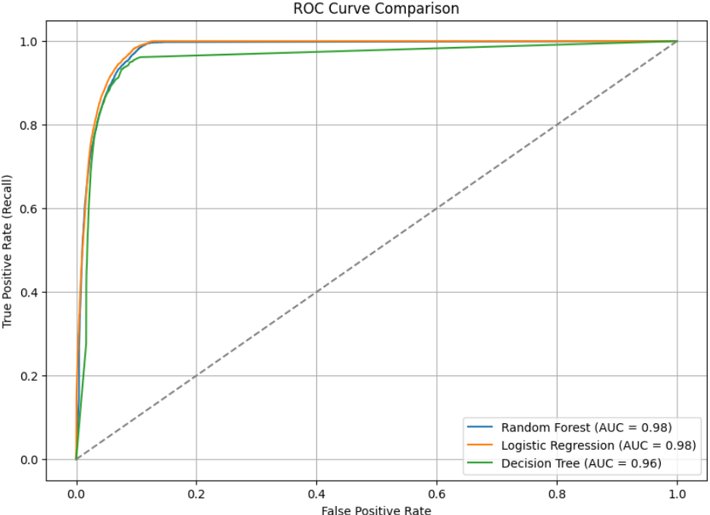
ROC Curve & AUC Scores
All models perform well, but Random Forest offers best trade-off between sensitivity and specificity
ROC curve shows model's ability to distinguish between fraud with loss vs. no loss
AUC (Area Under Curve) Scores:
Random Forest: 0.98
Logistic Regression: 0.98
Decision Tree: 0.96

Slide 13

Final Conclusion
Trend: Financial fraud has shown significant fluctuations between 2021 and 2025.
Fraud Types: Certain fraud types (e.g., investment scams, phishing) caused the highest losses.
Geographic Impact: Specific provinces experienced disproportionately high fraud cases.
Gender Distribution: Fraud affected both males and females nearly equally, with a slightly higher number of female victims. Very few cases were reported by individuals identifying as other genders or preferring not to say.
Age Demographics: Individuals aged 30–69 were the most targeted by fraud, with the peak in the 30–39 age range. Very young and very elderly age groups experienced significantly fewer incidents.
Random Forest is our recommended model for fraud detection.

Slide 14

Recommendations
Target education toward adults 30–69 and high-loss fraud types
Focus campaigns on high-report provinces
Use predictive modeling (Random Forest) to support fraud prevention efforts
Explore time-series forecasting and unsupervised anomaly detection in future work

Slide 15







Thank you!

