Slide 1
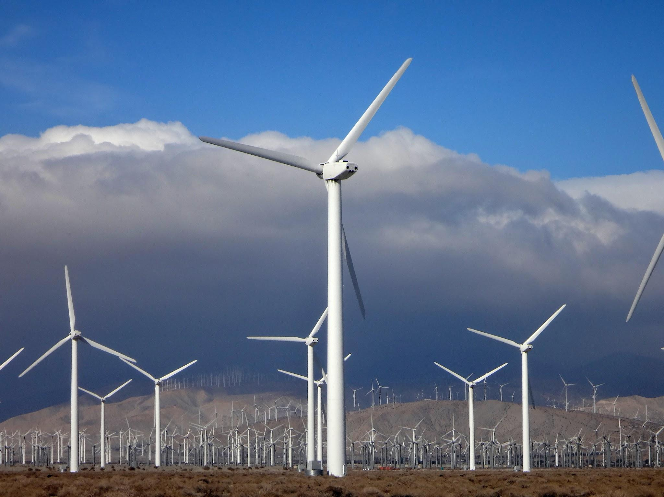
Wind Turbines in the U.S.
Data Analysis & Visualization Capstone Project
Mariia-Olena Zhupnyk
Apr 21, 2025

Slide 2
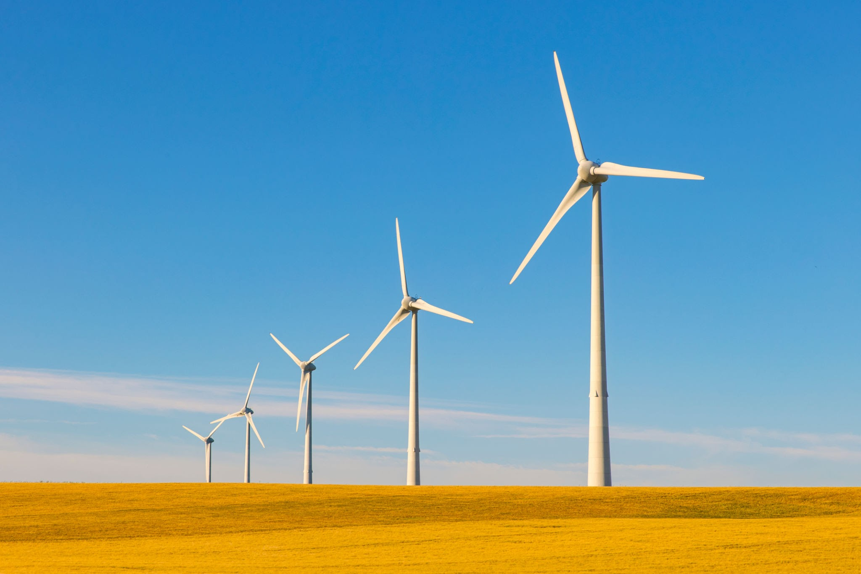
Goals of the Project
In this project I analyzed U.S. wind turbine data to identify trends in turbine capacity, technology development, and geographic distribution over time, using interactive visualizations to present key insights.
Mariia-Olena Zhupnyk - Apr 21, 2025

Slide 3
Understanding the problem
Why Wind Energy?
Why This Analysis Matters:
Project Impact:
Wind energy is one of the fastest-growing sources of renewable power in the world.
It helps reduce greenhouse gas emissions, decreases reliance on fossil fuels, and supports energy sustainability goals.
In the U.S., thousands of wind turbines are already installed across many states, but their distribution and capacity vary widely
Identifies which states are leading in wind energy development
Highlights potential for growth in underrepresented regions
Supports data-driven decision making for policy makers, investors, and engineers
Encourages public awareness by visualizing clean energy progress
By analyzing and visualizing this data, we can better understand how wind power is shaping the U.S. energy landscape — and where it can grow next.
Mariia-Olena Zhupnyk - Apr 21, 2025

Slide 4
Project objective:
Explore trends in wind turbine deployment across U.S. states
Analyze total turbine capacity and geographic distribution
Create interactive visualizations for deeper insights
Mariia-Olena Zhupnyk - Apr 21, 2025

Slide 5
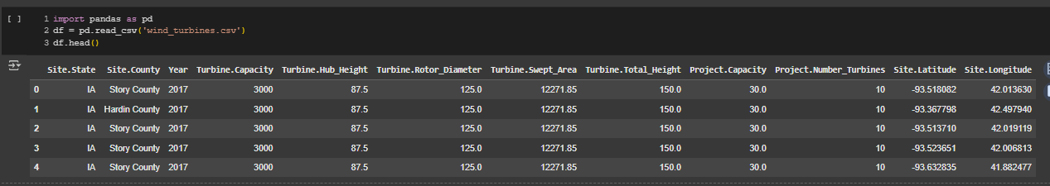
Dataset Overview
This dataset includes over 63,000 entries, each representing an individual wind turbine installed in the U.S. It contains details such as:
Location — State, County, Latitude, and Longitude
Technical Specifications — Hub Height, Rotor Diameter, Swept Area, Total Height
Performance — Individual Turbine Capacity and Total Project Capacity
Installation Info — Year of commissioning and number of turbines in the project
Data Source: CORGIS Wind Turbines Dataset
Mariia-Olena Zhupnyk - Apr 21, 2025

Slide 6
Tools Used
Tech Stack:
Python (Pandas, Bokeh, Plotly)
Google Colab and Jupyter Notebook for analysis
GitHub for version control
Netlify to publish visuals
PowerPoint to present insights
Mariia-Olena Zhupnyk - Apr 21, 2025

Slide 7
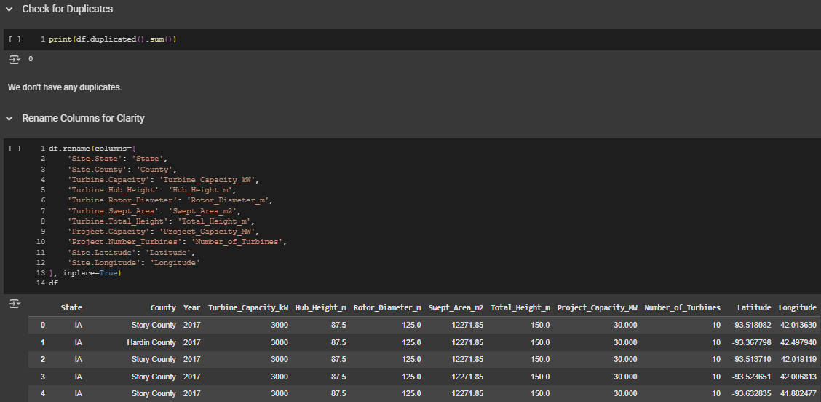
Data cleaning and transformation
The dataset was clean — no missing or duplicate values were found.
Renamed several columns to improve clarity and readability (e.g.,'Site.State': 'State','Site.County': 'County',).
Ensured date formats were consistent for analysis.
Applied filtering later during visualization to focus on specific states, years, and capacity ranges.
Mariia-Olena Zhupnyk - Apr 21, 2025

Slide 8
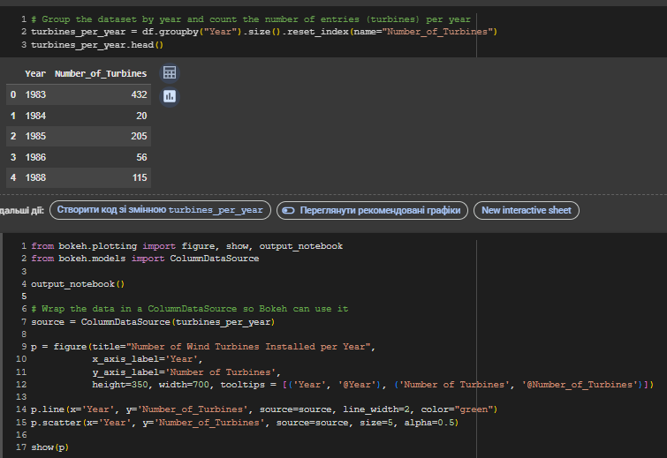
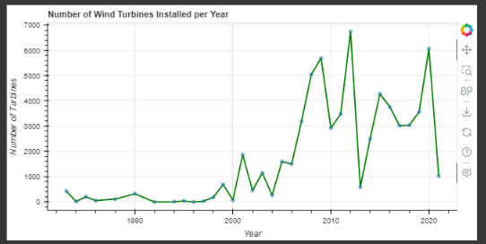
Trend analysis
Let’s see how wind turbine installations have changed over
Mariia-Olena Zhupnyk - Apr 21, 2025

Slide 9
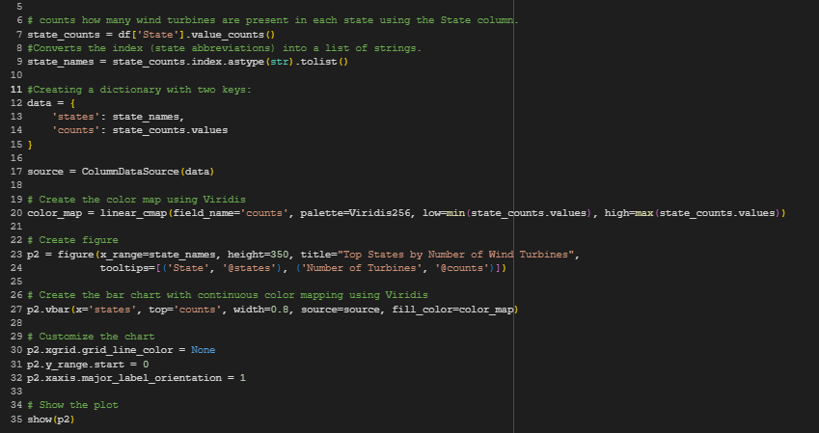
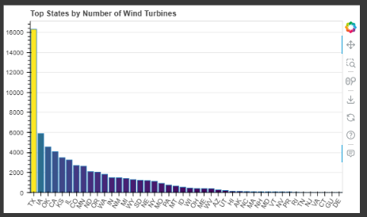
Turbine Distribution by State
Texas leads in wind energy — likely because of its large size, windy areas, and open land.
Wind power is concentrated in a few states with good natural conditions.
There’s a sharp drop after the top states, meaning wind energy is not spread evenly across the country.
Mariia-Olena Zhupnyk - Apr 21, 2025

Slide 10
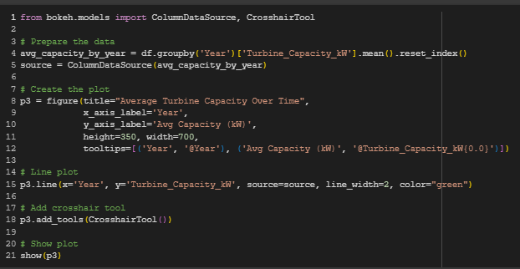
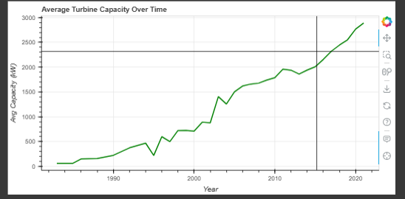
Analyze average turbine capacity by year.
This chart shows how the average capacity (in kilowatts) of wind turbines installed each year has changed over time. What it tells us:
The capacity of turbines has steadily increased since the 1980s.
Especially after the early 2000s, we see a sharp rise, which likely reflects improvements in turbine technology and a push for more efficient energy generation.
This suggests that rather than just building more turbines, the U.S. has also focused on building better turbines.
In short: Turbines are getting stronger and smarter over time.
Mariia-Olena Zhupnyk - Apr 21, 2025

Slide 11
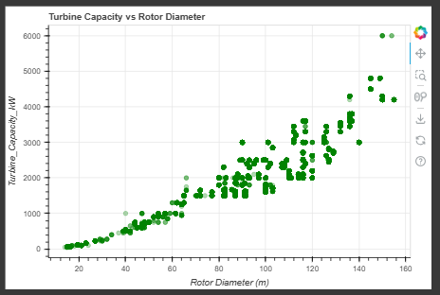
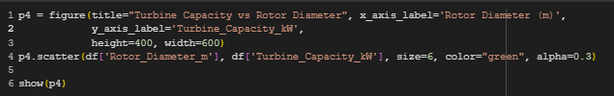
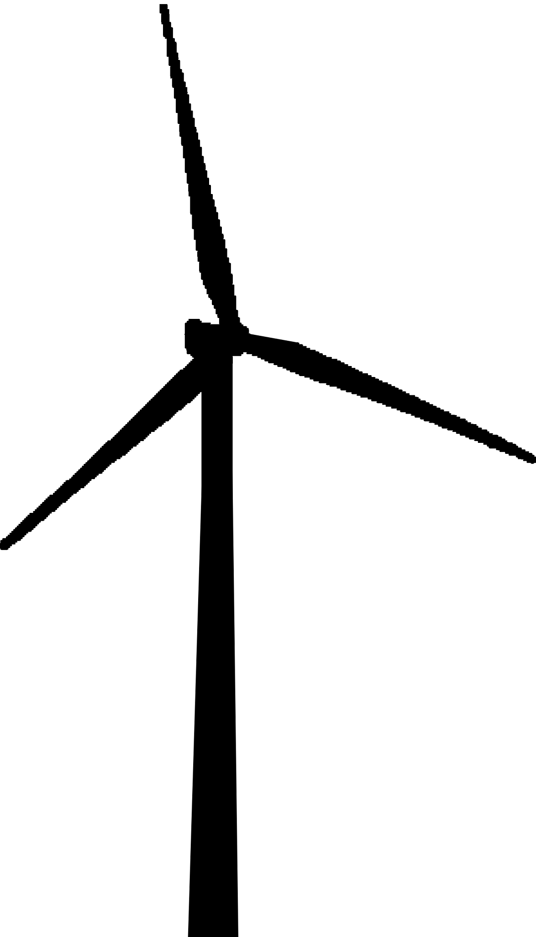
Turbine Capacity vs Rotor Diameter
There’s a clear positive correlation — newer turbines with larger rotors are designed to be more powerful. This shows how engineering advancements are making turbines more efficient over time.
Mariia-Olena Zhupnyk - Apr 21, 2025

Slide 12
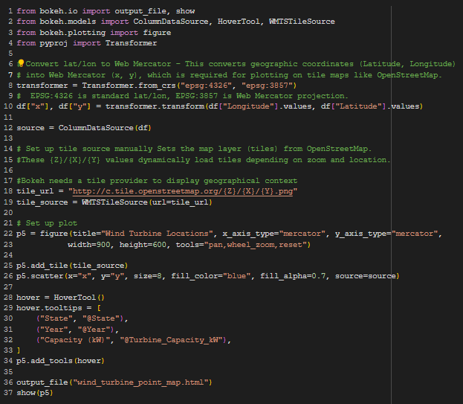
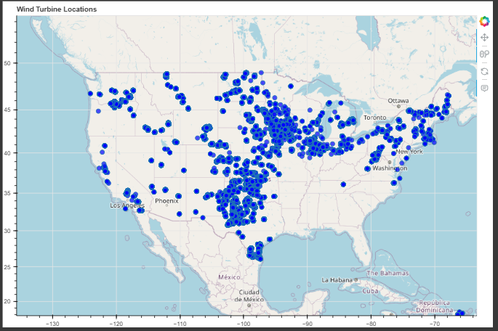
Wind Turbine locations across the US.(Point Map)
The map visualizes wind turbine locations across the US.
The majority of wind turbine installations are concentrated in the central and western parts of the United States, particularly in states like Texas, Oklahoma, Iowa, and Kansas, which are known for their favorable wind conditions and flat terrains.
The eastern seaboard and Great Lakes region also show notable activity.
A few scattered points are visible in Hawaii, Caribbean, and Pacific territories, indicating offshore or island-based turbines.
Mariia-Olena Zhupnyk - Apr 21, 2025

Slide 13
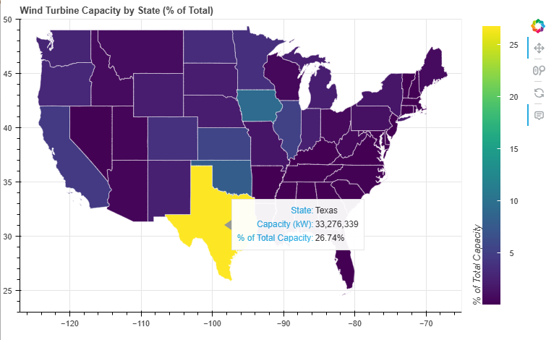
Wind Turbine Capacity by State (% of Total) Map
This interactive choropleth map visualizes each U.S. state's contribution to total wind turbine capacity.
🔹 Texas leads with 33 million kW, making up nearly 27% of the total U.S. capacity.
🔹 Brighter colors indicate higher contributions, while darker shades show lower capacity.
This view helps identify geographic patterns and leadership in wind energy adoption.
Interactive Map of Wind Turbine Capacity by State (% of Total)
Mariia-Olena Zhupnyk - Apr 21, 2025

Slide 14
Insights and Key Takeaways
Deliverable 1
Texas is the undisputed leader in wind energy, contributing over 26% of the total U.S. turbine capacity — more than double that of any other state.
Deliverable 2
Wind energy development is highly concentrated in the Midwest and Central U.S., especially in states like Iowa, Oklahoma, and Kansas, which benefit from favorable wind conditions and land availability.
Deliverable 3
Southern and Southeastern states show minimal wind energy adoption, highlighting potential gaps in infrastructure, policy, or geography that could be targeted for development.
Deliverable 4
The number of wind turbines installed annually peaked in the 2010s, showing a rapid expansion phase — a key trend for forecasting future growth or policy impact.

Slide 15
Business Recommendations:
Invest in high-capacity states (e.g., Texas, Iowa) to leverage existing infrastructure and workforce readiness.
Explore underserved states (e.g., Alabama, Louisiana) to pioneer wind energy services where competition is low.
Develop location-based service models using turbine data (maintenance, analytics, drone inspection).
Collaborate with policymakers in emerging regions to shape incentives and regulatory frameworks.
Use data storytelling (like this project) to pitch renewable strategies to stakeholders and clients.
Advanced projects

Slide 16
Thank You!
Contact:
GitHub: https://github.com/helenzhupnyk
Linkedin: https://www.linkedin.com/in/helenzhupnyk/
Email: mariia.olena.zhupnyk@gmail.com
Questions? I'm happy to discuss the project.

