Slide 1
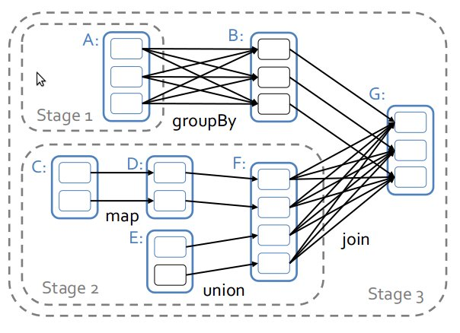
Resilient Distributed Datasets
6.824 Final Presentation, Spring 2013 Eben Freeman, Jonas Helfer

Slide 2
RDDs
Keep data in memory as long as possible
Schedule tasks with data locality in mind (code mobility)
Are fault-tolerant
Deal with stragglers
Suited for algorithms that don't fit the MapReduce pattern,
or for interactive data processing
Can be fast (~20x faster for PageRank than MapReduce)
We wrote a lightweight implementation in Python

Slide 3
RDD system architecture

Slide 4
RDD scheduler
A = textFileRDD(filename1)
C = textFileRDD(filename2)
E = textFileRDD(filename3)
B = A.groupBy(hash_func)
D = C.map(function)
F = D.union(E)
G = B.join(G)
The scheduler uses data locality information for optimal scheduling
Data-parallel tasks can be pipelined
fig: M. Zaharia et al

Slide 5
RDD example: concise PageRank
def map_contribs(link_destinations, src_rank):
return [(dest, src_rank) for dest in link_destinations]
## RDD: (url, [link_destinations])
links = rdd.TextFileRDD('links.txt', lambda line: line.split(),
multivalue = True, scheduler = sched)
## RDD: (url, rank)
ranks = rdd.TextFileRDD('urls.txt', lambda line: (line.strip(), 1. / N), scheduler = sched)
damped_ranks = ranks.mapValues(lambda x: a / N)
for i in range(iterations):
## RDD: (targetURL, passed_rank)
passed_ranks = links.join(ranks, [], 1. / N).flatMap(map_contribs) .
reduceByKey(lambda x, y: x + y, 0)
ranks = passed_ranks.mapValues(lambda s: (1 - a) * s) .
join(damped_ranks, 0, a / N).mapValues(sum)
ranks.execute()

Slide 6
Demo

