Slide 1

NEWS

Slide 2
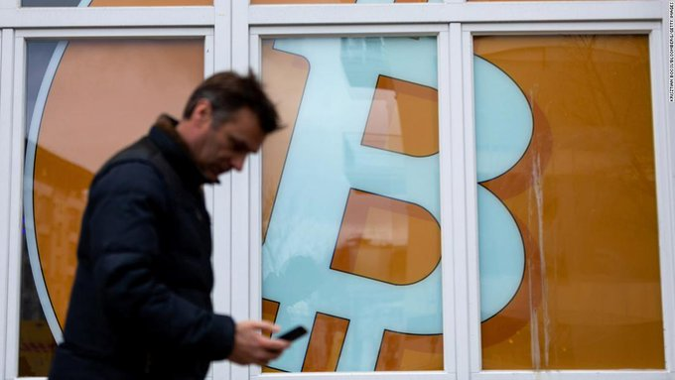
Bitcoin and other major cryptocurrencies have been feeling the heat this week as tensions between Russia and Ukraine escalate and investors shun riskier assets

Slide 3
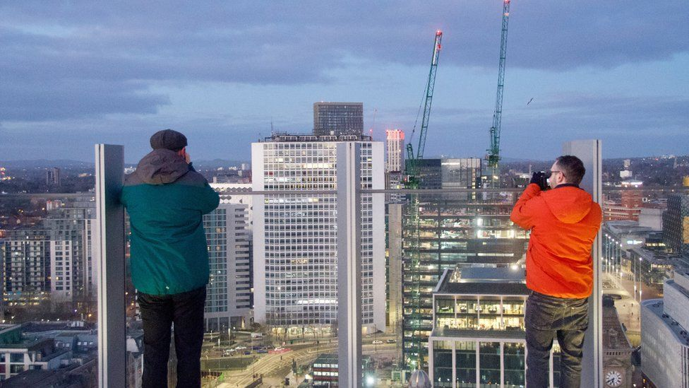
Sunrise treat for Birmingham tower photographers

Slide 4
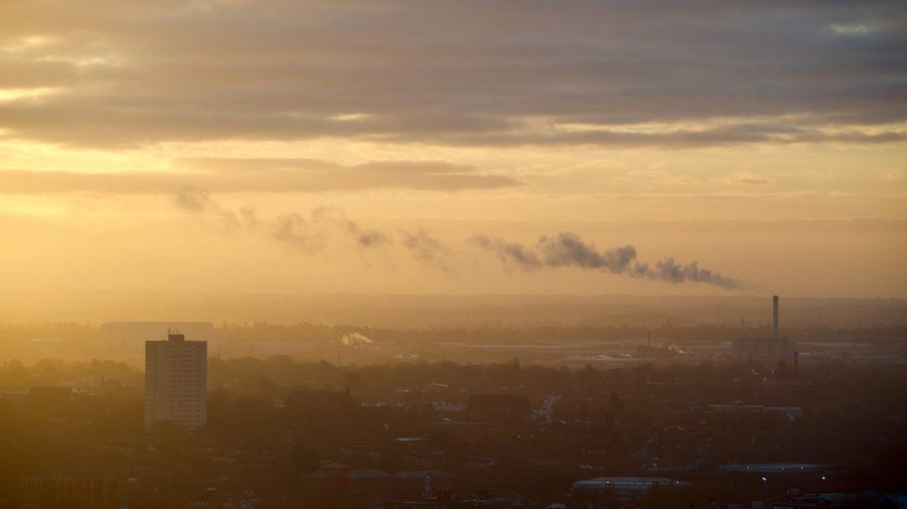
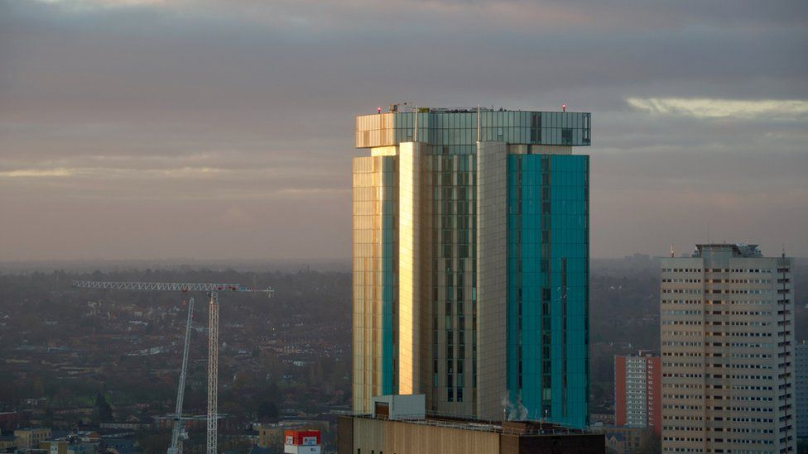



Slide 5
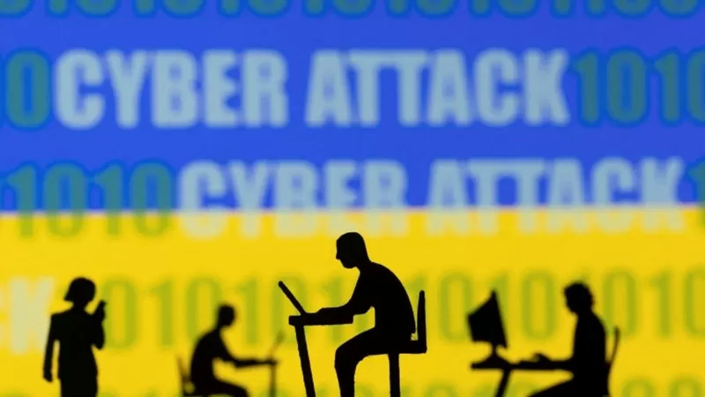
Ukraine crisis: Banks hit by cyber attacks as government website home pages inaccessible

