Slide 1
Resilience/failover &scalability

Slide 2

Resilience. Overview

Slide 3
Benefits of RMA
Address reliability issues early in design
Prioritize reliability-related work efforts
Provide tangible outputs for other reliability efforts

Slide 4
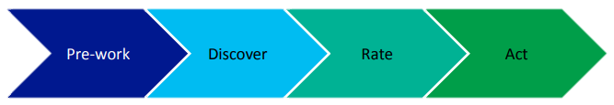
How it works
Pre-work. Creates a diagram to capture resources, dependencies, and component interactions.
Discover. Identifies failures and resilience gaps.
Rate. Performs impact analysis.
Act. Produces work items to improve resilience.

Slide 5
Pre-work
The primary purpose of this phase is to capture all resources and the interactions between those resources.
This phase includes 2 tasks:
create a component interaction diagram (CID);
transfer all of the interactions from the diagram into the RMA workbook template

Slide 6
some general guidance applies for create CID:
Do not include physical hardware.
Enumerating instances
Include all dependencies

Slide 7
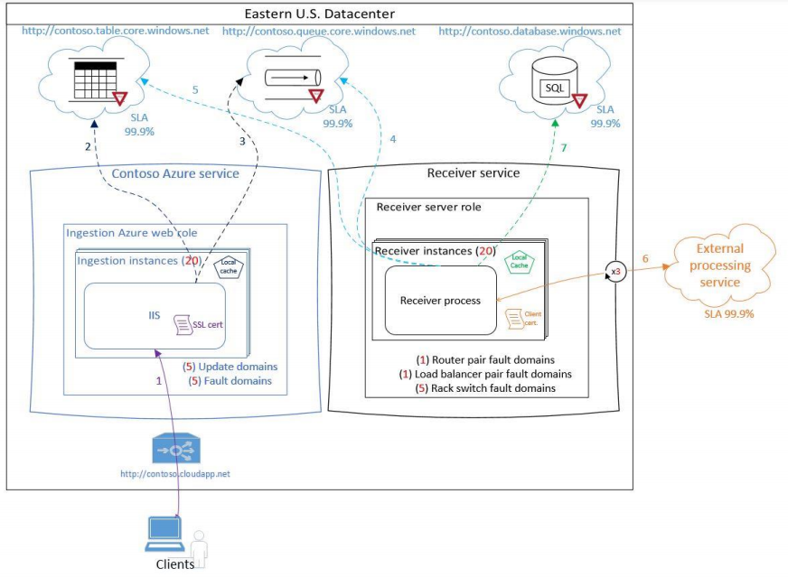
Task 1: Create the CID

Slide 8
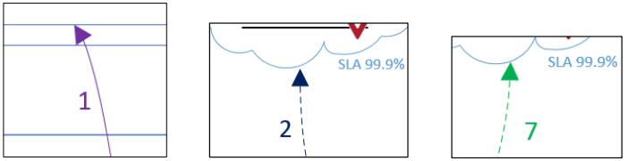
Interaction arrows and numbers. The most important pieces of information are the component interactions, which are analyzed in the Discover phase to explore all of the different failures that might be encountered. The interactions are all labeled with a number that will be transferred into the RMA workbook.

Slide 9
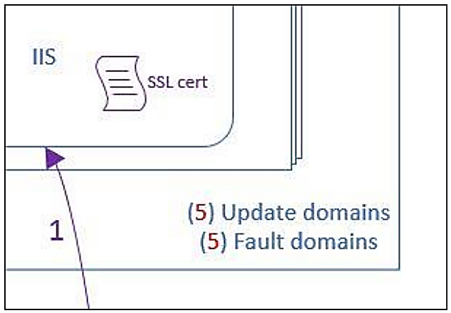
Certificates.
The certificate shape is used to highlight instances where certificates are required. Certificate related failures are frequent sources of failure. Notice how the certificates in the diagram are color-coded to match the corresponding interaction

Slide 10
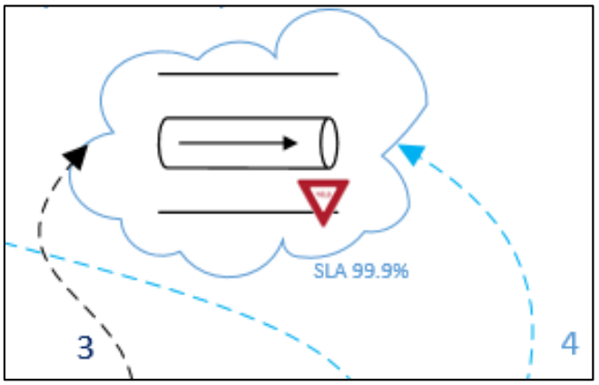
Yield sign.
The yield sign denotes that this resource employs throttling, which indicates a caller may encounter failures on interactions with this resource when there is an intentional slowing of the service.

Slide 11
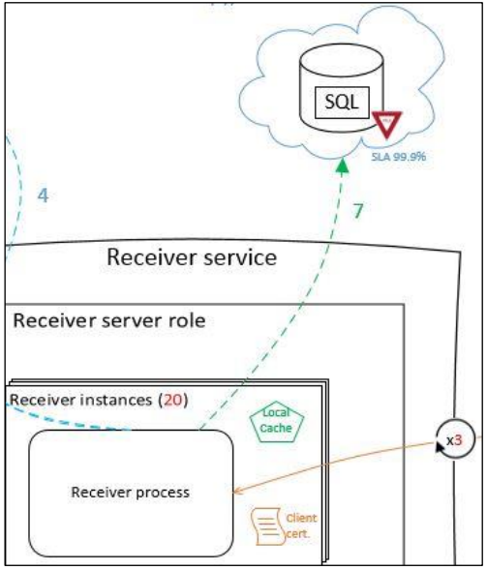
Cache.
Notice the local cache shape in green, which is included inside the receiver instances. Caching is a common mitigation against failures, and in this case, if the Receiver Service cannot succeed (via interaction #7) to store results in the database, it will cache the data locally until the connection to the database is restored.

Slide 12
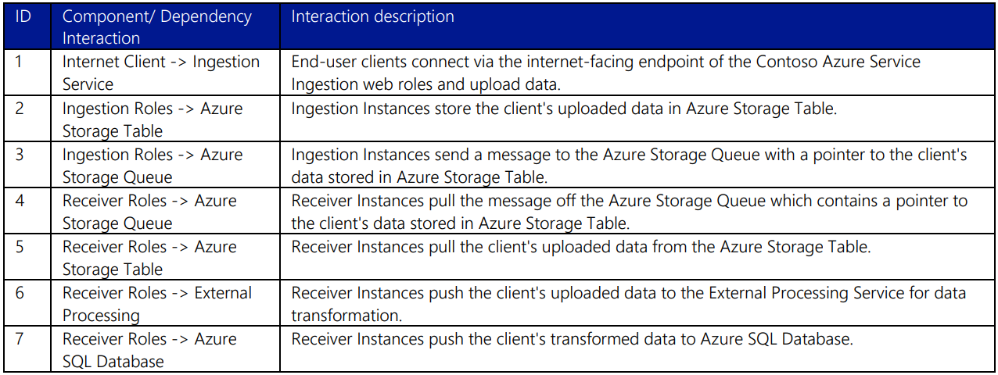
Task 2: Transfer the interactions from the diagram to the RMA workbook

Slide 13
discover
The purpose of the Discover phase is to enumerate and record potential failures for every component interaction.
Information that should be recorded in the RMA workbook during this exercise includes:
Interaction ID.
Interaction name.
Failure short name.
Failure description.
Response.

Slide 14
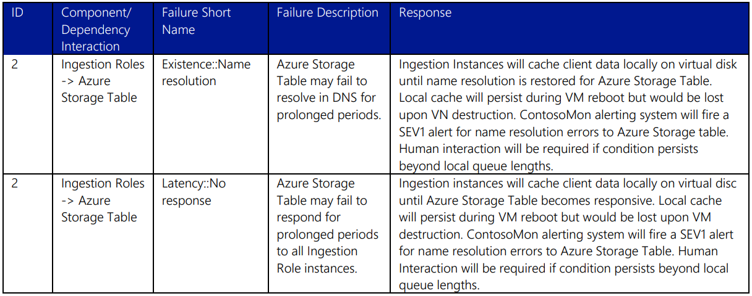
Example

Slide 15
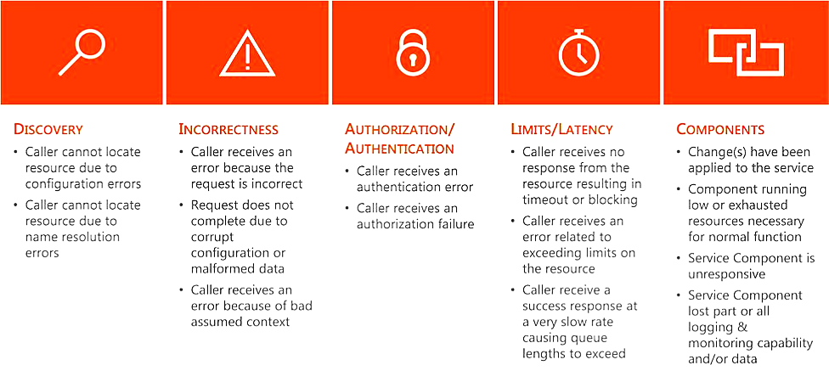
Failure categories

Slide 16
Rate
The purpose of the Rate phase is to analyze and record the effects that could result from each of the enumerated failures in the Discover phase.

Slide 17
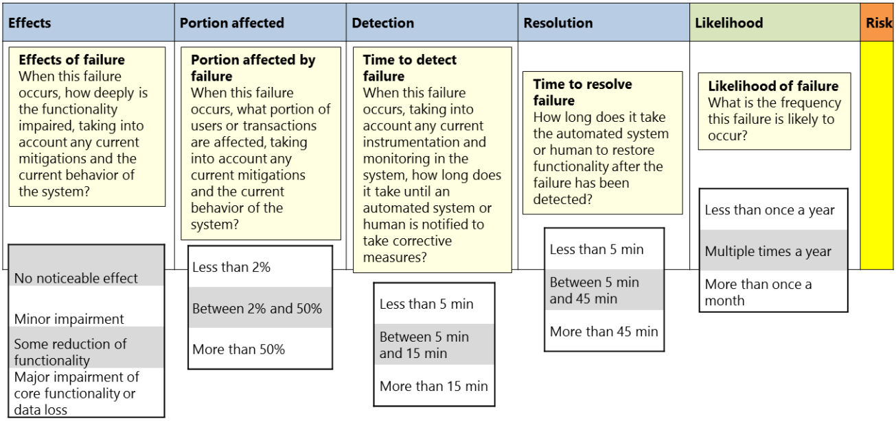
Columns of the RMA workbook used during the failure effects analysis exercise

Slide 18
ACT
The purpose of this final phase is to take action on the items discovered during the resilience modeling portion of the RMA process and make tangible investments to improve the reliability of the cloud service.

Slide 19
Implementation considerations
Timing
Approach
- End-to-end scenario
- Cloud service boundaries
- Component by component
Roles and responsibilities

Slide 20
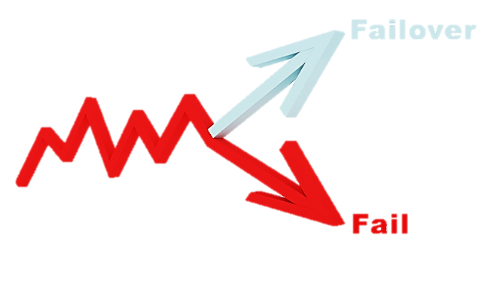
Failover Servers On The Cloud

Slide 21
failover server options
DNS failover technique
Cloud failover technique

Slide 22
Advantages of Cloud Failover
Removes colocation problems
Can be deployed remotely
Seamless traffic flow
Dynamic and more advanced
Low maintenance costs

Slide 23

Scalability in the Cloud

Slide 24
Vertical Scaling vs. Horizontal Scaling vs. Diagonal Scaling
"Scale up" - the ability to grow by using stronger hardware
"Scale out"- the ability to grow by adding more hardware
“mix” – the combination of vertical and horizontal scaling

Slide 25
Best Practices for Maximizing Cloud Scalability
Employ auto scaling
Use load balancing
Employ containers with container orchestration
Test, test, test again

