Slide 1
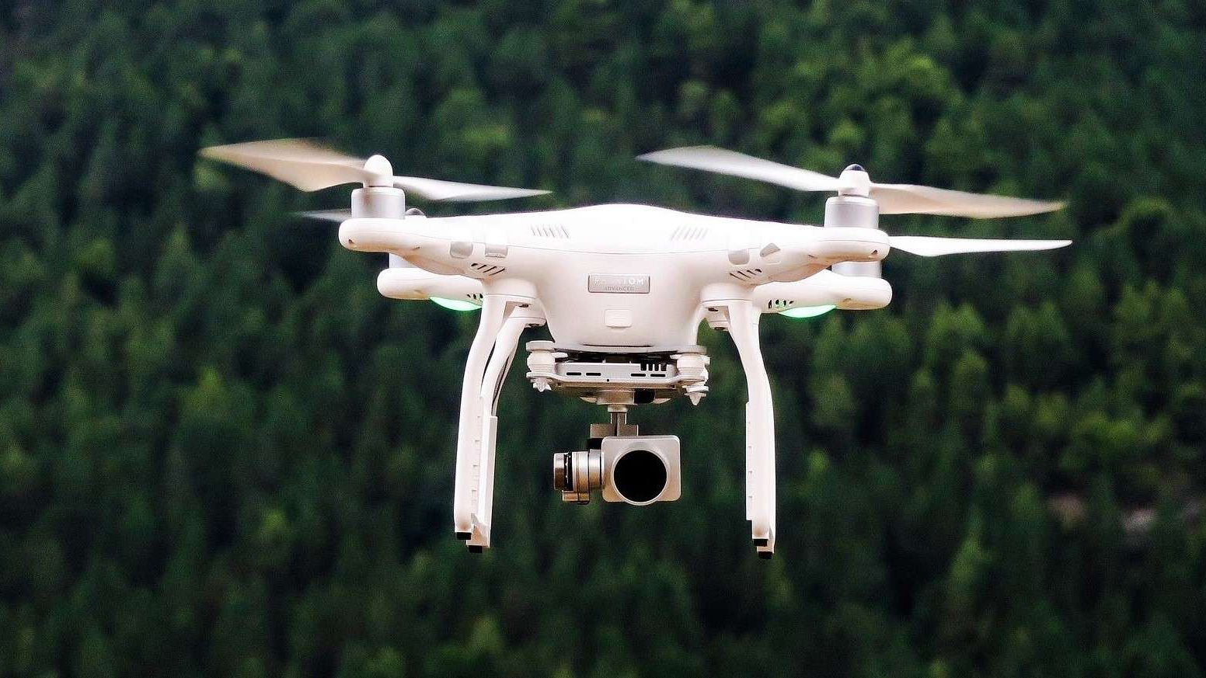
Drone Shuttles Website
Case Study

Slide 2
AGENDA
Business Drivers
Business Requirements
Hypothesis
Challenges
Solution Overview
Architecture Quality Attributes
Scalability
Consistency
Performance
Security
Disaster Recovery
Operation Excellence
Cost Optimization
Deployment
Confidential - Protected

Slide 3

Business Drivers

Slide 4
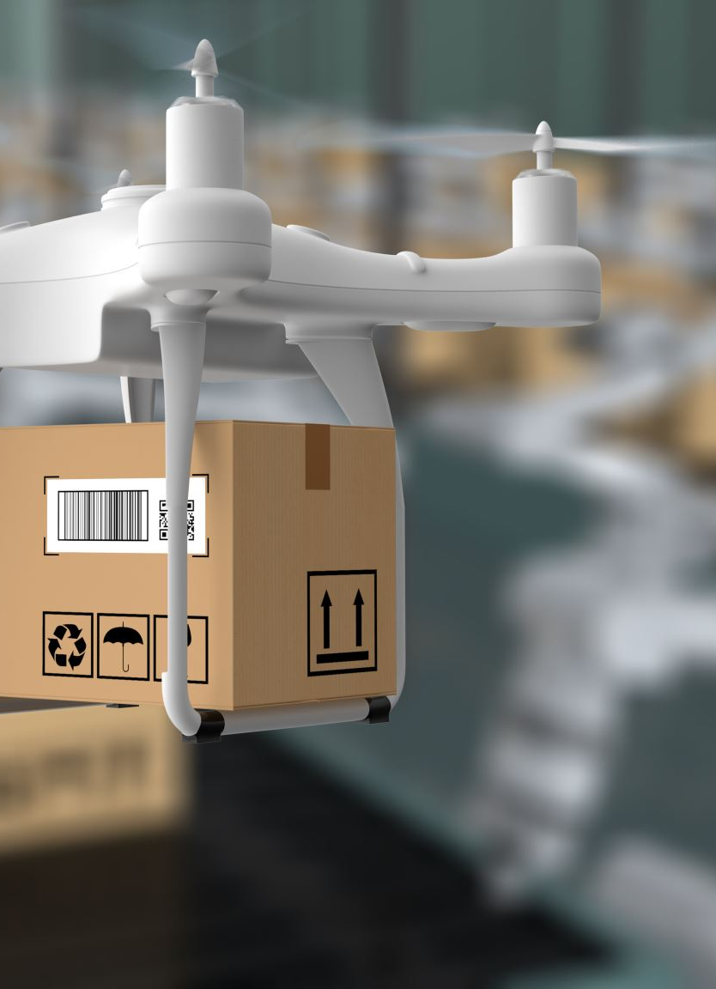
The customer Drone Shuttles Ltd. is currently running their website on an outdated platform hosted in their own datacenter. They are about to launch a new product that will revolutionize the market and want to increase their social media presence with a blogging platform. During their ongoing modernization process, they decided they want to use the Ghost Blog platform for their marketing efforts

Slide 5

Business Requirements

Slide 6

The application should be able to scale depending on the load.
There should be no obvious security flaws.
The application must return consistent results across sessions.
The implementation should be built in a resilient manner.
Observability must be considered when implementing the solution.
The deployment of the application and environment should be automated.

Slide 7
Hypothesis
Current system can afford limited number of users during marketing campaigns
Client does not know exactly volume of users
There might be a better way for deployment process
Current deployment process incur long downtime period
The solution life cycle only go through development and production environments
Rolling out a new feature is not an easy task

Slide 8

Challenges

Slide 9


Ghost platform hosting on Microsoft Azure cloud
Limited number of databases are supported by Ghost platform
Security
Operation tools and visualizations
Costs
Business continuity plan

Slide 10





Solution Overview

Slide 11
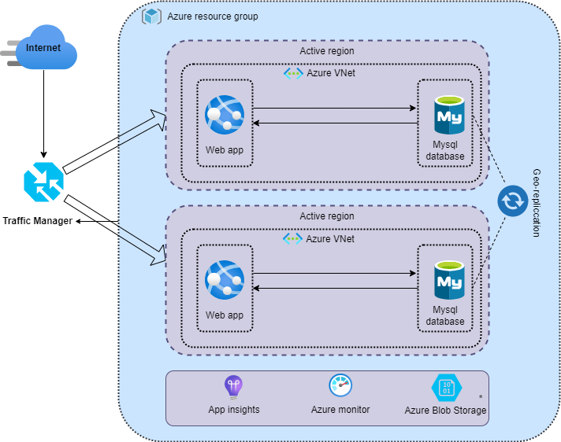

Slide 12

Architecture Quality Attributes

Slide 13
Scalability
Consistency
Performance
Security
Disaster Recovery
Operations Excellence
Cost Optimization

Slide 14

Deployment

Slide 15
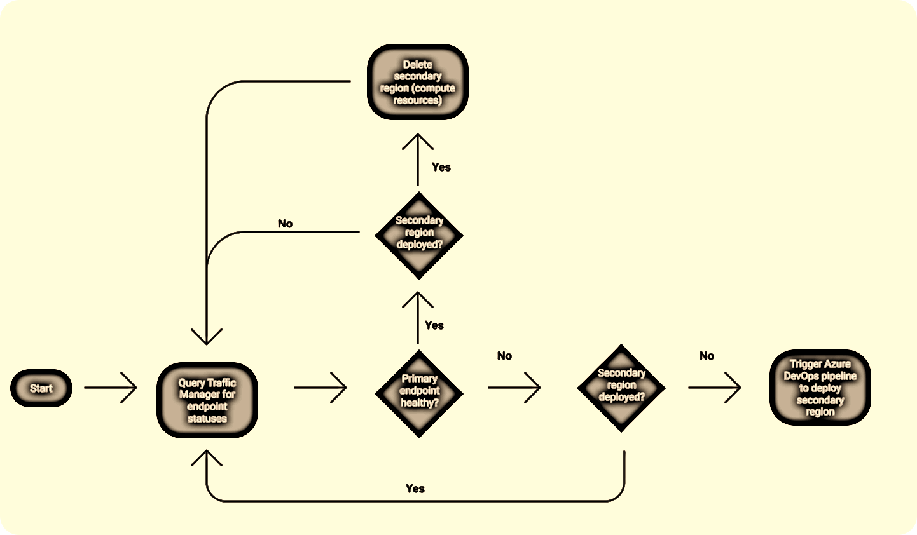

Slide 16
Thank you.

