Slide 1
Analyzing City Flags for Good Flag Design Metrics
Hamdy Elgammal, CSE

Slide 2
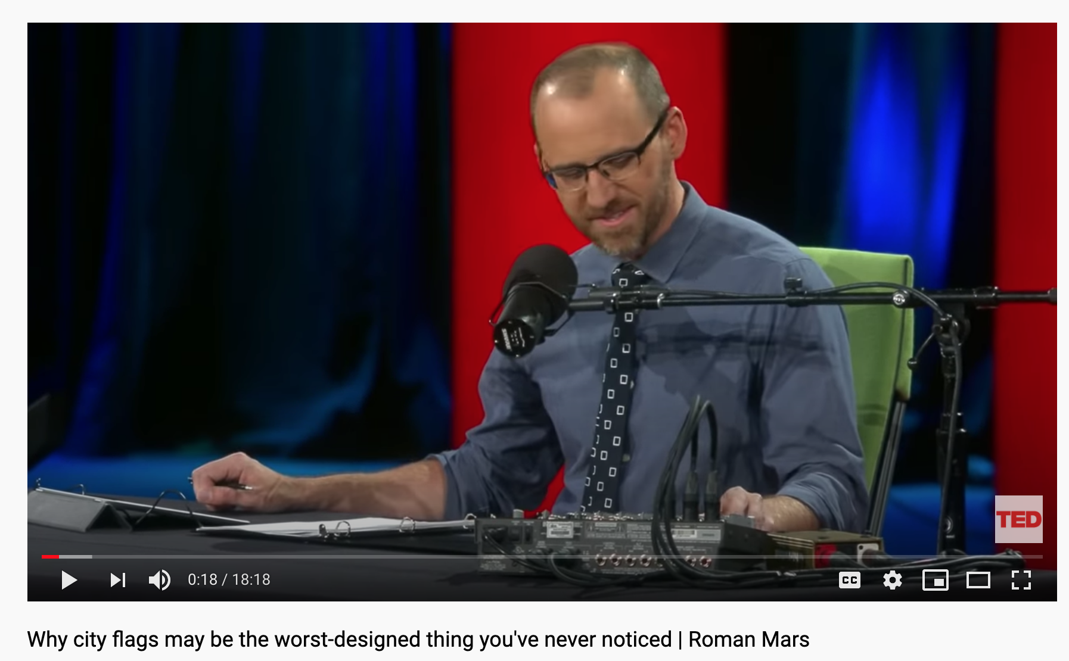
It started with...
This TED talk about city flags:
It’s by Roman Mars from the 99% Invisible podcast (which I highly recommend).
Fun talk about flag design, civic solidarity and the markers of good design.

Slide 3
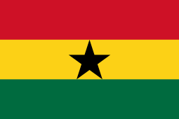
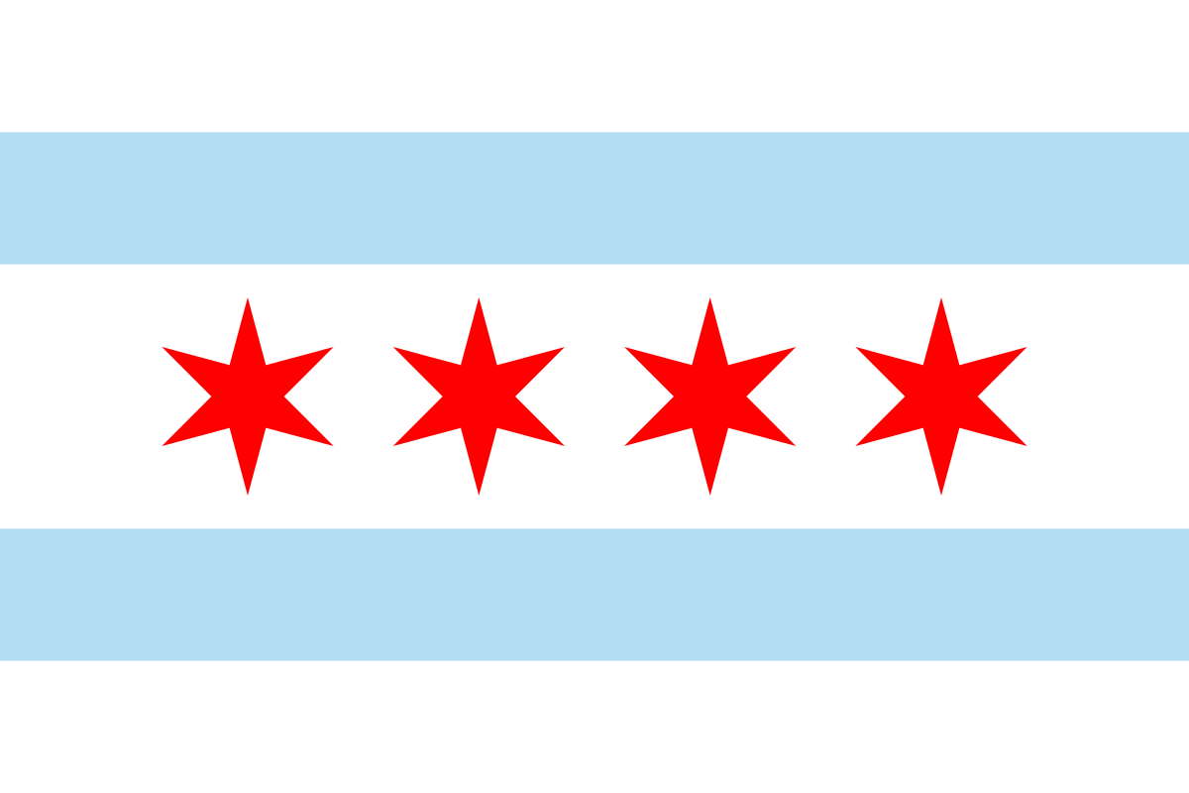


Fact 1: Some flags are nice to look at

Slide 4
Fact 2: It’s because they’re following basic flag design guidelines
Vexillology : the study of the history, symbolism and usage of flags or, by extension, any interest in flags in general (Wikipedia).
Flag design guidelines (which some nice vexillologist came up with):
Keep it simple.
Use meaningful symbolism.
Use 2-3 basic colors.
No seals or lettering.
Be distinctive or be related.

Slide 5
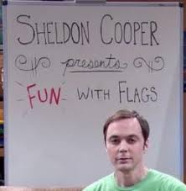
Toy project idea
“Can any of these flag design metrics be measured with code?” a.k.a Fun with Flags

Slide 6

Keep it simple + Use meaningful symbolism
How do you define “simple”, “meaningful” or “symbolism”?
One keep-it-simple heuristic: design should fit on a 1x1.5 in. rectangular piece of paper.
Maybe I try resizing all images to a unified smaller size then trying to measure how “crowded" an image looks by measuring the variation in pixel intensity?
Eh, seems complex, next...

Slide 7
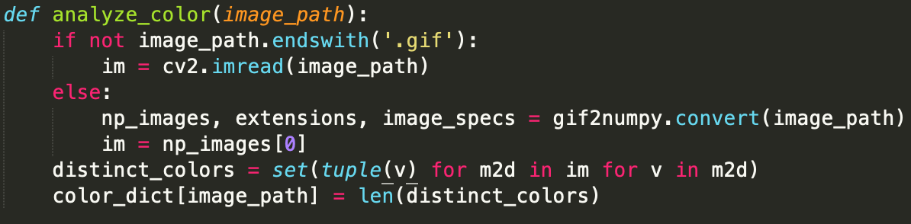
Use 2-3 basic colors
OK, I can work with this!
Wrote a script to download ~100 U.S. city flags from Wikimedia’s city flag collection.
Note: As of 2018, there were roughly 300 medium cities (100K or more people) in the U.S.
Wrote a small script to roughly get distinct colors in the image by counting distinct RGB combinations.

Slide 8


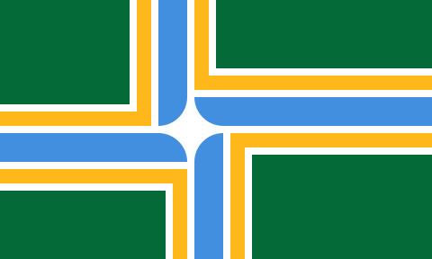
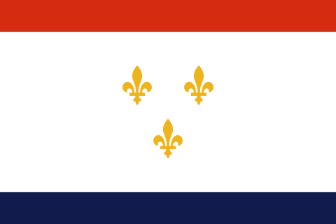
Some of the best (clockwise from top-left: Madison, WI / Denison, TX / New Orleans, LA / Portland, OR)

Slide 9
Some of the worst Hamdy’s Flag Design Rule of Thumb: if it needs its own slide, it’s probably a color-dense flag

Slide 10


Slide 11
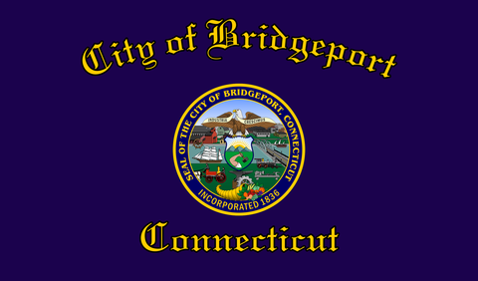

Slide 12


Slide 13


Slide 14
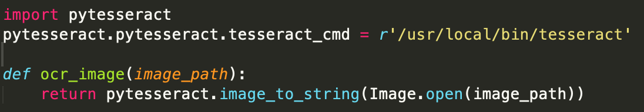
No seals or lettering
Seals are (kinda) hard to detect:
They are circles, circles are not that easy to detect because they’re famous for not having edges...so...next.
Lettering:
OK, I can (kinda) do this!
Let’s just run some optical character recognition (OCR) software on all the flags we have, see what percentage are text-ful and what percentage are text-less.

Slide 15
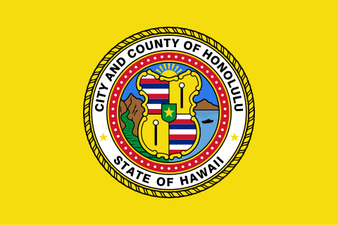
Lettering analysis
1st pass results (OCR only)
Textless flags: 57
Textful flags: 25
2nd pass results (manual):
Textless flags: 27
Textful flags: 55
Conclusion: the majority, about 67%, of available U.S. city flags available through Wikimedia are textful.

Slide 16
Be distinctive or be related + future “work”
How would we measure the degree of similarity between city flags within the same state/region?
How would we teach a computer to identify what a “cool" flag looks like and thus rank potential flags on a scale of coolness?
How would we teach a computer to “improve” a less cool flag into a cooler flag? Some easy targets:
Remove all lettering — how?
Remove all complex seals — how?

Slide 17


