Slide 1
Cache and Locality

Slide 2
Different types of cache.
Fully associative, no sets. Means that we have to search all tags in our cache and then look at block-offset (where in our block).
Increased Complexity: Because there is no mapping between memory addresses and cache locations, a fully associative cache must search through all of its entries to determine if a block of memory is already in the cache. This increases the complexity of the cache's design and can lead to longer cache lookup times.
Large size: A fully associative cache must be large enough to hold all possible blocks of memory. This makes fully associative caches less practical in many systems, especially those with limited space.
Less efficient use of cache space: Fully associative cache's lack of memory mapping might lead to a lower cache hit rate because a block from memory may be replaced by a block from memory that will be not used in a short time.
Direct map – 1way. Each set has exactly 1 block. We still need to compare the tag, and check valid bit.
2way set-associative– 2 blocks per set
4way set-associative– 4 blocks per set
… and so on.

Slide 3
Write allocate: fetch on write. Write value to cache from memory on cache miss.
no-write-allocate: cache miss simply writes the value to main memory
Writeback: not all data are written to memory when changed in cache. Data changed in cache are marked as dirty and changes are pushed to memory later. (can be done eg. When a buffer is full)
Downside if crash. Not all changed data are written to memory.

Slide 4
Row wise and column wise
In C data is written row wise in memory.
Eg. If we init a 2d array.
Input : mat[][] = {{1, 2, 3}, {4, 5, 6}, {7, 8, 9}}
Output : Row-wise: 1 2 3 4 5 6 7 8 9 Col-wise : 1 4 7 2 5 8 3 6 9
So we want to access all elements in a row, then proceed to the next row

Slide 5
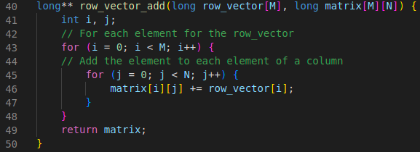
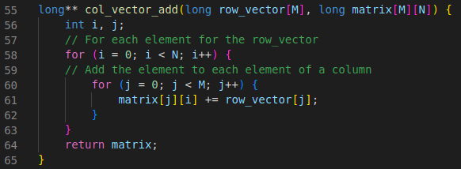
int M = 2000; // rows
int N = 500; // columns
Time elapsed: 0.001601 seconds
Time elapsed: 0.003158 seconds
Row_vector_add is approx 2x the speed of col_vector_add.
Depends on input parameters.
See code.zip

Slide 6
Temporal and spatial locality
Spatial and temporal locality form the principle of 'Locality of Reference'
Spatial locality refers to the likelihood that memory addresses close to each other in memory will be accessed close together in time.
Temporal locality refers to the likelihood that a memory location will be accessed again in the near future. Replacement policies, such as least recently used (LRU), are used to determine which locations to evict when the cache is full.

Slide 7
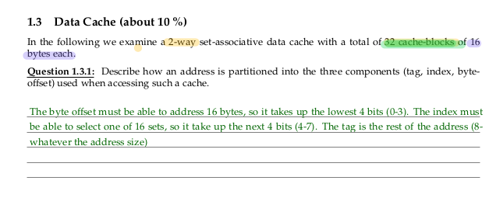
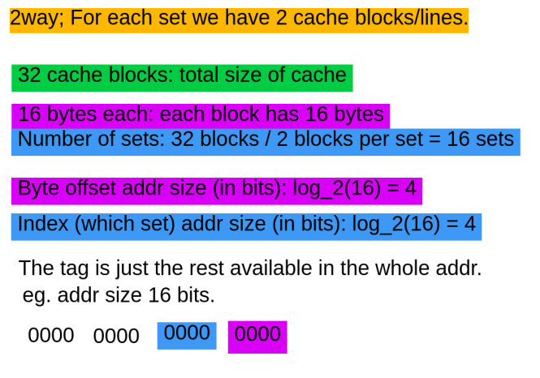
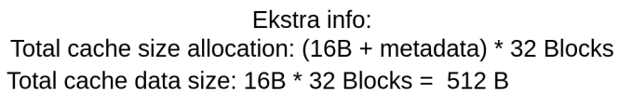
Block

Slide 8
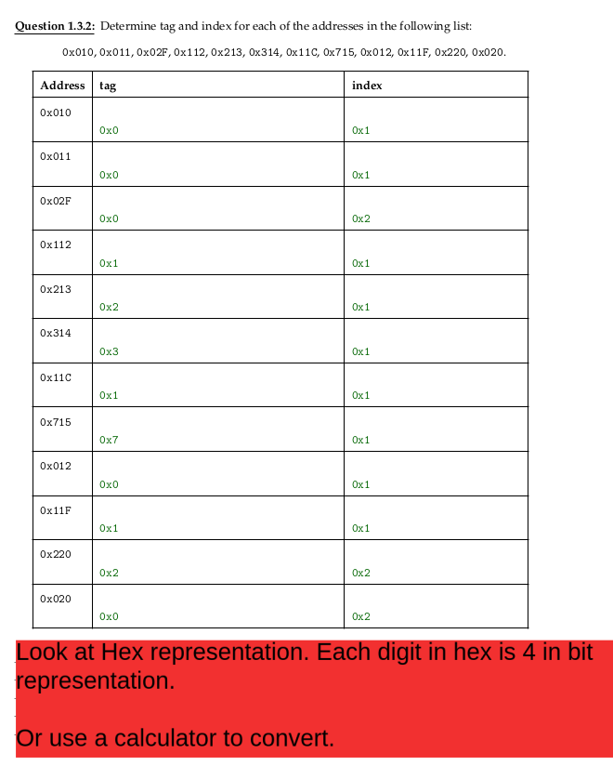
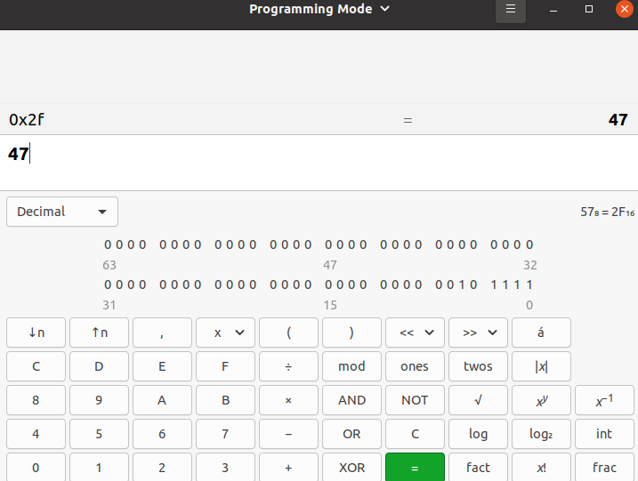
Extract tag and index from addr
Ubuntu has a smart calculator

Slide 9
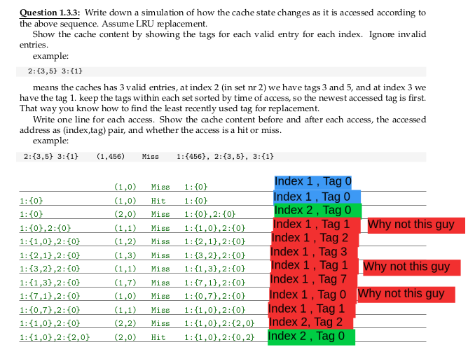
Write cache representation

Slide 10
Example direct mapped:
8 kibibyte total cache size
Each block is 8 byte
Direct mapped and 32-bit addr
Bitsize of offset = log_2 ( 8 ) = 3
# sets = 8 KB * 1024 B/KB / ( 8 B/block * 1 block/set ) = 1024 set
Bitsize of index = log_2 ( 1024 ) = 10
Tag is the rest
What if fully associative?
Its the same, we just dont have a set index.
So block-offset is 3 bits, and tag is the rest.
Data might be in kibi/kilo-byte
1 kibibyte = 1024 bytes
1 kilobyte = 1000 bytes

Slide 11
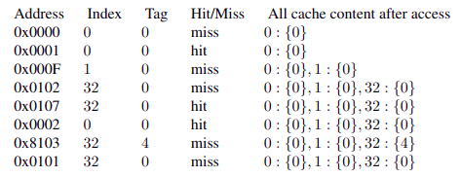
Tag Set Offset 0000 0000 0000 0000
Direct mapped (1-way)
0000 0000 0000 0000
0000 0000 0000 0001
0000 0000 0000 1111
0000 0001 0000 0010
0000 0001 0000 0111
0000 0000 0000 0010
1000 0001 0000 0011
0000 0001 0000 0001

Slide 12
Tag Set Offset 0000 0000 0000 0000
0000 0000 0000 0000
0000 0000 0000 0001
0000 0000 0000 1111
0000 0001 0000 0010
0000 0001 0000 0111
0000 0000 0000 0010
1000 0001 0000 0011
0000 0001 0000 0001

Slide 13
Tag Set Offset 0000 0000 0000 0000
0000 0000 0000 0000
0000 0000 0000 0001
0000 0000 0000 1111
0000 0001 0000 0010
0000 0001 0000 0111
0000 0000 0000 0010
1000 0001 0000 0011
0000 0001 0000 0001

Slide 14
Tag Set Offset 0000 0000 0000 0000
0000 0000 0000 0000
0000 0000 0000 0001
0000 0000 0000 1111
0000 0001 0000 0010
0000 0001 0000 0111
0000 0000 0000 0010
1000 0001 0000 0011
0000 0001 0000 0001

Slide 15
Tag Set Offset 0000 0000 0000 0000
0000 0000 0000 0000
0000 0000 0000 0001
0000 0000 0000 1111
0000 0001 0000 0010
0000 0001 0000 0111
0000 0000 0000 0010
1000 0001 0000 0011
0000 0001 0000 0001

Slide 16
Tag Set Offset 0000 0000 0000 0000
0000 0000 0000 0000
0000 0000 0000 0001
0000 0000 0000 1111
0000 0001 0000 0010
0000 0001 0000 0111
0000 0000 0000 0010
1000 0001 0000 0011
0000 0001 0000 0001

Slide 17
Tag Set Offset 0000 0000 0000 0000
0000 0000 0000 0000
0000 0000 0000 0001
0000 0000 0000 1111
0000 0001 0000 0010
0000 0001 0000 0111
0000 0000 0000 0010
1000 0001 0000 0011
0000 0001 0000 0001

Slide 18
Tag Set Offset 0000 0000 0000 0000
0000 0000 0000 0000
0000 0000 0000 0001
0000 0000 0000 1111
0000 0001 0000 0010
0000 0001 0000 0111
0000 0000 0000 0010
1000 0001 0000 0011
0000 0001 0000 0001

Slide 19
Tag Set Offset 0000 0000 0000 0000
0000 0000 0000 0000
0000 0000 0000 0001
0000 0000 0000 1111
0000 0001 0000 0010
0000 0001 0000 0111
0000 0000 0000 0010
1000 0001 0000 0011
0000 0001 0000 0001

