Slide 1

Decision Support Systems (DSS)
Information Systems and Management

Slide 2
Decision Support System
DSS
  Helping make informed decisions

Slide 3
Decision Making and
Problem Solving

Slide 4

Decision Making
Intelligence:
  identify and define problems or opportunities
Design:
  develop alternative solutions
Choice:
  select a course of action

Slide 5

Problem Solving
Build on the Decision Making steps (Intelligence, Design & Choice)
Problem Solve By:
Implementation:
  Solution is put into effect
Monitor:
  Evaluate the implementation

Slide 6
Decision Making and
Problem Solving
Optimization
  A process to find the best solution given identified goals
Satisficing
  A model that will find a good (but not necessarily the best) problem solution
Heuristics
  Commonly accepted guidelines or procedures that usually find a good solution

Slide 7
Types of Decisions
Programmed (Structured)
  Decision made using a rule, procedure, or quantitative method
  Know decision variables and their values
Non-programmed (Unstructured)
  Decision that deals with unusual or exceptional situations (SWP Prince Rupert)

Slide 8

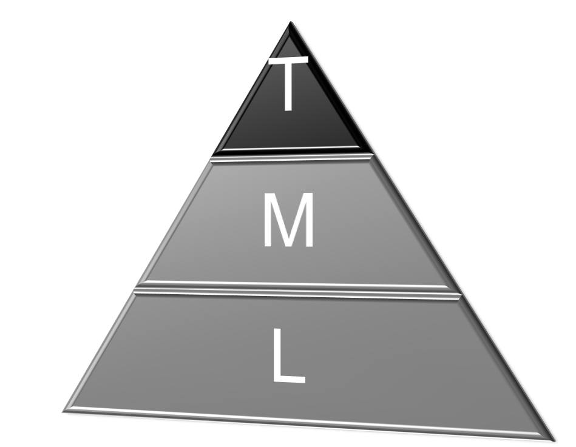
Unstructured
Strategic
DSS
Management Reporting
Tactical
MIS
Operational
TPS
Structured

Slide 9
Outputs of MIS
Management Reporting
Scheduled Report
  Produced periodically on a schedule
Key-indicator Report
  Summary of the previous day’s critical activities
  Typically available at the beginning of each workday

Slide 10
Outputs of MIS
Management Reporting
Demand Report
  Certain information produced at someone’s request
Exception Report
  Information about an unusual situation that requires management action

Slide 11
Outputs of MIS
Management Reporting
Drill-down Report
  Provides increasingly detailed data
Push Report
  Web-cast information

Slide 12
On Line Analytical Processing
Consolidation
  Summarizing by district or region
Drill Down
  Detail Back-up of Consolidation
Slicing and Dicing
  Different viewpoints of database
SaskOil story

Slide 13
Decision Support System (DSS)
Computer-based IS that provides interactive information and support to managers during the decision making process
Sask Wheat Pool story
  High throughput elevators

Slide 14
DSS Components
  Analytical Model
    Industry
    firm
  Specialized Databases
  An interactive, computer–based modeling process
    Support semi-structured and unstructured decision making by individual managers
  A decision makers insight and judgement
    Could use AI to incorporate some of these features

Slide 15
Group Support Systems (GSS)
Software that supports group decision making
Characteristics
  Delphi approach
    Encourages diversity and fosters creativity
  Brainstorming
    Ideas “off the top of your head”
  Group Consensus
    Reach a unanimous decision
  Nominal Group Technique
    Encourages individual feedback
    Final decision is made by voting

Slide 16

GSS Alternatives
The Decision Room
The Local Area Decision Network
The Teleconferencing Alternative
The Wide Area Decision Network
My Concerns:
  Humans are social animals

Slide 17

Expert Systems
Similar to a human expert in a particular field
Software that acts as a consultant to end users

Slide 18
Characteristics of an Expert System
Can display “intelligent” behaviour
Can draw conclusions from complex relationships
Can deal with uncertainty

Slide 19
Limiting Characteristics
Limited to relatively narrow problems
Can not readily deal with mixed knowledge
  Integration of different areas

Slide 20
When to use Expert Systems
Preserve irreplaceable human expertise
More consistent decisions
Training

Slide 21
Components of Expert Systems
Knowledge Base
  stores data, rules, cases, and relationships
  Rules (IF THEN ELSE)
Fuzzy Logic: allows approximate values and inferences as well as incomplete or ambiguous data
The Inference Engine
  Provide answers, predictions , and suggestions

Slide 22
Applications of Expert Systems
Games
Application of professional knowledge (lawyers)
Loan application analysis (banks)
Repair and Maintenance
Warehouse optimization (storage & retrieval)

Slide 23

Executive Support Systems (ESS)
Systems to assist senior level executives
  facilitate acquisitions of external data

Slide 24
Decision Support Systems (DSS)
Information Systems and Management

