Slide 1

Information Systems and Management

Slide 2

E-Commerce

Slide 3

Properties of the Internet
Mediating Technology
  Connects parties
Universality
  Enlarges the world
  Anyone, anywhere can make their products available to anyone anywhere

Slide 4

Properties of the Internet
Network Externalities
  More valuable to users as more people become involved
  Metcalfe’s Law:
    The value of a network increases as the square of the number of people in the network
  1st person to own a phone

Slide 5

Properties of the Internet
Distribution Channel
  Replacement effect: serve the same customers via a new channel
  Extension effect: serves new customers because the new channel is easier or cheaper to use

Slide 6
Properties of the Internet
Time Moderator
  Instant access – Quick
  24 hour access – anytime
Promotes Information Asymmetry
  Ensures both parties to a transaction have equal access to information that is important to the transaction
    My car purchase

Slide 7

Properties of the Internet
Infinite Virtual Capacity
  Capacity to serve users seems infinite
Low Cost Standard
  Most development costs have been underwritten by governments

Slide 8
Properties of the Internet
Creative Modifiers
  Facilitates the old giving way to the (superior) new
Transaction-Cost Reducer
  The internet reduces the cost per transaction
    or redistributes them
    my cheque book

Slide 9
The Business Value of the Internet
Generate new revenue streams
Reduce costs
Attract new customers
Increase the loyalty of existing customers
Develop new distribution channels for existing products
Develop new information based products

Slide 10
Impact of the Internet
Co-ordination: promotes collaboration
Commerce: purchasing and selling
Community: groups with similar interests
Content: provides information and entertainment
Communication: exchange electronic messages quickly

Slide 11
Creating Collaborative Partnerships through
E-Business
E-Commerce
  Buying and selling of goods and services over the internet
E-Business
  E-Commerce plus serving (post-sale) customers and collaborating with business partners
    Production plans
    inventory

Slide 12
Categories of Electronic Business

Slide 13
Business to Business (B2B)
  Involves electronic market places and direct market links between business
  The largest category in terms of number and value transactions

Slide 14
B2B Models
  Catalogue aggregators: super catalogue of many sellers
  Auction: Buyers Bid
  Market Exchange: standard, near commodity products
    Fee for transactions
  Barter: Exchange of physical assets

Slide 15
Business to Consumer (B2C)
  Selling products & services directly to customers
  Without mediation
  Models:
    Electronic stores – catalogue shopping online
    Online Auctions
    Electronic Mall – multiple firms at one portal
    Subscription – fees to subscribe

Slide 16
Consumer to Consumer (C2C)
  Through a 3rd party
  Models:
    E-Bay – fee for transaction
    Napster
3 ½ . Peer to Peer (P2P)
  Direct computer to computer
  Interaction with ‘W’ drive

Slide 17
Government to Constituents (G2C)
  Use the internet to help facilitate communications with and service delivery to both private citizens and organizations
4.1. Government to Business (G2B)
4.2. Government to Government (G2G)

Slide 18
Taxonomy of Business Models – 1
How businesses make money on the Internet
Commission-based (E-Bay)
  Fee levied on a transaction by a third party
Advertising-based (Yahoo)
  Users are subsidized by advertisers
Mark-up-based (Amazon)
  Value added in sales by providing volume

Slide 19
Taxonomy of Business Models – 2
Production-based (Dell)
  Value added in production by providing exactly what the customer wants
Referral-based (AutoByTel)
  A fee for referring customers to a business
Subscription-based (AT&T Worldnet)
  Fees for limited use
Fee-for-service-based (Fed Ex)
  Fees for metered service

Slide 20
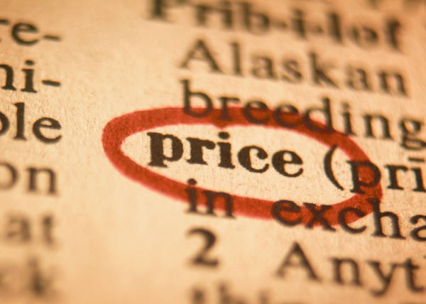
Types of Prices
The influence of the internet
How prices are set

Slide 21
Types of Prices
Menu
  Seller sets a price
  Buyer takes it or leaves it
  Most common form
One-to-one
  Buyer negotiates with seller

Slide 22
Types of Prices
Auction
  Seller solicits bids from interested parties
  Item goes to the highest bidder
Reverse Auction
  Buyer solicits bids from sellers for a particular product at a maximum price
  Buyer chooses the lowest bid from the sellers

Slide 23

Types of Prices
Barter
  Products and services are swapped

Slide 24
E-commerce Success
Unique website
Aesthetically pleasing
Easy to use
Motivate to visit, stay, and return
Advertise on other media
Learn from the website
  Number of visits
  Path through the website
  origin

Slide 25
The Next Generation
(Now)
M-Commerce
  The ability to purchase goods and services through a wireless Internet-enabled device

Slide 26
Challenges of the
E-Business Models
Security
  Consumer Perspective
    Information Safe?
      Personal
      Payment
  Business Perspective
    Valid Customer?

Slide 27
Challenges of the
E-Business Models
Royal Bank
  User ID and Passwords
  Challenge questions
  Now, by-pass challenge questions on my computer
  Remember challenge questions when using another computer

Slide 28
Challenges of the
E-Business Models
Taxation
  Should be the same as traditional businesses
  Not clear which jurisdiction applies
Consumer Protection
  Unsolicited goods and communication
  Illegal or harmful goods
  Insufficient information
  Invasion of privacy
  Cyber Fraud

Slide 29
Terms
Pure Play
  An internet retailer that has no physical store
E-Market Place
  Interactive business communities providing a central market space where multiple buyers and sellers can engage in E-Business activities

Slide 30
Future Trends
Channel Synchronization
  Serve customers seamlessly no matter what the entry point
Portal
  Gateway to gain access to an organization
E-Government
  Improve delivery service
  Enhance quality of interaction between government and its citizens

Slide 31
E-Commerce

