Slide 1
Project Management
Information Systems and Management

Slide 2
Project
A planned undertaking of a series of related activities to reach an objective that has a beginning and an end.
Versus
Process
on going and repetitive

Slide 3
Systems Development
Projects are undertaken for Two Primary Reasons
Take advantage of a business opportunity
To solve a business problem

Slide 4
Project Management
Project Initiation
  Assess the size, scope, and complexity
Project Planning
  Define clear, discrete activities and the work needed to complete each activity

Slide 5
Project Management
Work Breakdown Structure (WBS)
  The process of dividing the project into manageable tasks and logically ordering them to ensure a smooth evolution between tasks

Slide 6
Project Management
Estimating
  Unique tasks
  Three estimates
    Optimistic
    Most likely
    Pessimistic
  Colin’s approach

Slide 7
Project Management
3. Project Execution
  Plans are put into action
    Execute Baseline Plan
    Monitor Progress
    Manage Changes to Baseline
      Re-do activities
      Revise Completion Dates
      Modify functionality

Slide 8
Project Management
4. Project Close
  Bring project to an end
  Successful or not
  Starvation: Cut budget

Slide 9
The Mythical Man-Month by Brooks
When working with an intellectual medium that has few physical elements, such as I.S., we are highly optimistic and foolishly assume that all will go well.
PM’s may assume that workers and time are interchangeable. More workers will require more communication which will not directly off-set time.

Slide 10
Brooks’ Law
Adding manpower to a late software project makes it later.

Slide 11
Parkinson’s Law
The work done on project elements is almost certain to “expand to fill the additional time”.

Slide 12
Project Control
The process of monitoring the actual project to see whether it is meeting the objectives detailed in the project plan.
Analysts must continue to monitor a project throughout its lifespan
Slippage – falling behind schedule
  Add more resources
  Allow more time (admit estimates were wrong)
  Trim tasks
Scope Creep – expanding commitments

Slide 13
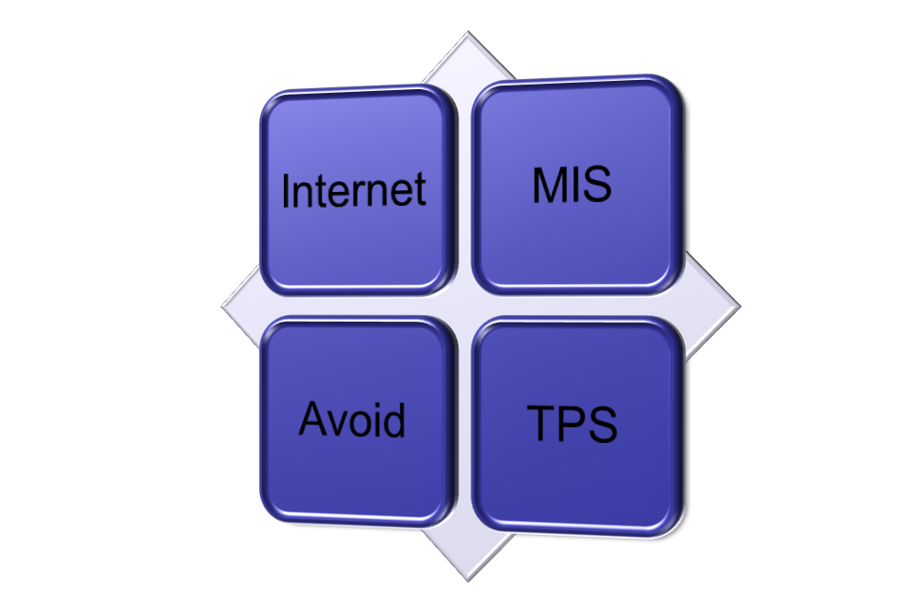
Portfolio Analysis
Project Risk
High
Low
High
Potential benefits to Firm
Low

Slide 14
Project Management
Information Systems and Management

