Slide 1
Project Management
Information Systems and Management

Slide 2
Project
A planned undertaking of a series of related activities to reach an objective that has a beginning and an end.
Versus
Process
on going and repetitive

Slide 3
Systems Development
Projects are undertaken for Two Primary Reasons
Take advantage of a business opportunity
To solve a business problem

Slide 4
Project Management
Project Initiation
  Assess the size, scope, and complexity
Project Planning
  Define clear, discrete activities and the work needed to complete each activity

Slide 5
Project Management
Work Breakdown Structure (WBS)
  The process of dividing the project into manageable tasks and logically ordering them to ensure a smooth evolution between tasks
  *Estimating

Slide 6
Project Management
3. Project Execution
  Plans are put into action
    Execute Baseline Plan
    Monitor Progress
    Manage Changes to Baseline
      Re-do activities
      Revise Completion Dates
      Modify functionality

Slide 7
Project Management
4. Project Close
  Bring project to an end
  Successful or not
  Starvation: Cut budget

Slide 8
The Mythical Man-Month by Brooks
When working with an intellectual medium that has few physical elements, such as I.S., we are highly optimistic and foolishly assume that all will go well.
PM’s may assume that workers and time are interchangeable. More workers will require more communication which will not directly off-set time.

Slide 9
Brooks’ Law
Adding manpower to a late software project makes it later.

Slide 10
Parkinson’s Law
The work done on project elements is almost certain to “expand to fill the additional time”.

Slide 11
Project Control
The process of monitoring the actual project to see whether it is meeting the objectives detailed in the project plan.
Analysts must continue to monitor a project throughout its lifespan
Slippage – falling behind schedule
  Add more resources
  Allow more time (admit estimates were wrong
  Trim tasks
Scope Creep – expanding commitments

Slide 12
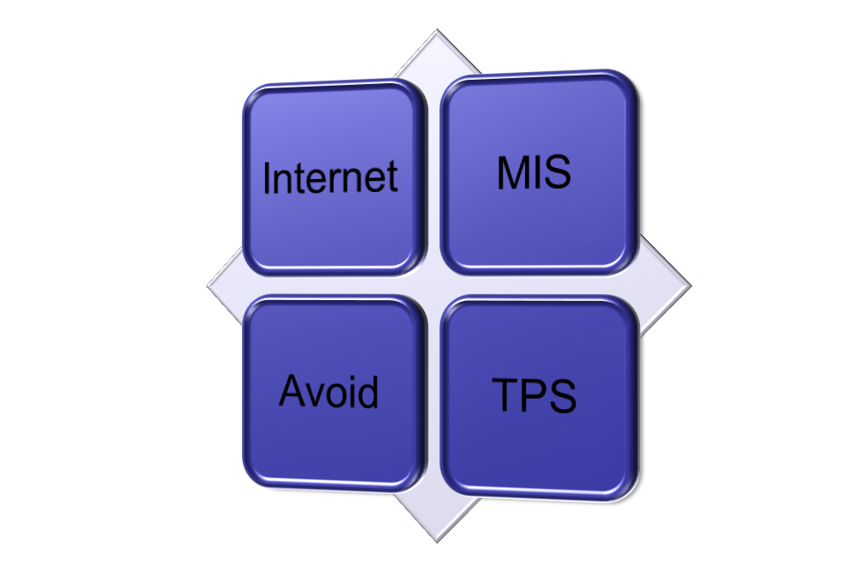
Portfolio Analysis
Project Risk
High
Low
High
Potential benefits to Firm
Low

Slide 13
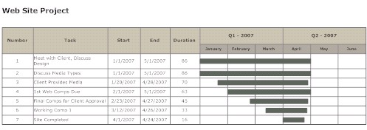
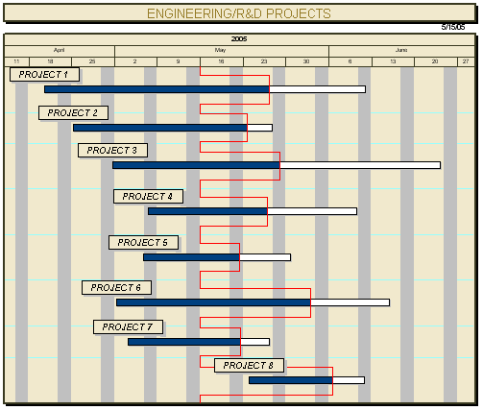
Bar Charts

Slide 14
GANTT Charts
Henry L.Gantt – 1917
Show planned and actual progress
Advantages
  Easy to understand
  Easy to maintain
  Provides a clear picture of the project’s current status.

Slide 15
Network Techniques
Program Evaluation and Review Technique (PERT)
Critical Path Method (CPM)
The two methods are quite similar and are often combined

Slide 16
PERT
Projects can be described in a very formal way by structuring them as a network of activities
Activities: Basic jobs, tasks, or operations that must be performed
  May be sequential or parallel
  Represent the passage of time
Events: Mark the beginning or end of an activity, represents points in time
Activity:
Event:

Slide 17
PERT Notation
Activity
Event

Slide 18
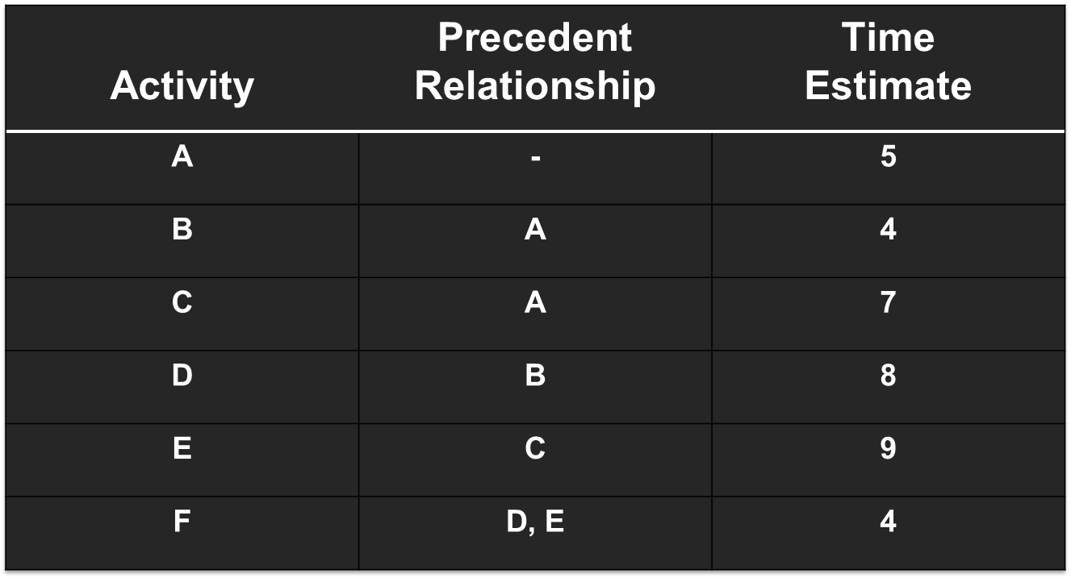
PERT - Example

Slide 19
B (5,9)
D (9,17)
[9,13]
[13,21]
F (21,25)
(O,5)
A
[0,5]
[21,25]
C (5,12)
E (12,21)
[5,12]
[12,21]

Slide 20
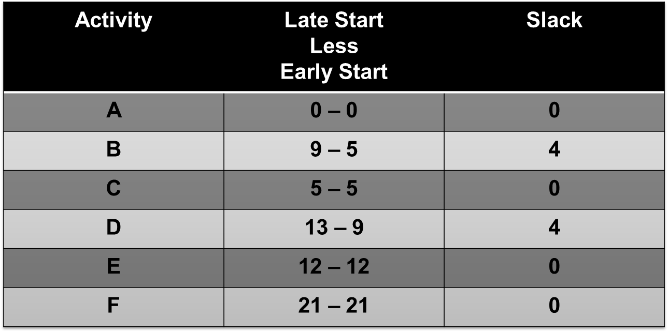
What is the Critical Path?
Slack Time
Critical Path A-C-E-F

Slide 21
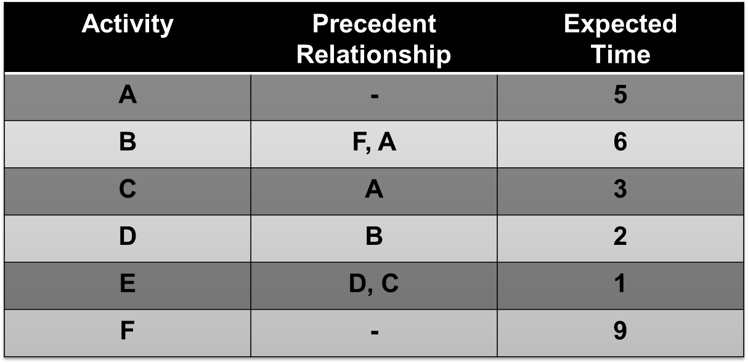
Dummy Activities
Used whenever two or more activities have some but not all of their immediate predecessors in common

Slide 22
C
A
E
F
D
B

Slide 23
Dummy Activity
Takes zero time
Used to maintain correct relationships
Used to diagram concurrent examples

Slide 24
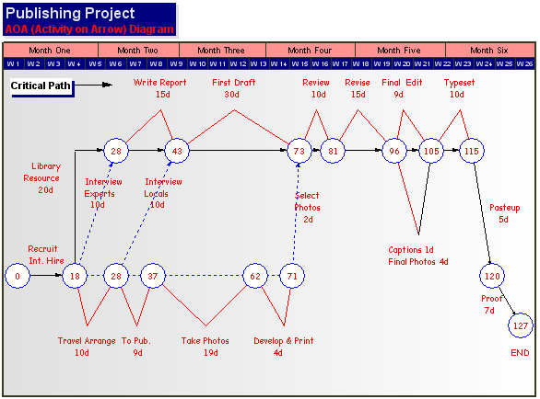
Two Network Conventions
Activity on Arrow (AOA)
Activity on Node (AON)

Slide 25
Estimating in PERT
PERT suggests developing three time estimate for each activity
  Optimistic
  Most likely
  Pessimistic
Then apply formula
  Te = To + 4Tm + Tp
  6
Te = expected time
To = optimistic time
Tm = most likely time
Tp = pessimistic time

Slide 26
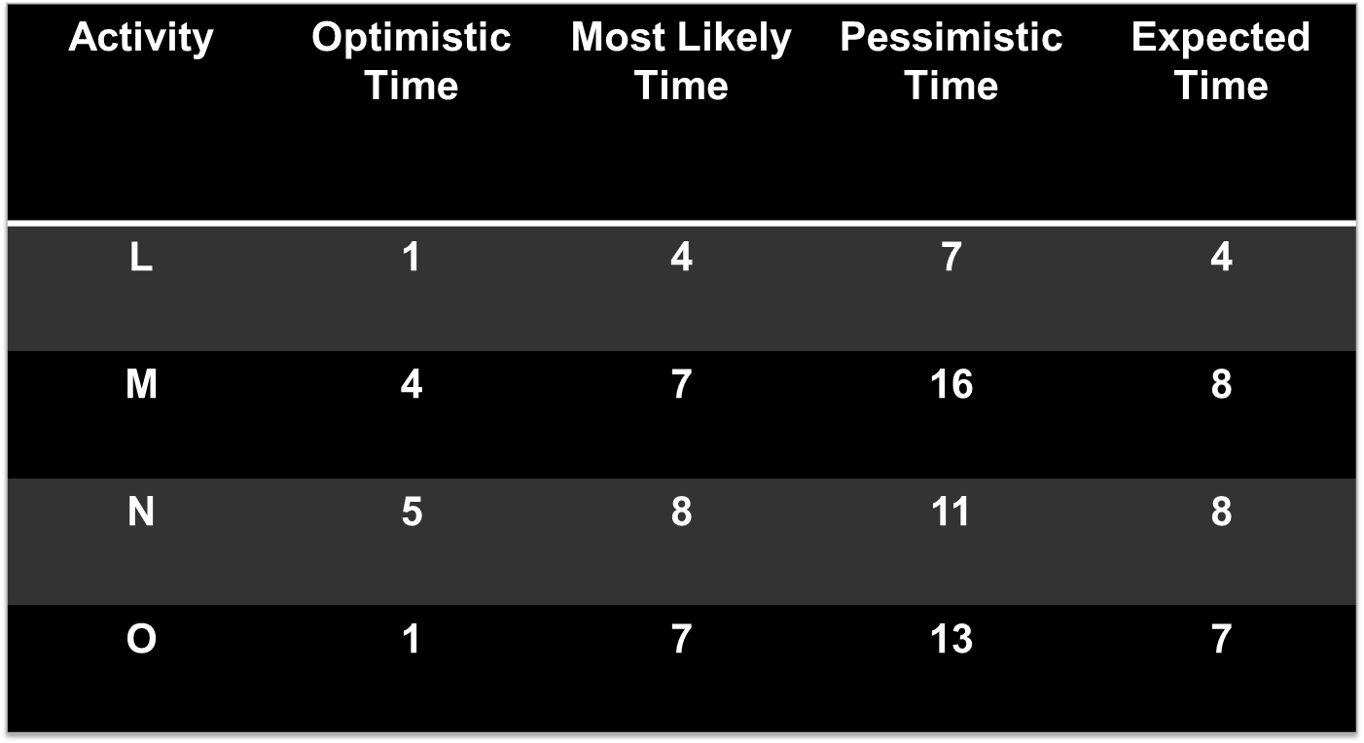
PERT Estimate Example

Slide 27
Project Management
Information Systems and Management

