Slide 1
Systems Development Life Cycle
(SDLC)
Information Systems and Management

Slide 2
SDLC Overview (NCC)
Initial Strategy
Feasibility Study
Requirements Analysis
Systems Analysis
Systems Specification
Design
Development
Testing
Implementation
Production/Maintenance
Review

Slide 3

The Initial Strategy
SDLC
Obtain an understanding of the problem
Investigate the environment of the:
  Company
  Project

Slide 4

Feasibility Study
SDLC
Decide whether the problem is worth solving
Types of feasibility
  Operational
  Technical
  Economic
  Schedule
  Organizational
  Political
  Legal/Contractual

Slide 5
Types of Feasibility
Operational
  User acceptance
Technical
  Can proposed components provide the required response?
Economic
  Will benefits exceed costs (not CBA)
Schedule
  Will the system be available within the required time frame?

Slide 6
Types of Feasibility
Organizational
  Will the resulting system support organizational objectives?
Political
  Does the project have senior management support?
Legal/Contractual
  Will the system function within laws and union agreements?

Slide 7

Requirements Analysis
SDLC
Provides information about what the system “should“ do
Types of requirements
  Basic Functional
  User Transaction
  User Decision
  Organization-wide

Slide 8

Systems Analysis
SDLC
Produces an accurate record of the current system (what the system does)
Fact finding techniques
  Interview
  Questionnaire
  Observation
  Record Review
  Document Review
  Sampling

Slide 9

SDLC
Systems Analysis
Documentation Tools
  Entity Relationship Diagrams
  Data Flow Diagrams
  Data Dictionaries
  Flow Charts
  Decision Trees
  Decision Tables
  Structured English

Slide 10

Systems Analysis
SDLC
Concepts
  Human Behaviour
  Communication
  Data Analysis
    Formal technique of entity analysis and normalization

Slide 11

Systems Specification
SDLC
Statement of what the new system “will“ do
Produced so user and system analyst can be sure they understand and agree
Characteristics
  Top down
  Graphic
  Easily Maintained
  Understandable
  Precise
  Logical

Slide 12

6. Design
Shows “how“ the system will operate
Identify alternatives and choose the best
  Cost/Benefit Analysis
  Net Present Value (Best Method)
  Must also consider intangible benefits
Objectives
  Flexibility
  Control
  Performance

Slide 13

6. Design
Components
  Files
  Procedure & program specifications
  Screen layout & dialogue design
  Forms design
  Input and output procedures
  Coding systems
  Security
  Systems quality assurance

Slide 14
6. Design
Logical Design
  Description of the functional requirements of the proposed information systems
Physical Design
  Specification of the components necessary to put the logical design into action

Slide 15

7. Development
Construction of the information system
Concerned with productivity
  LOC/ELOC/Function Points
Decide between in-house development versus a package
  RFP and evaluation

Slide 16

8. Testing
Levels
  Unit
  System
  Special
    Volume/year-end
Verification
  Alpha test
  Simulated environment
    All logic paths
Validation
  Beta Test
  Live environment
Certification
  Independent opinion of vendor claims
  External audit of custom development

Slide 17
8. Testing
Bugs versus defect free code

Slide 18

9. Implementation
The old system is replaced by the new system
Site preparation
Education and training
File conversion
Change-over
  Direct
  Parallel
  Pilot-organization
  Phased-system

Slide 19

10. Production/Maintenance
Ensure the system continues to operate as required
Types
  Emergency
  Enhancement
  Environment

Slide 20

11. Review
Develop recommendations for improvement
Types of Review
  Project
    Determine the appropriateness of project activities and team members
  System
    Obtain the users experience with the new system
  Periodic

Slide 21
General Comments
The SDLC process is iterative
  Within stages
  Back to prior stages
Go/No Go decisions
  At the end of each stage & phase
    Analysis, design, development
Organization of Project
  Steering Committee, Project Team, Project Management

Slide 22

General Comments
Managing project review and selection
  Portfolio Analysis
    Assess the individual projects based upon project complexity and technical maturity of the organization
    Decide on the mix of high and low risk projects taking into consideration functional requirements

Slide 23
Software Development Methodologies
Waterfall
RAD: Incorporates prototyping
Extreme Programming Method: small reusable modules
Agile Method: Extreme method & limited project scope
  Fast continuous delivery
  Improved customer satisfaction

Slide 24
The Changing IS Development Environment
The SDLC is affected directly by:
  Structured Methods
  Prototype
  Application Packages
  End-user Development
  CASE
Changes outside the immediate Domain
  Outsourcing
  Knowledge of Information Technology
  Business Process Re-engineering (BPR)

Slide 25
Structured Methods
Highly formalized techniques and methods of analysis and documentation
Specifications need to be:
Comprehensible to the user & accurate and detailed enough for the designer
Database software concentrates on a logical system definition
Structured techniques
  ERD
  DFD
  DD

Slide 26
Prototype
-The process of building an experimental model of a proposed system quickly and inexpensively for demonstration and evaluation so that users can better determine information requirements.

Slide 27

Prototype
Purpose
  Reduce the time for the user to see something tangible
  Allows for rapid feedback from the user to the designer
  Allows for meaningful user involvement in systems analysis and design

Slide 28

Prototype
Comments
  Changes should be encouraged
  Be aware it is only a model
  Doesn’t include the editing and error checking of a finished system
  Purpose is to show what CAN BE accomplished and not to demonstrate that a system is complete

Slide 29
Prototyping Approaches
Type II
  A throwaway model
  Uses a 4GL language to develop the model
  Uses a 3GL language to develop the final system
Type I
  An iterative model
  Uses the prototype as the final system after a series of evolutionary changes based upon user feedback

Slide 30
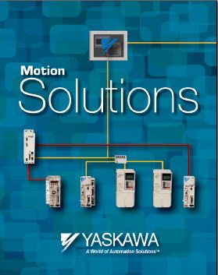
Application Packages
A set of prewritten, pre-coded application software programs that are commercially available for sale of lease

Slide 31
Selecting Application Packages
Request for Proposal
Evaluation Criteria
Quantitative evaluation technique
  The package must meet at least 90% of the requirements to provide you with advantages of use

Slide 32

Package Customization
Do NOT do it!

Slide 33

System Integration
  Refers to the practice of combining various components that are purchased and/or custom developed to form a complete system
  The difficulty arises when system integration involves legacy systems, which may be based on outdated technology

Slide 34
Advantages of Packages
The system exists and can be tried out
Less total development time
Should result in lower cost
May have more functions or extra features
Programs included in the system will have been debugged

Slide 35
End-User Development
The development of information systems by end users with little or no formal assistance from technical specialists
Grew out of frustration
too long to process new system or system change requests
Software Crisis
  Excess demand for IS development
    Identified backlog: 30 work months
    Hidden back-log: 4-7 years

Slide 36

Advantages
Requirements determined by users
Increased user involvement and satisfaction
Control of the system development process by users
Reduced application backlog

Slide 37
Information Centre
A Unit within the Information System Department which supports End-user development with training and support
Provides advice on hardware and software selection, and training
Ensures:
  Data Availability
    End-users control their own data and share it through local networks
    Corporate data are downloaded from corporate computers
  Data Security
    Access is limited to only the data users needs

Slide 38
Computer-Aided Systems Engineering (CASE)
In the past SDLC has often been considered too:
  Inflexible
  Time consuming
  Expensive
And thus creating a backlog in systems development.
CASE involves automating some of the SDLC processes

Slide 39
CASE
Upper CASE (front end)
Lower CASE (back end)
Integrated CASE
  All SDLC, calendaring and PM
Forward Engineering
Reverse Engineering (backward engineering)
  Y2K
Note: No SDLC stages are eliminated

Slide 40

Outsource
The practice of contracting computer centre operations, telecommunication networks or applications development to external vendors
This will bring economies of scale into the situation

Slide 41
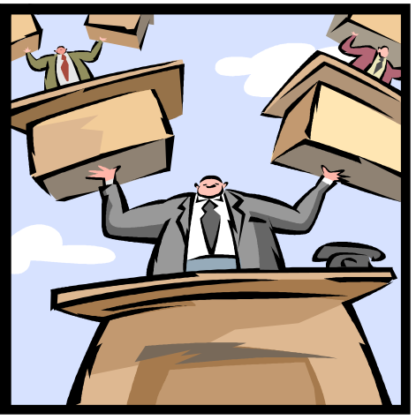
Advantages
Economy
Service
Predictability
Flexibility
Freeing resources
  Human resources for other projects
  Finances

Slide 42

Disadvantages
Loss of control
Vulnerability of strategic information
Dependency

Slide 43
Knowledge of Information Technology
People, in general, commonly interact with IT on a daily basis.
History
Phone
  Originally used for emergencies in munitions factories and for changes to train schedules
Car
  Potential sales volume was limited to the number of individuals thought capable of driving an automobile
Computer
  Originally expected only a few computers would be sold – now they are everywhere!

Slide 44
Business Process
Re-Engineering (BPR)
The radical redesign of business processes, combining steps to cut waste and eliminate repetitive, paper-intensive tasks in order to improve costs, quality or service, and to maximize the benefits of information technology.
New ways are being investigated to apply IT to support business goals and gain competitive advantage
Emphasis changing from efficiency to effectiveness
  “Paving the cow paths”
  Hammer and Champy
  Davenport and Short

Slide 45
Systems Development Life Cycle
(SDLC)
Information Systems and Management

