Slide 1
Specialized
Information Systems
Information Systems and Management

Slide 2
Measuring the Success of Strategic Initiatives
Organizations spend enormous sums of money on IT to compete in today’s fast-paced business environment
To justify IT expenditures an organization must measure the payoff of these investments, their impact on business performance, and the overall business value gained
Table Stakes VS Trump Card

Slide 3
Benchmarking
Process of continuously measuring system results
Comparing results to optimal system performance (benchmark values)
Identifying steps and procedures to improve system performance
Internal standards versus Industry standards

Slide 4
Metrics
Efficiency
  Measure the performance of IT
Effectiveness
  Measure the impact of IT

Slide 5
Efficiency IT Metrics
Throughput
  Amount of data that can travel through a system at any point in time
Speed
  Amount of time a system takes to perform a transaction
Availability
  Number of hours a system is available for use by customers and employees

Slide 6
Efficiency IT Metrics Focus on Technology
Accuracy
  Extent to which a system generates the correct results when executing the same transactions numerous times
Web Traffic
  Hits
Response Time
  Time it takes to respond to users interactions, such as a mouse click

Slide 7
Effectiveness IT Metrics
Relates to an organization’s goals, strategies and objectives
  Increase new customers by 10%
  Reduce product development life cycle time to 6-months

Slide 8
Effectiveness IT Metrics
Usability
  Ease with which people perform transactions and/or find information
    Number of clicks to get desired information
Customer Satisfaction
  Satisfaction Surveys
  Percentage of existing customers retained
  Increase in revenue dollars per customer

Slide 9

Effectiveness IT Metrics
Conversion Rates
  Number of first time customer touches that result in a purchase
Financial
  Return on Investment (ROI)
  Cost/Benefit analysis

Slide 10
An Alternative Perspective
It is a utility like phone or electricity
It is necessary to carry on business
Why measure it?
Why evaluate it?

Slide 11
Another Perspective
Differentiate between
  IT infrastructure
    Treat as a utility
  IT business applications
    evaluate

Slide 12
Customer Relationship Management
(CRM)
Involves all aspects of a customer`s relationship with an organization
  Increase customers’ loyalty and retention
  Increase organization’s profits
CRM allows an organization to gain insights into customer shopping and buying behaviours

Slide 13

CRM
IT
  Identifies types of customers
    Design marketing campaigns tailored to each customer types
      Increase customer spending
      Demographics
  Treat customers as individuals
    Identify specific buying patterns and behaviours
    Increase customer loyalty
    Increase customer spending

Slide 14
CRM Examples
Drug representative story
Book representatives
Amazon purchasing history
  IS Research
  Breast Feeding
Air Canada – Seat 22A

Slide 15

CRM Allows an Organization to:
Provide better customer service
Cross-sell products more effectively
Help sales staff close deals faster

Slide 16
CRM Allows an Organization to:
Personalization
  Know enough about a person`s likes and dislikes to appropriately fashion offers for the specific individual
Develop an integrated view of the customer
  By demographics
  By specific individuals

Slide 17

CRM
Contact Management
Opportunity Management
Web-based Self-service

Slide 18
CRM
Contact Management
  Customer contact information
  Customer profiles
  My car and Kilometers
Opportunity Management
  Identify potential customers
Web-based Self-Service
  Customers can use the company’s web-site to find answers to their questions
    Fed-Ex tracking
    Potential students: courses

Slide 19
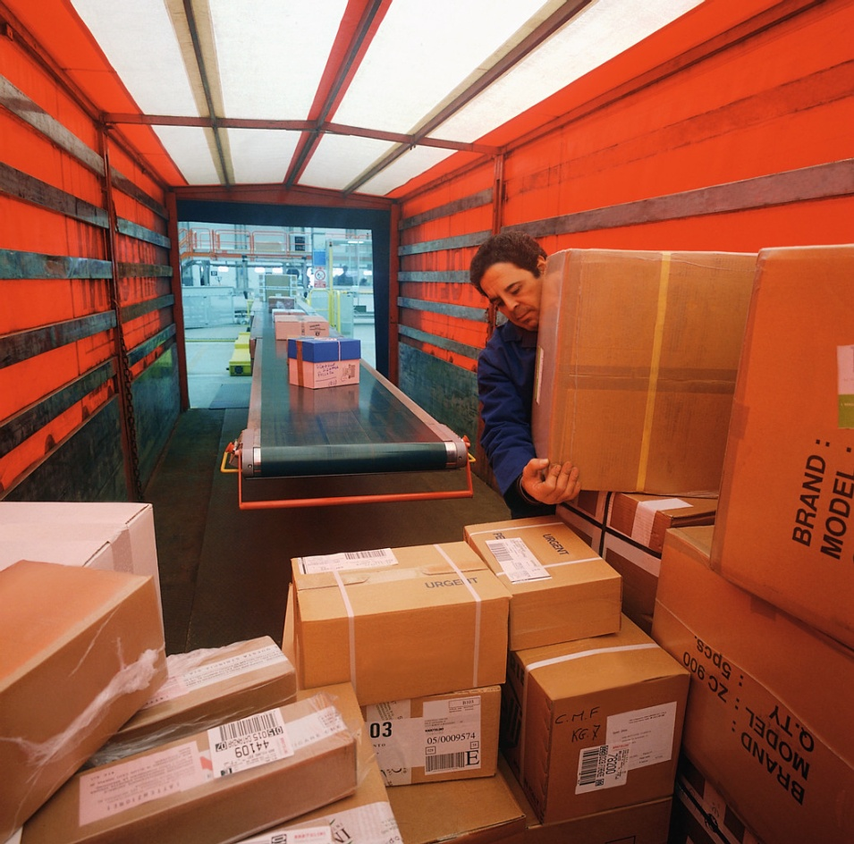
Current CRM Trends
Supplier Relationship Management (SRM)
  Focus on keeping suppliers satisfied
  Categorize suppliers
  Optimize supplier selection

Slide 20
Current CRM Trends
Partnership Relationship Management (PRM)
  Focus on keeping vendors satisfied
  Manage re-selling relationships to optimize sales channel

Slide 21

Current CRM Trends
Employee Relationship Management
  Provide browser-based access to employee's personal details
    Salary
    Benefits
Also product information for dealing with customers

Slide 22
Supply Chain Management
(SCM)
Involves the management of information flows between and among stages in a supply chain to maximize total supply chain effectiveness and profitability

Slide 23
How to Improve SCM success
Convince suppliers it's a good idea
Wean employees off traditional business practices (formalize all communication)
Ensure SCM supports organizational goals
Deploy incrementally and measure and communicate success
Be future oriented

Slide 24
Future Trends
Selling Chain Management
  Applies SCM to customers
  Order life cycle (inquiry to sale)
Collaborative Demand Planning
  Reduce inventory investment
  Improve customer satisfaction through product availability

Slide 25
Enterprise Resources Planning (ERP)
Integrates all departments and functions throughout an organization into a single IT system
Employees can make enterprise-wide decisions by viewing enterprise-wide information on all business operations
IT infrastructure must be compatible across the organization

Slide 26

Enterprise Resources Planning (ERP)
IT Integration Tools
  Intranet
    Provide employees with corporate information
      Standard operating procedures
  Enterprise Information Portal
    Links to information
      UofL Bridge

Slide 27
Why ERP Solutions are so Powerful
Logical solution to incompatible applications
Addresses the need for global (within company) information sharing and reporting
Avoids pain and expense of fixing legacy systems

Slide 28
ERP Systems Change the Culture
By revising and integrating business processes
  systems were designed to facilitate business processes
  ERP system business processes are adapted for “best of breed“ software

Slide 29
ERP Components
CORE:
  Accounting and finance
  Production and materials management
  Human Resources
EXTENDED
  Business Intelligence
  CRM
  SCM
  E-Business

Slide 30
The Future of ERP
Internet
  Apply the concept of functional data sharing to multiple organizations
Interface
  Customize each users view of the data
  Control access to sensitive information
Wireless Technology
  Connect hand-held devices to ERP

Slide 31

Cognitive Science
Research on how the brain works
Personal Construct Systems

Slide 32
Artificial Intelligence (AI)
Perspective
  Computer systems and machines that demonstrate characteristics of intelligence
  The objective is to replicate human decision making for certain types of well-defined problems

Slide 33

Artificial Intelligence (AI)
The Nature of Intelligence
  Characteristics of Intelligent Behaviour
    Learn from experience
    Handle complex situations
    Problem solve
    Determine what is important
    React quickly and correctly
    Process and manipulate symbols
    Creative & imaginative
    Use heuristics

Slide 34
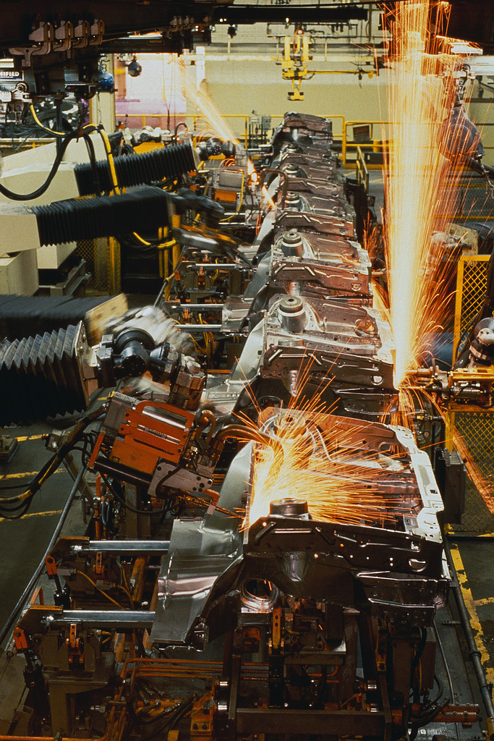
The Major Branches of AI
Expert System
Robotics
Vision Systems
Natural Language Processing
Learning Systems
Neural Networks
Fuzzy Logic
Genetic Algorithms
Intelligent Agents
Virtual Reality

Slide 35

Virtual Reality (VR)
Interface Devices
  HMD = head-mounted device
  Glove: for touch sensations
Immersive VR
  Full scale 3D
  Star Trek Holo-Deck
  Caves

Slide 36

Virtual Reality (VR)
Applications
  Medicine
    glove
  Education
    Ancient Egypt; flight training
  Real Estate
    Virtual walk-through
  Computer Generated Images
    movies

Slide 37
Specialized
Information Systems
Information Systems and Management

