Slide 1


Ministry of Communications and Information Technology
Information Technology Institute
Information Technology Institute
TCP/IP Protocol Suite

Slide 2
Collision Domain vs. Broadcast Domain
Collision Domain
  It consists of all devices (NICs) that can see or be involved in a collision.
Broadcast Domain
  It consists of all devices that can see the broadcast.
Generally, layer 2 devices border a collision domain, while layer 3 devices border a broadcast domain.

Slide 3
Collision Domain vs. Broadcast Domain
Hub
Switch
Broadcast Domain Boundaries
R
Collision Domain Boundaries

Slide 4
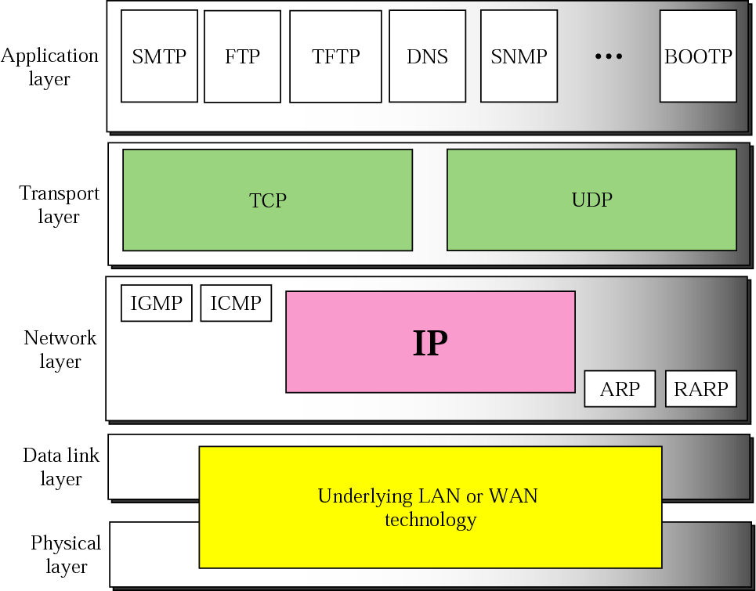
ARP and RARP

Slide 5
ARP and RARP
ARP
  Address Resolution Protocol
RARP
  Reverse Address Resolution Protocol

Slide 6
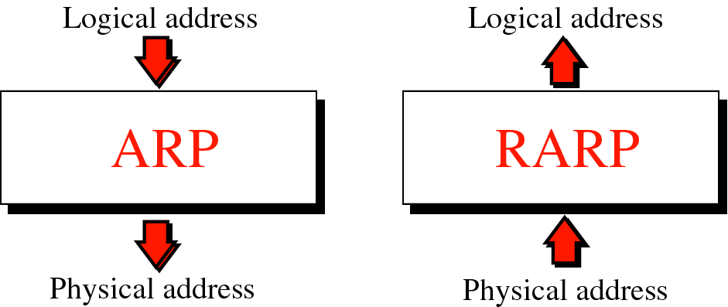
ARP and RARP

Slide 7
Fragmentation
Some physical networks are not able to encapsulate a datagram of 65,535 bytes in their frames
  The datagram must be fragmented to pass through this network
  Each fragment has its own header with most of fields repeated, but some changed
  A fragment datagram may be fragmented if it encounters network with smaller MTU
  Each fragment becomes an independent datagram
  Fragments of same datagram may follow any path

Slide 8
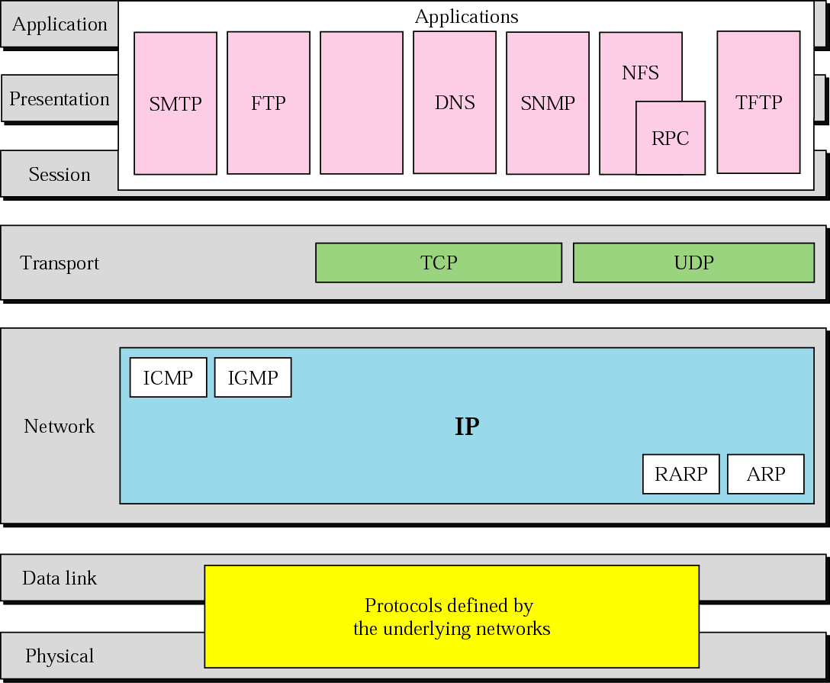
TCP/IP Protocol Suite

Slide 9
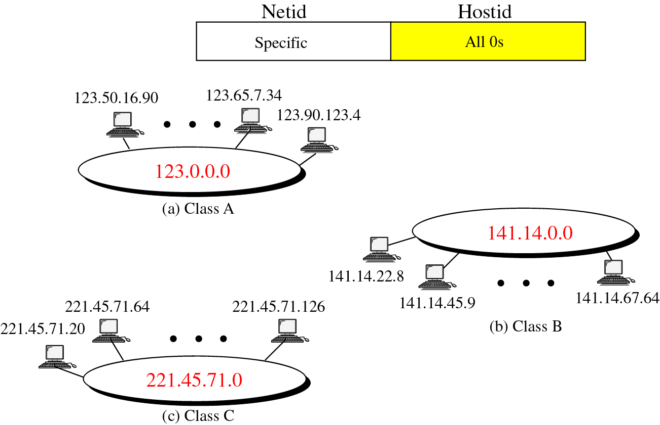
Network Address

Slide 10
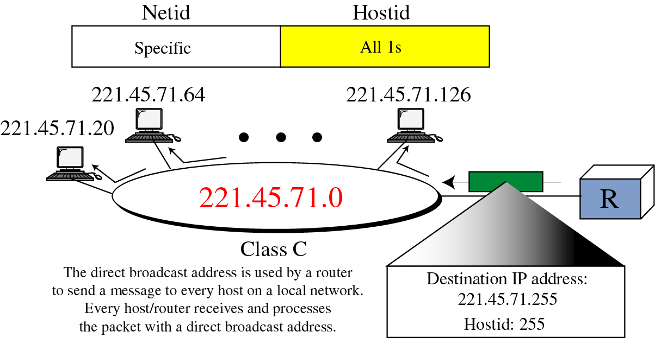
Direct Broadcast Address

Slide 11
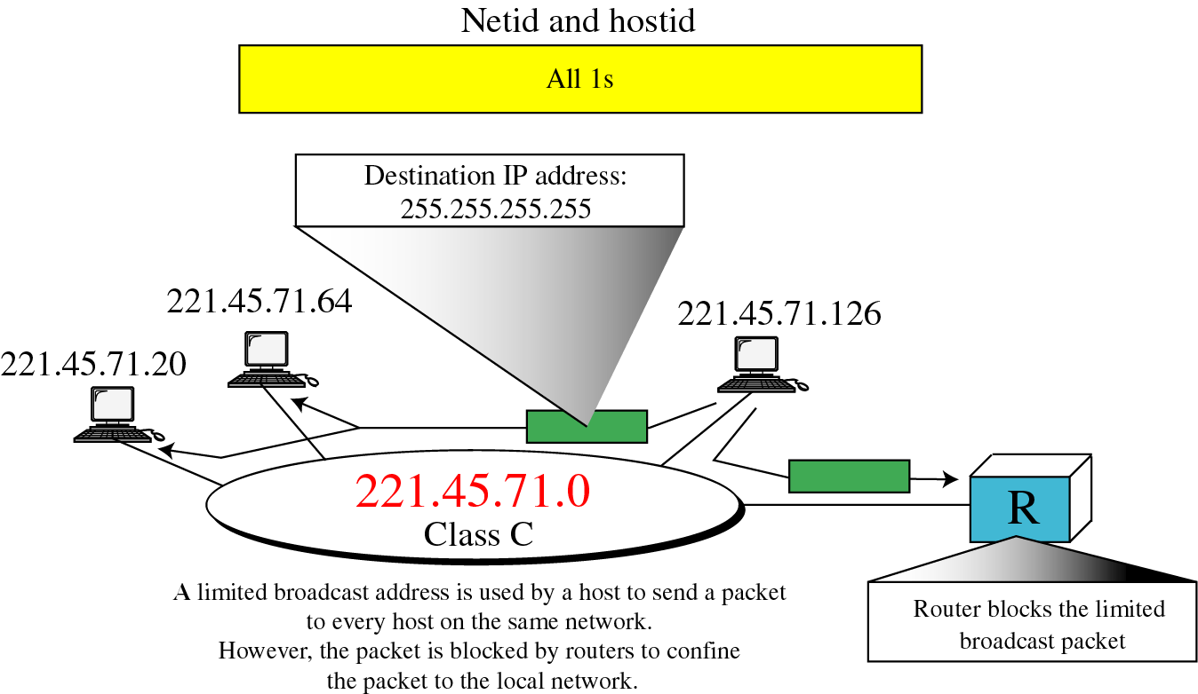
Limited Broadcast Address

Slide 12
Subnetting
In subnetting, a network is divided into smaller subnets with each subnet having its own subnet address.
Benefits of subnetting:
  Reduced network traffic
  Simplified management

Slide 13
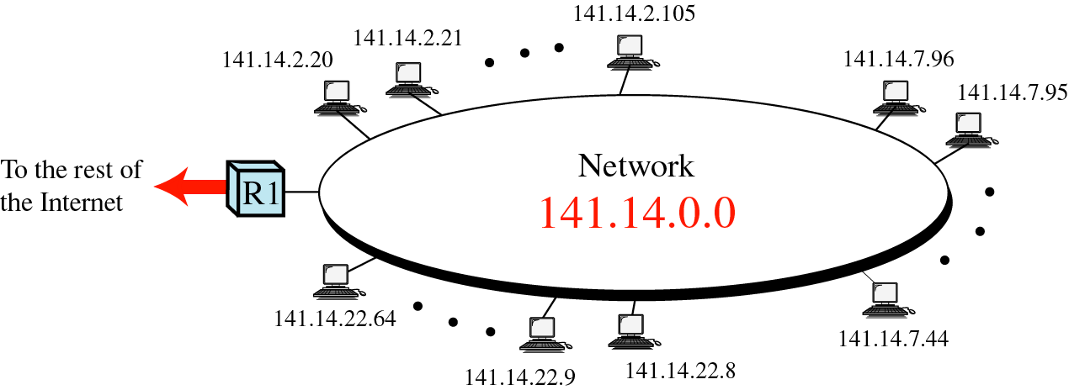
Network Before Subnetting

Slide 14
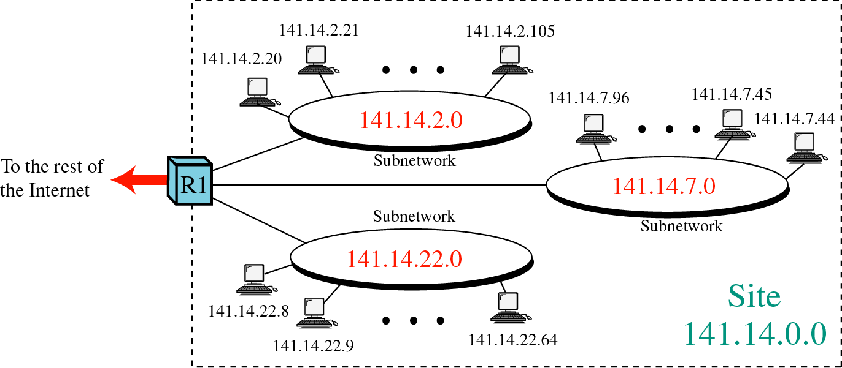
Network After Subnetting

Slide 15
Static Versus Dynamic Routing
A static routing table contains information entered manually.
A dynamic routing table is updated periodically using one of the dynamic routing protocols such as RIP, OSPF, or BGP

Slide 16
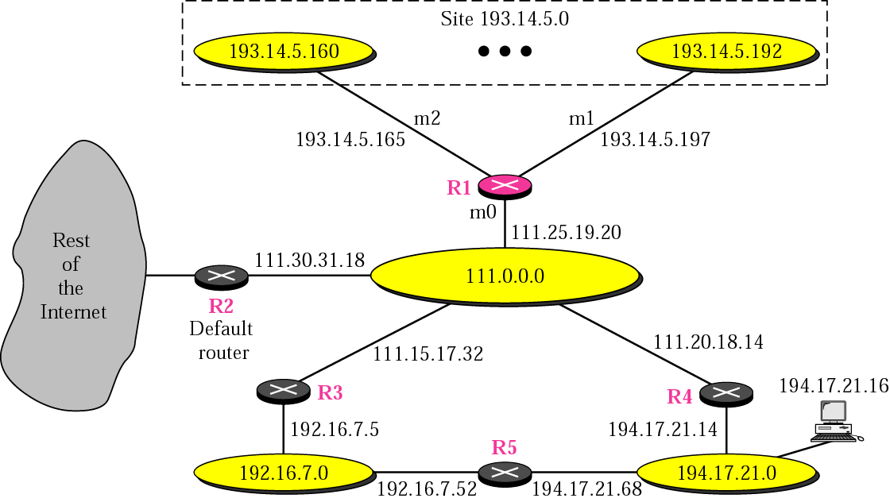
Routing Example

Slide 17
Routing Example
Mask Dest. Next Hop I.
255.0.0.0 111.0.0.0 -- m0
255.255.255.224 193.14.5.160 -- m2
255.255.255.224 193.14.5.192 -- m1
-------------------------------------------------------------------------------------
255.255.255.255 194.17.21.16 111.20.18.14 m0
-------------------------------------------------------------------------------------
255.255.255.0 192.16.7.0 111.15.17.32 m0
255.255.255.0 194.17.21.0 111.20.18.14 m0
-------------------------------------------------------------------------------------
0.0.0.0 0.0.0.0 111.30.31.18 m0

